Slide 1
FUNCTION MODIFIERS IN SOLIDITY

Slide 2
WHAT ARE FUNCTION MODIFIERS?
Definition: Function modifiers are reusable pieces of code that can be attached to Solidity functions to modify their behavior.
Purpose: Enhance code readability, simplify access control, validate inputs, and guard against reentrancy attacks.

Slide 3
SYNTAX AND USAGE
Syntax: modifier <modifierName>(<parameterList>) { ... }
Attach to functions using the `modifierName` keyword above the function definition.
Multiple modifiers can be applied to a single function by separating them with whitespace.
The underscore in the modifier represents where the function will start

Slide 4
RESTRICTING ACCESS
Purpose: Enforce access control to restrict function execution based on certain conditions.
Example: Restricting access to only address given on deployment of contract

Slide 5
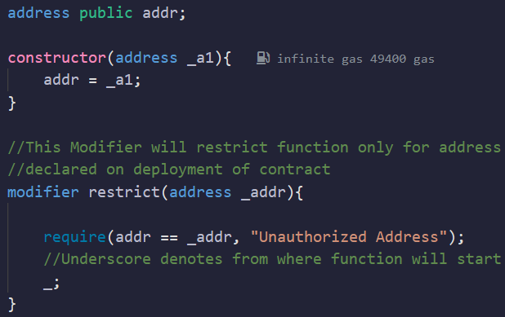
RESTRICTING ACCESS
-

Slide 6
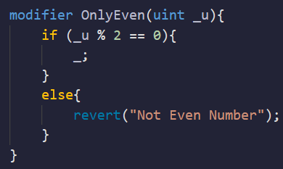
VALIDATING INPUTS
Purpose: Validate input parameters to ensure they meet certain conditions.
Example: Ensures that the number is even

Slide 7
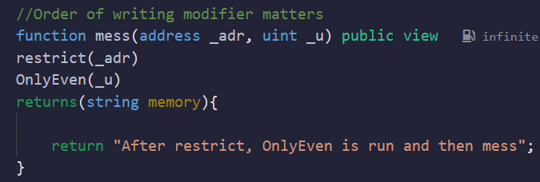
RESTRICTING AND VALIDATING INPUTS
Using the above two mentioned modifiers, we can implement them in a function that can only be run by the address declared on deployment of contract, and can only take even numbers

Slide 8
GUARDING AGAINST REENTRANCY ATTACKS
Purpose: Prevent reentrancy attacks, where a malicious contract tries to recursively call a function before it completes.

Slide 9
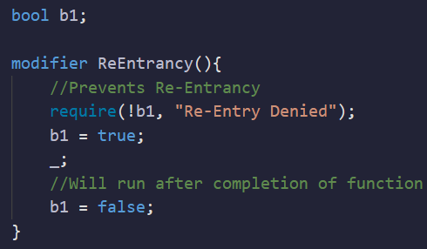
GUARDING AGAINST REENTRANCY ATTACKS
Example: Implementing a reentrancy guard.

Slide 10
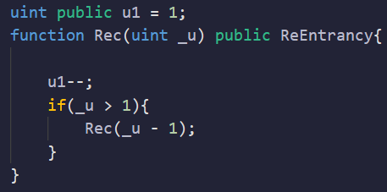
GUARDING AGAINST REENTRANCY ATTACKS
Only if _u <= 1, will the code run, so this prevents recursive call

Slide 11
ADDITIONAL USE CASES
Gas Cost Optimization: Reuse common code and reduce gas costs.
Event Logging: Simplify event logging by incorporating it within modifiers.
Time-Based Restrictions: Enforce execution within specific timeframes.

Slide 12
ADDITIONAL USE CASES
Authorization Levels: Implement different levels of authorization.
Circuit Breaker Mechanism: Temporarily disable functions in exceptional circumstances.
Parameter Validation: Validate input parameters and enforce rules.

