Slide 1
INTERFACE IN SOLIDITY

Slide 2
What is an Interface?
Definition: An interface is a contract that defines a set of functions without implementing their logic.
Purpose: Defines a standard interface for communication between contracts.

Slide 3
Why Use Interfaces?
Interoperability: Enables interaction with external contracts and systems.
Code Decoupling: Allows contracts to communicate without exposing their internal implementation details.
Standardization: Facilitates integration with existing contract interfaces and frameworks.

Slide 4
When to Use Interfaces?
Use interfaces when you need to interact with external contracts or systems.
Examples: Interacting with third-party contracts, accessing external data sources, integrating with decentralized exchanges.

Slide 5
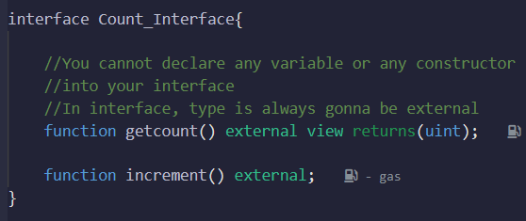
Basic Syntax of Interfaces
Syntax: Declare the interface using the `interface` keyword.
Functions: Define function signatures without implementation.
Example:

Slide 6
Variables in solidity programming
Variables in Solidity are used to store and manipulate data.
They are declared with a specific data type and can hold values of that type.

Slide 7
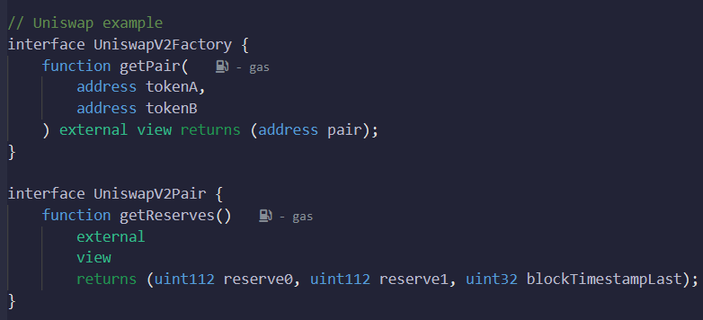
UniswapExample Contract
-

Slide 8
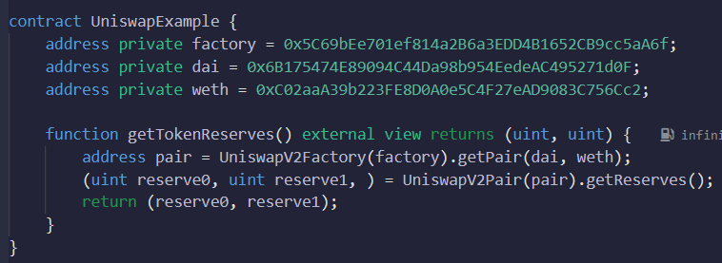
UniswapExample Contract
-

Slide 9
UniswapExample Contract
UniswapV2Factory Interface:
The `UniswapV2Factory` interface declares a function named `getPair` that takes two addresses (`tokenA` and `tokenB`) as parameters.
The `getPair` function is an `external` view function that returns an `address` representing the pair of tokens.

Slide 10
UniswapExample Contract
UniswapV2Pair Interface:
The `UniswapV2Pair` interface declares a function named `getReserves`.
The `getReserves` function is an `external` view function that returns three values: `reserve0`, `reserve1`, and `blockTimestampLast`. These values represent the reserves of the token pair and the block timestamp of the last update.

Slide 11
UniswapExample Contract
The `UniswapExample` contract is a Solidity contract that demonstrates the usage of the Uniswap interfaces.
It declares three private variables: `factory`, `dai`, and `weth`, which store the addresses of the Uniswap factory, DAI token, and WETH token, respectively.
The `getTokenReserves` function is an `external` view function that returns the reserves of the DAI-WETH token pair.

Slide 12
UniswapExample Contract
Inside the `getTokenReserves` function, it uses the `UniswapV2Factory` interface to get the pair address for the DAI-WETH tokens by calling `getPair` with the `dai` and `weth` addresses.
Then, it uses the `UniswapV2Pair` interface to get the reserves of the token pair by calling `getReserves` on the obtained pair address.
Finally, it returns the values of `reserve0` and `reserve1`, representing the token reserves.

Slide 13
Benefits of Using Interfaces
Code Reusability: Interfaces can be implemented by multiple contracts, promoting code reuse.
Clarity and Readability: Clearly defines the expected interface for external communication.
Easier Testing: Interfaces provide clear boundaries for mocking and testing.

Slide 14
Restrictions in Using Interfaces
No State Variables: Interfaces cannot declare state variables.
No Constructors: Interfaces cannot have constructors.
Only External Functions: All functions in interfaces are implicitly external.
Pure and View Functions: Interfaces can include pure and view functions.
No Function Implementations: Interfaces only define function signatures without the actual logic.

Slide 15
Best Practices and Considerations
Name Conventions: Use clear and descriptive names for interface functions.
Documentation: Document the purpose and usage of each interface function.
Versioning: Consider versioning the interfaces to ensure compatibility.

Slide 16
Summary
Interfaces provide a standard way to interact with external contracts and systems.
They define function signatures without implementation.
Interfaces enhance code reusability, decoupling, and interoperability.

