Slide 1
Mapping in Solidity

Slide 2
WHAT IS A MAPPING?
Definition: A key-value data structure that allows efficient lookup and storage of data
Similar to dictionaries or hash maps in other programming languages
Syntax of Mapping
mapping(keyType => valueType) public mappingName;
Notes:
Example: USER_NAME => BALANCE

Slide 3
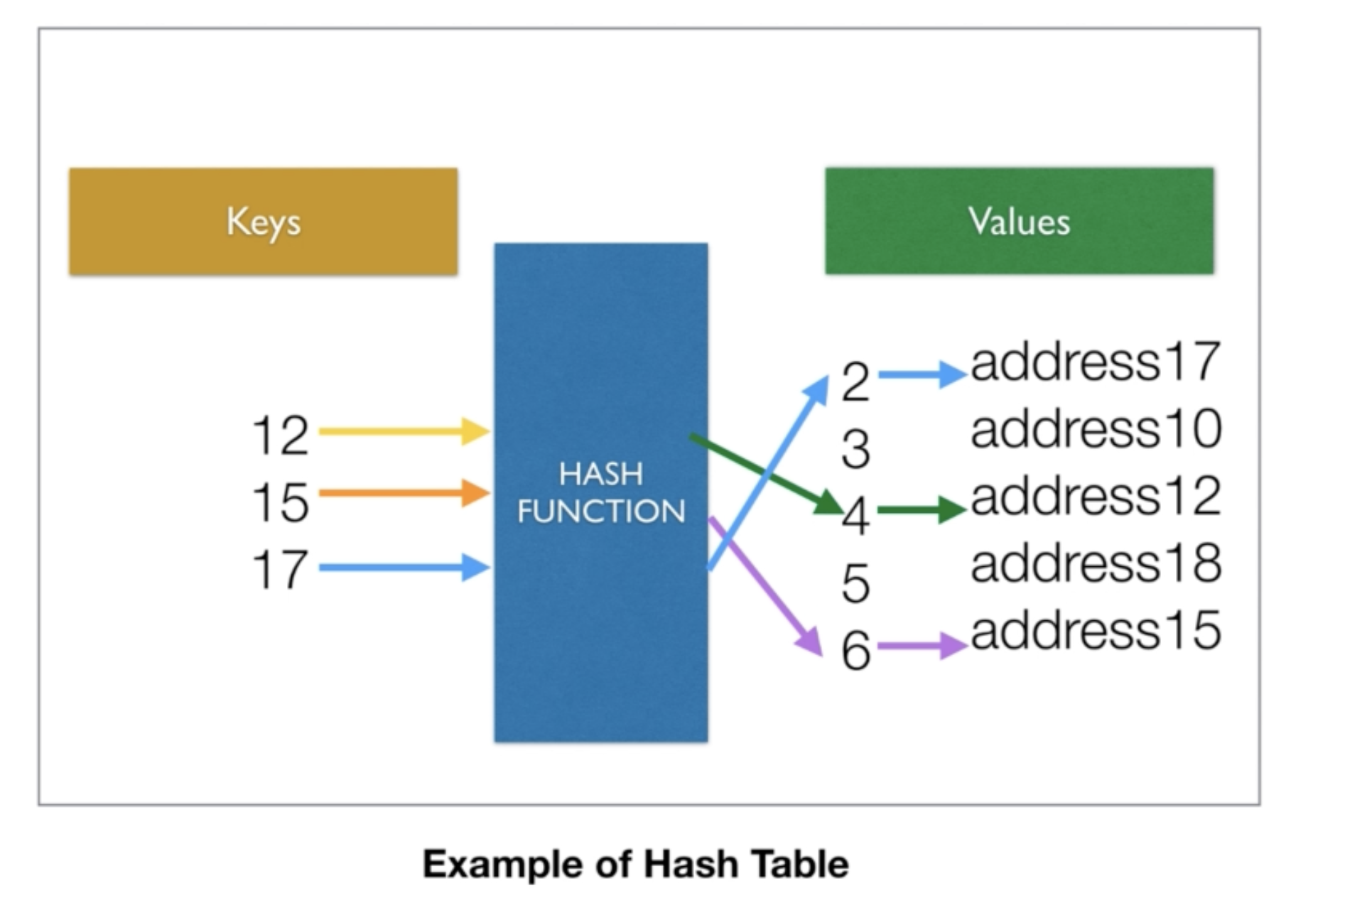
Hash Table
Notes:
Key ->(Hashed)-> Index -> value.
Key can be infinite but the total space to store key/value is finite hence we use hash tables. It may cause collision but we use(chaining) linked list for this. Hash function example h(k) = kmod10.

Slide 4
WHEN AND WHY DO WE USE MAPPINGS?
Storing and retrieving data with a unique identifier (key)
Efficient lookup and retrieval of values based on keys
Use cases: address balances, user profiles, token ownership, etc.

Slide 5
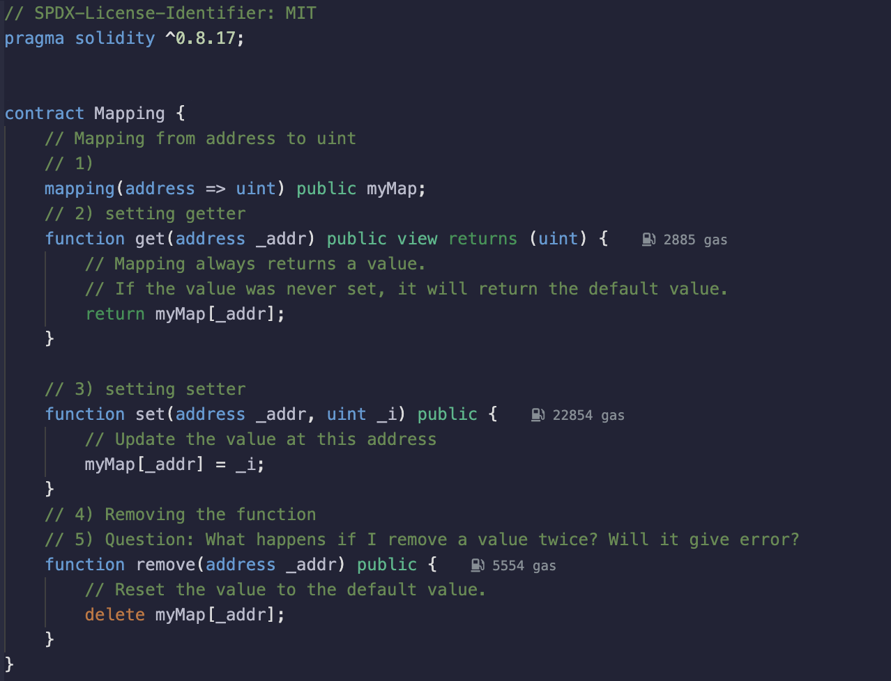
MAPPING
Notes:
Remix demo

Slide 6
NESTED MAPPING
Definition: Using mappings as values within another mapping
Allows for more complex data structures and relationships
Example: Mapping of addresses to mappings of token balances

Slide 7
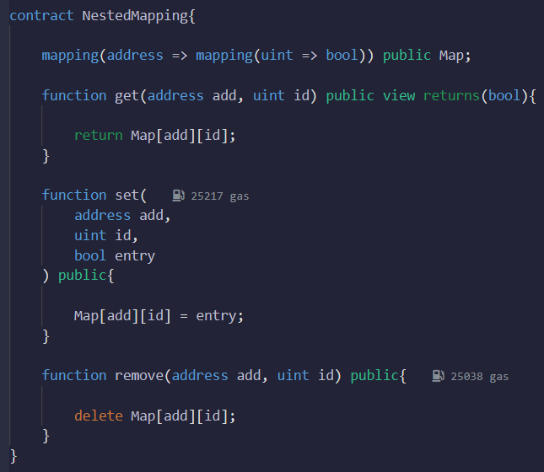
NESTED MAPPING
Notes:
Remix demo

Slide 8
MAPPING PROPERTIES AND CONSIDERATIONS
Unique keys: Each key in a mapping must be unique
Non-sequential keys: Mappings don't have a specific order or index
Value initialization: Unset values in a mapping return default values
Gas costs: Consider gas costs when working with large mappings

