Slide 1
SHADOWING INHERITED STATE VARIABLES

Slide 2
WHAT IS SHADOWING?
Definition: Shadowing refers to the situation where a child contract declares a state variable with the same name as a state variable inherited from a parent contract.
Effect: The child contract's state variable "shadows" or hides the inherited state variable.

Slide 3
WHEN AND WHY TO USE SHADOWING
When to use: Shadowing is used when you want to have a separate state variable in the child contract with the same name as the inherited state variable.
Why to use:
- Customization: Allows child contracts to have their own unique state variable that overrides the value of the inherited state variable.
- Flexibility: Provides the ability to modify or extend the behavior of the inherited state variable in the child contract.

Slide 4
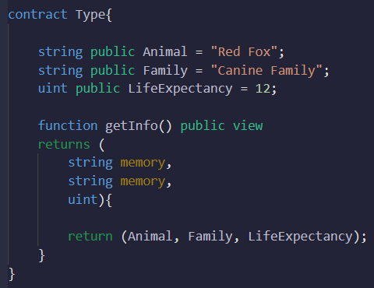
BASIC SYNTAX OF SHADOWING
If you declare a state variable with the same name as the inherited state variable in the child contract. You will get an error

Slide 5
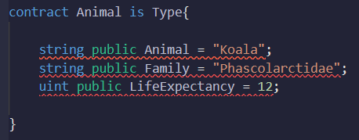
BASIC SYNTAX OF SHADOWING

Slide 6
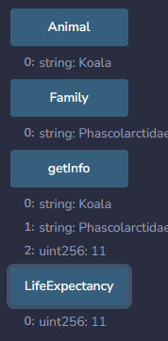
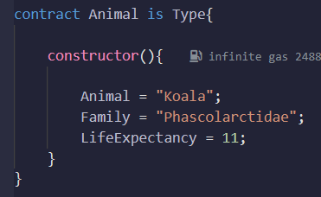
BASIC SYNTAX OF SHADOWING
Instead, you will make a constructor that updates the parent state variable in the child contract

Slide 7
BEST PRACTICES AND CONSIDERATIONS
Use shadowing sparingly and with caution.
Avoid confusion and potential bugs by providing clear naming conventions for shadowed state variables.
Ensure proper documentation to explain the purpose and functionality of shadowed state variables.

Slide 8
SUMMARY
Shadowing allows child contracts to declare state variables with the same name as inherited state variables.
Shadowing provides customization and flexibility in modifying the behavior of inherited state variables.
Use proper naming conventions and documentation when using shadowed state variables.

