Slide 1
Array in Solidity

Slide 2
What is an Array?
Definition: An array is a collection of elements of the same type stored in contiguous memory locations.
Arrays allow storing and accessing multiple values using a single variable.
In Solidity, arrays can be of fixed size or dynamic size.

Slide 3

Fixed-Size Array
Definition: An array with a predefined size that cannot be changed after declaration
Use cases: When the number of elements is known and constant, such as storing daily temperatures for a week
Syntax: type[size] arrayName;

Slide 4

Dynamic Array
Definition: An array with a variable size that can be changed during execution
Use cases: When the number of elements may vary, such as storing user-generated data or dynamic lists
Syntax: type[] arrayName;

Slide 5
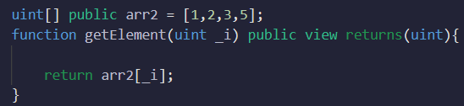

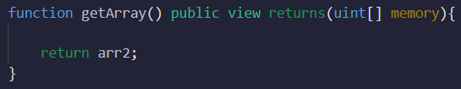

Viewing
Viewing element of an array:
Viewing entire array:

Slide 6
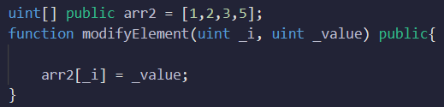
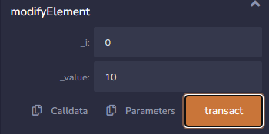

Updating element of an array
Updating single element of an array:

Slide 7
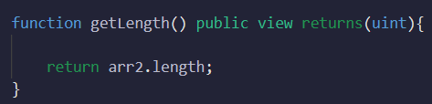

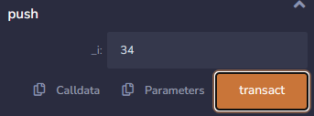
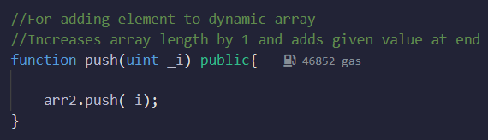

Array Properties and Functions
.length: Property to get the length of the array
.push(): Function to add elements to the end of a dynamic array

Slide 8

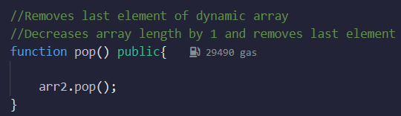


Array Properties and Functions
.pop(): Function to remove the last element from a dynamic array

Slide 9
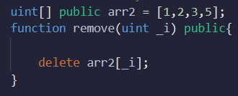


Deleting element of an array
Length of array remains same
Sets the element _i of array to default value
Works for both dynamic and fixed arrays

Slide 10
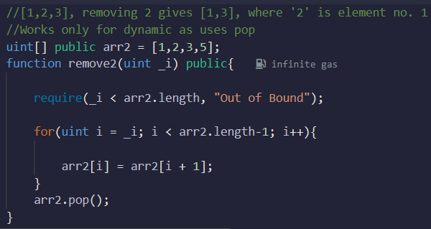


Deleting element of an array
Removes element of an array
Updates the length of the array as well
‘require’ returns an error message “Out of Bound” if false

Slide 11
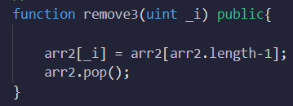


Deleting element of an array
Removes element of an array
Updates the length of the array as well
More gas efficient, to be used when order doesn’t matter

Slide 12
Dynamic to fixed-size
The function `exp` is declared as `external` to make it accessible only from outside the contract.
Inside the function, a dynamic array of type `uint` is created in the memory using the `new` keyword.
The `memory` keyword specifies that the array is stored in temporary memory space, which will be cleared once the function execution is complete.

Slide 13
Dynamic to fixed-size
The array `a` can be accessed and manipulated within the function but will not persist beyond the function execution.
The function create array in memory, only fixed size can be created
function exp() external pure{
uint[] memory a = new uint[](3);
}

Slide 14
Differences Between Dynamic and Fixed-Size Arrays
Size flexibility: Dynamic arrays can change their size, while fixed-size arrays have a predetermined size.
Gas cost: Dynamic arrays may incur more gas costs due to resizing operations.
Storage efficiency: Fixed-size arrays use less storage as their size is known and fixed.
Use case suitability: Choose the appropriate array type based on the expected number of elements and flexibility requirements.

Slide 15
Mapping vs. Array - Mapping
Efficient data retrieval: Mappings provide fast lookup based on keys.
Key-value pairs: Each value in the mapping is associated with a unique key.
Flexibility: Keys can be of different types, allowing for versatile data structures.
Unset values: Unset values in a mapping return default values, simplifying logic.

Slide 16
Mapping vs. Array - array
Sequential access: Arrays are useful when data needs to be accessed sequentially.
Index-based operations: Arrays provide random access and support operations like sorting.
Fixed or dynamic size: Arrays can be fixed-size or dynamically resized.
Iteration: Iterating over an array allows processing each element sequentially.

Slide 17
When to use mappings
When data needs to be accessed or retrieved based on a unique identifier (key).
Storing and retrieving data with efficiency and fast lookup is crucial.
Maintaining associations between keys and values is necessary.

Slide 18
When to use arrays
When data needs to be stored and accessed sequentially or based on indices.
Random access or manipulation of elements at specific positions is required.
Sorting, filtering, or iterating over the data is necessary.

Slide 19
Choosing the right data structure
Consider the specific requirements of the use case.
Assess the need for efficient lookup, association, or sequential access.
Evaluate the performance and gas cost implications for large-scale usage.

