Slide 1
CALL FUNCTION IN SOLIDITY

Slide 2
Introduction
The call function in Solidity is a low-level function used to invoke external contract functions.
It provides a way to interact with contracts whose source code may not be available.

Slide 3
Purpose and Usage
Purpose: The call function allows contracts to call external contract functions and receive their return values.
Usage: It is commonly used to invoke functions on other contracts, especially when the function signatures are known.

Slide 4
Benefits of Using Call Function
Interacting with External Contracts: Call function enables interaction with external contracts by invoking their functions.
Accessing Return Values: Call function allows retrieving return values from external contract function calls.
Flexible Gas and Value Specification: Call function allows specifying the amount of gas and value to send along with the function call.

Slide 5
Basic Syntax
Syntax: `address.call{value: amount, gas: gasAmount}(functionSignature)`
`address`: The address of the contract to call.
`value`: The amount of Ether to send with the call.
`gas`: The amount of gas to allocate for the call.
`functionSignature`: The signature of the function to call, encoded using `abi.encodeWithSignature`.

Slide 6
Restrictions and Considerations
Incorrect Function Signatures: Providing incorrect function signatures can result in unexpected behavior or failure of the call.
Gas Limitations: The gas provided to the call is limited and can impact the execution of the called function.
Error Handling: The call function returns a boolean success flag and a bytes array for error handling and retrieving return data.

Slide 7
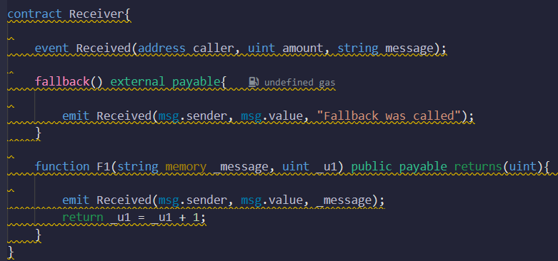
Code Example
-

Slide 8
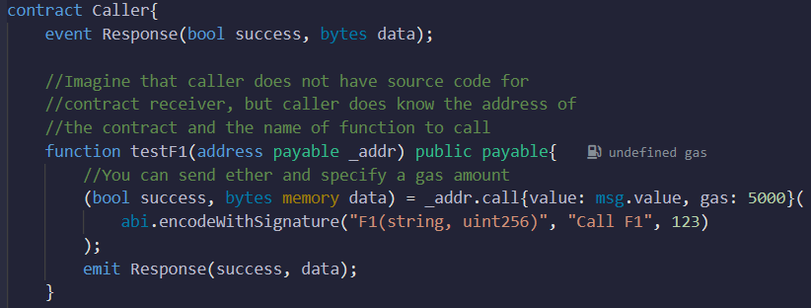
Code Example
-

Slide 9
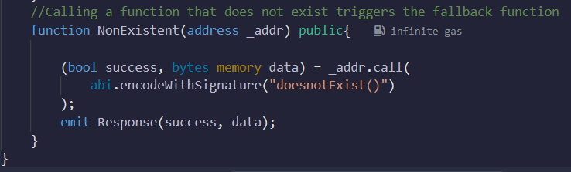
Code Example
-

Slide 10
Explanation of the Code Example
The `Receiver` contract defines a fallback function and a function `F1` that emits an event when called.
The `Caller` contract uses the call function to invoke `F1` on the `Receiver` contract and receive the return value.
The `Caller` contract also demonstrates how calling a non-existent function triggers the fallback function.

Slide 11
Summary
The call function in Solidity provides a way to invoke external contract functions and retrieve their return values.
It offers flexibility in interacting with other contracts, even when the source code is not available.
Care should be taken to provide correct function signatures and handle the return data and success flag properly.

