Slide 1
EVENTS IN SOLIDITY

Slide 2
WHAT ARE EVENTS?
Definition: Events are a way to emit and log messages from a smart contract.
Purpose: Facilitate communication between smart contracts and external applications, allowing them to react to specific contract state changes.

Slide 3
WHEN AND WHY TO USE EVENTS
When to use: Events are used when you want to provide information or notify external entities about important state changes within your smart contract.
Why to use:
- Enable off-chain applications to listen for and respond to contract events.
- Provide transparency and auditability of contract interactions.
- Allow for historical contract state analysis.

Slide 4
BASIC SYNTAX OF EVENTS
Syntax: event EventName([parameter1Type parameter1, parameter2Type parameter2, ...]);
Declare an event using the `event` keyword followed by the event name and its parameters (if any).

Slide 5
EMITTING AN EVENT
Use the `emit` keyword to emit an event within a function.
In the function use ‘emit EventName(parameter values)’ to execute it

Slide 6
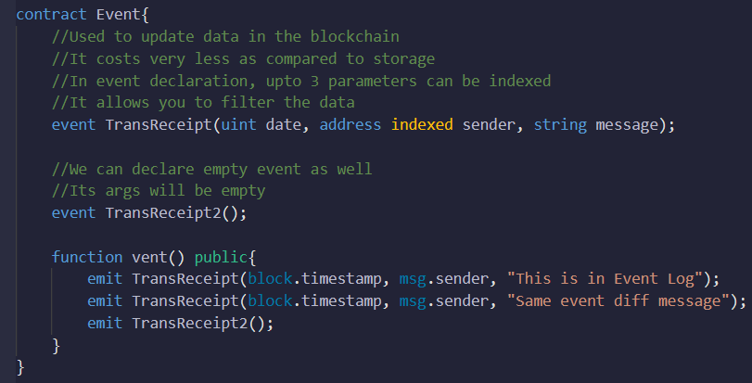
EVENT
-

Slide 7
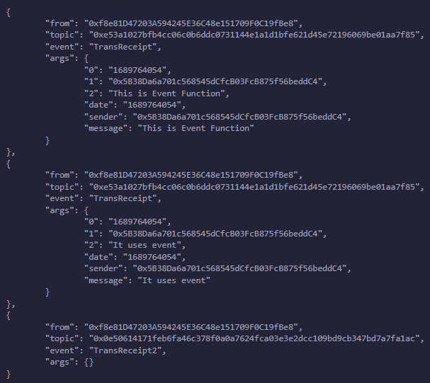
OUTPUT (Log)
-

Slide 8
EVENT PARAMETERS
Events can have parameters to provide additional information in the event logs.
Parameters can be indexed for efficient filtering and searching.
In event declaration, up to 3 parameters can be indexed

Slide 9
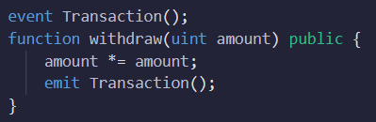
EMPTY EVENTS
An event with no parameters, known as an "empty event," can still be useful for signaling or triggering actions.
Example:

Slide 10
GAS OPTIMIZATION WITH EVENTS
Events do not consume gas for the contract emitting them.
Events store a hash reference in the transaction receipt, allowing off-chain applications to retrieve event data without consuming excessive gas.
They are more gas-efficient than storage state variables

Slide 11
CONSIDERATIONS FOR USING EVENTS
Limitations: Events cannot be accessed or read within the contract itself.
Gas costs: Emitting large or frequent events can increase transaction costs, so use events judiciously.
Event naming: Use descriptive names that reflect the event's purpose for clarity and understandability.

