Slide 1
FUNCTIONS IN SOLIDITY

Slide 2
Introduction to Functions
Functions are a fundamental building block in Solidity, used to define reusable and modular pieces of code.
They allow us to encapsulate a specific set of instructions and execute them whenever needed.
Functions provide flexibility and enhance the readability and maintainability of our smart contracts.

Slide 3
Basic Function Syntax
Function Declaration:
- Starts with the keyword `function` followed by the function name.
- Can include visibility modifiers (`public`, `private`, `internal`, or `external`).
- Can specify the function type (`pure`, `view`, `payable`, or default).

Slide 4
Basic Function Syntax
Function Parameters:
- Enclosed within parentheses after the function name.
- Parameters can have data types and names.
Return Type:
- Specified after the parentheses.
- Multiple return types can be declared using parentheses and commas.

Slide 5
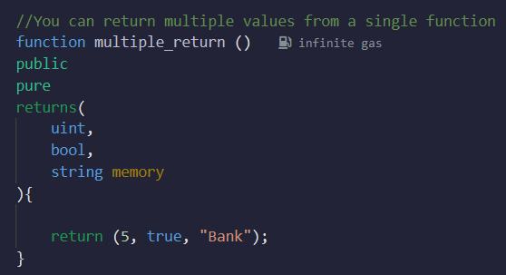
Returning Values from Functions
Functions can return multiple values by listing them within the return statement.

Slide 6
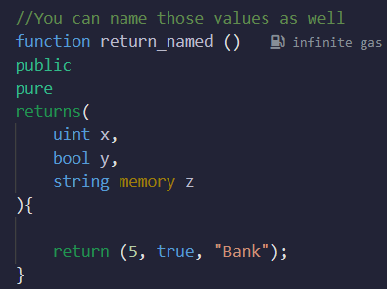
Returning Values from Functions
Return values can be named within the function declaration.

Slide 7
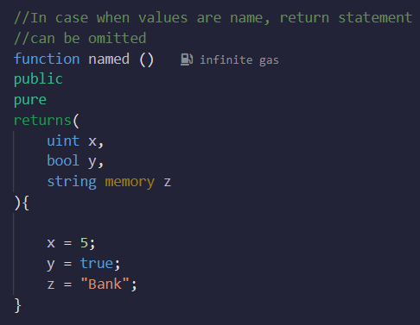
Returning Values from Functions
When return values are named, the return statement can be omitted within the function body.

Slide 8
Destructuring Return Values
When calling a function that returns multiple values, we can destructure the returned values directly.
Assign the desired return values to variables using the destructuring syntax.
Unused return values can be skipped by leaving a blank space.

Slide 9
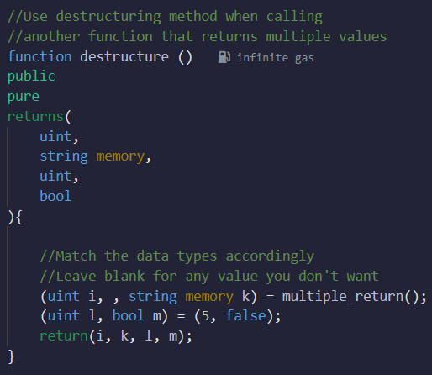
Destructuring Return Values

Slide 10
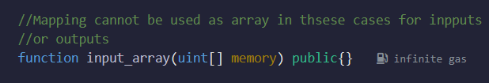
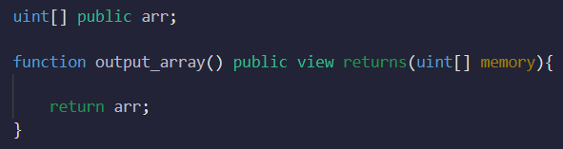
Array Inputs and Outputs
Array Inputs:
Array Outputs:

Slide 11
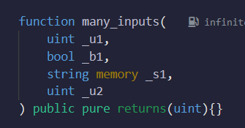
Key-Value Inputs
Function `many_inputs()` accepts multiple inputs using key-value pairs.

Slide 12
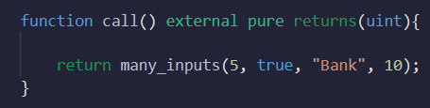
Key-Value Inputs
Inputs can be passed in a specific order, matching the function signature.

Slide 13
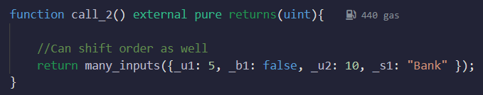
Key-Value Inputs
Inputs can be passed in any order using key-value pairs.

Slide 14
summary
Functions provide code modularity, reusability, and readability.
Multiple return values can be achieved using tuples or named returns.
Destructuring simplifies handling multiple return values.
Arrays can be used as function inputs and outputs.
Key-value inputs offer flexibility in passing function arguments.

