Slide 1
DELEGATECALL IN SOLIDITY

Slide 2
INTRODUCTION
The delegatecall is a low-level function in Solidity used to execute code from another contract while preserving the context of the calling contract.
It is mainly used for code reuse and upgrading contract functionality.

Slide 3
PURPOSE AND USAGE
Purpose: Delegatecall allows a contract to execute code from another contract while accessing its storage and context.
Usage: It is commonly used when contract A wants to execute code from contract B but preserve its own storage and state.

Slide 4
BENEFITS OF USING DELEGATECALL
Code Reusability: Delegatecall enables reusing code from other contracts without duplicating storage or functionality.
Contract Upgradability: By using delegatecall, contract logic can be upgraded without modifying the calling contract's storage or interface.
Gas Efficiency: Delegatecall executes the called contract's code in the context of the calling contract, reducing gas costs.

Slide 5
BASIC SYNTAX
Syntax: `target.delegatecall(functionSignature)`
`target`: The address of the contract to call.
`functionSignature`: The signature of the function to call, encoded using `abi.encodeWithSignature`.

Slide 6
RESTRICTIONS AND CONSIDERATIONS
Storage Layout: The storage layout of the calling contract and the target contract must be the same for delegatecall to work correctly.
Context Preservation: Delegatecall executes the code in the context of the calling contract, so the target contract can modify the calling contract's storage.
Error Handling: Delegatecall does not revert on failed calls, so additional checks and error handling are required.

Slide 7
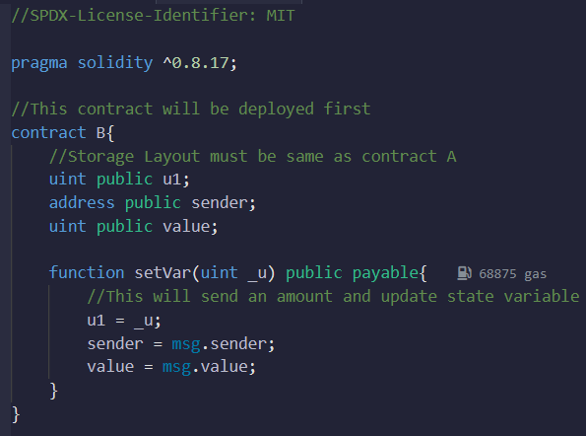
CODE EXAMPLE
-

Slide 8
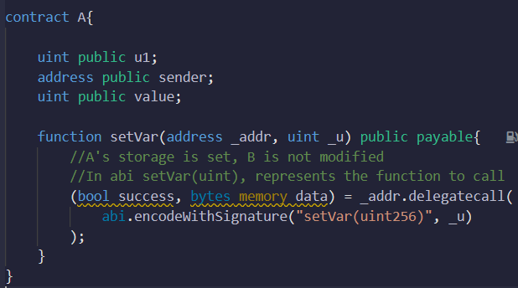
CODE EXAMPLE
-

Slide 9
EXPLANATION OF THE CODE EXAMPLE
Contract B defines a function `setVar` that updates its storage variables based on the input parameters.
Contract A uses delegatecall to execute the `setVar` function from contract B while preserving its own storage and context.

Slide 10
SUMMARY
Delegatecall in Solidity allows contracts to execute code from other contracts while preserving their own storage and context.
It provides code reusability and contract upgradability benefits.
Care should be taken to ensure the storage layout compatibility and handle error scenarios properly when using delegatecall.

