Slide 1
CALLING OTHER CONTRACTS

Slide 2
Introduction
In Solidity, there are multiple ways to call functions in other contracts.
One of the approaches is using low-level calls, which provides more flexibility and control over the interaction.
However this method is generally not recommended

Slide 3
What is a Low-level Call?
A low-level call is a direct way to invoke functions in other contracts.
It allows for dynamic dispatch and provides the ability to pass arbitrary data to the target contract.

Slide 4
Where is Low-level Call Used?
Contract Interaction: Low-level call is used to invoke functions in other contracts to perform various operations.
Interoperability: It enables communication and integration with external contracts or systems.

Slide 5
Benefits of Using Low-level Call
Flexibility: Allows calling any function in a contract dynamically, even if the function is not exposed in the contract's interface.
Custom Data Encoding: Provides the ability to encode and pass custom data to the target contract.
Gas Estimation: Low-level call returns a boolean value indicating the success or failure of the call, enabling better gas estimation.

Slide 6
Considerations in Using Low-level Call
Error Handling: It's important to handle the return value of the low-level call to handle any potential errors.
Security: Care should be taken when passing user-provided data to prevent vulnerabilities like reentrancy attacks.

Slide 7
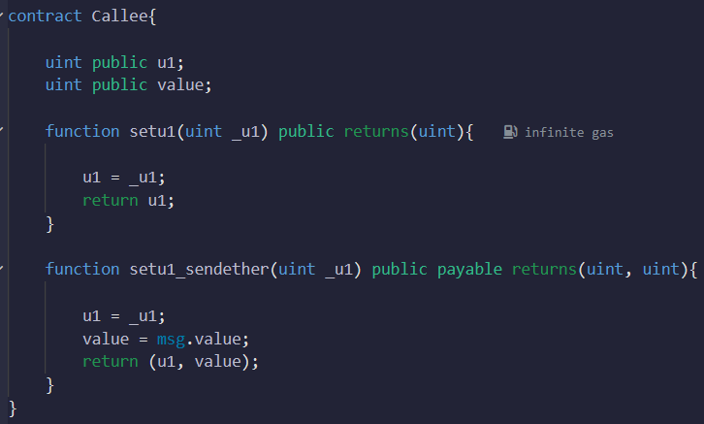
Code Example
-

Slide 8
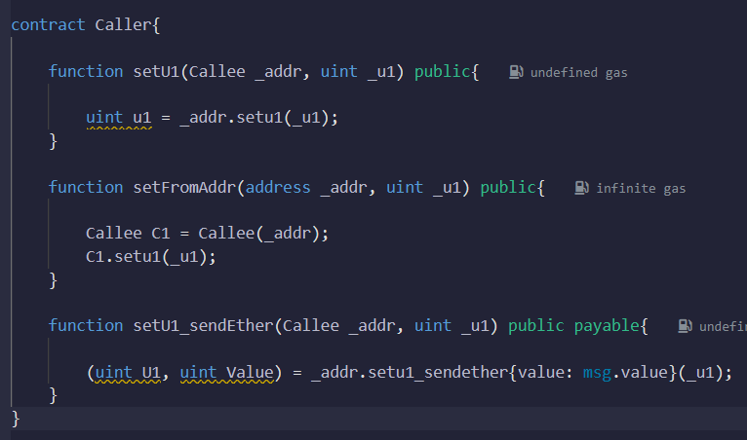
Code Example
-

Slide 9
Summary
Low-level call provides a flexible and dynamic way to call functions in other contracts.
It is useful for scenarios where the target contract or function is not known at compile time or custom data handling is required.
Care should be taken for error handling and security considerations when using low-level call.

