Slide 1
CREATING CONTRACT FROM ANOTHER CONTRACT

Slide 2
Introduction
In Solidity, contracts can be created dynamically from other contracts using the `new` keyword.
Creating a contract from another contract refers to the ability to deploy a new contract instance from within an existing contract.
It allows for contract composition and building complex systems with multiple interconnected contracts.

Slide 3
usage
Contract Factories: It is used to create multiple instances of a contract with different parameters or settings.
Contract Composition: It enables the creation of contract hierarchies and modular contract design.
Contract Deployment Automation: It can be used in deployment scripts to create and configure contracts programmatically.

Slide 4
When to use
Dynamic Contract Creation: When the number or configuration of contracts needed is determined at runtime.
Contract Hierarchies: When there is a need to create parent-child relationships between contracts.
Contract Customization: When contracts need to be created with specific initial settings or parameters.

Slide 5
‘new’ keyword
The new keyword in Solidity can be used to create a new contract instance from another contract. This can be useful for a variety of purposes, such as creating a child contract from a parent contract, or creating a contract that inherits the functionality of another contract.

Slide 6
‘new’ keyword
The new keyword can be used at any time during the execution of a contract. However, it is most commonly used during the constructor function of a contract, as this is when the contract's state variables are initialized.

Slide 7
‘new’ keyword
The new keyword takes two arguments:
the name of the contract to be created,
and any arguments that the contract's constructor function requires.
The new keyword will then deploy the new contract and return the address of the new contract instance.

Slide 8
How to Create a Contract using New Method
Syntax: `ContractType instance = new ContractType(arg1, arg2, ...);`
The `new` keyword is used to create a new instance of the contract.
Arguments can be passed to the contract's constructor as comma-separated values.

Slide 9
How to Create a Contract using Old Method
Syntax: `ContractType instance = (new ContractType){value: msg.value, salt: _salt}(arg1, arg2, ...);`
The `new` keyword is used with additional options like `value` and `salt`.
`value` specifies the amount of Ether to send along with the contract creation.
`salt` can be used to deterministically compute the address of the new contract.

Slide 10
Benefits
Code Reusability: Allows for modular contract design and reuse of existing contract logic.
Contract Composition: Enables building complex systems by composing multiple contracts together.
Customization and Flexibility: Contracts can be created with specific initial settings or parameters.

Slide 11
Benefits of new keyword
It can make code more modular and reusable. By creating a child contract from a parent contract, you can reuse the functionality of the parent contract in the child contract.
The new keyword can help to improve security. By creating a new contract instance, you can isolate the new contract from the parent contract, which can help to prevent malicious attacks.

Slide 12
Considerations in Creating a Contract
Gas Costs: Creating a contract incurs gas costs, and it should be considered when designing gas-efficient systems.
Contract Interaction: Communication and interaction between the newly created contract and other contracts should be planned and implemented.

Slide 13
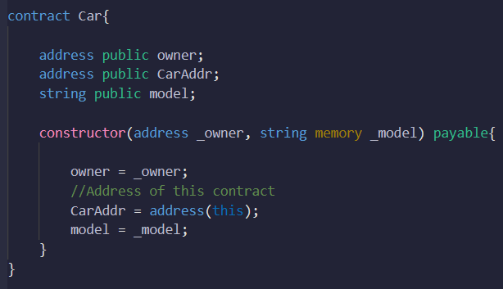
Code Example
-

Slide 14
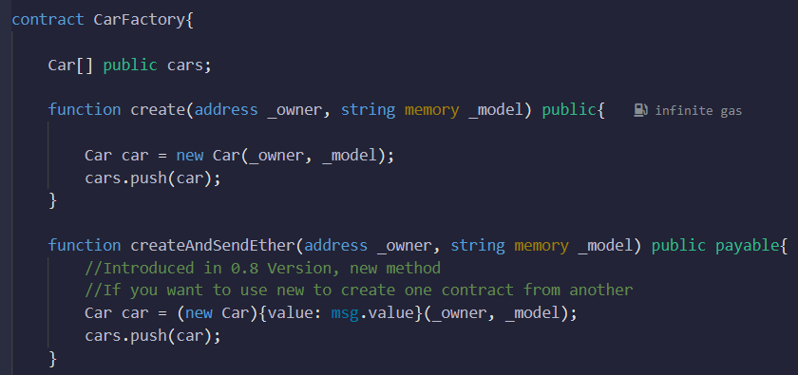
Code Example
-

Slide 15
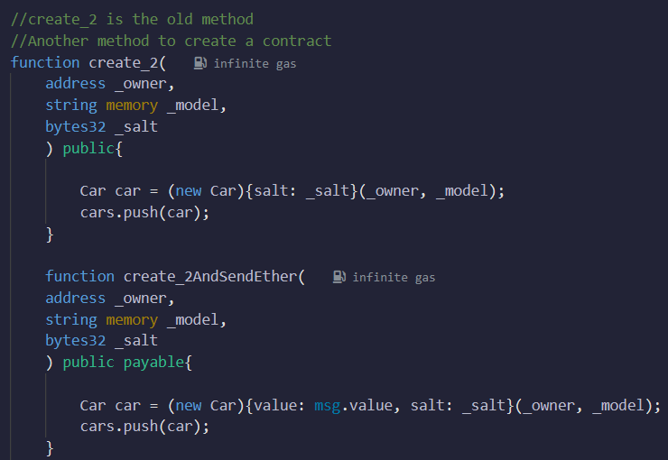
Code Example
-

Slide 16
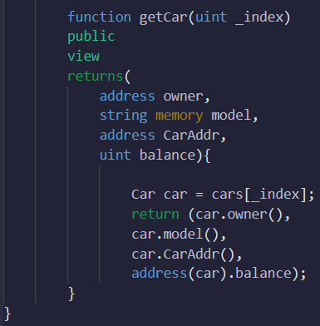
Code Example
-

Slide 17
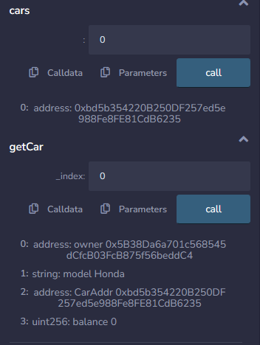
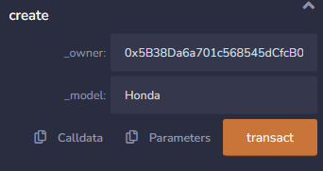
Code Example
-

Slide 18
Summary
Creating a contract from another contract allows for dynamic deployment of contract instances.
It is useful for contract factories, contract composition, and automation of contract deployment.
Consider gas costs and contract interaction when creating contracts from within other contracts.

