Slide 1
FUNCTION SELECTOR IN SOLIDITY

Slide 2
Introduction
The function selector is a mechanism in Solidity used to identify and differentiate functions based on their signatures.
It plays a crucial role in contract communication and function dispatching.

Slide 3
What is a Function Selector?
A function selector is a unique identifier for a function in Solidity.
It is a hash value calculated from the function signature.

Slide 4
Where is the Function Selector Used?
Function Dispatch: Function selectors are used to identify the function to be called when interacting with another contract.
Function Encoding: Function selectors are used to encode function calls and their arguments when passing data between contracts.

Slide 5
When to Use Function Selector?
Contract Interactions: When calling functions on other contracts, the function selector is required to specify the target function.
ABI Encoding: When manually encoding function calls and their arguments in ABI format, the function selector is needed.

Slide 6
How to Compute the Function Selector?
Compute Process: The function selector is calculated by taking the keccak256 hash of the function signature.
Syntax: `bytes4(keccak256(bytes(_func)))`
`_func`: The function signature or name for which the function selector is calculated.

Slide 7
Benefits of Using Function Selector
Efficiency: Function selectors optimize contract function calls by directly identifying the intended function, avoiding unnecessary checks.
Code Safety: Function selectors ensure that only the intended functions can be called, preventing accidental invocations.
Interoperability: Function selectors provide a standardized way to identify and call functions across different contracts.

Slide 8
Considerations in Using Function Selector
Signature Accuracy: The function signature used to compute the function selector must match the actual function signature in the target contract.
Uniqueness: Function selectors must be unique within a contract to avoid conflicts and ensure correct function identification.

Slide 9
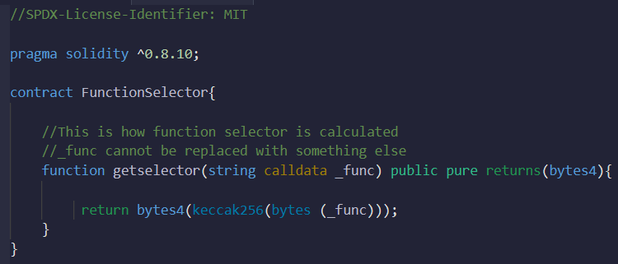
Code Example
-

Slide 10
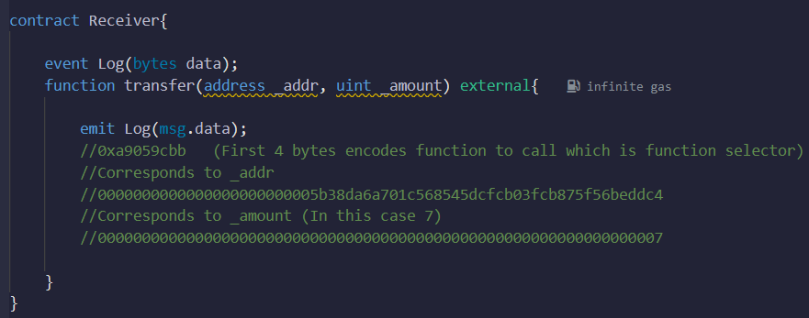
Code Example
-

Slide 11
Summary
Function selectors are unique identifiers for functions in Solidity.
They are used for function dispatch and ABI encoding.
Function selectors improve efficiency, code safety, and interoperability.
Computation involves taking the keccak256 hash of the function signature.
Care should be taken to ensure accurate signatures and uniqueness within a contract.

