Slide 1
IMPORT IN SOLIDITY

Slide 2
Introduction
Definition: Import is a feature in Solidity that allows you to include and use external source code files in your contract.
It enables code reuse and modularity by importing external contracts, libraries, and interfaces.
Similar to importing modules or libraries in other programming languages.

Slide 3
Syntax
Syntax: `import "filename";` or `import * as SymbolName from "filename";`
The filename can be a local file or a remote URL pointing to a Solidity source file.
The imported file should have a `.sol` extension.

Slide 4
How is it used?
Importing external contracts: Use `import "ContractName";` to import a contract from another file and use its functionalities.
Importing libraries: Use `import "LibraryName";` to import a library and utilize its functions or data structures.
Importing interfaces: Use `import "InterfaceName";` to import an interface and implement it in your contract.

Slide 5
When do we use it?
Code reuse: Importing allows you to reuse existing code from external contracts or libraries, saving development time and effort.
Modularity: Importing external contracts, libraries, or interfaces promotes modular code design and separation of concerns.
Interoperability: Importing interfaces enables interaction with contracts from other projects or ecosystems.

Slide 6
example
Create a new folder named Day-10
In that folder create a new file named foo.sol

Slide 7
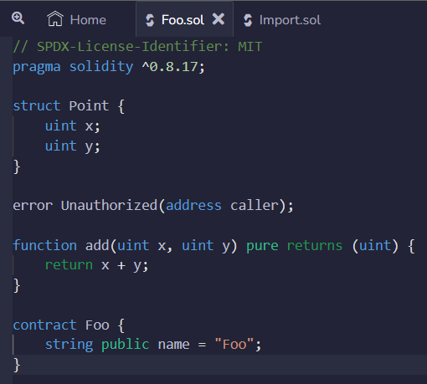
example
-

Slide 8
example
Create a new file named import.sol in the same folder, you can import the foo.sol file using the import command

Slide 9
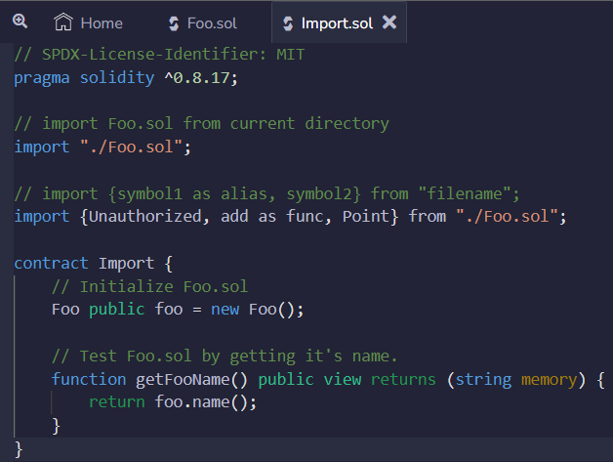
example
-

Slide 10
Benefits of using Import
Code reuse: Avoid reinventing the wheel by leveraging existing and proven code.
Modularity: Encourage separation of concerns and improve code organization.

Slide 11
Benefits of using Import
Interoperability: Facilitate interaction with external contracts and interfaces.
Simplified development: Importing simplifies development by providing access to established and tested functionalities.

Slide 12
Restrictions in using Import
Source code availability: The imported file must be available and accessible during compilation.
Circular dependencies: Be cautious of circular dependencies between contracts, which can cause compilation errors.

