Slide 1
INTRODUCTION TO REMIX IDE

Slide 2
INTRODUCTION
Remix IDE is a web-based integrated development environment (IDE) designed specifically for blockchain development and smart contract creation.
It provides a user-friendly interface and a comprehensive set of tools for writing, testing, and deploying smart contracts on various blockchain platforms.

Slide 3
WHAT IS REMIX IDE?
Remix IDE is a powerful development environment for creating and interacting with smart contracts.
It offers a range of features, including code editing, debugging, deployment, testing, and contract interaction.
Remix is highly influenced by C++, python and JavaScript and it is designed to target Ethereum virtual machine (EVM)

Slide 4
APPLICATIONS OF REMIX IDE
Remix IDE is primarily used for developing decentralized applications (DApps) and smart contracts on blockchain platforms like Ethereum.
It is suitable for both beginner developers and experienced professionals looking to build and deploy blockchain-based applications.

Slide 5
PROGRAMMING LANGUAGES IN REMIX IDE
Remix IDE supports multiple programming languages for writing smart contracts, including:
- Solidity: A popular language for creating Ethereum smart contracts.
- Vyper: A Pythonic language with enhanced security features.
- Yul: A low-level language for Ethereum Virtual Machine (EVM) bytecode.

Slide 6
ADVANTAGES OF REMIX IDE
Easier Development: Remix IDE simplifies the process of smart contract development by providing a user-friendly interface and a range of integrated tools.
Built-in Environment: It offers a complete development environment, eliminating the need for additional installations or setups.
Real-time Feedback: Remix IDE provides instant feedback on code compilation, execution, and debugging, making the development process more efficient.

Slide 7
ACCESSING REMIX IDE
Remix IDE is a web-based tool accessible through a web browser.
It can be accessed by visiting the official Remix IDE website at remix.ethereum.org.
Or you can just search Remix IDE and click on the first link you get

Slide 8
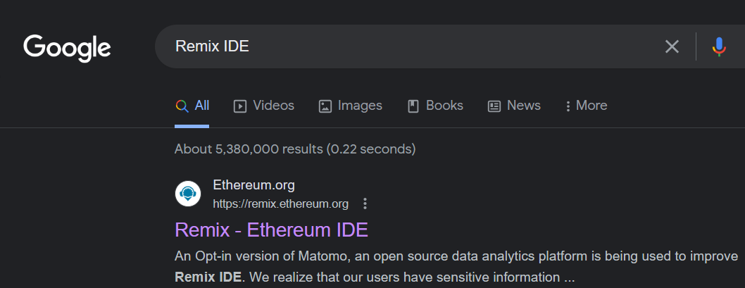
ACCESSING REMIX IDE
-

Slide 9
ACCESSING REMIX IDE
Click on it, you will go to the homepage. It will look something like this:

Slide 10
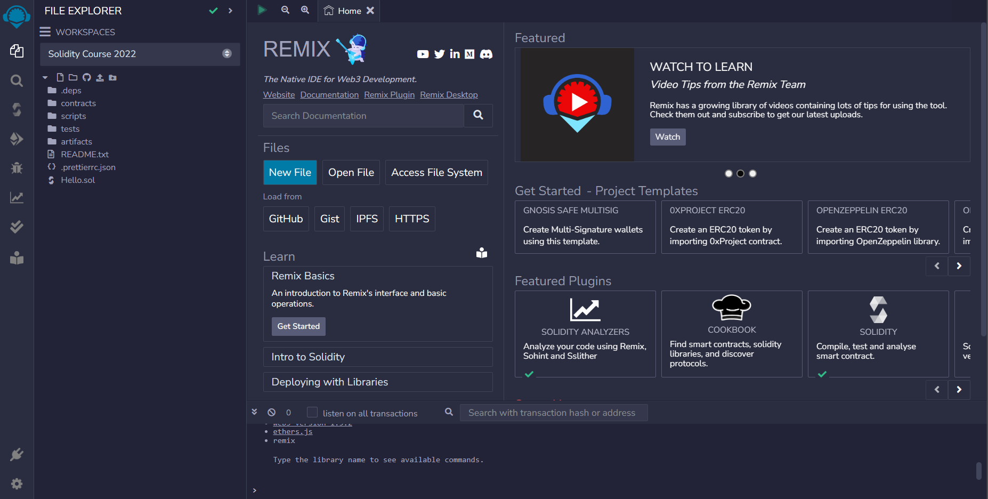
ACCESSING REMIX IDE
-

Slide 11
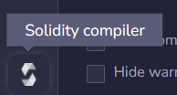
STARTING REMIX IDE
Click the solidity compiler option
Select the compiler version you want to use. It is best to select the latest compiler version

Slide 12
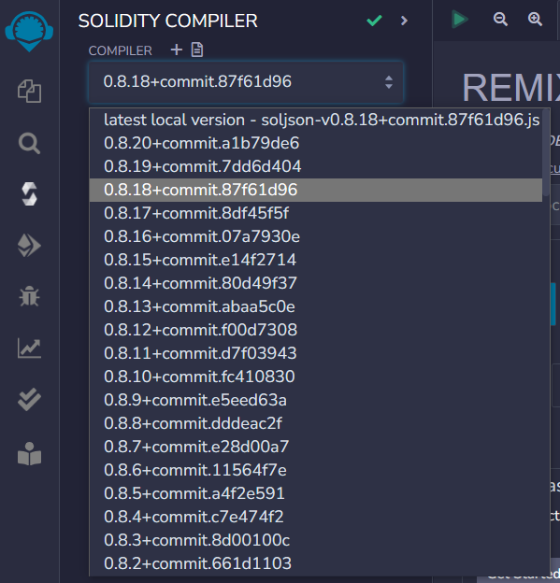
STARTING REMIX IDE
-

Slide 13
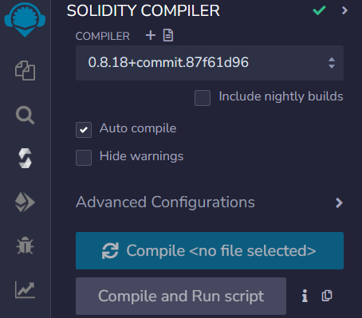
STARTING REMIX IDE
There will also be an auto-compile check box there, make sure to check it if it is not already checked, it will notify you of any errors and warnings in your code:

Slide 14
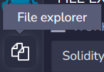
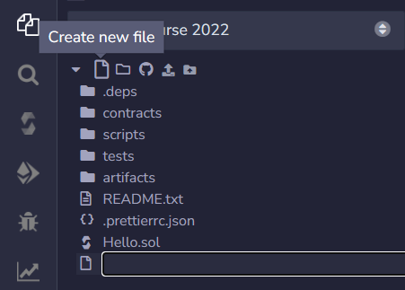
STARTING REMIX IDE
Go to the File Explorer option, click on it
Click on create new file icon to create a new file

Slide 15
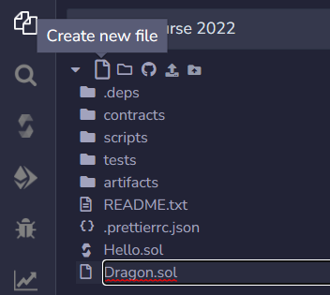
STARTING REMIX IDE
Give it any name you want and end it with .sol, click ENTER, you will have created a new solidity programming file

Slide 16
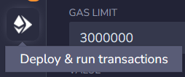
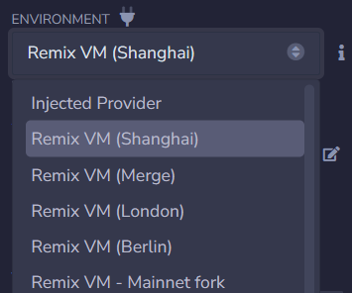
STARTING REMIX IDE
Now click on the Deploy and Run Transaction icon
Here you may select the environment you want to work in, for now you may select Remix VM (Shanghai)

Slide 17
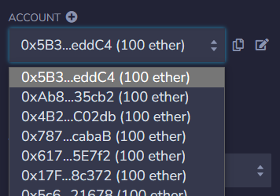
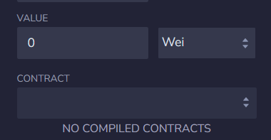
STARTING REMIX IDE
You can then select any account you want
No need to enter any value for now
The contract name that you make will be
Visible in contract

Slide 18
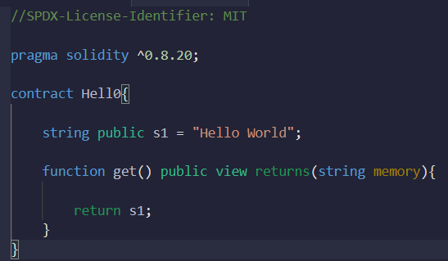
MAKING CONTRACT
Suppose you make a random contract

Slide 19

MAKING CONTRACT
Keep in mind that the pragma solidity version that you write here, represents your compiler version and it should be lesser than or equal to the compiler version that you have selected previously

Slide 20
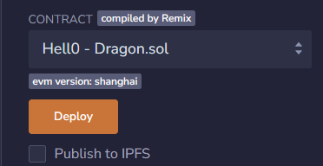
DEPLOYING CONTRACT
The contract name will become visible, you just need to click on deploy to run it
Then all the public state variables and public functions will be visible to you under deployed contracts

Slide 21
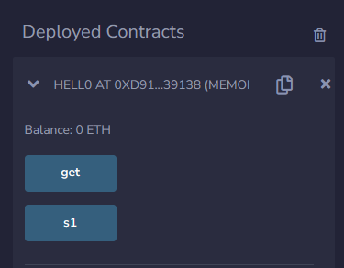
DEPLOYING CONTRACT

Slide 22
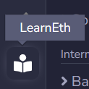
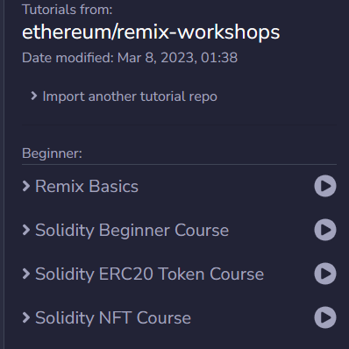
MORE INFORMATION
For more knowledge you can click on the LearnEth icon
From there you can access Remix Basics

Slide 23
REMIX IDE SETTINGS
Remix IDE allows customization through various settings and configurations:
- Compiler Version: Choose the desired compiler version for compiling smart contracts.
- Plugin Integration: Enable or disable specific plugins to extend Remix IDE's functionality.

Slide 24
REMIX IDE SETTINGS
- Editor Themes: Customize the visual appearance of the code editor with different themes.
- Network Configuration: Configure connections to different blockchain networks for testing and deployment.

Slide 25
SUMMARY
Remix IDE is a web-based development environment for building and deploying smart contracts on blockchain platforms.
It supports programming languages such as Solidity, Vyper, and Yul.
Remix IDE offers an intuitive interface, real-time feedback, and a range of tools to simplify the smart contract development process.
It can be accessed through a web browser and allows customization through various settings and configurations.

