Slide 1
Try and Catch in Solidity

Slide 2
What is Try and Catch?
Try and Catch is a programming construct used to handle exceptions and errors in a structured manner.
It allows developers to anticipate and handle potential errors that can occur during the execution of their code.

Slide 3
Syntax of Try and Catch
try {
// Code that might throw an exception
} catch {
// Code to handle the exception
}

Slide 4
How is Try and Catch Used?
Try and Catch is used to capture and handle exceptions and errors that occur during the execution of code.
It provides a structured way to handle unexpected scenarios and recover from errors gracefully.

Slide 5
When to Use Try and Catch?
Use Try and Catch when you expect certain code segments to potentially throw exceptions or errors.
It is particularly useful when interacting with external contracts or performing complex operations that may fail.

Slide 6
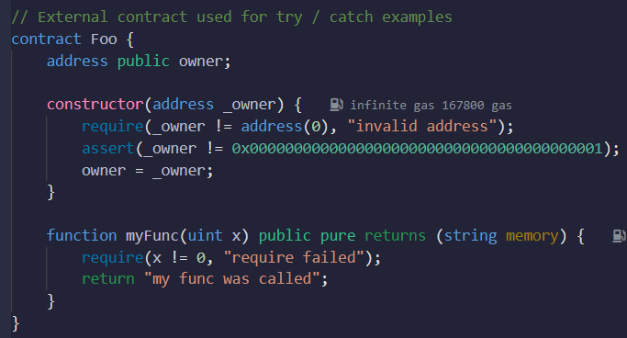
Example
-

Slide 7
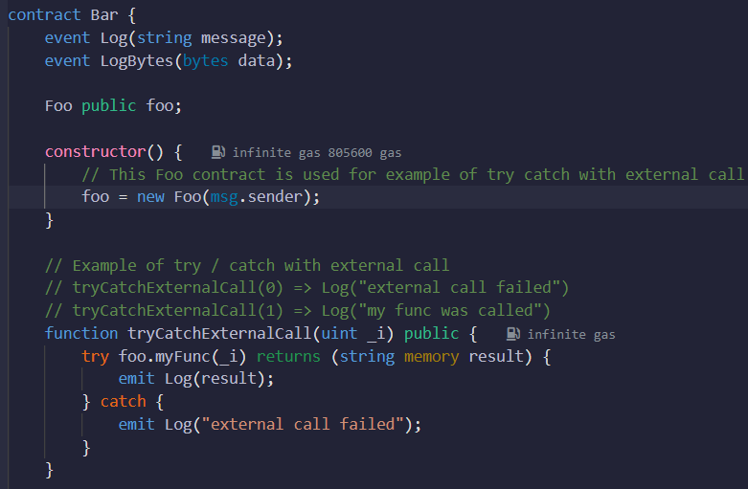
Example
-

Slide 8
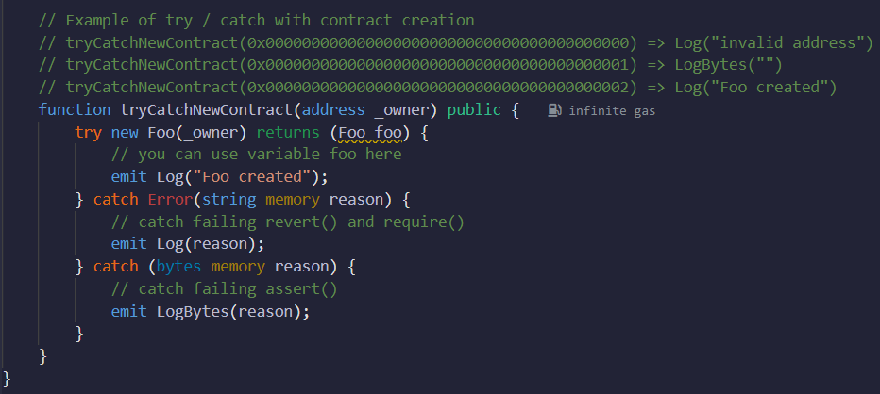
Example
-

Slide 9
Example
This example demonstrates the usage of Try and Catch in Solidity.
The Foo contract is used for illustrating try / catch with external calls and contract creation.
The tryCatchExternalCall function showcases how to handle exceptions thrown by an external call.

Slide 10
Example
The tryCatchNewContract function demonstrates how to handle errors during the creation of a new contract.
Emits appropriate log messages based on the execution result.
Try and Catch allows developers to handle exceptions and errors gracefully, enhancing the robustness of smart contracts.

Slide 11
Benefits of Using Try and Catch
Provides error handling capabilities to handle unexpected scenarios.
Helps prevent the abrupt termination of the program.
Allows developers to take specific actions based on the encountered error or exception.

Slide 12
Restrictions in Using Try and Catch
It cannot catch all types of exceptions or errors.
It cannot catch exceptions or errors that occur outside the try-catch block.
It has limitations in handling reverts, requires, and asserts.

Slide 13
Summary
Try and Catch in Solidity is a construct used to handle exceptions and errors.
It provides a structured way to capture and handle potential errors during code execution.
By using Try and Catch, developers can anticipate and handle unexpected scenarios, improving the robustness of their smart contracts.

