Slide 1
Structure & Pair
11/18

Slide 2
01
Structure

Slide 3
Why Structure?
INT
Vector
String
Char
Bool
My_definition

Slide 4
Why Structure?
Student
Teacher
ID
grade
ID
name
gender
name
subject
…

Slide 5
Why Structure?
Class
Class
Teacher
Student
Teacher
Student
Student
Student…
Student
Student…

Slide 6
Why Structure?
School
School
class
class
class
class
class
class
class
class

Slide 7
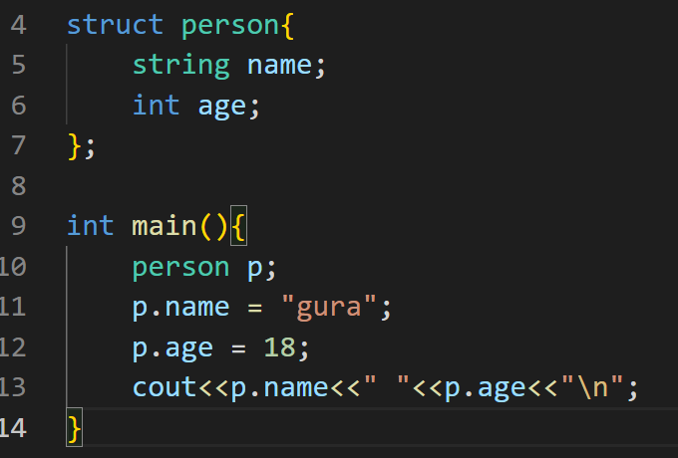
Example for C++

Slide 8
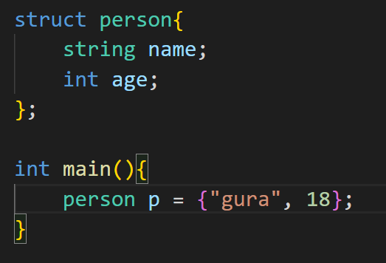
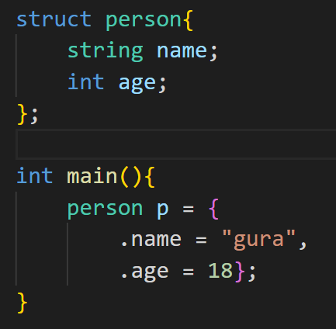
Example for C++

Slide 9
Example for C++

Slide 10
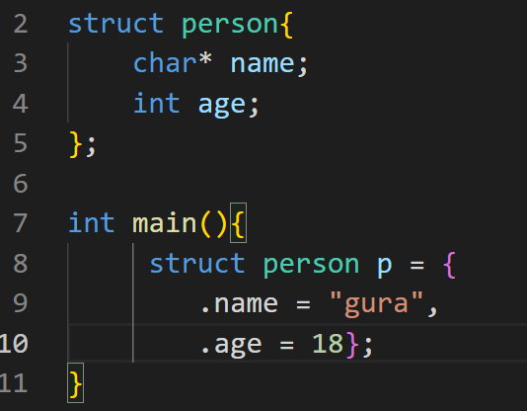
Example for C

Slide 11
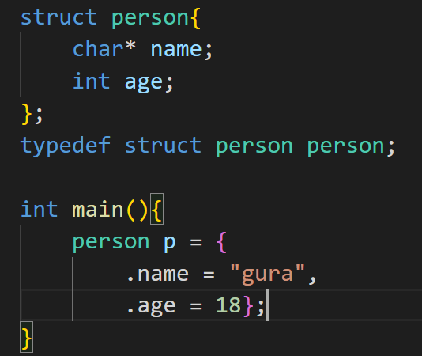
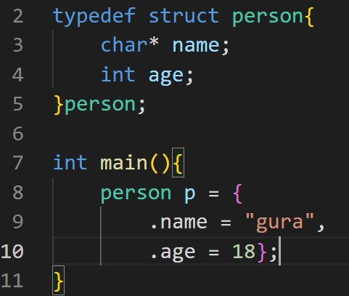
Example for C

Slide 12
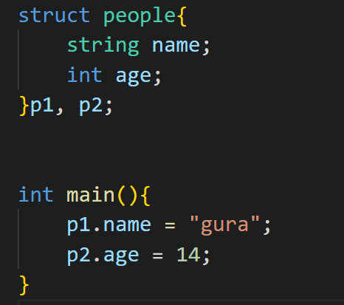
Example for C/C++

Slide 13
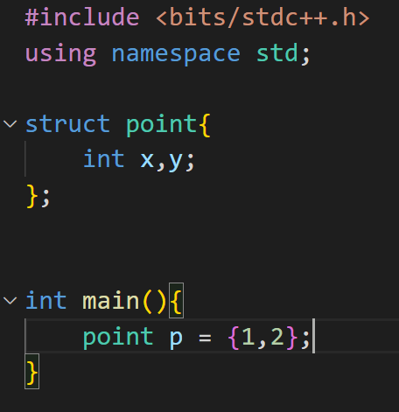
Common Example

Slide 14
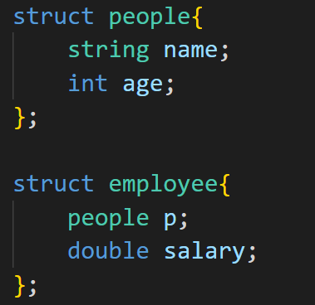
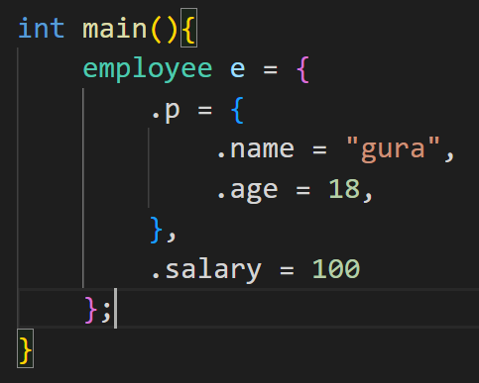
Structure in structure

Slide 15
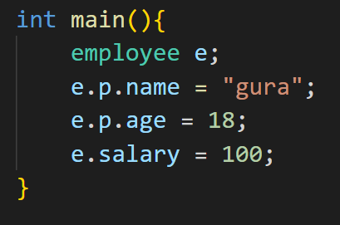
Structure in structure

Slide 16
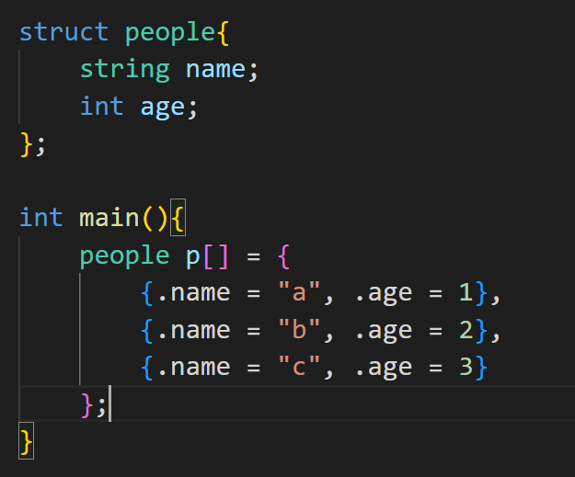
Structure with array
p[1].name = “a”
p[1].age = 2

Slide 17
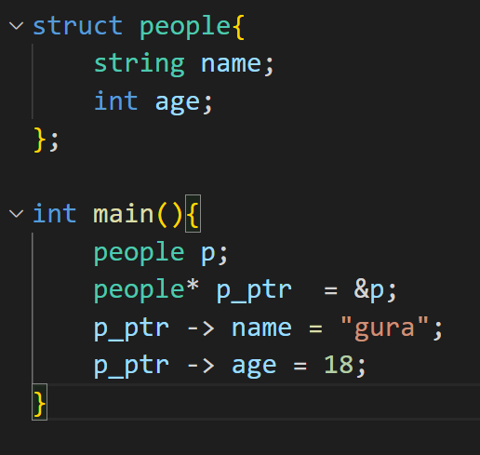
Structure with pointer

Slide 18
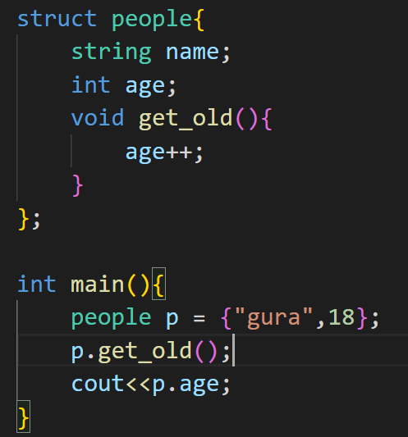
Structure with function only for C++
>>> 19

Slide 19
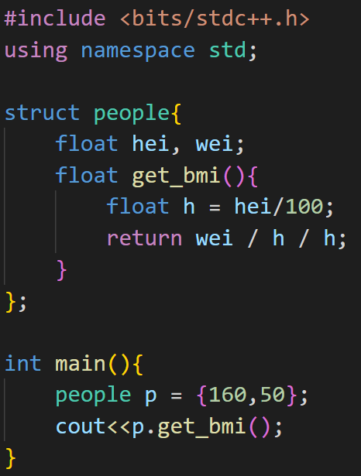
Structure with function only for C++
>>> 19.5312

Slide 20
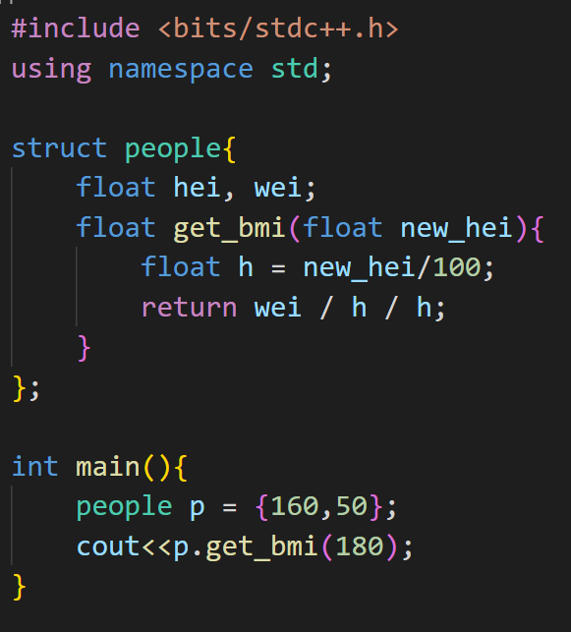
Structure with function only for C++
>>> 15.4321

Slide 21
02
Pair

Slide 22
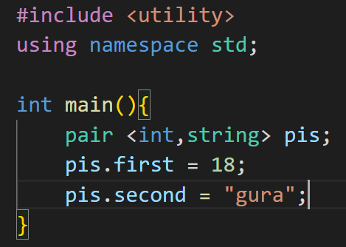
Usage

Slide 23
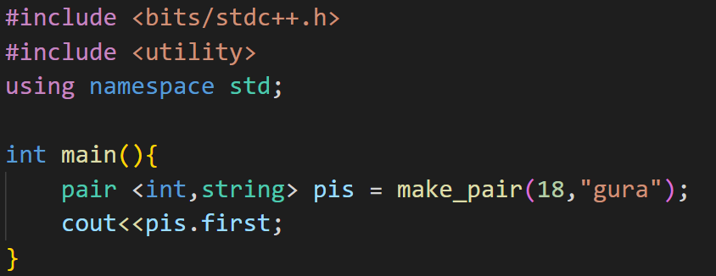
Make_pair

Slide 24
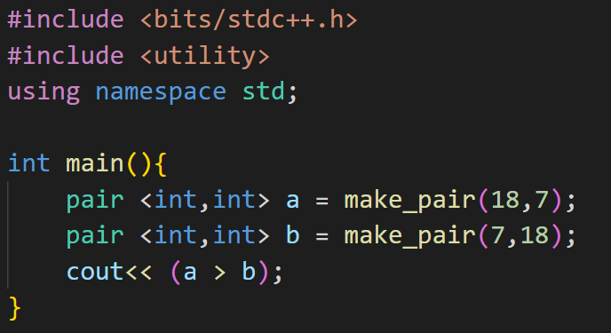
Comparison
>>> 1

Slide 25
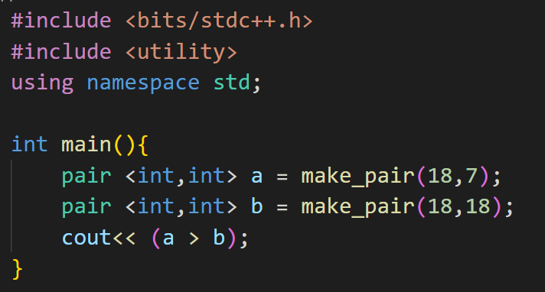
Comparison
>>> 0

Slide 26
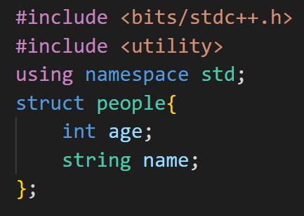
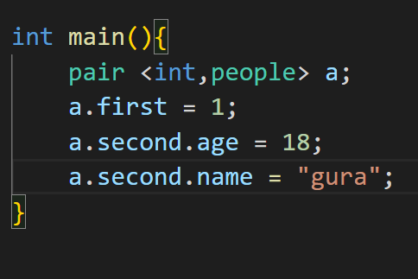
Combine with Structure

