Slide 1
Structure

Slide 2
Why Structure?
INT
Vector
String
Char
Bool
My_definition

Slide 3
Why Structure?
Student
Teacher
ID
grade
ID
name
gender
name
subject
…

Slide 4
Why Structure?
Class
Class
Teacher
Student
Teacher
Student
Student
Student…
Student
Student…
…
…

Slide 5
Why Structure?
School
School
class
class
class
class
class
class
class
class

Slide 6
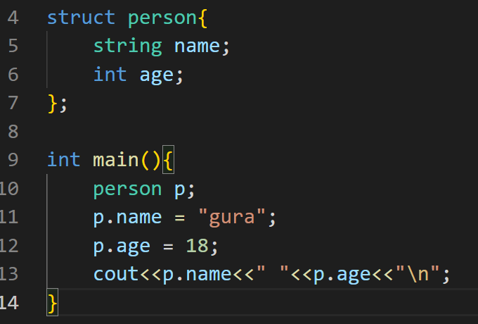
Example for C++

Slide 7
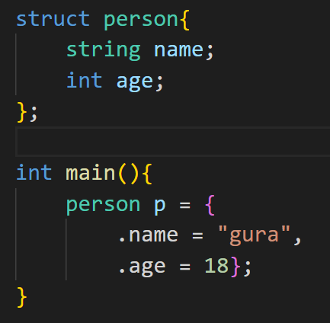
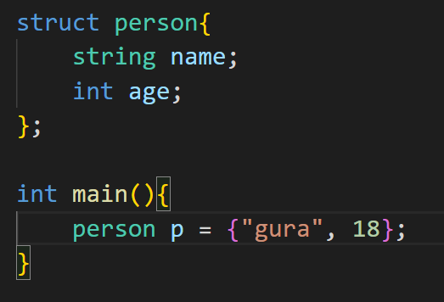
Example for C++

Slide 8
Example for C++

Slide 9
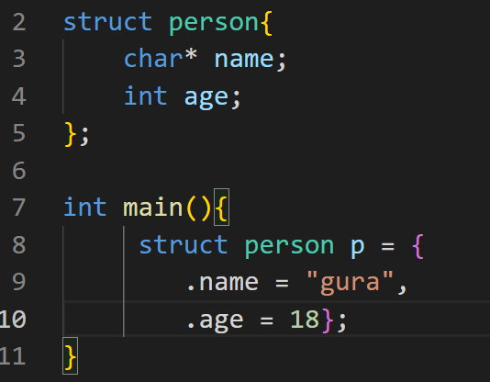
Example for C

Slide 10
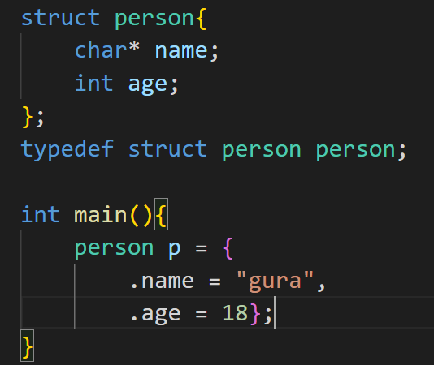
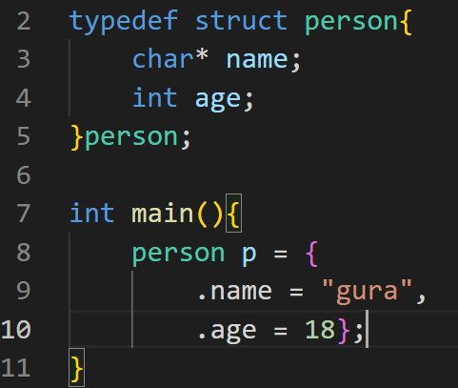
Example for C

Slide 11
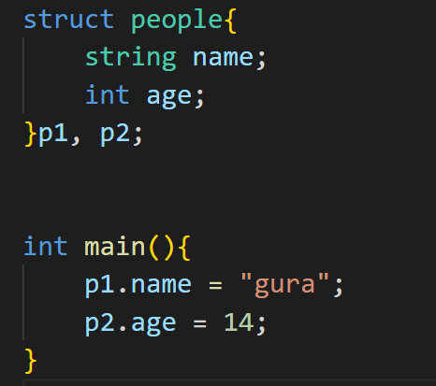
Example for C/C++

Slide 12
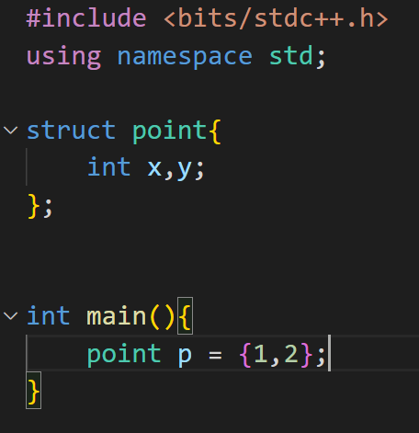
Common Example

Slide 13
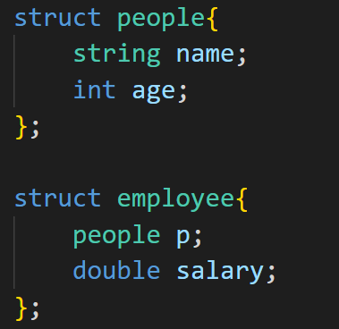
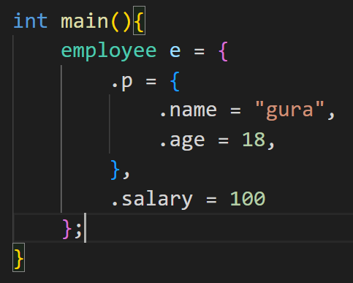
Structure in structure

Slide 14
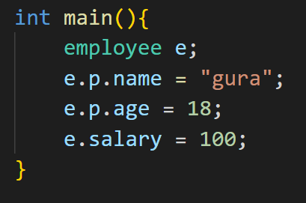
Structure in structure

Slide 15
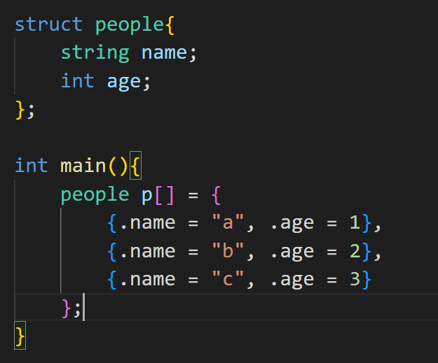
Structure with array
Notes:
陣列出小例題

Slide 16
Why Structure?
INT
Vector
String
Char
Bool
My_definition

Slide 17
Why Structure?
INT
Vector
INT
Vector
INT
Vector
String
Char
String
Char
String
Char
Bool
Bool
Bool
INT
Vector
INT
Vector
INT
Vector
String
Char
String
Char
String
Char
Bool
Bool
Bool

Slide 18
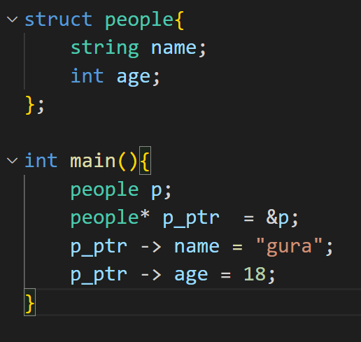
Structure with pointer

Slide 19
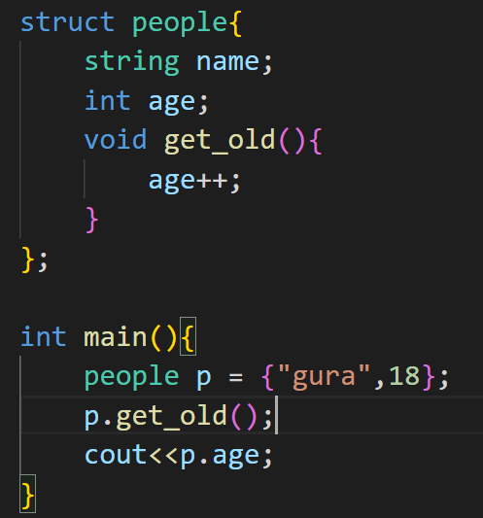
Structure with function only for C++
>>> 19

Slide 20
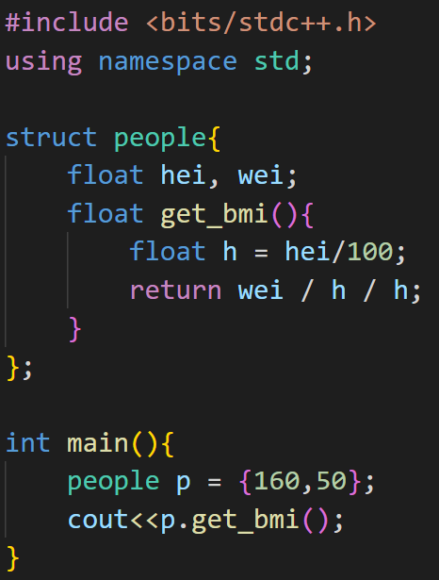
Structure with function only for C++
>>> 19.5312

Slide 21
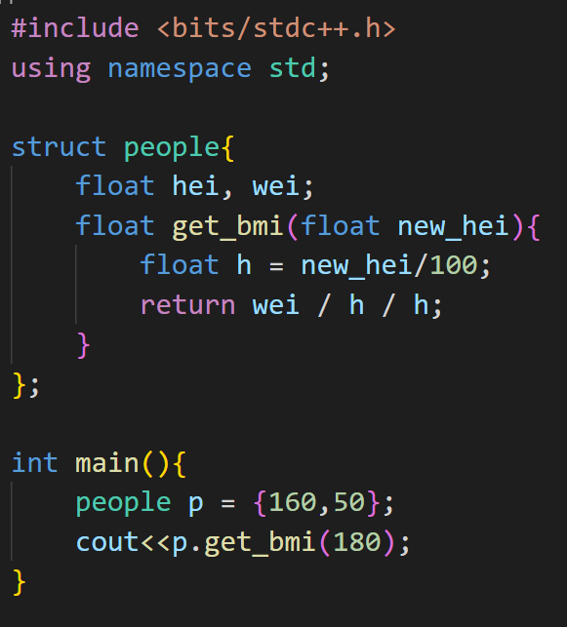
Structure with function only for C++
>>> 15.4321

Slide 22
Pair

Slide 23
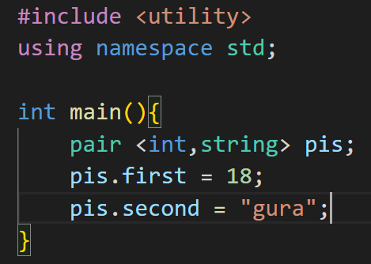
Usage

Slide 24
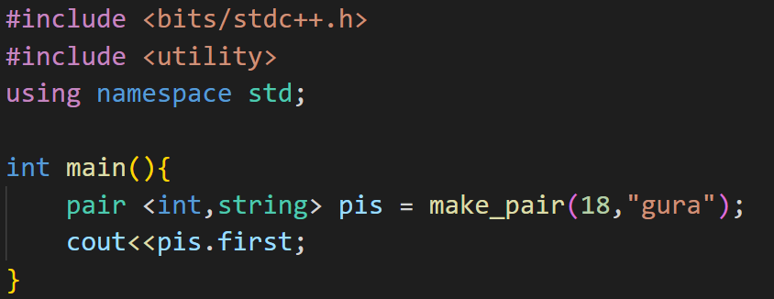
Make_pair

Slide 25
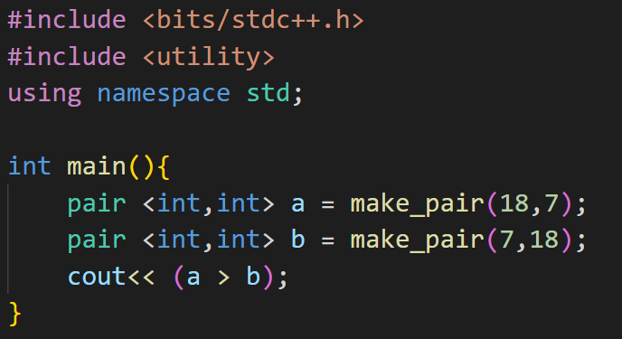
Comparison
>>> 1

Slide 26
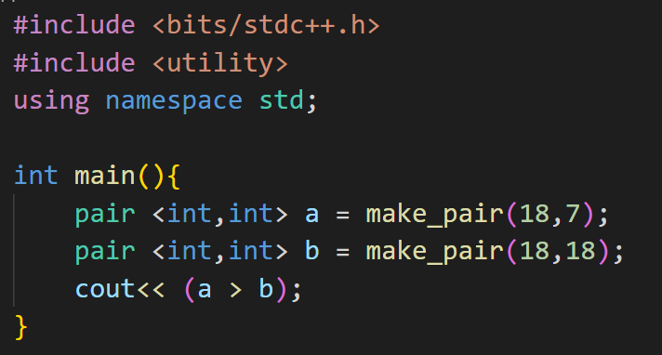
Comparison
>>> 0
Notes:
多一個string問比較結果
(a>b)用if代替

Slide 27
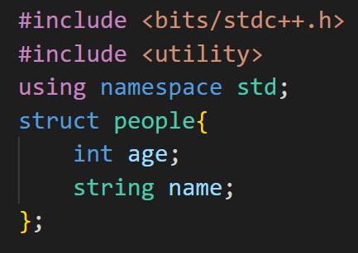
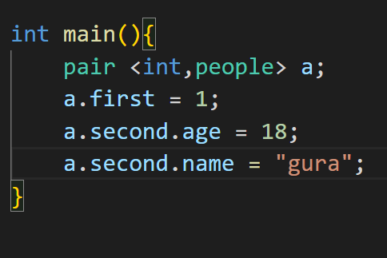
Combine with Structure
Notes:
注意不能比較

