Slide 1
Letr: A Lightweight And Efficient Transformer For Keyword Spotting
Kevin Ding∗ , Martin Zong∗ , Jiakui Li, Baoxiang Li†
ICASSP
2022

Slide 2
Target
Reduce the model size and computing

Slide 3
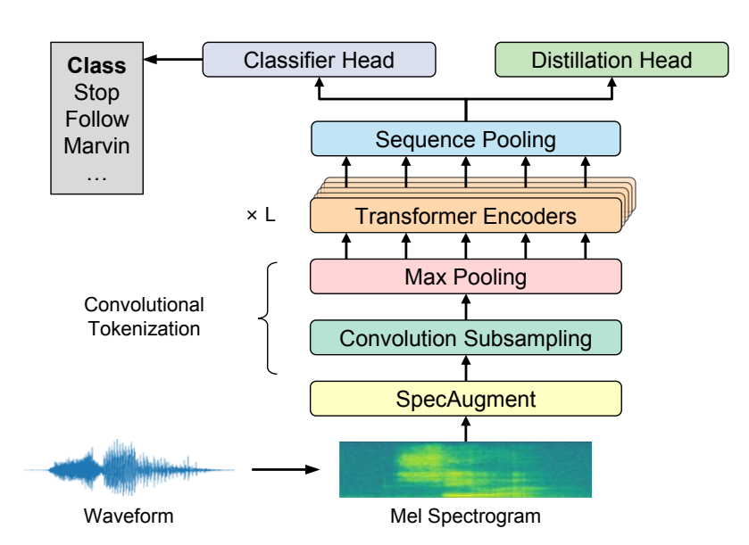



x₀ = MaxPool(ReLU(Conv2d(x)))
$x_{0}∈R^{d∗h∗w}$
Data augmentation
$x∈R^{1∗T∗F}$
T is the number of time window
F is the frequency

Slide 4
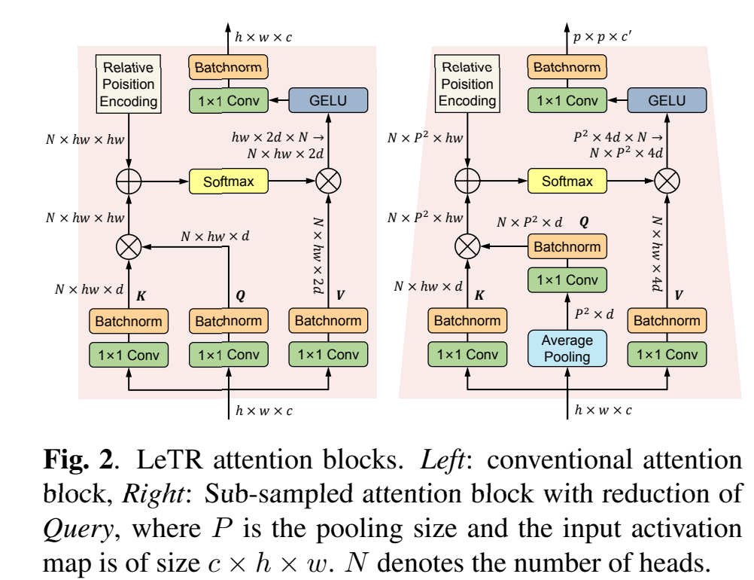
Sub-Sampled Attention
減
少
運
算
減少大小

Slide 5








Sequence Pooling
T is the number of time window
F is the frequency
$x_{0}∈R^{d∗h∗w}$
x_{S} is the output of an S stage Transformer encoder, b is the mini-batch size,
n is the sequence length, and d is the embedding dimension
Then z can be sent into a classifier head to infer the final keyword label

Slide 6
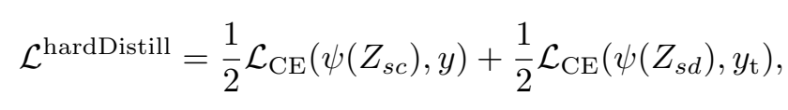





Notes:
hard decision of the teacher as a true lab

Slide 7

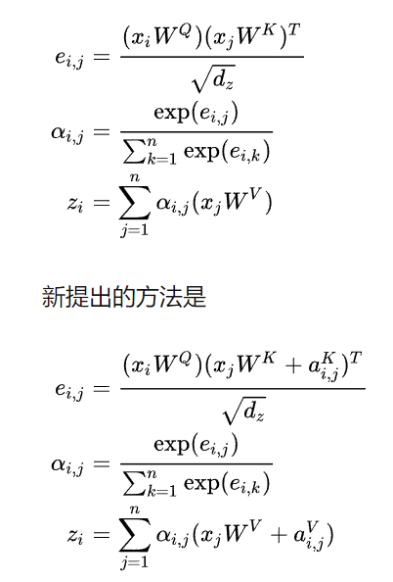
Position encoding & Relative position encoding

Slide 8

GELU

Slide 9
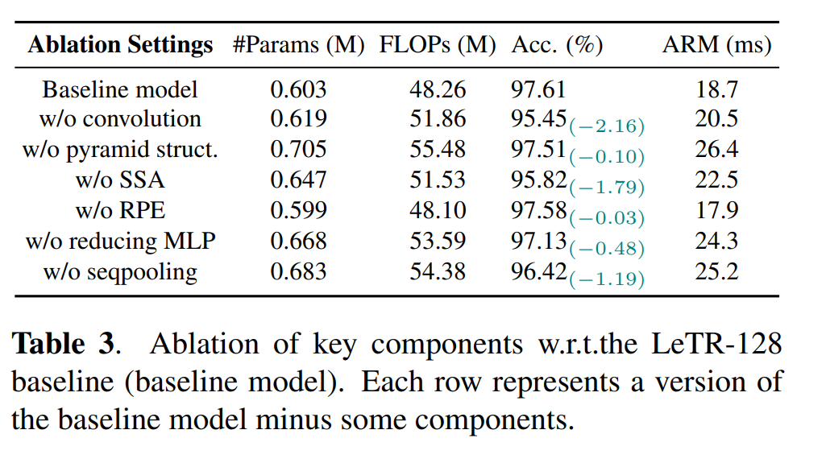

Slide 10
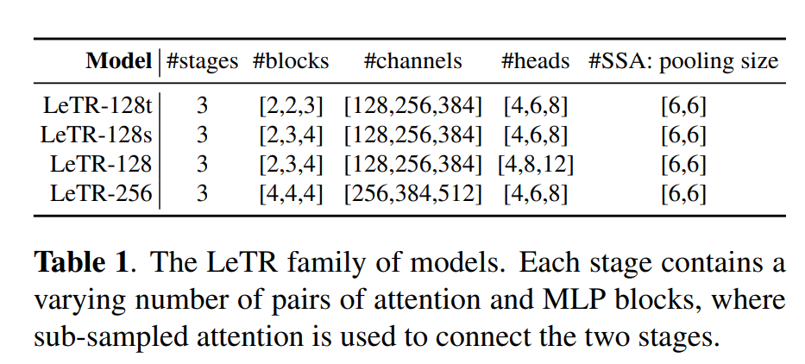
EXPERIMEN
V1 contains 65,000 snippets of 30 different keywords, whereas V2 contains 105,000 snippets of 35 different keyword
80% instances for training, 10% for validation and 10% for testing

Slide 11
