Slide 1
KWS Final Report
鄭采玲

Slide 2
Outline
KWS Introduction
KWS Corpus
Keyword Transformer
My Task and Corpus
Experiment

Slide 3
KWS Introduction
Keyword spotting deals with the identification of keywords in utterances. (Hey, Siri; OK Google…)
Characteristic
Resource-efficient and Energy-efficient
Need robust, low latency, less complexity and less computation
Method
CNN, ResNET, NN, LSTM, GMM, HMM……
Dataset
Google search command dataset
Evaluate
Accuracy, ROC (False alarm vs false reject)

Slide 4
KWS Corpus
Google Command Dataset
English
27.92 hr
2618 speakers
3.8GB
105829 utterances
Version 1 and Version 2
35 keywords
Multilingual Spoken Words
Qualcomm

Slide 5
KWS Corpus
Google Command Dataset
Multilingual Spoken Words
23.4 million utterances
50 languages
344286 keywords
6601.39hr
115000 speakers
Subset of common voice
Qualcomm

Slide 6
KWS Corpus
Google Command Dataset
Multilingual Spoken Words
Qualcomm
Target -> wake word (“OK Google”, “Hey Siri”)
4 keywords (‘hey Snapdragon’, ‘Hey Android’, ‘Hi Galaxy’, ‘Hi Lumina’)
English
4270 utterances
50 speakers
1.19 hr

Slide 7
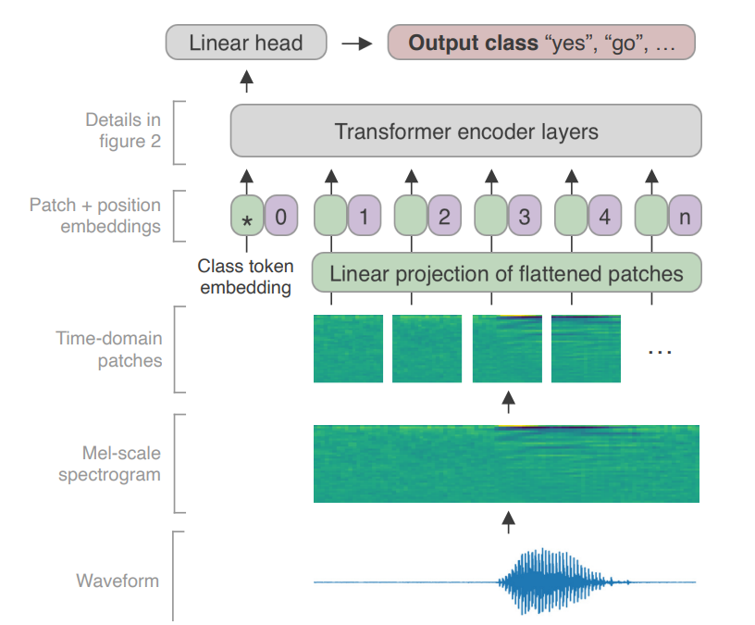
Keyword Transformer
F
…
T

Slide 8
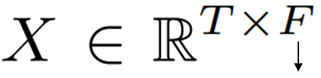
Keyword Transformer
F
…
T

Slide 9
Keyword Transformer
T
…
F

Slide 10
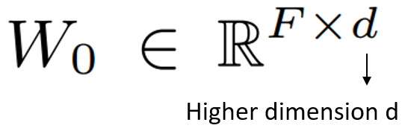

Keyword Transformer
,
$$XW_{0}∈ℝ^{T×d}$$
T
F

Slide 11


Keyword Transformer
d
$$X_{class}∈ℝ^{1×d}$$
$$XW_{0}∈ℝ^{T×d}$$
T+1

Slide 12


Keyword Transformer
d
$$X_{class}∈ℝ^{1×d}$$
$$XW_{0}∈ℝ^{T×d}$$
T+1
$$+$$
$$X_{pos}∈ℝ^{(T+1)×d}$$

Slide 13
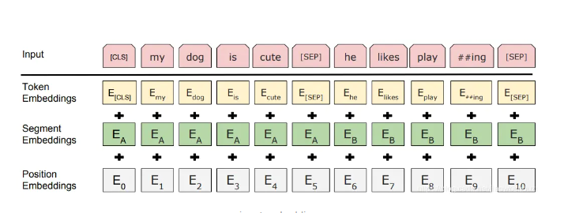
Notes:
通过建立字向量表将每个字转换成一个一维向量，作为模型输入。特别的，英文词汇会做更细粒度的切分，比如playing 或切割成 play 和 ##ing，中文目前尚未对输入文本进行分词，直接对单子构成为本的输入单位。将词切割成更细粒度的 Word Piece 是为了解决未登录词的常见方法。
假如输入文本 ”I like dog“。下图则为 Token Embeddings 层实现过程。输入文本在送入 Token Embeddings 层之前要先进性 tokenization 处理，且两个特殊的 Token 会插入在文本开头 [CLS] 和结尾 [SEP]。
Bert 在处理英文文本时只需要 30522 个词，Token Embeddings 层会将每个词转换成 768 维向量，例子中 5 个Token 会被转换成一个 (6, 768) 的矩阵或 (1, 6, 768) 的张量。

Slide 14
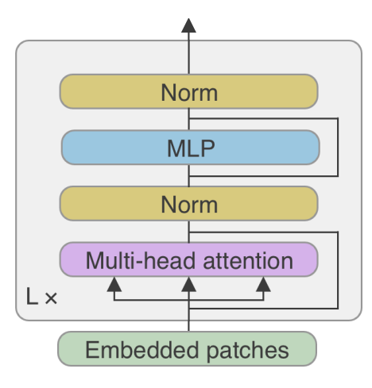
Keyword Transformer

Slide 15

My Task and Corpus
Use ESPnet to implement keyword spotting
Multiple Keyword Spotting with a short sentence
Make the multiple Keyword Spotting Corpus
Make from Google Speech Command
2~7 utterances
bed_forward
forward_three_one_wow
house_no_up_two_on_forward

Slide 16
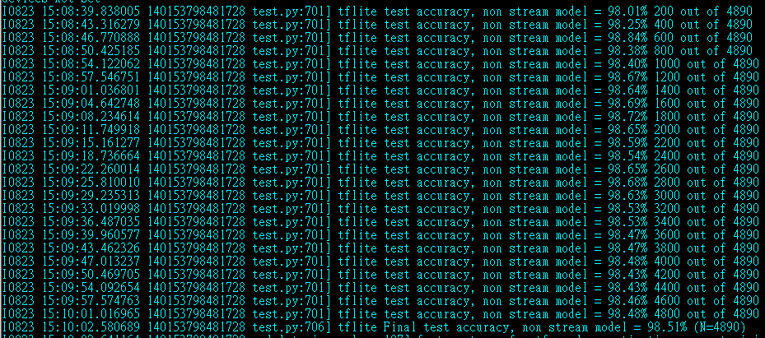

Experiment

