Slide 1
Keyword Transformer: A Self-Attention Model for Keyword
Axel Berg and Mark O'Connor and Miguel Tairum Cruz
Interspeech 2021

Slide 2
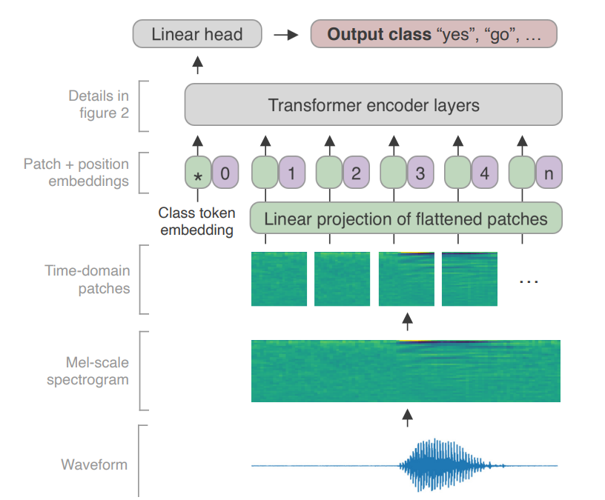
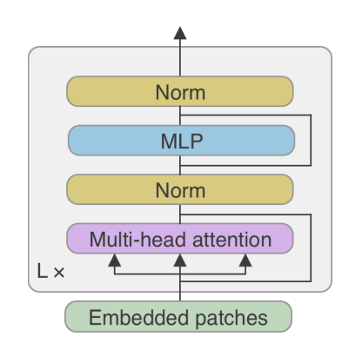
Layer Norm

Slide 3
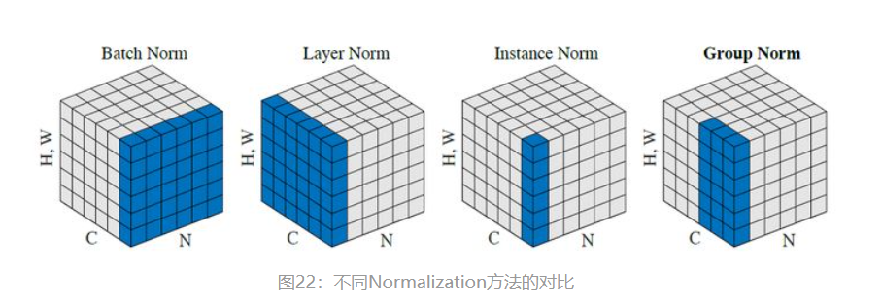
Norm

Slide 4


Model Architecture
Time windows from 1 to T
MFCC
frequencies from 1 to F
Project matrix
Higher dimension d

Slide 5



Model Architecture
Learnable class
Learnable
positional
embedding

