Slide 1

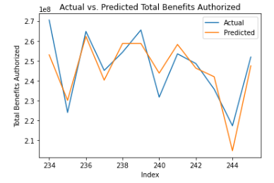
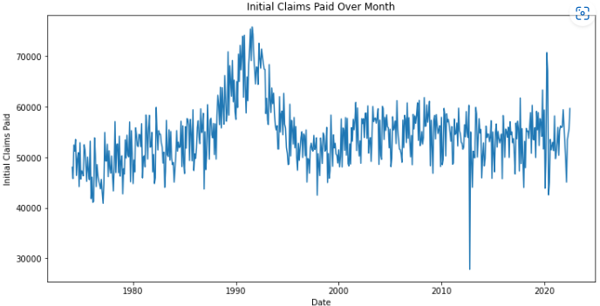
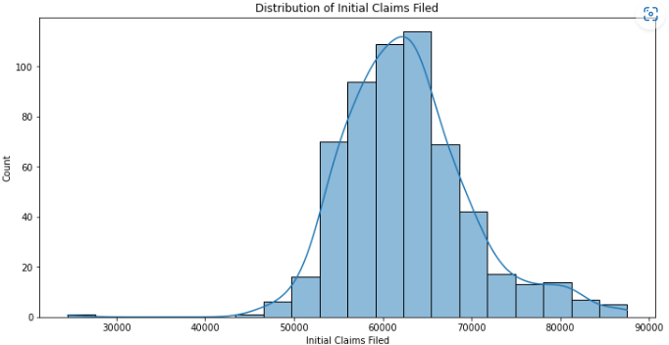
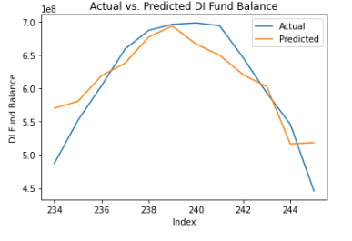
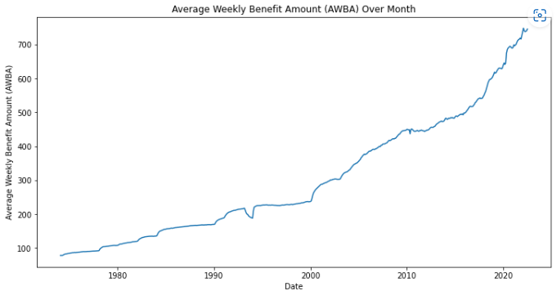
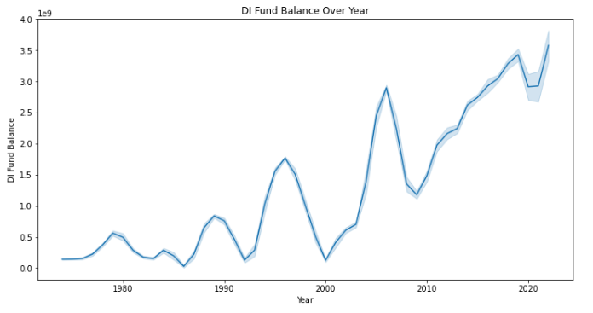
Disability Insurance Claim Prediction (State of California)
Ramya Dhabade
Mentor: Dr. Christelle Scharff ​
Pace University, Seidenberg School of CSIS
GitHub: https://bit.ly/3LBz9Zd
Abstract
Methodology
Results
Conclusion
The objective of this research is to develop a predictive model to determine the chances of a Disability Insurance Claims being filed in the state of California for 2023, based on historical data. The analysis will use machine learning techniques, specifically regression models, to predict the number of claims that will be filed. The model will be used to assess whether the allocated funds for the state department are sufficient, particularly if the weekly benefit amount is increased. The model will also be used to estimate the amount of funding needed for the next year, based on the predicted number of claims and the cost of the weekly benefit amount. The results of this project can be used by the state department to allocate sufficient funds in its budget to ensure that all eligible claimants receive their benefits.
On basis of literature review, we identified potential machine learning models like regression models i.e., Linear Regression, Decision Tree, Random Forest, Gradient Boosting, and Support Vector Regression. These models were evaluated using two key metrics MSE & R-squared value. These models were trained and tested against the dataset and the model with the highest accuracy rate is selected as the best model for prediction.
Based on the analysis of the Disability Insurance monthly data from California, the Gradient Boosting Regression model demonstrated the best performance in predicting disability insurance claims. Furthermore, the R-squared value of 0.99 indicates that the model explains 99% of the variance in the target variable. These results suggest that the Gradient Boosting Regression model can accurately predict disability insurance claims in California using the provided data.
The model can be used by the state department to allocate sufficient funds in its budget to ensure that all eligible claimants receive their benefits. By predicting the number of claims and estimating the cost of the weekly benefit amount, the state department can determine the funding needed for the next year. Additionally, the claim filling predictions can be used by the State to better prepare their infrastructure for the claim filing volume changes. Overall, this predictive model can be a valuable tool for the state department in budgetary and administrative planning, program evaluation, and reports to the Legislature and the public.
Dataset
The dataset has Disability Insurance claim data for every month for over the past 48 years that contains monthly information on claims activities like average weekly benefit amounts, average duration of claims, benefits authorized, the DI Fund balance and other statistics for the state of California. These data points are essential for budgetary and administrative planning, program evaluation, and preparing reports for the Legislature and the public.
Related work
Introduction
Disability insurance (DI) claim prediction is crucial for society that provides support to individuals who are unable to work due to a disability. We will be analyzing a dataset containing monthly data on claims activities, benefit amounts, duration of claims, and other key statistics related to the DI program. Here we are trying to identify patterns and trends in the data that can help to take informed decisions. With the help of historical data, we are trying to predict how many claims will be filed in the coming year, and whether sufficient funds are allocated to cover the average weekly benefit amount. The idea is to get potential insights from the analysis that will help the department to make better decisions in fund allocation.
Previous research by Axel Börsch-Supan(Feb 2011) in Health & Disability Insurance paper has demonstrated the effectiveness of machine learning techniques in predicting disability insurance claims using a range of predictors.
Research by Kara Contreary on claimants who exhaust their benefits assess predictive accuracy using ROC curve analysis, repeating on successive subsamples, omitting claims that resolve within two, four, and six weeks.
Experimentation
While analyzing the data, 4 outliers were identified based on their number of claims filled information. These outliers were removed to improve the accuracy of the models. The models were retrained and retested against the updated dataset to evaluate the accuracy changes.
Future work
Evaluating other machine learning algorithms such as Neural Networks, XGBoost, and K-Nearest Neighbor to predict future Disability Insurance claim trends.
Incorporating text mining and natural language processing techniques as Disability insurance claims data often comes with a significant amount of text data, such as records and forms would be efficient.
Research
Can one predict how many claims will be filed in the coming year based on the historical data so that a state department can allocate a certain amount in its budget?
​Can one predict the assigned funds will be sufficient if we increase the weekly benefit amount?​​

