Slide 1
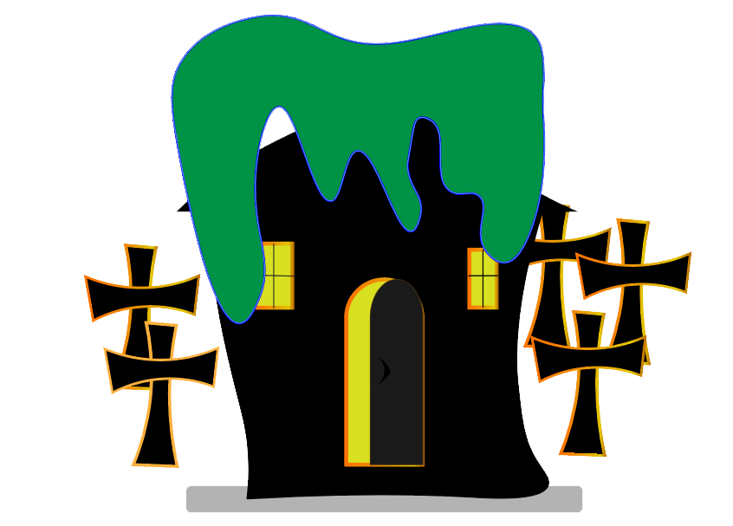

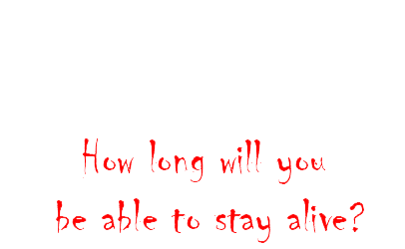

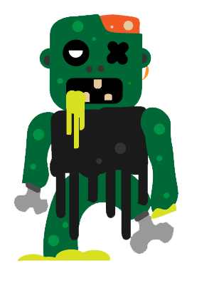
Adam Birch
Michael Binks
Enejan Bendova
Mohamed Abbass
Heston Sanctis

Slide 2
What is our game about ?
Our game is a horror themed top down 2d survival shooter
Fight against hoards of zombies that have been plagued by the deadly virus
Your mission should you choose to accept it (actually you have no choice) is to just … survive
Your scores will be uploaded on the leader-boards online.
The longer you live the harder it gets ☹
… you can’t run, you can’t hide, there is no escape

Slide 3
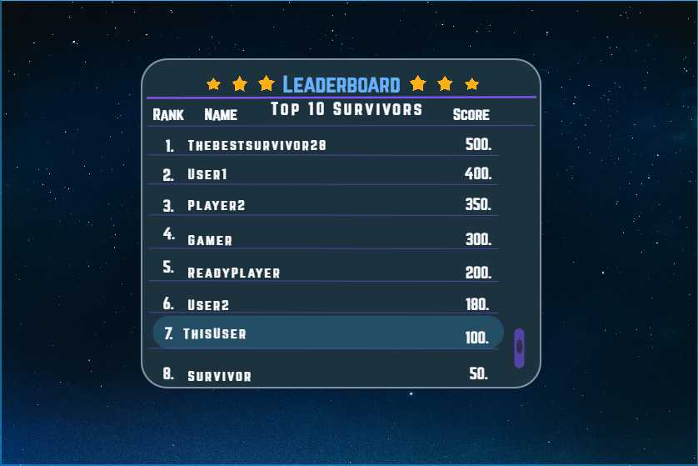
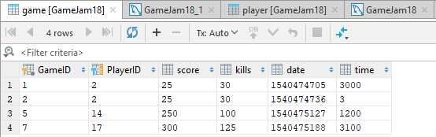
Competition
Score based game.
The longer you survive the higher your score is.
Kills increases your score.
Highscore leaderboard
http://dev2.themadgamers.co.uk:3000/players /{playerID}
http://dev2.themadgamers.co.uk:3000/games /{gameID}

Slide 4
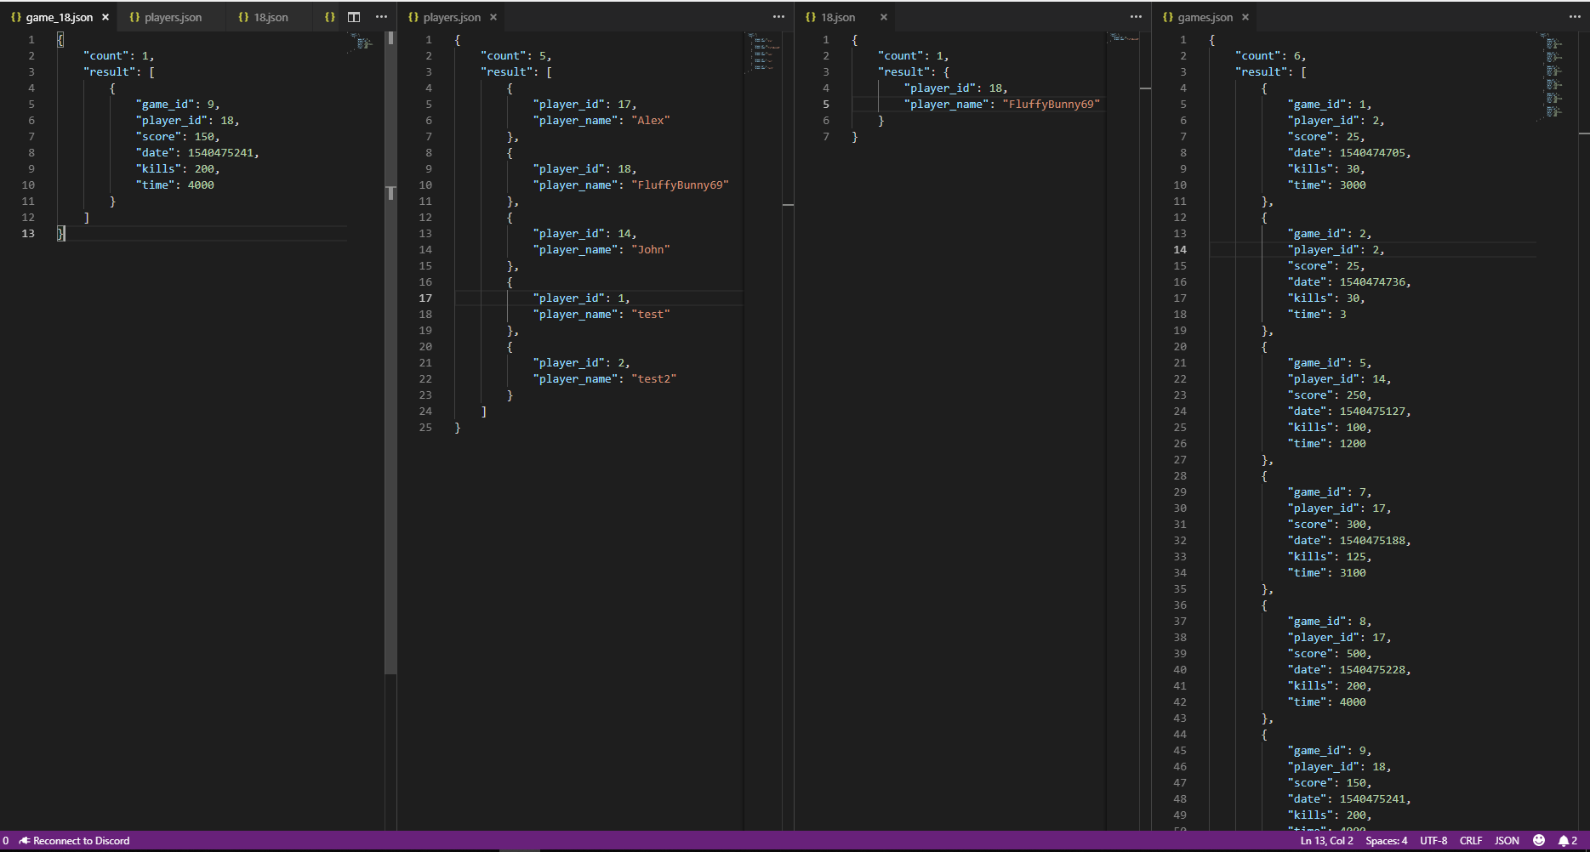

Slide 5
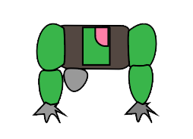
Marketing and promotion
To get our game out there, we could create:
post videos/trailer/teaser to make the game viral.
SOCIAL MEDIA ADDS/SHARING WITH FRIENDS
Collaborating with other games by sharing adds for both games
Another option is to let influencers such as youtubers do a review of the game.
A real Virus news article.

Slide 6
Target audience
Our audience is mainly targeted to people who love horror games and Survival game.
It provides the thrill of the game added with the suspense of the increased difficulty overtime.
The game is for competitive people who loves getting the highs-scores.

Slide 7
Method of income ?
“Freemium” has been a dominant business model in the games industry, because the word free entices users to play the game (or at least try it), income is generated through in game purchases (micro-transactions) whereby the player is given enhanced features such as longer survivability, e.g a shield, power-ups etc. this freemium model is enough to attract gamers without the use of expensive ad campaigns and costly sales force
Because the game uses a scoreboard, players are likely to fight for the top spot, this encourages players to buy enhanced items/ power-ups so that they can survive longer and reach the top of the score board
The use of Advertising using social media, Instagram, Facebook, is a cheap way of attracting our user base

Slide 8
As a player, I …
We are passionate about creating games as we love playing them, This game jam has given us the opportunity to apply our skills and interact and learn from people with different disciplines to create something that is truly fun and scary ☺

Slide 9
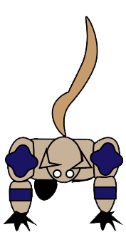
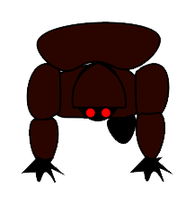

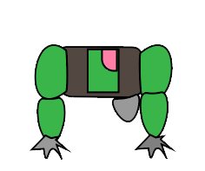
Q & A
Thank You!
Do you have any questions ?

