Slide 1
Heart Attack Possibility - By KGB

Slide 2

Index
1.What is Heart Disease?
2.Signs & Symptoms
3.What are your risks?
4.What can you do to prevent Heart Diseases?
5.Deaths Due to Heart Attack
6.Well, what can we do?
7.About the Model
8.Model depends on the following Factors
9.Model Predicts…

Slide 3
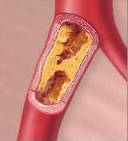
What is Heart Disease?
Occurs when the coronary arteries that supply the heart muscle become blocked.
Partially blocked it causes angina.
When fully blocked it causes a heart attack.

Slide 4
Signs & Symptoms
Heart Attack
Pressure, fullness, squeezing or pain in the center of the chest.
Chest discomfort
Pain that spreads to the shoulders, neck, or arms.
Sudden Cardiac Arrest
The stopping of the heartbeat, usually because of interference with the electrical signal.

Slide 5
What are your risks?
Risks that Can be changed
Hypertension (high blood pressure)
Smoking Cigarette
Diabetes
Hyperlipidaemia (high cholesterol)

Slide 6
What can you do to prevent Heart Diseases?
Exercise at least 30 minutes a day
Eat a healthy diet low in saturated fat and cholesterol
Quit Smoking
Take control of your weight
Monitor your blood pressure and cholesterol numbers

Slide 7
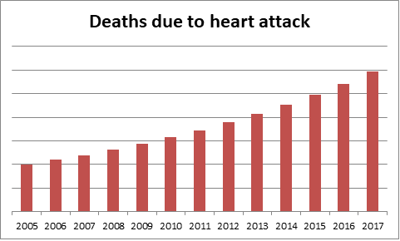
Deaths Due to Heart Attack
As you can see there has been a rapid growth in deaths due to heart attack in the recent years . Over 17.9 million people die due to cardiovascular diseases every year, according to WHO.

Slide 8
If only there was something which could tell you beforehand that there is a possibility that you would get a heart attack …. Don't worry, we have created a model for predicting heart attack possibility!
Well, what
can we do?

Slide 9
About the Model
A Support Vector Machine model (85.71% accurate) created using python (GoogleColab – Jupyter Notebook)
Used libraries:-
1. Pandas
2. NumPy
3. Sklearn
4. Seaborn

Slide 10
Model depends on the following Factors
1) Age 2) Sex 3) Chest pain type 4) Resting blood pressure 5) Serum cholesterol in mg/dl 6) Fasting blood sugar > 120 mg/dl 7) Resting electrocardiographic results 8) Maximum heart rate achieved 9) Exercise induced angina 10) Old peak = ST depression induced by exercise relative to rest 11) The slope of the peak exercise ST segment 12) Number of major vessels 13) Thalassemia (i.e., passed from parents to children through genes)

Slide 11
Model Predicts…
On the basis of the factors given in the previous slide, the model predicts whether the person is prone to heart attack or not as it gives us a target value (0&1):
0= Less chance of heart attack
1= More chance of heart attack

Slide 12
THANK YOU

