Slide 1
How many people have accidentally done something that made them frustrated or sad?

Slide 2
What kind of operations do you do in spreadsheets?
Which ones do you think spreadsheets are good for?

Slide 3
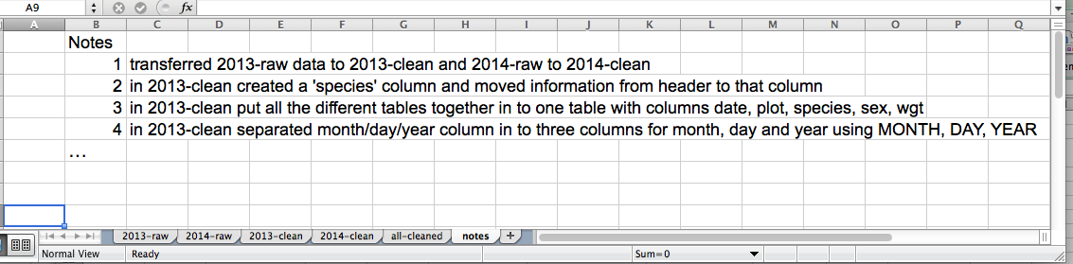
Separate Sheets tabs for information

Slide 4
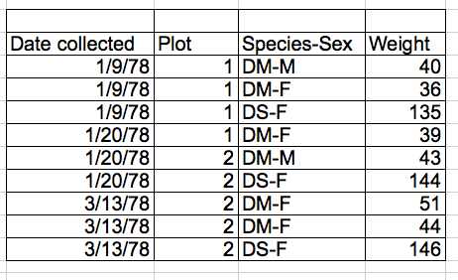
Combined variables in a single column
What is one problem you see with the recorded data in the example?

Slide 5
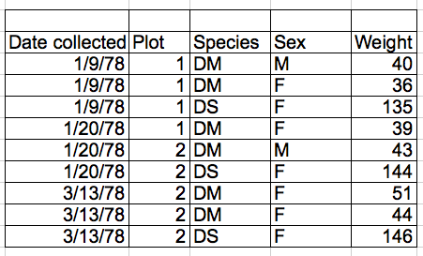
separate variables in unique column
Columns = variables, rows = observations, cells = data (values)

Slide 6
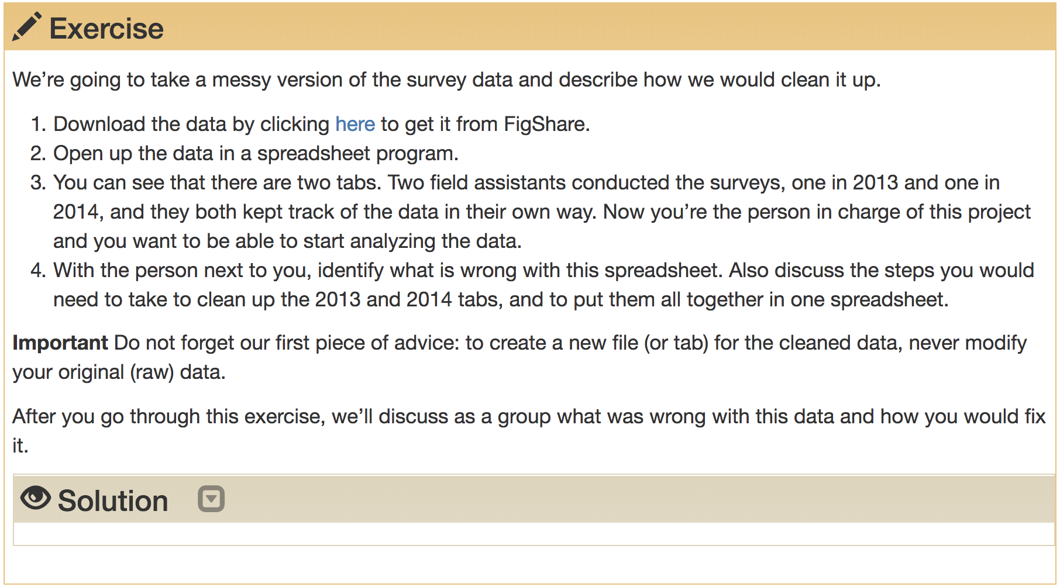
Exercise 1

Slide 7
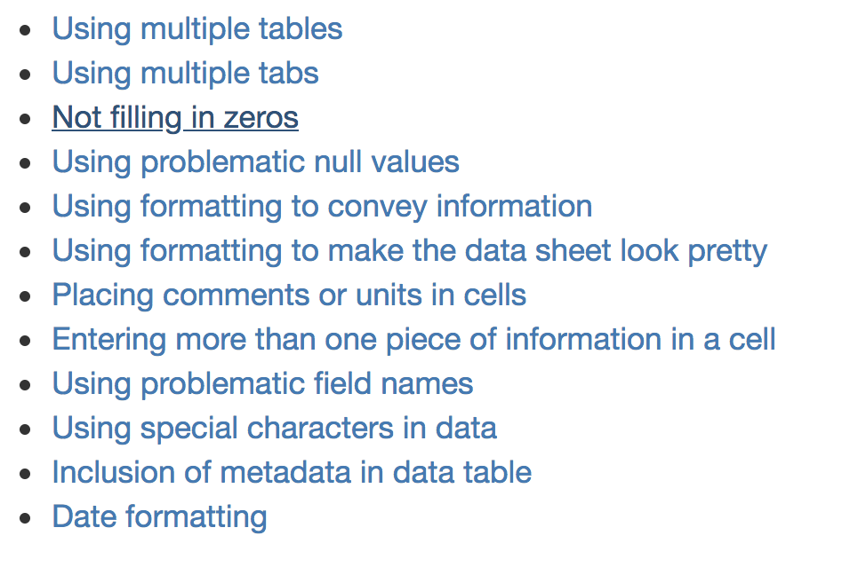
Exercise 1 - issues list - solutions

Slide 8
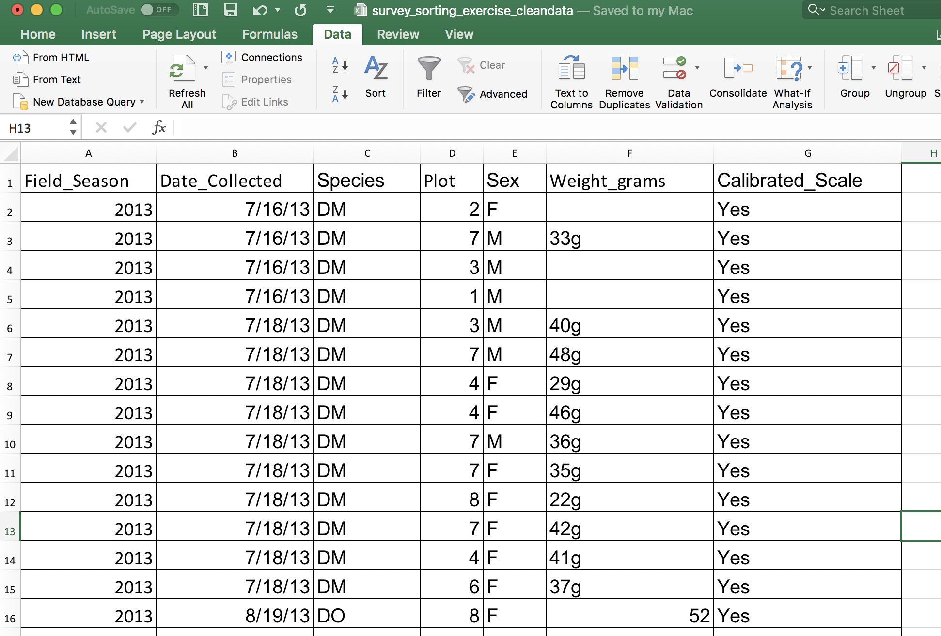
Cleaned worksheet example:

Slide 9
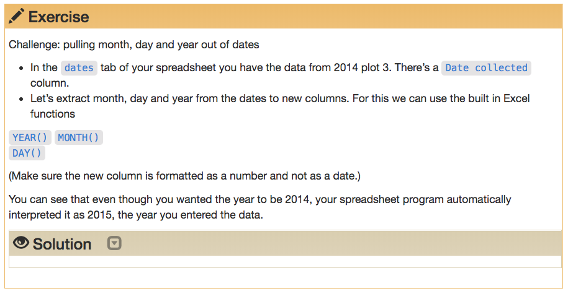
Exercise 2

Slide 10
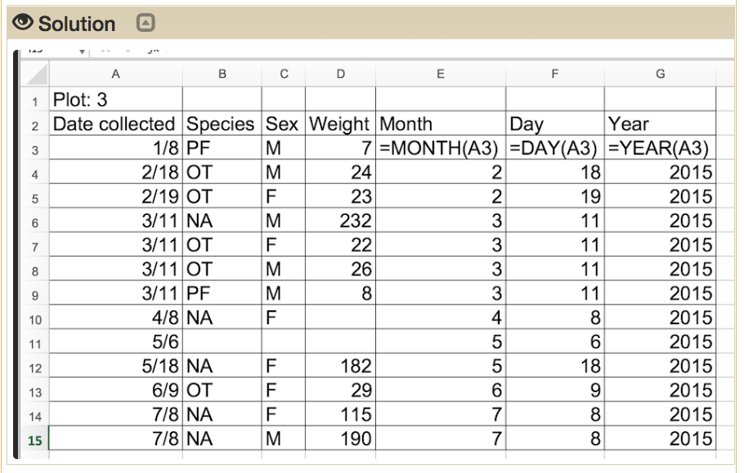
Exercise 2 solution

Slide 11
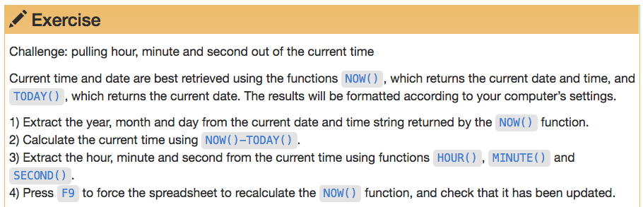
Exercise 3

Slide 12
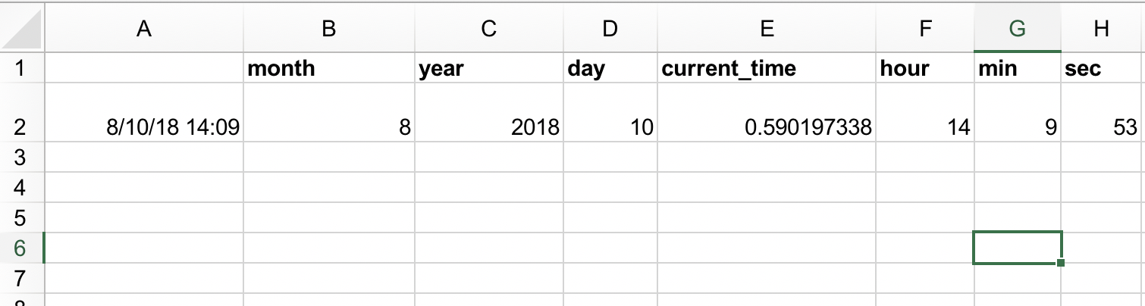
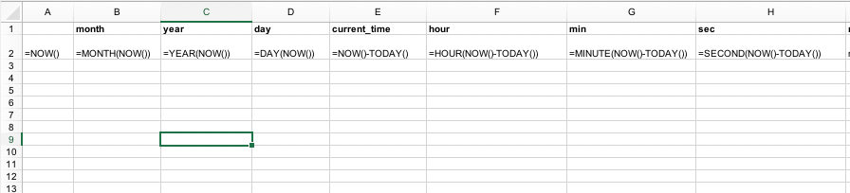
Exercise 3 solution

Slide 13
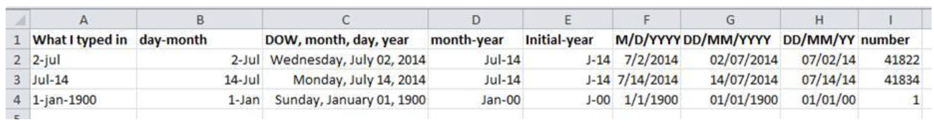
Date formats in spreadsheets example:

Slide 14
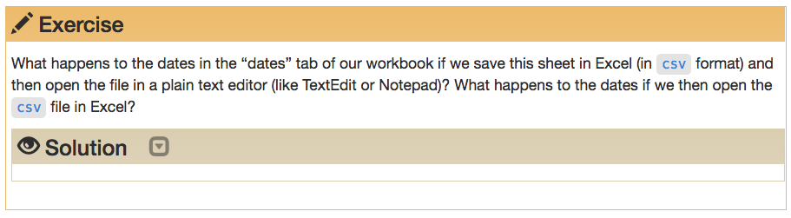
Exercise 4: saving dates as CSV

Slide 15
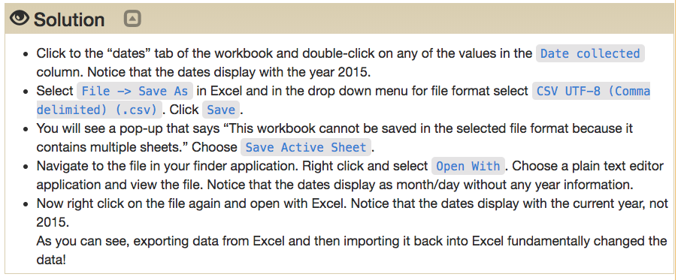
Exercise 4: solution

Slide 16
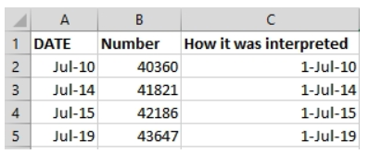
Spreadsheet date interpretation

Slide 17
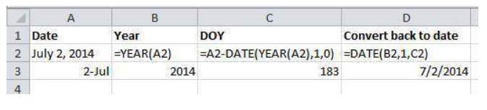
Storing dates as Year, Day-of-Year
Or as a string: YYYYMMDDhhmmss
March 24, 2018 17:25:35 = 20180324172535

Slide 18
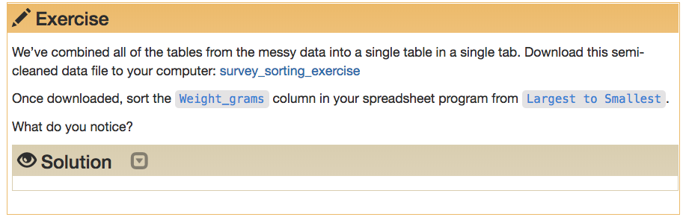
Exercise 5 - Sorting

Slide 19
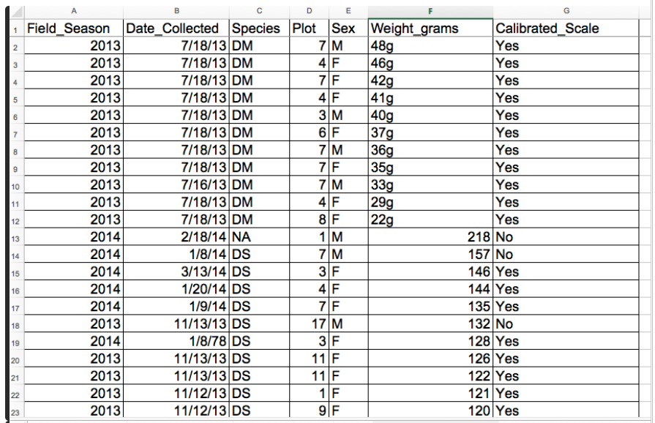
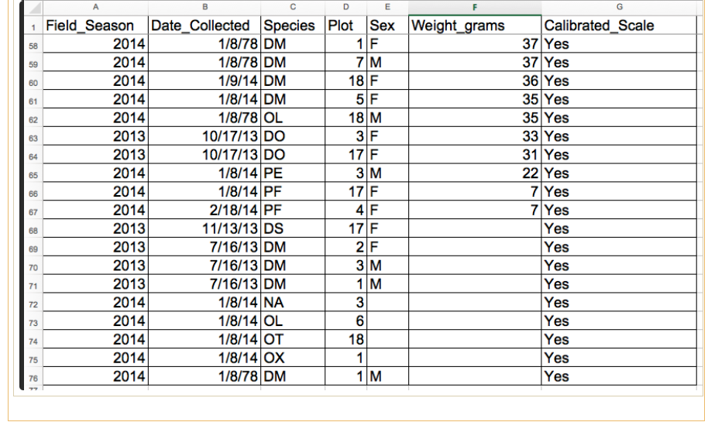
Exercise 5 - Sorting Solution 1

Slide 20
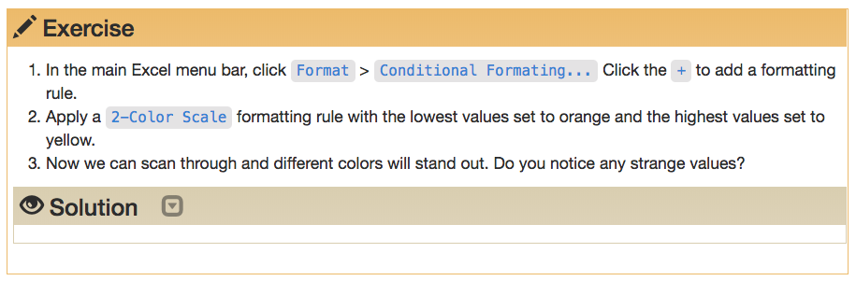
Exercise 6 - Conditional formatting

Slide 21
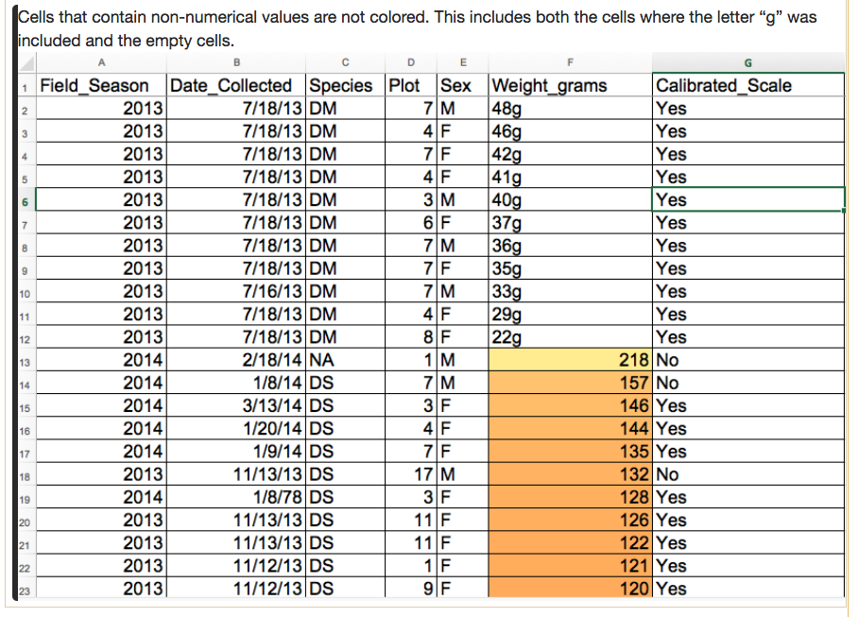
Exercise 6 - Conditional formatting Solution

Slide 22
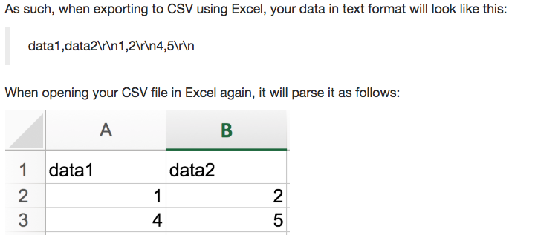

Slide 23
