Slide 1

Data Mangement 101
Best Practices
Reid Otsuji
Data Curation Specialist Librarian
rotsuji@ucsd.edu
Course Site:
http://lib.ucsd.edu/dm101

Slide 2
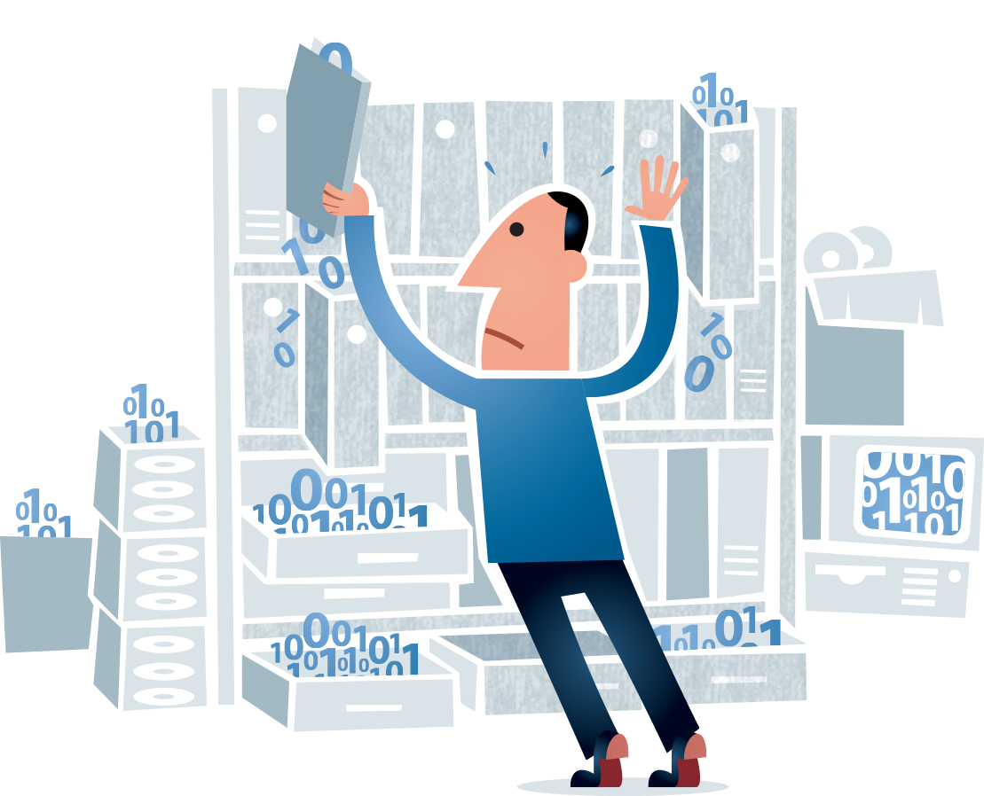
Course Overview
Part 1:
Why is data management important?
Best practices to Consider
Part 2:
Hands-on with the Unix Shell
Graphic created by Jørgen Stamp and published under a Creative Commons Attribution 2.5 Denmark License (www.digitalbevaring.dk).
Notes:
This workshop will be divided into 2 parts.
The first part of this workshop will briefly introduce the importance of data management and best practices for data management.
And
The second part of the course will consist of a hands on lessons using the Unix Shell today, Friday and next Monday.

Slide 3
Why is Data Management Important?
Part 1a:
Why Manage Data?
Notes:
Why is data management important and why manage your data?
Basically, Managing your research data ensures physical integrity of files and helping to preserve them.
This reason alone leads us into the importance of understanding data management in the data life cycle...

Slide 4
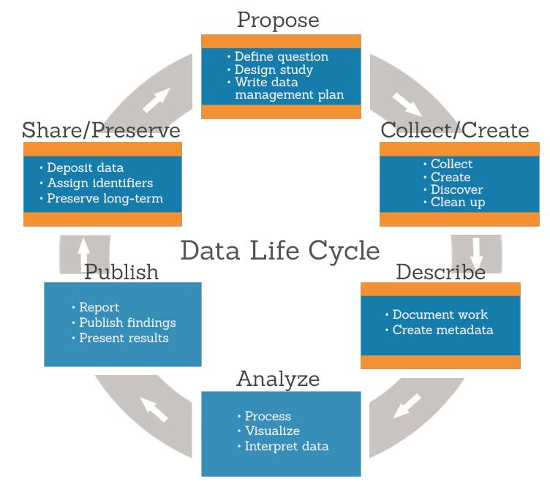
Why is Data Management Important?
Managing data in the Data Life Cycle:
Data management planning
Documenting project/file details
Choosing file formats
File organization & naming conventions
Access control & security
Backup & Storage
Sharing and Preservation
Notes:
This slide shows an example of the data life cycle and what process research data requires as it moves through the different segments of the life cycle.
For example,
Planning to manage your data begins at the propose segment. This is where the initial data management planning begins. starting with the research study and the data management plan.
The collect/create segment is where data is produced, collected and organized.
The next segment is describing data by creating good metadata and documentation.
The next two segments, analyze and publish focuses more on using data produced for processing and the final documentation for the project.
Finally the last segment, sharing and preservation, is the final step in the data life cycle. This phase is where data is archived and stored for re-use.
Understanding the flow of data in data life cycle leads us into the importance of having a good data management strategy...

Slide 5
Why is Data Management Important?
A good data management strategy:
Establish best practices for your data management
Plan to share well-documented data
Well prepared data saves time
Create a concise data management plan for your grant proposal
Reduces cost of creating, protecting and storing data
Ensures your data will be available to future generations to enable reproducible research
Notes:
when working on a project plan, you want to have a good data management strategy.
For example:
establish best practices for data management enables both you and others to share, discover, understand, and re-use data more effectively, even years after data have initially been collected or published.
Plan to share well-documented data, you potentially can increase your research impact and credibility, number of citations for associated papers, and future collaborations.
well prepared data saves time. Data preparation can consume 60-80% of your time spent analyzing the data. Proper data management can help reduce this time and improve the quality of your analyses.
A well-crafted data management plan is important for satisfying funding agency requirements. However, if you are not working on a grant, DMPs can still be useful as guide for managing project data.
Having an effective data management strategy can reduce the cost of creating and storing data, enhance data security, and minimize data loss.
Most importantly, a good data management strategy during the early phases of a project helps ensure that your data will be available to future generations to enable reproducible research

Slide 6
Why is Data Management Important?
Benefits of good data management:
Promotes successful data collection.
Ease of using and sharing data.
Helps to increase research impact and visibility.
Standardize data management practices and policies in your research lab.
Saves you time, effort and resources during the research project.
Notes:
Once your data management strategy is in place, there are many benefits of adhering to that strategy.
For example, the benefits of good data management planning and implementation:
Promotes successful data collection throughout the life of the research project.
Ease of use and sharing data from maintaining organized and well documented data.
Ultimately good data management helps to increase research impact and visibility.
Standardizes data management practices and policies for your project.
Implementing a good data management strategy will saves you time, effort and resources throughout the research data life cycle.

Slide 7
Best Practices for Data Management
Organization
TEIR Protocol v2
Documentation and Description
Metadata
Data Clean-up
Basic Storage
Backup
Preservation
Notes:
Now, that you I have given you a quick over view of data management, lets take a look at some common best practices for managing your data. Here is a list that i'm going to cover.
Starting with -
Organization
The Havoford TIER protocol (Teaching Integrity and Emperical Research).
Documenting your research and data and describing it for future reuse
Metadata requirements
Clean data
Basic storage and back up practices
And having a preservation strategy

Slide 8
Best Practices for Organization
File and Folder organization
Choose a consistent filing system that will make sense to you or someone else five years from now.
Choose a logical directory hierarchy. For example: TIER Documentation Protocol.
Assign descriptive file names. E.g. DOLInterview_DoeJane_20061207
//Project001/SiteB/SiteB_2010_rawdata.txt
Is better than . . .
//Project001/SiteB/2010/rawdata.txt
Notes:
Beginning with organization,
Don't rely on solely on directory structure to provide critical information about file contents, it's possible individual files can be copied elsewhere and will lose the context of the folder structure but...
do choose a logical file system that will make sense to you or someone in 5 years from now.
Organize your files and use descriptive file names as in the first example.
once you have your files organized, you’ll need to think about how to organize your data in those folders.

Slide 9
Organization: TIER Documentation Protocol
Developed by Haverford College –
The Teaching Integrity in Empirical Research or TIER protocol, is a protocol for comprehensively documenting all the steps of data management and analysis that go into an empirical research paper.
All documentation, do-files, scripts, raw data, metadata, that are presented in a paper are organized in a specific file structure.
This file structure keeps your data organized and offers easy replication of results reported in a paper.
https://www.haverford.edu/project-tier/protocol-v2
Notes:
This is where the TEIR protocol comes in to play,
The teaching integrity in empirical research or TEIR protocol is a one method to organize your project files. is a protocol for comprehensively documenting all the steps of data management and analysis that go into an empirical research paper.
The protocol covers All documentation, do-files, scripts, raw data, metadata, that are presented in a paper and are organized in a specific file structure.
This file structure which you will see in the next slide, keeps your data organized and offers easy replication of results reported in a paper.

Slide 10
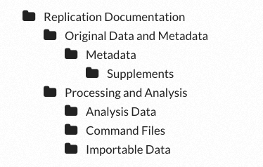
Create and use the folder hierarchy
TIER file structure contains all the data, computer programs, and explanatory information an independent researcher would need to be able to replicate the data processing and analysis you conducted for the project and to reproduce exactly all the results reported in your paper.
Notes:
And …. Here is the the TIER Protocol file structure.
The structure contains all the data, computer scripts of do-files, and explanatory information organized in a neat folder hierarchy, that any independent researcher would need to be able to replicate the data processing and analysis you conducted for the project, and to reproduce exactly all the results reported in your paper.

Slide 11
What to put in the folders
Replication documentation folder -readme file, copy of final paper
Original Data and Metadata folder:
original data folder – all original data
metadata folder – metadata guide – info about your original data
supplements folder – user guides or codebooks
Processing and Analysis Folder:
Importable data folder – file version of import data: .csv, .dta
Command files folder – do-files or scripts used for data processing and analysis to reproduce results
Analysis data folder – analysis data files, data appendix
Notes:
Now that we know the hierarchy of the folders, what do you put in them?
Replication documentation folder -readme file, copy of final paper
Original Data and Metadata folder:
original data folder - all original data
metadata folder – info about each of your original data files
supplements folder – user guides or codebooks
Processing and Analysis Folder:
Importable data folder - version of original data files
Command files folder – do-files or scripts used for data processing and analysis to reproduce results
Analysis data folder – analysis data files, data appendix
One note, in this course we are introducing the TEIR protocol and for the UNIX assignment later on, we are only going to use the processing and Analysis folder hierarchy in conjunction with how to manipulate directories and files using the Unix Shell.

Slide 12
Documentation & Description
Describe the method used to create derived data products.
Consider creating templates for data collection.
At the file level: Take consistent notes on file changes, name changes, dates of changes, etc.
Include critical information, such as date or location, in the data table, not just as metadata embedded in the file name.
Notes:
Moving on… Once you have your folders setup for your project you want to think about your documentation and description.
Things you want to describe are data processing performed, software (including version number) used, and analyses applied to data.
This helps you to ensure completeness of data collection and can help you to think forward about analysis.
Keep a record of these changes as an internal worksheet within the file or in an external README.txt located in the same folder as the files to which they pertain.

Slide 13
Metadata
Metadata is data about your data.
Creating metadata, i.e., information about your data's contents, structure, and permissions, makes it possible for others to find and use your data properly.
Without good metadata, you might not be able to reuse your own data five years from now!
Notes:
Along with documenting your data, you will want to create metadata for your files. Basically you want to track technical information about your data, contents, structure, or any additional information that will make it easy for you or others to reuse your data later on.

Slide 14
Data Clean-up
OpenRefine (http://openrefine.org/), for making sure records and variables are consistently coded, filling in known blanks, replacing text selectively, transforming data, and more.
Notes:
Next is data-clean up, when preparing your data for analysis, it is good practice to use a program such as OpenRefine to help you explore and clean-up large data sets with ease. It is a powerful tool for working with messy data: cleaning it; transforming it from one format into another. Next week we’ll be looking at open refine.

Slide 15
Basic Storage
Computers and shared servers can be good places for temporary storage of your working files.
Store copies of data in open, stable formats (e.g., ascii, .txt, .csv, .pdf) for long term accessibility. . .
Use flash drives only for file transfer.
Cloud storage can be a convenient way to store and share temporary working files.
For long-term storage, data should be put into well-managed preservation system.
Notes:
When thinking about the computing hardware side of data management, there are best practices to remember when storing your data these are:
Computers and shared servers can be good places for temporary storage of your working files.
Store copies of data in open, stable formats (e.g., ascii, .txt, .csv, .pdf) for long term accessibility. . .
Use flash drives only for file transfer – it is too easy to lose them!
Cloud storage can be a convenient way to store and share temporary working files, but keep in mind there are many issues with putting data into the cloud.
For long-term storage, data should be put into well-managed preservation systems. E.g. Dataverse or ICPSR open repositories if you are doing research etc.

Slide 16
Backup
Rule of 3: Keep 2 copies onsite, 1 offsite.
LOCKSS concept – Lots Of Copies Keeps Stuff Safe
Backup regularly and frequently - automate the process if possible.
Notes:
Related to basic storage, you must remember, basic storage is not backing up. Have a backup plan.
Use the rule of 3 and remember the LOCKSS concept.
Most importantly, back up regularly and often. Using software or dedicated disaster recovery services that automate the process.

Slide 17
Preservation
Preservation is the act of making sure your data are secure and accessible for future generations.
Long-term preservation is not merely storage or backing up of your data.
Identify data with long-term value. Preserve the raw data and any intermediate/derived/time consuming products that are expensive to reproduce or can be directly used for analysis.
Preserve any scripted code and data that was used to clean and transform the raw data.
Example:
Save tabular data in a delimited text format.
Save data in uncompressed and unencrypted formats, where possible.
Notes:
Lastly, tied to backup is preservation:
Preservation is the act of making sure your data are secure and accessible for future generations.
Long-term preservation is not merely storage or backing up of your data.
Identify data your with long-term value. Preserve the raw data and any intermediate/derived products that are expensive to reproduce or can be directly used for analysis.
Preserve any scripted code that was used to clean and transform the raw data.
Example:
Save tabular data in a delimited text format.
Save data in uncompressed and unencrypted formats, where possible.

Slide 18
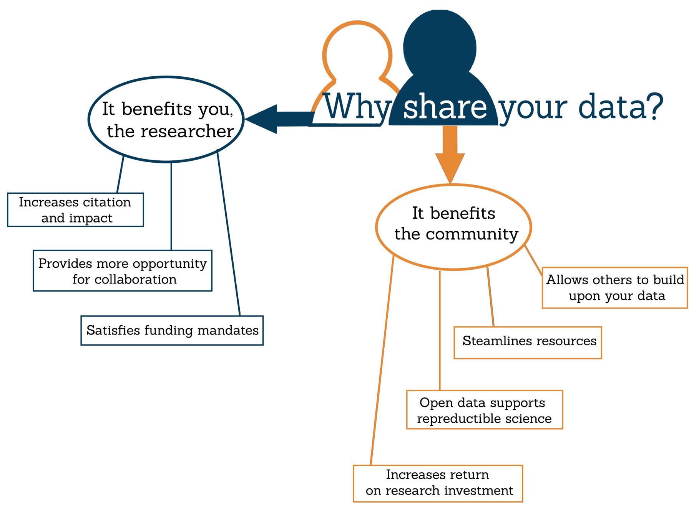
Benefits of Sharing Your Data
Data sharing allows for
reproducibility, transparency, and data re-use in research.
Sharing is easier if
data are managed well from the start of a project.
Notes:
And finally, now that we’ve covered the best practices for data management
When you work on a research project consider the reasons why to share your data?
Sharing your data has several benefits:
It benefits you, the researcher...
Increases citation and impact. By sharing well-documented data, you potentially increase your research impact and credibility, and number of citations for associated papers.
Provides more opportunity for collaboration. Increased visibility can lead to greater potential for collaboration.
If working on federally funded grant, sharing Satisfies mandates. Funding agencies and journals are increasingly requiring that data be shared as a condition of receiving funding or being accepted for publication. Some of these mandates include:
National Science Foundation (NSF): Data Sharing Policy & Data Management Plan Requirements
National Institutes of Health (NIH): Data Sharing Policy & Implementation Guidance
PLOS Journals: Publishing Policies on Sharing of Data, Materials, and Software
... and it benefits the research community
Allows others to build upon your data. By sharing well-documented data, you enable additional scientific inquiry and meta-analysis that cannot be generated by a single researcher or laboratory.
Streamlines resources. When data is shared, recollection of data is minimized and resources are saved.
Open data supports reproducible science. Re-analysis and replicability of data helps verify results and is a key part of the scientific process.
Increases return on research investment. Funding agencies and journals are increasingly promoting or requiring data management plans and data sharing because of the potential for a greater return on research investment.

Slide 19

Hands-On with the Unix Shell
Course Site:
http://lib.ucsd.edu/dm101
Etherpad:
https://public.etherpad-mozilla.org/p/gps-dm101
Socrative Room Name: UCSDGPSDM101
Notes:
Unix is a good tool b/c it is also very useful tool when you need to interact with remote machines, such as when doing machine learning or text mining
dual goals: we want to introduce you to standard ways to organize your research data and analysis and 2) introduce you to tools that you might need as you proceed with newer research methods

