Slide 1
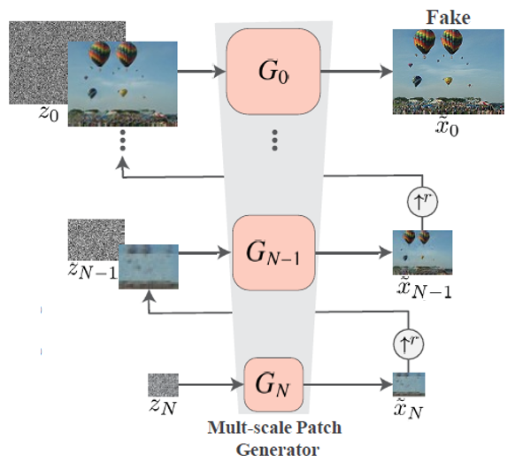




Training & Inference image
Down
sampling
Result of scale N-1
Result of scale N

Slide 2
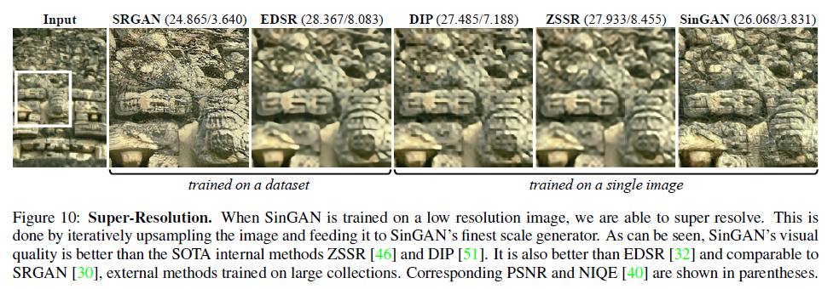
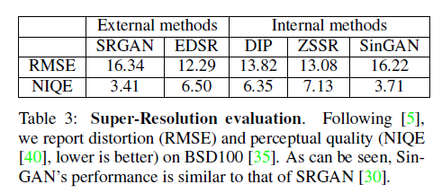

Slide 3
