Slide 1


Team Details
Project: LingoLive — Understand. Reply. Keep going.
Team name: CreativeEngine
Team leader: Ashish T. Vasant | Member: Janhvi Singh
Problem: Help migrants participate in everyday conversations in an unfamiliar language.
Theme: Sustainability & Social Impact | Category: Accessibility

Slide 2
Brief about the idea
A conversation assistant for life in a new place.
LingoLive listens to another person, explains their words and offers three useful replies in the local language, with pronunciation. Plans, recent turns and location-linked memory make those replies personal.
Understand now
Reply confidently
Learn afterwards
Live speech → familiar-language meaning
Relevant options + pronunciation
Saved exchanges → personal practice
2

Slide 3
Opportunities
The problem: understanding is only half the conversation
A newcomer must also decide what to say, pronounce it and complete a task while the other person waits.
The solution: replies that fit the person and the moment
Combines the current turn, a pre-task plan, activities, preferences and nearby saved-place notes. Learner readbacks update context.
Users and customers across regions
Interstate and international migrants. Customers: migrant associations, NGOs, universities, employers and relocation teams anywhere.
3

Slide 4
List of features offered by the solution
Hear and respond
Say it your way
Live multilingual speech; three contextual replies.
Express familiar-language intent in the local language.
Recognize learner readbacks
Plan before leaving
Forgiving repeat matching + session voice estimates.
Cab → optional tea → station; Done / Skip / Previous.
Location-linked memory
Personal memory
Opt-in place facts recalled on a fresh return nearby.
Editable activities and preferences; relevant retrieval.
Learn afterwards
Simple, guarded access
Saved exchanges; word bubbles and pronunciation.
One large microphone control; Google sign-in; quotas.
4

Slide 5
Process flow diagram or Use-case diagram
1. Plan + listen
2. Understand
3. Route the turn
→
→
Optional goal; one large microphone button
Live Transcribe produces committed speech
Readback matching + recent voice clues
Learner repeats a suggested reply
A new turn needs assistance
Keep the actual spoken words in context and preserve the options. Continue listening for the other person.
Parallel Flash-Lite tasks → meaning + three replies → learner speaks → Saved review afterwards.
The learner can correct who spoke. Goals, plan progress and relevant place memories follow the conversation.
5

Slide 6
Wireframes/Mock diagrams of the proposed solution (optional)
6

Slide 7
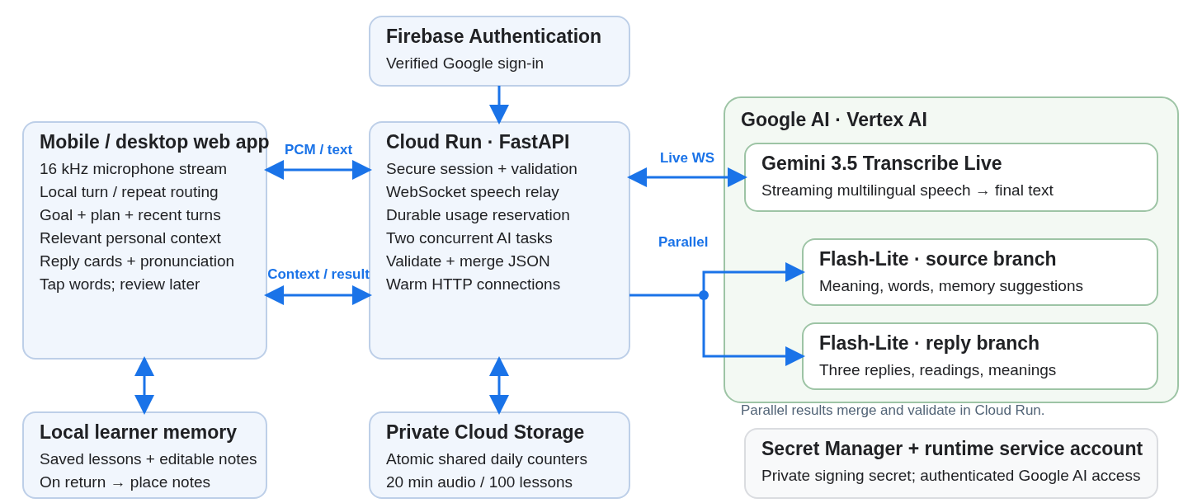
Architecture diagram of the proposed solution
7

Slide 8
Technologies to be used in the solution
Live speech
Gemini 3.5 Transcribe Live streams multilingual audio while the person speaks.
Fast, economical replies
Two concurrent Gemini 3.1 Flash-Lite tasks: source understanding and reply generation; compact JSON.
Google Cloud
Cloud Run + Vertex AI; Firebase Google sign-in; private Cloud Storage quotas; Secret Manager.
Local personalization
IndexedDB lessons; editable learner profiles, task plans and guarded location-linked memory.
8

Slide 9
Estimated implementation cost (optional)
~US$5 / learner / month · ₹450
100 learners · ~US$465 / month
200 listening minutes + 400 new reply turns per month.
Shared community estimate, including contingency.
Per learner: speech $1.79 + generation $1.76 + shared infrastructure $0.30. Add 20% contingency, then round the budget to US$5.
Usage estimate: 10 minutes and 20 new reply turns per day, on 20 days per month; hosting shared across 100 active learners. Each turn uses two parallel calls.
Rate basis: Live Transcribe $0.008925/min; Flash-Lite $0.25/M input and $1.50/M output. Standard global rates checked 18 Oct 2026; before tax and credits. INR planning rate: ₹90/US$. Detailed assumptions: technical PDF.
9

Slide 10
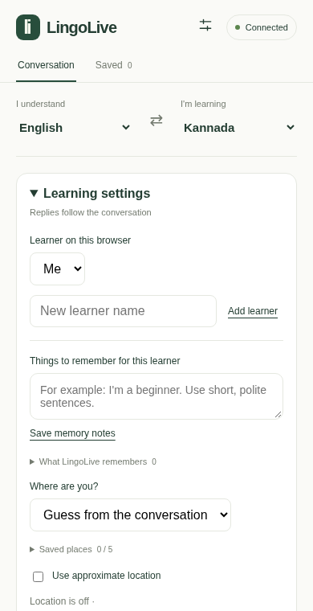
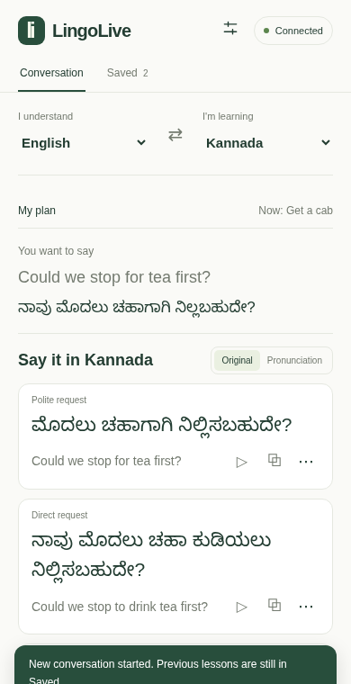
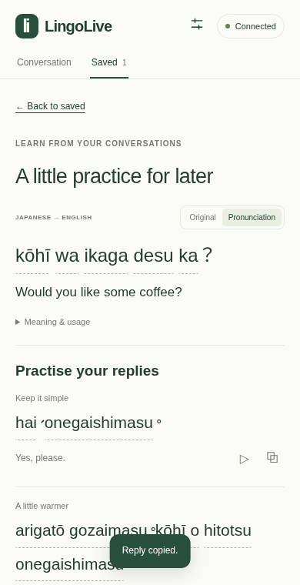
Snapshots of the prototype
Plan before leaving
Find a useful reply
Learn afterwards
Recorded prototype UI; Saved view uses sample lesson data. The demonstration includes real Google AI responses.
10

Slide 11
Prototype Performance report/Benchmarking
Designed for an approximately two-second warm lesson.
1.79 s mean · 10 lessons
Recorded v1.5 warm hosted run; all complete responses succeeded.
2.065 s mean · 4 cases
Later v1.9 Kannada task flows: cab, tea, café and station.
Parallel critical path
Source understanding and replies run together; compact output and warm HTTP.
Local reuse
Readbacks preserve replies; word taps and saved review reuse lesson data.
Memory and access checks
134 backend tests; 16 place-core checks and 8 place browser flows.
Timings measure warm lesson requests; speech also includes transcription finalization and device/network time.
11

Slide 12
Additional Details/Future Development (if any)
Adoption and business estimates
Pilot targets and next delivery
20 partners × 100 learners = 2,000 learners.
Community-sponsored usage packages.
Estimated operating budget: ~US$5 / active learner / month in a 100-member community.
Partners: migrant groups, NGOs, campuses and employers globally.
Four weeks, 50 learners: ~1,600 encounters and 8,000 assisted turns.
Targets: 70% useful reply sets; 80% task completion.
Next: more language pairs, partner allowances and opt-in local voice enrollment.
Adoption, pilot outcomes and unit economics are planning estimates/targets; assumptions and scale scenario are in the technical PDF.
12

Slide 13
Provide links to your:
GitHub source — github.com/U4AR/LingoLive
Demo video — 3:17 working demonstration
Final product — live Google Cloud Run prototype
Submission materials — pitch, technical PDF and entry text
Sign in with any verified Google account. A personal Google model key is optional.
Shared daily demo allowance: 20 listening minutes and 100 two-branch lessons; midnight IST reset.
13

Slide 14


