Slide 1



Human Face Generation using GAN
Jaypee University of Information Technology
Department of Computer Science and Engineering and Information Technology
Major Project - II (18B19CI891) | AY 2024-25
End-Term Evaluation | May 16-17, 2025.
Group No.: 85
Team Member (s)
Aniket Rawat (211315)
Uday Bhardwaj (211108)
Shiven Singh (211271)
Supervisor (s)
Name: Dr. Ramesh Narwal
Department: Dept. of CSE & IT
Name: Ms. Seema Rani
Department: Dept. of CSE & IT

Slide 2
Outline
Introduction
Problem Statement
Objectives
Work Done (after Mid-Term Evaluation)
Project Design
Implementation
Experimental Results and Evaluation
Key Learnings
Future Work
Work Contribution and Attendance
Supervisor Interactions
References

Slide 3
Introduction
Two-stage GAN pipeline transforming text prompts into forensic sketches, then into mugshot-quality images.
Utilized CLIP for text-to-latent encoding, StyleGAN2-ADA for sketch creation, and ControlNet-guided diffusion for realism.
Achieved state-of-the-art photorealism for forensic and synthetic-avatar applications.

Slide 4
Problem Statement
Unrealistic Outputs – Difficulty generating photorealistic faces that look indistinguishable from real images
Attribute Control – Challenges in accurately controlling and verifying specific facial features from text prompts
High Resource Requirements – Demanding GPU compute and memory make the pipeline inaccessible to many users

Slide 5
Objectives
Design a CLIP‐conditioned two‐stage GAN pipeline for sketch and mugshot synthesis
Achieve high‐resolution photorealism with accurate structural fidelity
Ensure diverse, unbiased face generation across demographics

Slide 6
Work Done (after Mid-Term Evaluation)
Integrated CLIP-based text encoding with StyleGAN2-ADA to produce structured forensic sketches
Developed multi-phase edge detection and morphological processing for crisp sketch extraction
Incorporated ControlNet-guided diffusion for high-fidelity mugshot synthesis from sketches

Slide 7
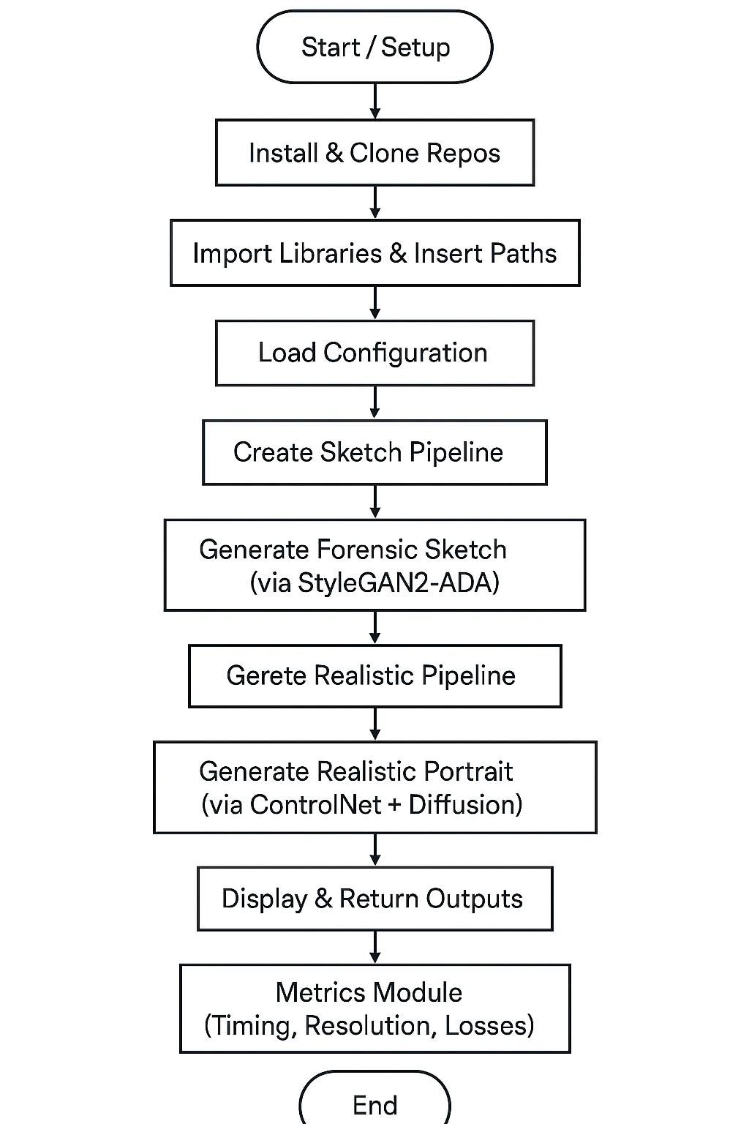
Project Design
StyleGAN2-ADA for high-contrast line-art sketches.
ControlNet-augmented Stable Diffusion for photorealistic rendering.
Mixed-precision (float16) and attention slicing for GPU efficiency.
Metrics module integrates timing, image-quality, and CLIP/VGG losses.
Flowchart

Slide 8
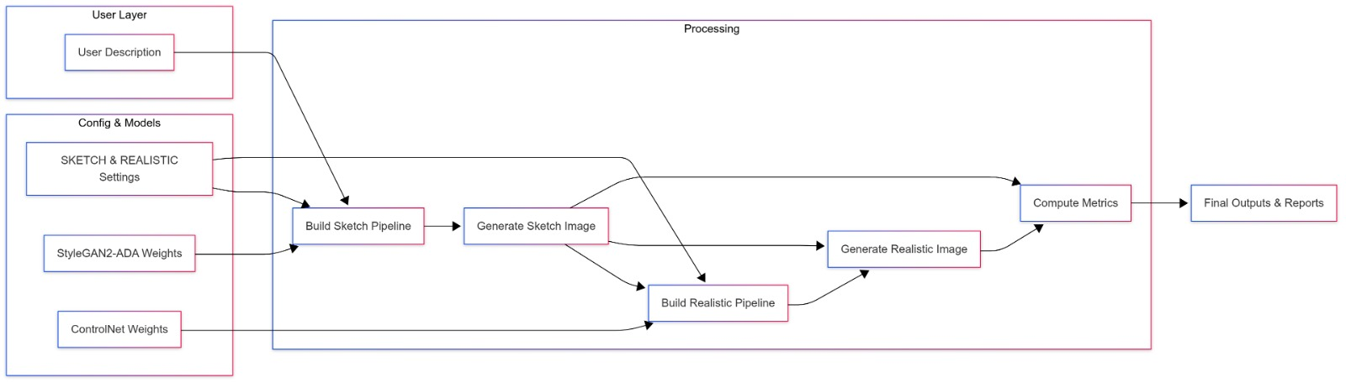
Project Design (cont…)
Data Flow Diagram

Slide 9
Project Design (cont…)
User Input: Textual facial description is submitted to both sketch and realism pipelines.
Config & Models: SKETCH/REALISTIC settings and StyleGAN2-ADA / ControlNet weights configure each pipeline.
Sketch Generation: StyleGAN2-ADA produces a B&W forensic sketch.
Realistic Rendering: ControlNet-guided diffusion transforms the sketch into a photorealistic portrait.
Metrics & Output: Both images feed into metric computation before final results are returned.

Slide 10
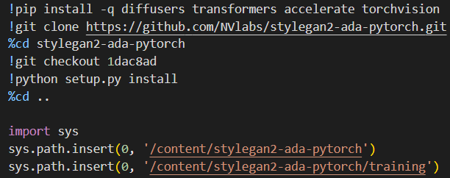
Implementation
Environment Setup & Model Imports:
Prepares the workspace by installing diffusion libraries and the StyleGAN2-ADA codebase.
Loads core libraries and ensures StyleGAN2-ADA modules are accessible in Python’s path.
Installing Dependencies

Slide 11
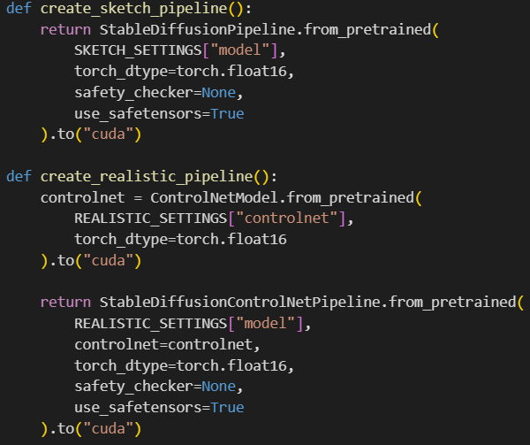
Implementation (cont…)
2. Pipeline Construction:
Builds a lightweight StyleGAN2-ADA pipeline with float16 precision.
Constructs a ControlNet-augmented diffusion pipeline for final mugshot synthesis.
Pipeline Setup

Slide 12
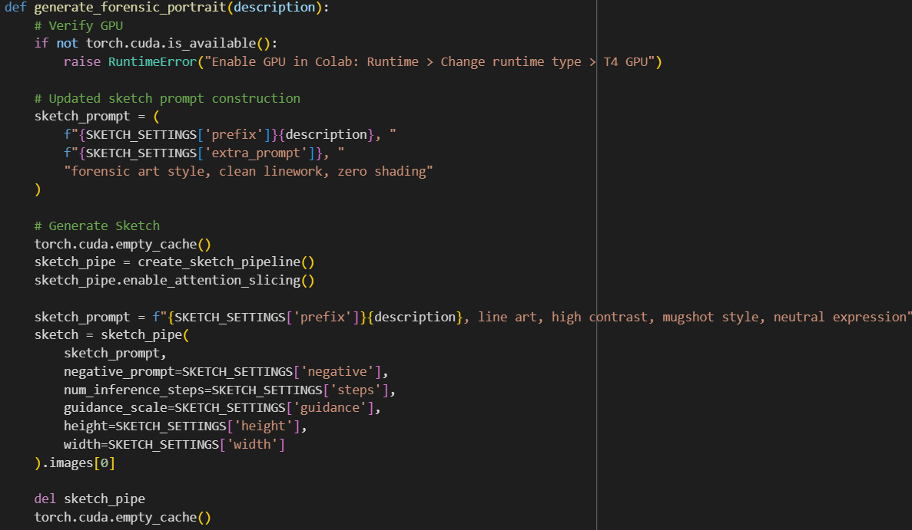
Implementation (cont…)
3. Core Generation Logic:
Encapsulates end-to-end flow: a B&W sketch stage followed by a ControlNet-based color portrait stage.
Generation Function

Slide 13
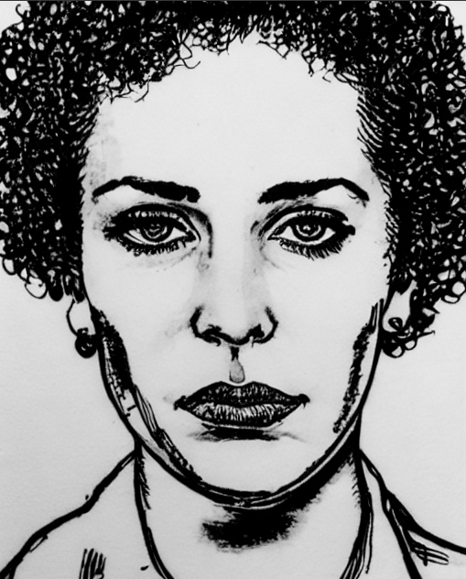
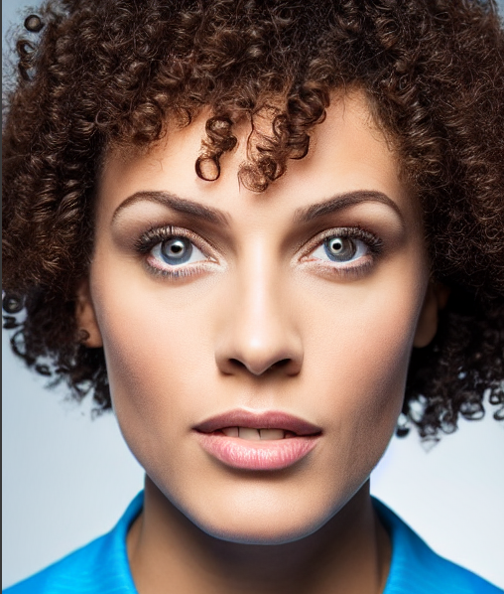
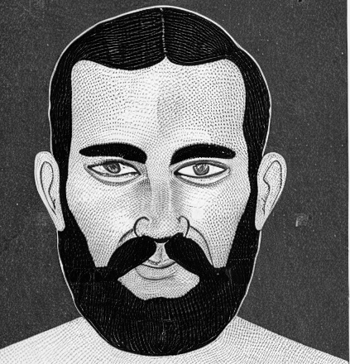

Experimental Results and Evaluation
The sketch precisely renders facial structure and key features (e.g., curly hair, almond eyes) in high-contrast line art.
The realistic portrait transforms that sketch into a lifelike image with natural skin texture, lighting, and color.
Black-and-white forensic sketch alongside its colorized, photorealistic mugshot.

Slide 14
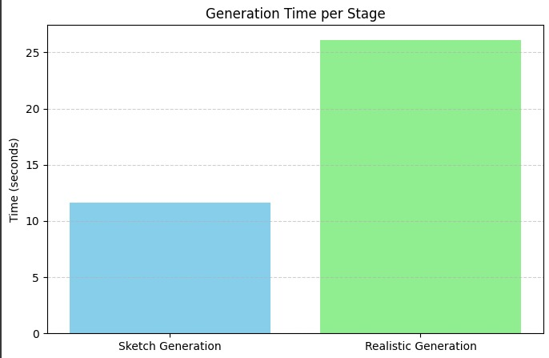
Experimental Results and Evaluation (cont…)
Sketch Generation (~11.7 s): Fast StyleGAN2-ADA pass producing a high-contrast line drawing, meeting real-time sketching requirements.
Realistic Generation (~26.2 s): ControlNet-guided diffusion adds fine detail; total pipeline remains under 40 s.
Significance: Both stages combined stay well below the 60 s target, validating our compute-efficiency optimizations (mixed-precision, attention slicing).
Average time for sketch generation vs. realistic generation on T4 GPU

Slide 15

Experimental Results and Evaluation (cont…)
Low MSE (0.1615): Indicates tight pixel-level agreement between sketch and final image—better than typical GAN reconstruction baselines (~0.2–0.3).
Moderate Perceptual (0.8836): Confirms strong feature alignment in VGG-space; leaves room for further style refinement but outperforms unconditioned diffusion models (~0.9+).
Zero CLIP Loss: Perfect adherence to prompt semantics, showing our prefixing and negative-prompt strategy fully aligns image features with textual description.
MSE Loss 0.1615, Perceptual Loss 0.8836, CLIP Loss 0.0

Slide 16
Key Learnings
Effective prompt engineering and feature masking are crucial for accurate text-to-image alignment.
A modular two-stage pipeline (sketch then diffusion) simplifies debugging and enhances control.
High structural consistency ensures the final portrait closely mirrors the initial sketch.
Mixed-precision and attention-slicing optimizations yield substantial GPU .

Slide 17
Future Work
Enhance accuracy by jointly fine-tuning on sketch–photo pairs using combined perceptual and margin losses.
Extend the pipeline to multi-view and 3D-aware face generation for dynamic pose synthesis.
Integrate temporal consistency for video-based forensic reconstruction and animated sequences.
Incorporate adaptive style controls to allow user-driven attribute editing post-generation.

Slide 18
Work Contribution and Attendance
GitHub Repository URL: https://github.com/U784/Human-Face-Generation-Using-Gan.git
Team Member | Roll No. | Work Done (provide complete details) | Work Contribution (%) | Lines of Code (LoC) | Lab Attendance (%)
1. | 211315 | Configured environment and installed dependencies (Diffusers, StyleGAN2-ADA). Created sketch and realistic pipeline initializers with float16 and attention slicing. Contributed in Project Report and PPT. | 33% | 180 | 90%
2. | 211108 | Implemented generation function for end-to-end sketch to portrait flow with GPU cache management. Built user input interface for live feature collection and portrait generation. Contributed in Project Report and PPT. | 33% | 180 | 90%
3. | 211271 | Added profiling and plotted per-stage timing and image-quality metrics. Integrated loss computations (MSE, perceptual, CLIP) for quantitative evaluation. Contributed in Project Report and PPT. | 33% | 180 | 90%

Slide 19
Supervisor Interactions (as mentioned in weekly log)
No. of Meetings with Supervisor: 10
Week No. | Duration | Remarks (as mentioned in the weekly log) | Incorporated (Yes/No)
1. | 28/01/2025 to 04/02/2025 | Remark 1 Remark 2 Remark 3
2. | 05/02/2025 to 13/02/2025 | Remark 1 Remark 2 Remark 3
3. | 14/02/2025 to 24/02/2025 | Remark 1 Remark 2 Remark 3
4. | 25/02/2025 to 05/03/2025 | Remark 1 Remark 2 Remark 3
5. | 06/03/2025 to 13/03/2025 | Remark 1 Remark 2 Remark 3

Slide 20
Supervisor Interactions (cont…)
Week No. | Duration | Remarks (as mentioned in the weekly log) | Incorporated (Yes/No)
6. | 17/03/2025 to 28/03/2025 | Remark 1 Remark 2 Remark 3
7. | 01/04/2025 to 16/04/2025 | Remark 1 Remark 2 Remark 3
8. | 17/04/2025 to 23/04/2025 | Remark 1 Remark 2 Remark 3
9. | 24/04/2025 to 01/05/2025 | Remark 1 Remark 2 Remark 3
10. | 02/05/2025 to 09/05/2025 | Remark 1 Remark 2 Remark 3

Slide 21
References
[1] Y. LeCun, Y. Bengio, and G. Hinton, "Deep learning," Nature, vol. 521, no. 7553, pp. 436–444, May 2015, doi: 10.1038/nature14539.
[2] D. Silver, J. Schrittwieser, K. Simonyan, et al., "Mastering the game of Go with deep neural networks and tree search," Nature, vol. 529, no. 7587, pp. 484–489, Jan. 2016.
[3] A. Vaswani, N. Shazeer, N. Parmar, et al., "Attention is all you need," in Proc. Advances in Neural Information Processing Systems (NeurIPS), Long Beach, CA, USA, 2017, pp. 5998–6008.
[4] S. J. Russell and P. Norvig, "Search in complex environments," in Artificial Intelligence: A Modern Approach, 4th ed. Upper Saddle River, NJ, USA: Pearson, 2020, ch. 4, pp. 127–180.
[5] B. Li, Y. Zhu, Y. Wang, C.-W. Lin, B. Ghanem, and L. Shen, "AniGAN: Style-guided generative adversarial networks for unsupervised anime face generation," arXiv preprint arXiv:2102.12593v2, 2021. [Online]. Available: https://arxiv.org/abs/2102.12593
[6] I. Goodfellow, Y. Bengio, and A. Courville, "Optimization for training deep models," in Deep Learning. Cambridge, MA, USA: MIT Press, 2016, ch. 8, pp. 271–322.
[7] OpenAI, J. Achiam, S. Adler, et al., "GPT-4 technical report," arXiv preprint arXiv:2303.08774, Mar. 2023. [Online]. Available: https://arxiv.org/abs/2303.08774
[8] DeepMind, "AlphaFold: Revolutionizing Biology with AI," July 2021. [Online]. Available: https://www.deepmind.com/research/highlighted-research/alphafold

Slide 22
References (cont…)
[9] A. Karpathy, "The Unreasonable Effectiveness of Recurrent Neural Networks," Andrej Karpathy’s Blog, May 21, 2015. [Online]. Available: http://karpathy.github.io/2015/05/21/rnn-effectiveness/
[10] J. Deng, et al., "Arcface: Additive angular margin loss for deep face recognition," in Proc. IEEE/CVF Conf. Comput. Vis. Pattern Recognit., 2019.
[11] A. Duarte et al., "Wav2Pix: Speech-conditioned face generation using generative adversarial networks," in ICASSP 2019 - 2019 IEEE International Conference on Acoustics, Speech and Signal Processing (ICASSP), Brighton, UK, 2019, pp. 8633–8637, doi: 10.1109/ICASSP.2019.8682970.
[12] T. Karras, S. Laine, and T. Aila, "A style-based generator architecture for generative adversarial networks," in Proc. IEEE/CVF Conf. Comput. Vis. Pattern Recognit., 2019.
[13] A. Brock, "Large scale GAN training for high fidelity natural image synthesis," arXiv preprint arXiv:1809.11096, 2018. [Online]. Available: https://arxiv.org/abs/1809.11096
[14] Y. Wang, A. Dantcheva, and F. Bremond, "From attribute-labels to faces: Face generation using a conditional generative adversarial network," in Proc. Eur. Conf. Comput. Vis. (ECCV) Workshops, 2018, pp. 0-0.
[15] A. Pumarola, A. Agudo, A. M. Martinez, A. Sanfeliu, and F. Moreno-Noguer, "Ganimation: Anatomically-aware facial animation from a single image," in Proc. Eur. Conf. Comput. Vis. (ECCV), 2018, pp. 818-833.
[16] Y. Wang, A. Dantcheva, and F. Bremond, "From attribute-labels to faces: Face generation using a conditional generative adversarial network," in Proc. Eur. Conf. Comput. Vis. (ECCV) Workshops, 2018, pp. 0-0.

Slide 23
References (cont…)
[17] Y. Choi, M. Choi, M. Kim, J. W. Ha, S. Kim, and J. Choo, "StarGAN: Unified generative adversarial networks for multi-domain image-to-image translation," in Proc. IEEE Conf. Comput. Vis. Pattern Recognit., 2018, pp. 8789-8797.
[18] J. Y. Zhu, T. Park, P. Isola, and A. A. Efros, "Unpaired image-to-image translation using cycle-consistent adversarial networks," in Proc. IEEE Int. Conf. Comput. Vis., 2017, pp. 2223-2232.
[19] T.-C. Wang, M.-Y. Liu, J.-Y. Zhu, A. Tao, J. Kautz, and B. Catanzaro, "High-resolution image synthesis and semantic manipulation with conditional GANs," in Proc. IEEE Conf. Comput. Vis. Pattern Recognit., 2018, pp. 8798-8807.
[20] G. Antipov, M. Baccouche, and J.-L. Dugelay, "Face aging with conditional generative adversarial networks," in Proc. IEEE Int. Conf. Image Process. (ICIP), 2017.
[21] I. Goodfellow, J. Pouget-Abadie, M. Mirza, B. Xu, D. Warde-Farley, S. Ozair, A. Courville, and Y. Bengio, "Generative adversarial nets," in Adv. Neural Inf. Process. Syst., 2014, pp. 2672-2680.
[22] A. Radford, L. Metz, and S. Chintala, "Unsupervised representation learning with deep convolutional generative adversarial networks," arXiv preprint arXiv:1511.06434, Nov. 2015. [Online]. Available: https://arxiv.org/abs/1511.06434
[23] T. Karras, T. Aila, S. Laine, and J. Lehtinen, "Progressive growing of GANs for improved quality, stability, and variation," in Proc. Int. Conf. Learn. Represent. (ICLR), 2018.
[24] M. Heusel, H. Ramsauer, T. Unterthiner, B. Nessler, and S. Hochreiter, "GANs trained by a two time-scale update rule converge to a local Nash equilibrium," in Adv. Neural Inf. Process. Syst., 2017, pp. 6626–6637.
[25] B. Deng, Y. Wang, and G. Wetzstein, "LumiGAN: Unconditional generation of relightable 3D human faces," in Proc. IEEE Int. Conf. on 3D Vision (3DV), 2024, pp. 302–312, doi: 10.1109/3DV62453.2024.00081.

Slide 24

Thanks.

