Slide 1
Optimizing Deep Networks
7.5: Batch Normalization
11.11: Learning Rate Scheduling

Slide 2
Practical Challenges in Deep Learning
Diverging weights – changing weights in one layer result in different inputs to next
Overfitting – deeper networks are more complex, so regularization becomes more critical
Efficiency
Accuracy
Generalizability

Slide 3
Batch Normalization

Slide 4
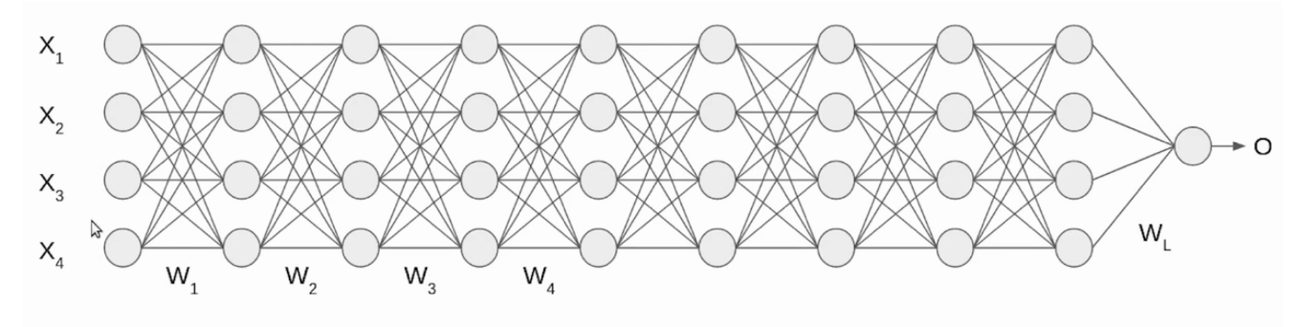
Batch Normalization
What is Batch Normalization?
Standard Normalization - Used in pre-processing and applied over the full dataset.
Batch Normalization – Applied to individual layers and over a single mini-batch at a time
Popular and effective for accelerating convergence of deep networks
Makes it possible to train networks with over 100 layers!
https://www.analyticsvidhya.com/blog/2021/03/introduction-to-batch-normalization/

Slide 5
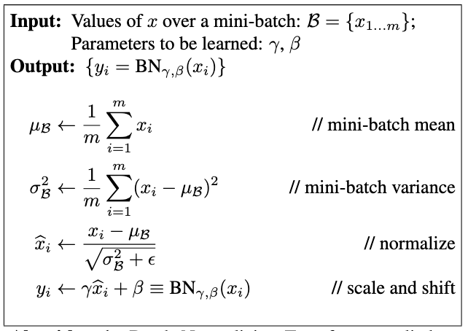
Batch Normalization
How does it work?
Find mean and standard deviation of inputs to layer for one minibatch
Normalize inputs using that mean and standard deviation
Apply a scale coefficient (𝛾) and a scale offset (β) – these are additional model parameters that need to be learned

Slide 6
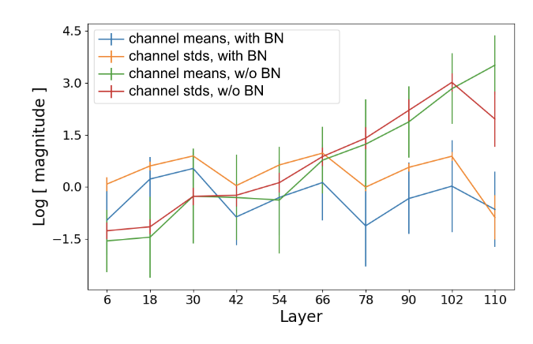
Batch Normalization
How does it work?
Figure: Bjorck et al. (2018)

Slide 7
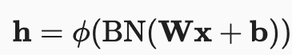
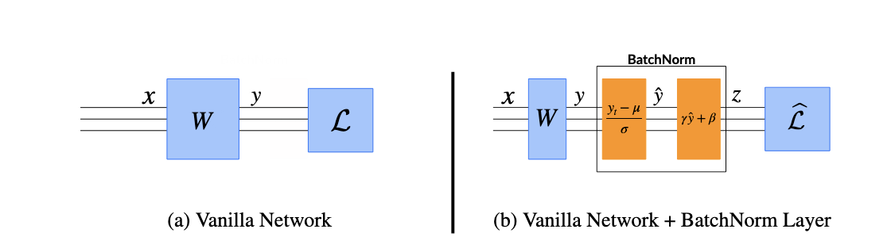
Batch Normalization
In Practice
Practitioner’s Note:
When applying to a convolutional layer, normalize after the convolution, but before the activation and separately for different channels.
Batch normalization is applied to individual layers (sometimes all)
Example: applying to a normal layer in a fully-connected network.
Take some initial input x
Perform the transformation Wx+b where W is the weight and b is the bias
*Perform batch normalization*
Apply some activation function (φ)
Figure: Santurkar et al. (2018)

Slide 8
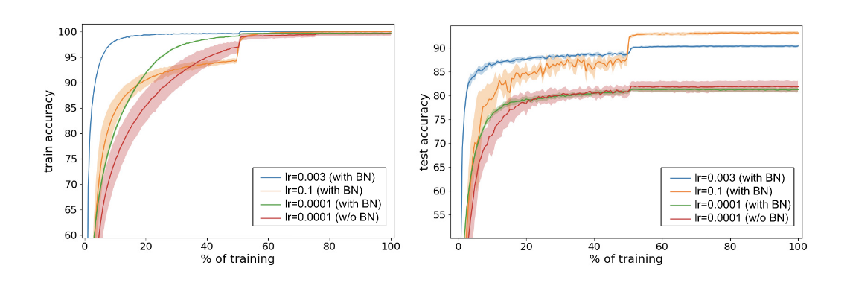
Batch Normalization
In Practice
Batch normalization:
1. Can be applied to most network types
2. Works differently during the training and at test time
3. Allows for more aggressive learning rates
Figure: Bjorck et al. (2018)

Slide 9
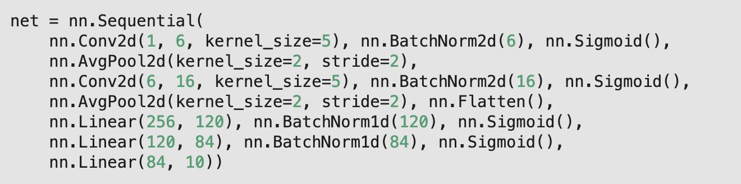
Batch Normalization
In Practice

Slide 10
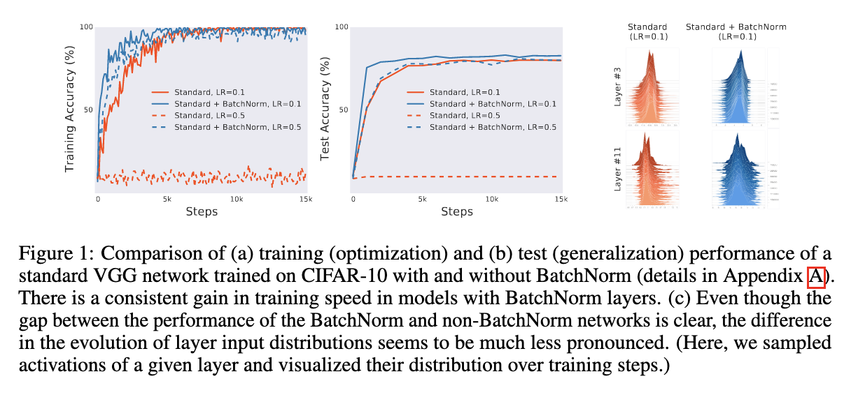
Batch Normalization
Results
Batch normalization has been shown to:
1. Accelerate training
2. Increase generalization accuracy
But does it work for the reason it was initially thought to?
Figure: Santurkar et al. (2018)

Slide 11
Batch Normalization
Take aways about batch normalization
It is a popular and effective way to accelerate and improve the training of a deep network
It continuously adjusts the intermediate outputs of the network to make the layers more stable
It allows you to use larger learning rates
It can be applied to most network types
Intuitively, it makes the optimization landscape smoother, but has faced controversy over the technical reason it works

Slide 12
Learning Rate Scheduling

Slide 13
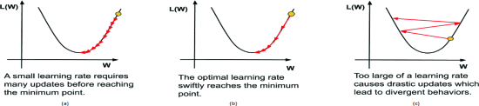
Learning Rate Schedulers
What matters when it comes to learning rate?
Magnitude – How large is our step size?
Rate of decay – How does the step size evolve with time?
Initialization – How do we set our parameters and how to do they evolve initially?
Figure: Konar et al. (2020)

Slide 14
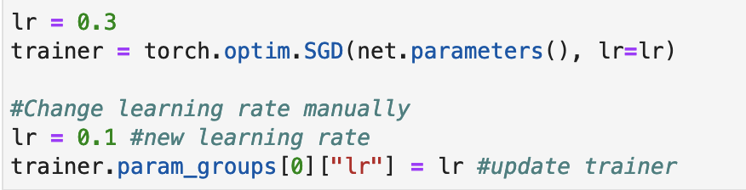
Learning Rate Schedulers
How can we adjust the learning rate?
Option 1: Update learning rate explicitly at each step (could be every epoch or even every minibatch)
Option 2: Define a scheduler

Slide 15

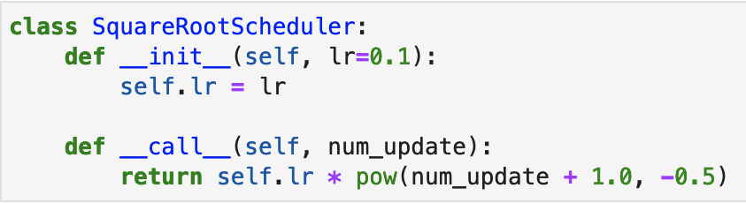
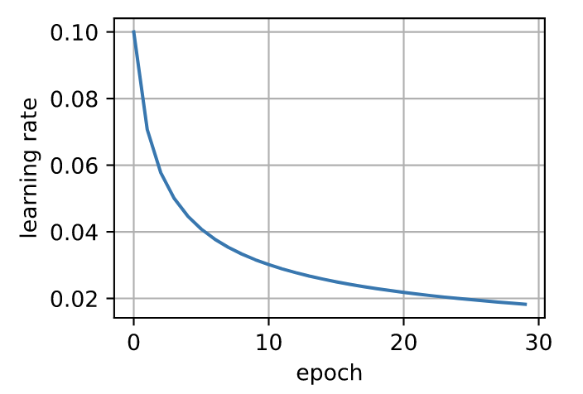
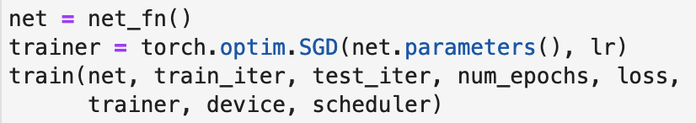
Learning Rate Schedulers
What is a scheduler?
A scheduler should take the number of updates we’re on and return the appropriate learning rate
For example, consider a square root scheduler.
But does it work?

Slide 16
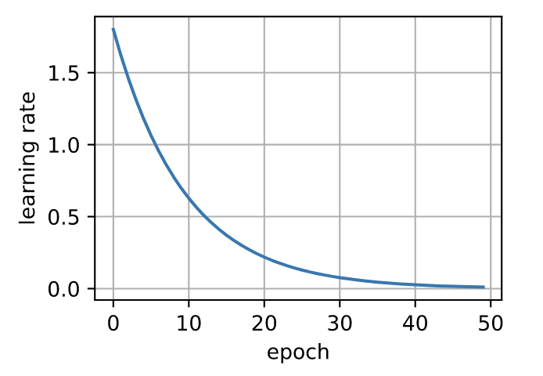
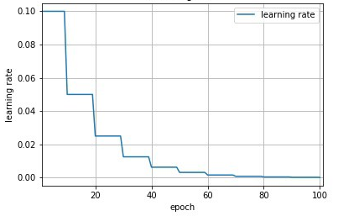
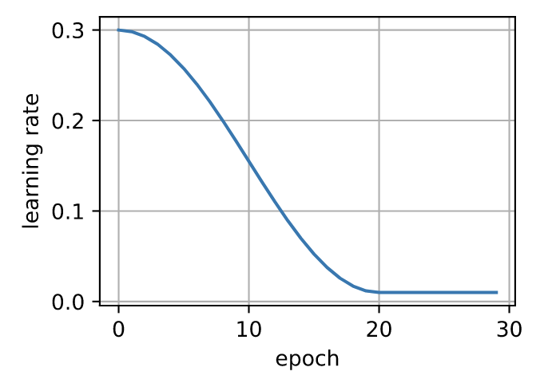
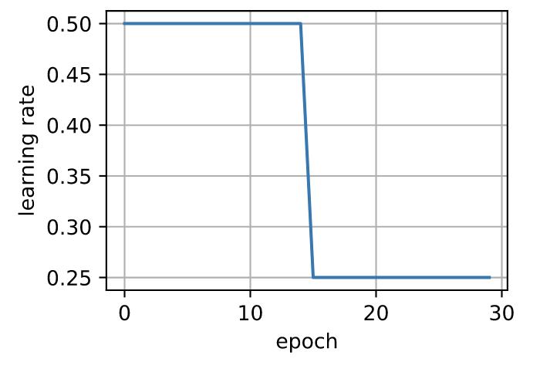
Learning Rate Schedulers
Popular Policies
Continuous Decay
Piecewise Decay
Cosine Decay
Generally, a polynomial or multiplicative (above) decay
Let’s optimization proceed until a stationary point is reached and only then decreases learning rate.
Based on idea that we might want a slow decay in the beginning but very small learning rate later.
Can work very well with computer vision problems.
Middle plot: https://neptune.ai/blog/how-to-choose-a-learning-rate-scheduler

Slide 17
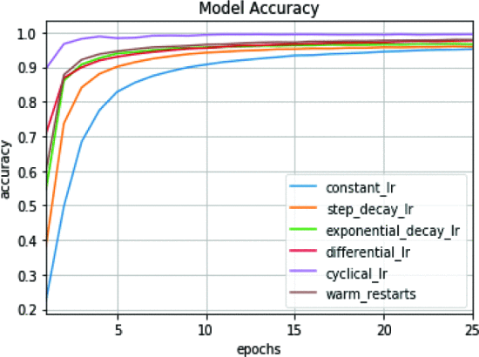
Learning Rate Schedulers
Choosing a policy
Depends on the task and the network
Cyclical learning rate = vary between two boundary values. Can prevent the optimizer from getting stuck on a narrow valley.
A comparison between learning rate schedules for learning the MNIST dataset from Konar et al. (2020)

Slide 18
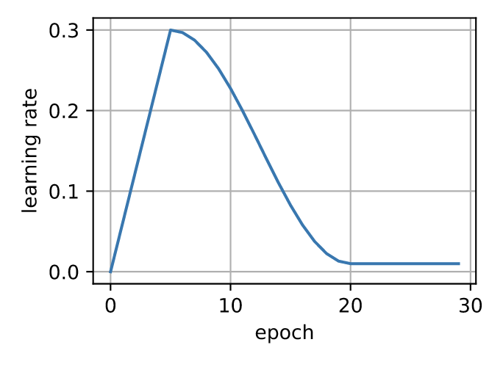
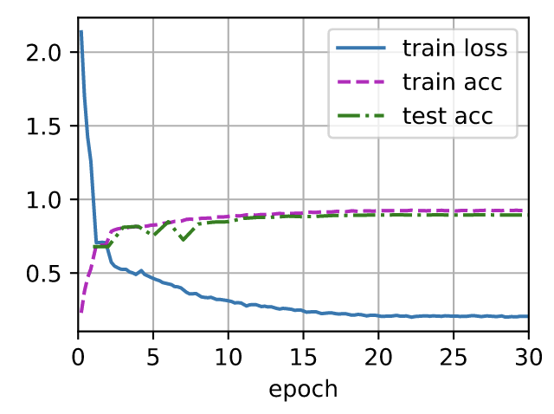
Learning Rate Schedulers
Warm Up
Random parameter initialization -> May be far from a good solution
Large learning rate -> Potential divergence
Small learning rate -> Slow progress
Solution: Use a warmup period where the learning rate increases (generally linearly) to its initial maximum and then apply your learning rate decay as before.

Slide 19
Learning Rate Schedulers
Summary (+ a few new things)
Decreasing the learning rate during training can improve accuracy and reduce overfitting
A piecewise decay is effective in many scenarios
Cosine schedulers are popular for some computer vision problems
Circular schedulers can prevent the optimizer getting stuck on a narrow valley
Warmup can prevent divergence

Slide 20
A Final Note on Optimization
The main purpose of optimization algorithms is to minimize training loss. But different choices of of optimization algorithms, learning rate schedules, and regularization strategies can also affect efficiency and generalization.

Slide 21
References
Dive into Deep Learning, Ch. 7.5, 11.11 (https://d2l.ai/)
S. Ioffe and C. Szegedy (2015) “Batch Normalization: Accelerating Deep Network Training by Reducing Internal Covariate Shift”
S. Santukar et al. (2018) “How does Batch Normalization Help Optimization?”
J. Bjorck et al. (2018) “Understanding Batch Normalization”
J. Konar et al. (2020) “Comparison of Various Learning Rate Scheduling Tecnhiques on Convolutional Neural Network”

