Slide 1
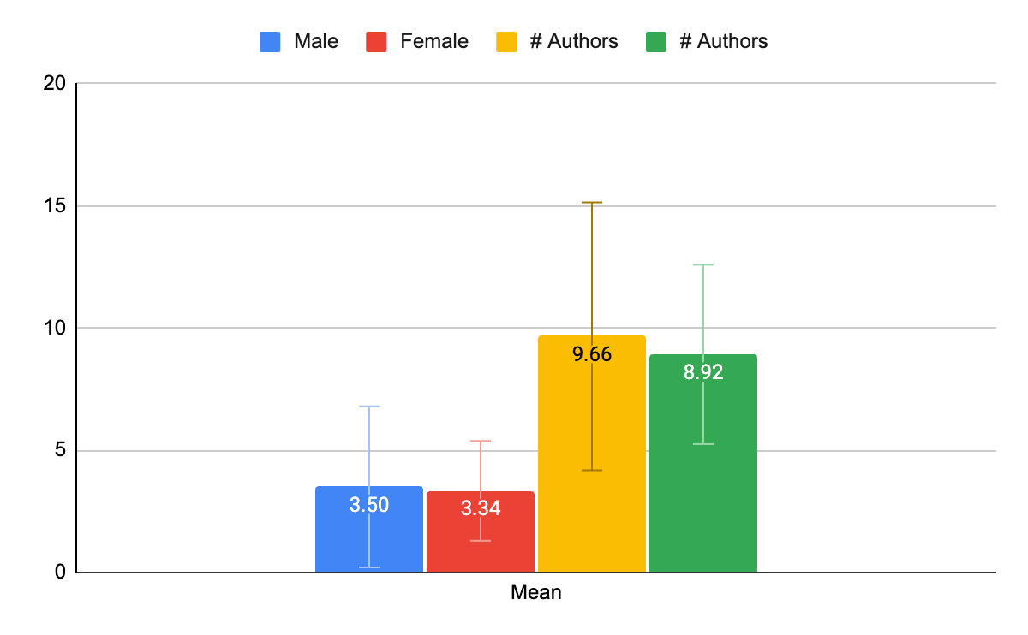
Figure 1. Author position and total number. The average author position of candidates was 3.5 for males (blue) and 3.34 for females (red). On average, male candidates worked in research groups with 9.66 authors (orange) while females worked in groups of 8.92 authors (green).

Slide 2
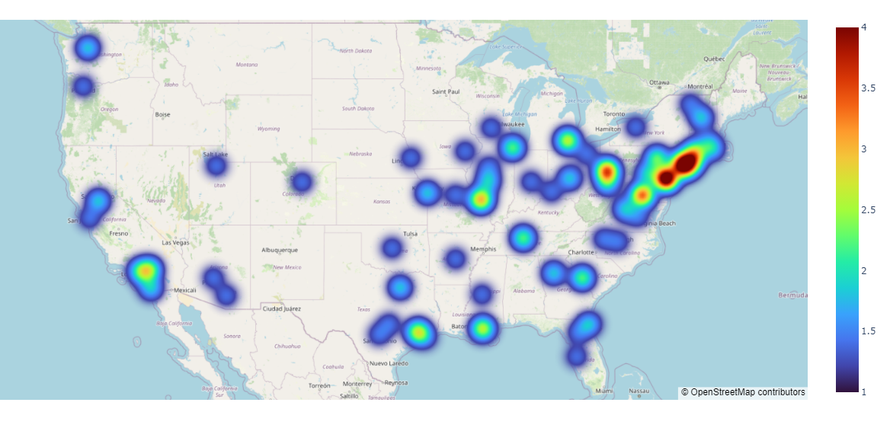
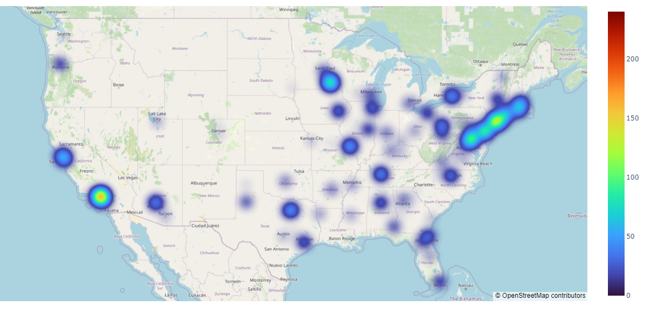
a
b
Figure 2. Geographic distribution of Residents and Research affiliations. Heatmaps showing the distribution of (a) incoming neurosurgery residents and (b) the research affiliations linked to their publications.

Slide 3
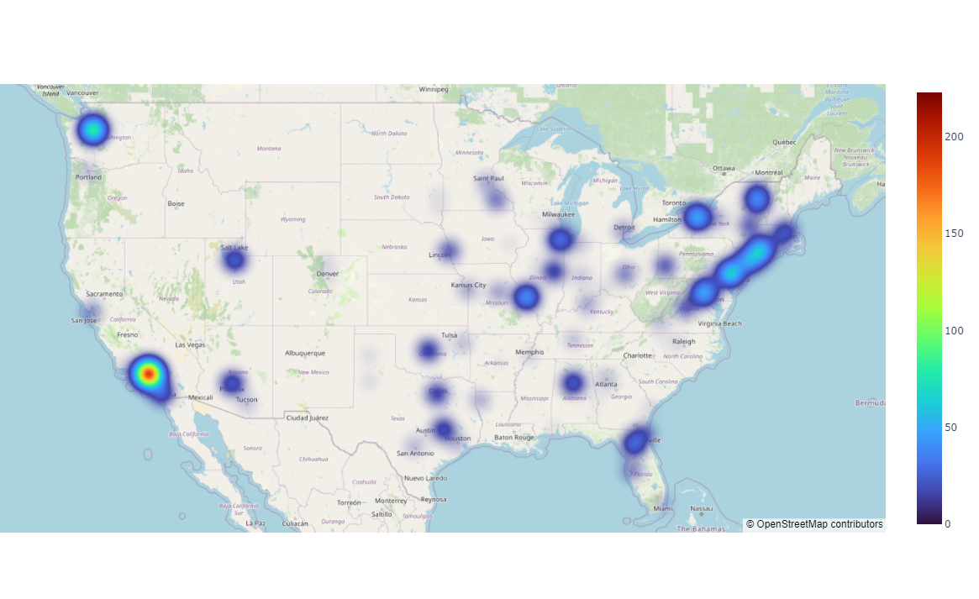
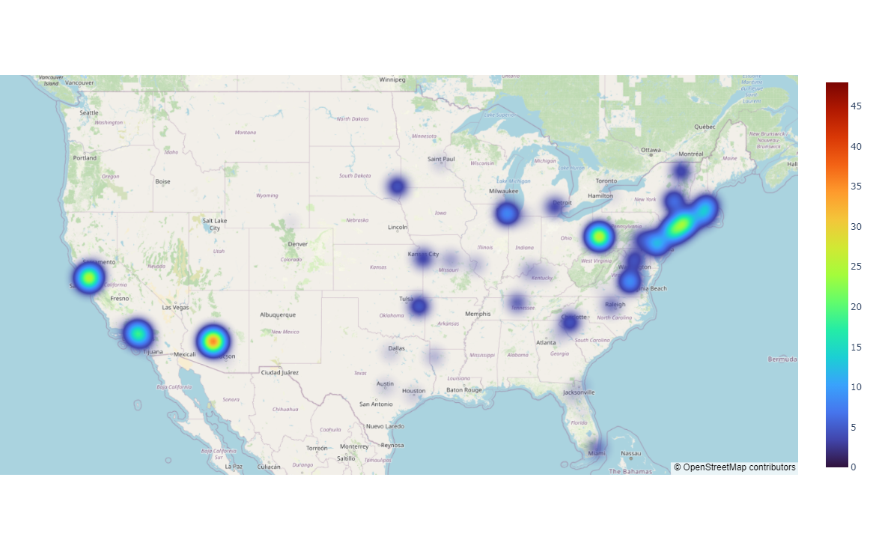
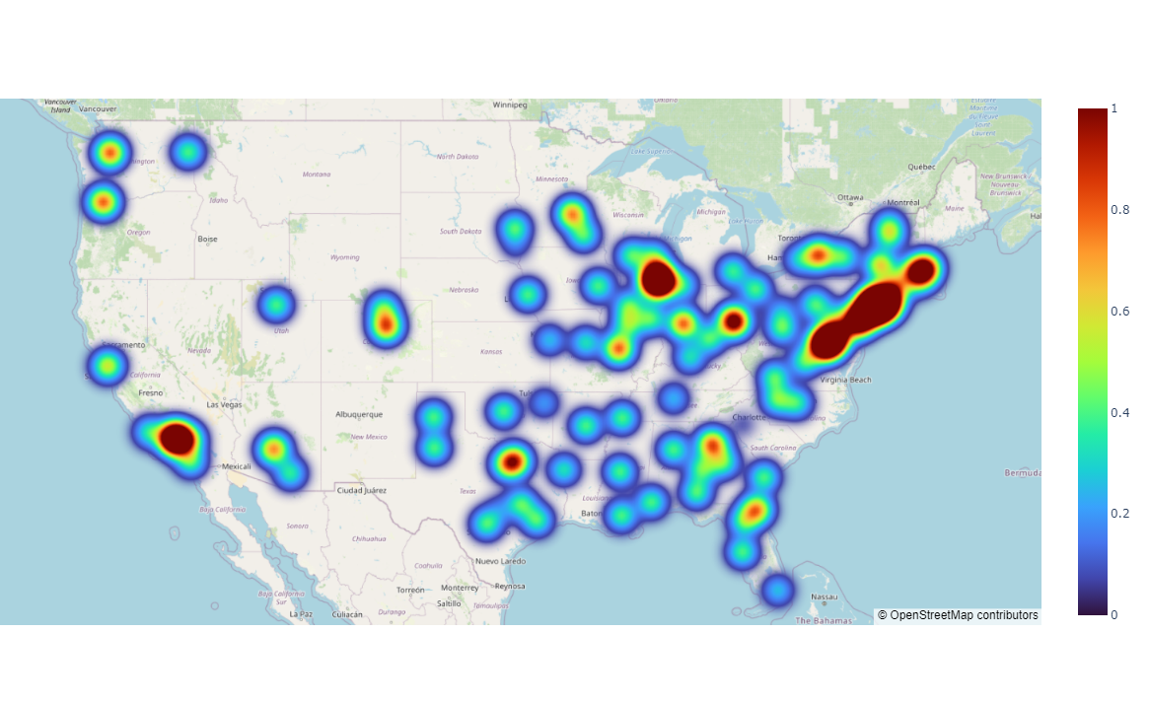
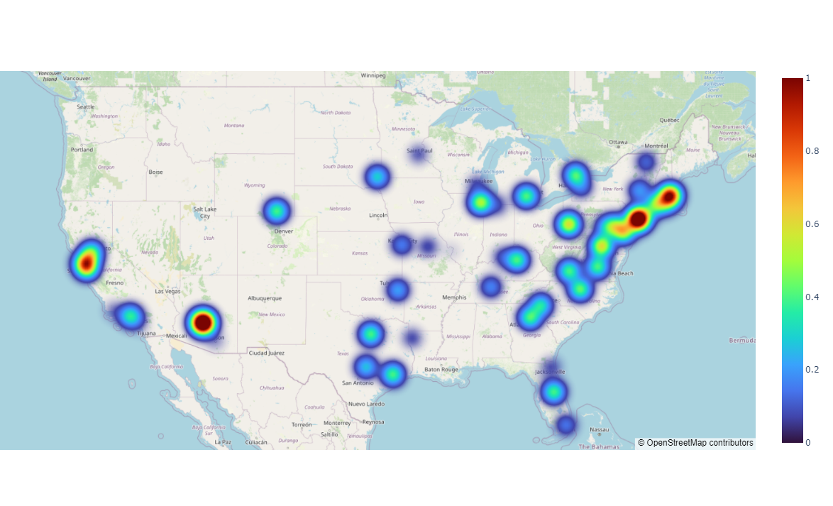
a
b
c
d
Figure 3 - Gender Comparison of Paper Density Comparison of where male residents and female residents completed their research. (a) Distribution of male author affiliations. (b) Distribution of female author affiliations. (c) Fraction of authors that are male at each sampled location. (d) Fraction of female authors within each location.

