Slide 1
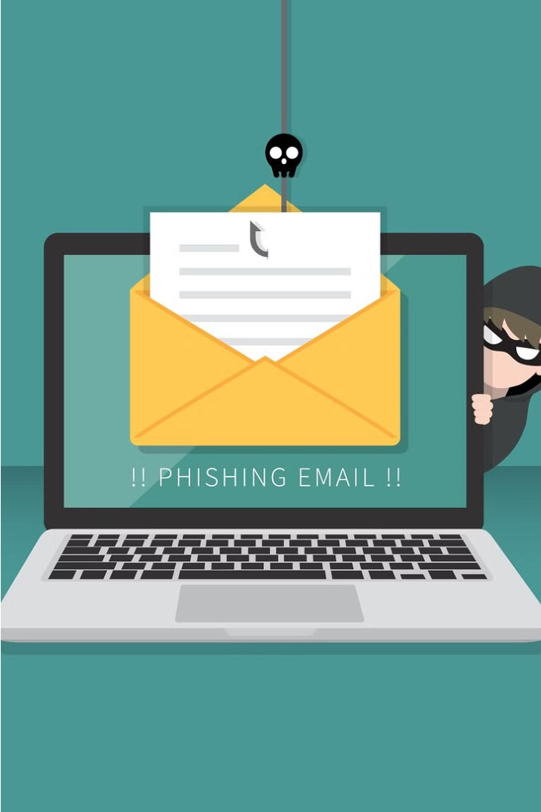

Phishing: Defend Against Cyber Deception
Phishing is a form of cybercrime where attackers use fraudulent emails, websites, or messages to trick victims into revealing sensitive information, such as login credentials or financial data. By understanding common phishing tactics, you can protect yourself and your organization.

Slide 2
Common Phishing Tactics
Spoofed Emails
Fake Websites
Urgency and Threats
Phishers create emails that appear to be from legitimate organizations, tricking recipients into clicking malicious links or providing personal information.
Fraudulent websites are designed to mimic real, trusted websites in order to steal login credentials and other sensitive data.
Phishers create a sense of urgency or fear to pressure victims into taking immediate action, such as verifying account information.

Slide 3
Identifying Phishing Emails
1
Unusual Sender Address
2
Vague Greetings
Check the email address - it may not match the purported sender's domain.
Generic greetings like "Dear Customer" rather than using your name are a red flag.
3
Suspicious Links or Attachments
4
Urgent or Threatening Tone
Hover over links to verify the URL, and be cautious of unsolicited attachments.
Phishing emails often create a sense of urgency to pressure you into taking action.

Slide 4




Recognizing Phishing Websites
Secure Connection
Suspicious URLs
Privacy Policy
Website Quality
Look for "https://" in the URL and a padlock icon to ensure the website is secure.
Be wary of URLs that are slightly different from the real website or contain unusual characters.
Legitimate websites should have a clear and comprehensive privacy policy.
Poor design, spelling errors, and low-quality images can indicate a phishing site.

Slide 5
Social Engineering Tactics
Impersonation
Manipulation
Attackers may pretend to be a trusted authority figure, such as a bank representative or IT support, to gain your trust.
Phishers use psychology to exploit human emotions and vulnerabilities, such as fear, greed, or a desire to help.
Pretexting
Baiting
Attackers create a plausible scenario or "pretext" to justify their request for sensitive information.
Leaving malware-infected USB drives or other physical media in a public place, hoping someone will use them.

Slide 6



Protecting Yourself from Phishing
Be Cautious
Update Software
Use Strong Passwords
Verify the legitimacy of any requests for personal or financial information before responding.
Keep your operating system, browsers, and security software up-to-date to protect against known vulnerabilities.
Create unique, complex passwords for each of your accounts to prevent credential theft.

Slide 7
Best Practices for Avoiding Phishing
Verify Sender
Check the email address and sender's identity before responding.
Scrutinize Links
Hover over links to check the URL before clicking, and avoid shortlinks.
Avoid Attachments
Be cautious of unsolicited attachments, which may contain malware.
Use Two-Factor Auth
Enable two-factor authentication on your accounts to add an extra layer of security.

Slide 8
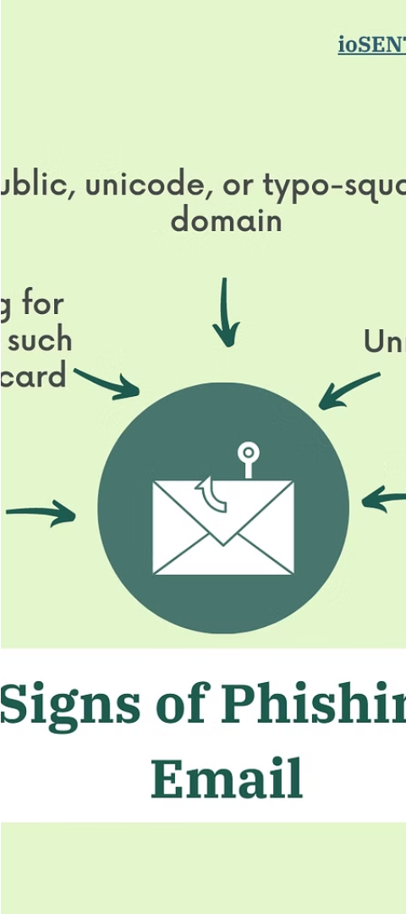
Reporting Suspected Phishing Attempts
1
Identify
Recognize the signs of a phishing attempt and do not respond.
2
Document
Take screenshots and save any relevant information about the suspected phishing message.
3
Report
Notify your organization's IT or security team, as well as any relevant authorities, about the incident.

