Slide 1
Matlab Memory Adjustment

Slide 2
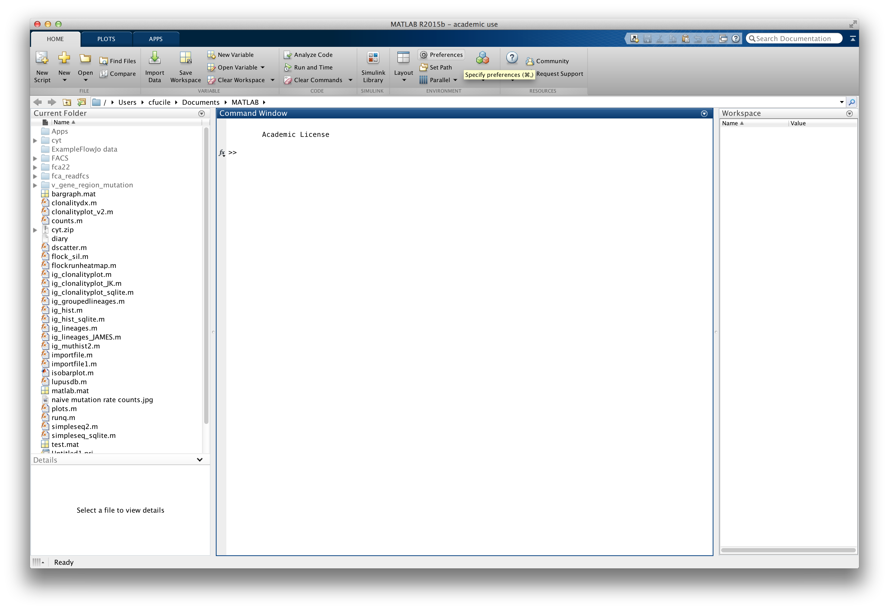
After launching Matlab click the Preferences button.

Slide 3
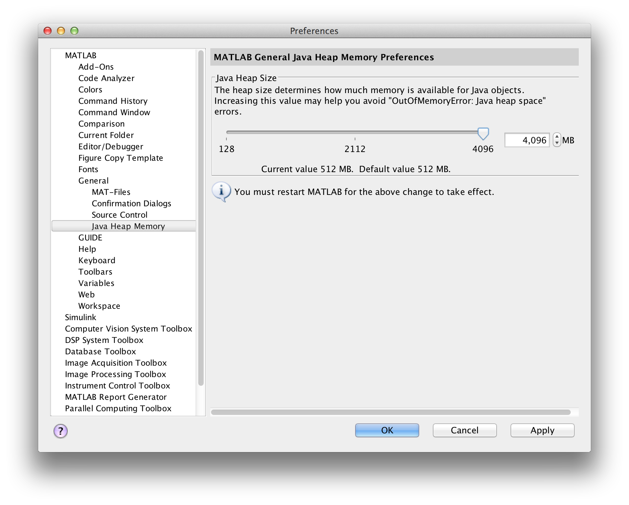
Navagate to the Java Heap Memory Setting and increase the slide bar all the way to the right. It will prompt you that you need to restart Matlab for the setting to take affect. Hit Apply then Ok then restart Matlab.

Slide 4
Matlab: Exporting to Excel

Slide 5
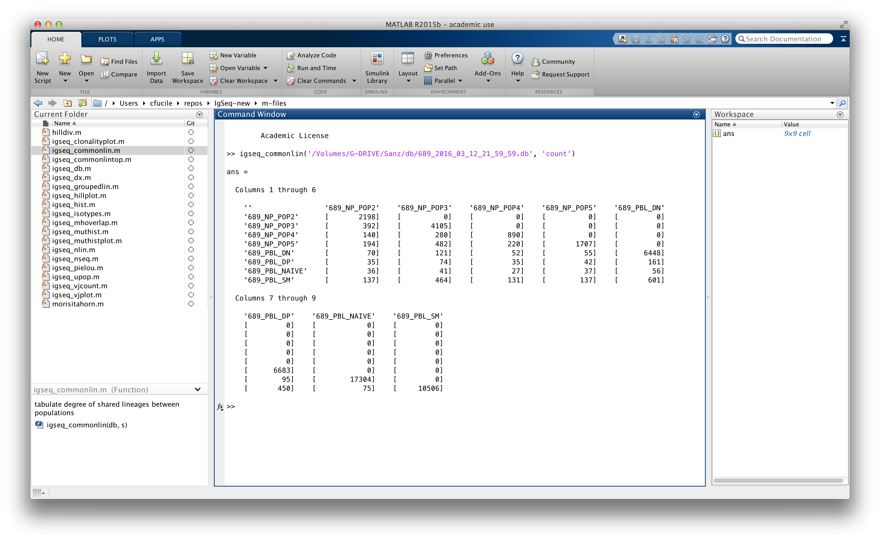
After running a function, a variable will be created in the Workspace containing the answer. Generally it’s called “ans” unless you specify something different. Double click on the variable.

Slide 6
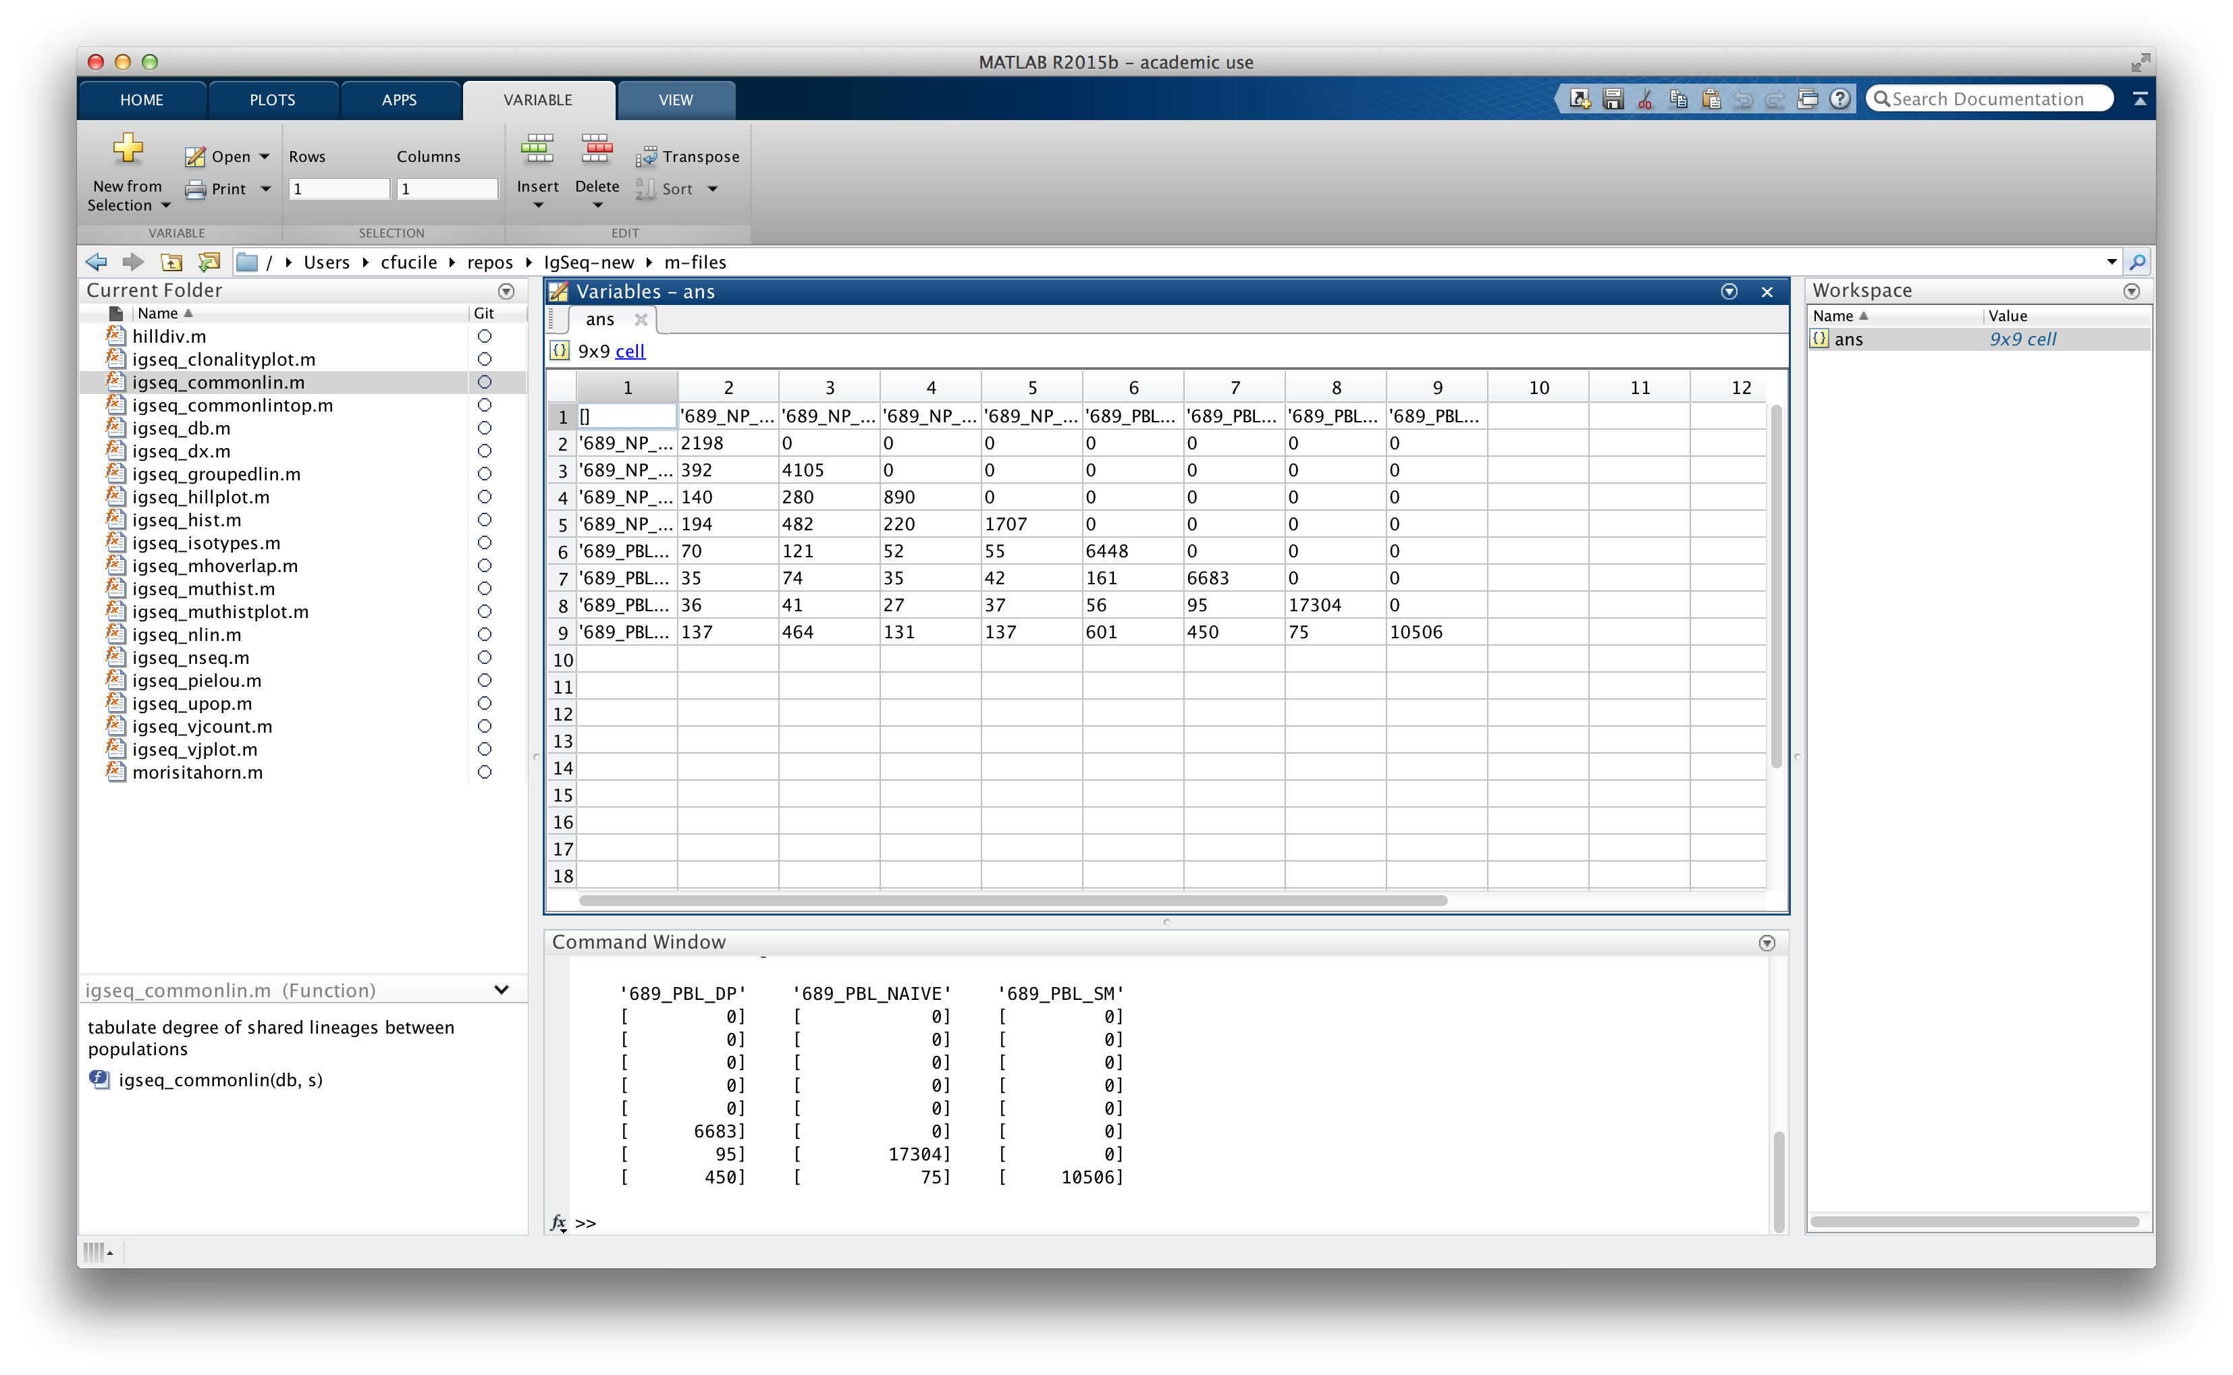
Upon opening the variable, it will display the contents in a table. You can select the cells then copy and paste it into Excel.

