Slide 1

Git & Github
Michael Gathara
BS/MS Computer Science & Math @ UAB
President @ ACM at UAB

Slide 2
Attendance
Place attendance QR code here
Michael Gathara - CS & Math @ UAB

Slide 3
Git vs Github
Git:
Source/Version Control
The underlying technology for Github, Gitlab, Code-Commit, and Bitbucket
Learn it once, Use it everywhere
Can be self-hosted to create your very own Github
Github:
Utilizes Git as it’s underlying technology, hence “Git as a service”
Graphical user interface to view files
No need to know Git to use
Super popular
Michael Gathara - CS & Math @ UAB
Notes:
Showcase how to Git Checkout to a specific, mention how Code-Commit is used internally by Amazon

Slide 4
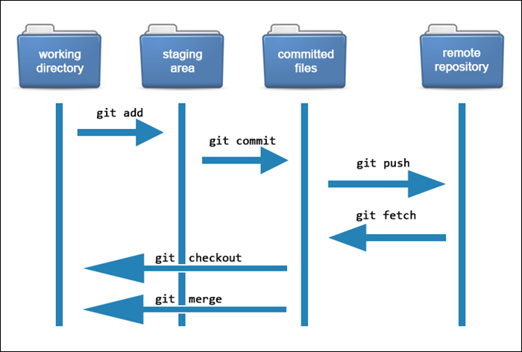
How Git Works
Git:
Working Directory
Your current files, where you make changes
Staging Area
Git starts keeping track of your files
Committed Area
A screenshot of your working directory, ready to be sent to Github
Remote Repo
Github, Gitlab, Bitbucket, etc
https://phoenixnap.com/kb/how-git-works#:~:text=Git%20allows%20users%20to%20track,and%20track%20each%20one%20independently.
Michael Gathara - CS & Math @ UAB
Notes:
Showcase how to Git Checkout to a specific, mention how Code-Commit is used internally by Amazon

Slide 5
Why Source/Version Control?
Keep track of changes within files regardless of the amount of users making those changes
Create checkpoints as you work on a problem
See your progress through time
Access your files anywhere in the world
Michael Gathara - CS & Math @ UAB

Slide 6
Live Demo: A live showcase of Git/Github working
Download Git if you don’t have it yet (https://git-scm.com/downloads)
Creating an organization to host your UAB files
Creating a repo for a class and some good practices for structuring files
Git add
Git commit
Git push
Git checkout
Git pull
Michael Gathara - CS & Math @ UAB
Notes:
Showcase a live demo using github

Slide 7
Git Exercise
Navigate over to https://acmatuab.org/github
Find the first contributions repo
Follow the instructions to use what you learned
Discover pull requests, branches and merging
Ask for help!

Slide 8
Questions?/Resources
Setting up your school organization: gathara.org/files/Github_Tutorial.pdf
Ry’s Git Book: gathara.org/files/Git_Book.pdf
Ray Winderlich, How Git Actually Works: https://www.raywenderlich.com/books/advanced-git/v1.0/chapters/1-how-does-git-actually-work
Version Control with Git: https://www.udacity.com/course/version-control-with-git--ud123
Michael Gathara - CS & Math @ UAB

