Slide 1
Proposal - Theme 1: Real-Time AI for Critical Decisions
1. SPEI Transfer Fraud Shield (Fraud Detection)
Instant transfers through SPEI are fast and irreversible, which makes them a prime target for scams like fake sellers on Marketplace and “your account was compromised, transfer your money to this safe account” calls. Build a scoring engine that flags a transfer in real time based on new beneficiary, unusual amount, time of day, and recently created destination accounts, and then shows the user a warning (“This account was created 2 days ago and received 40 transfers today”) before they confirm. MVP: synthetic transaction stream, a simple model (Isolation Forest or rules plus XGBoost), and a mock banking app screen showing the intervention.

Slide 2
Proposal - Theme 1: Real-Time AI for Critical Decisions
3. ER Triage Assistant for Saturated Clinics (Healthcare Prioritisation)
IMSS and ISSSTE emergency rooms are often overloaded and triage depends on manual judgment under pressure. Build a dashboard that takes vitals and symptoms at check-in and ranks the queue using a triage scale like Manchester, re-prioritizing in real time when someone’s vitals worsen. MVP: a simulated patient queue that reorders live, with an explanation for each priority level. Frame it as decision support for staff, not a replacement for clinicians.

Slide 3
Proposal - Theme 1: Real-Time AI for Critical Decisions
5. Auto Insurance Claim Fraud Detector (Insurance Risk)
Vehicle theft and staged accidents are common insurance fraud patterns in Mexico. Build a claim-intake system that flags suspicious claims: policy bought days before the incident, repeated workshops or adjusters, claim location inconsistent with history, or damage photos reused from the internet. MVP: claim form, risk score with reasons, and an image check using reverse search or perceptual hashing on uploaded photos.

Slide 4
Proposal - Theme 1: Real-Time AI for Critical Decisions
7. Border Crossing Delay Predictor (Supply Chain)
Wait times at crossings like Laredo, Piedras Negras, and Reynosa can disrupt just-in-time manufacturing. Build a predictor that estimates crossing delays and recommends which crossing and departure time to use for each shipment. MVP: model trained on historical CBP wait-time data plus a recommendation dashboard for a logistics coordinator.
Are historical datasets available?

Slide 5
Theme 2: AI Secured – Innovation Without Exposure
9. Personal Data Anonymizer for Mexican Documents (Sensitive Data Protection)
Companies handle tons of documents containing CURP, RFC, INE numbers, CLABE accounts, and addresses, and they’re bound by Mexico’s personal data protection law. Build a tool that detects and masks Mexican-specific identifiers in documents and spreadsheets, while still allowing aggregate analysis (for example, revenue by state without exposing who). MVP: upload a PDF or CSV and get a redacted version plus a privacy report. Regex plus an NER model works well for CURP and RFC since they have predictable formats.

Slide 6
Theme 2: AI Secured – Innovation Without Exposure
10. Fake Invoice (CFDI) Detector (Cybersecurity / Fraud)
“Shell companies” that sell fake invoices are a big tax fraud problem, and the SAT publishes a list of these companies (EFOS). Build a tool that analyzes a company’s received CFDI invoices and flags suppliers on the SAT list or with suspicious patterns like round amounts, newly registered RFCs, or vague concepts. MVP: upload XML invoices, cross-check against the public list, and show a risk report.

Slide 7
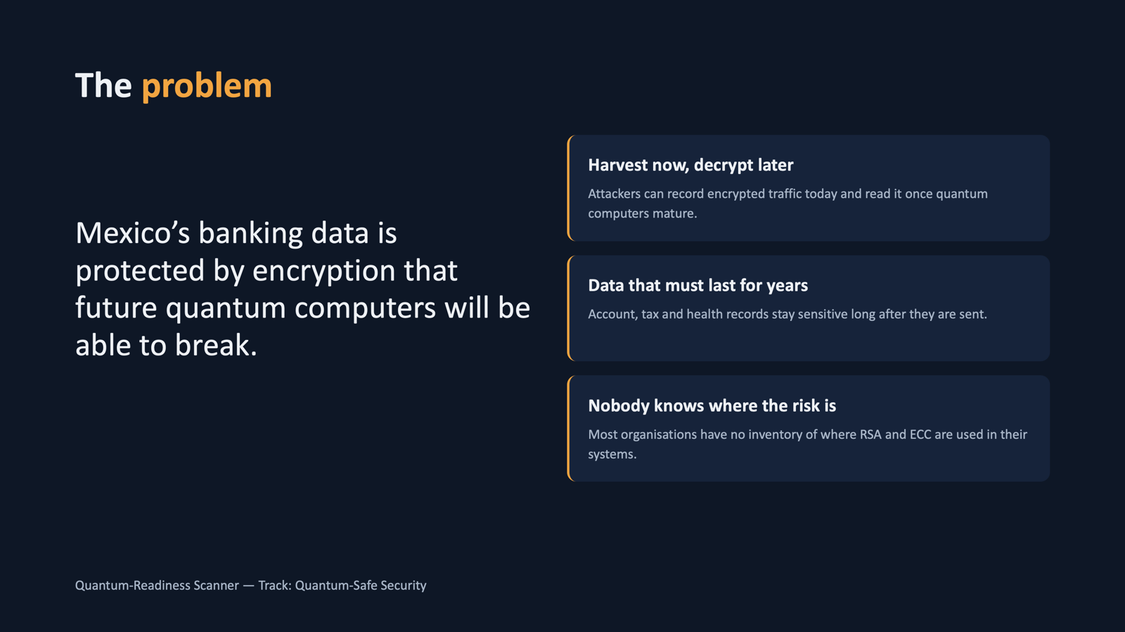
Theme 2: AI Secured – Innovation Without Exposure
14. Quantum-Readiness Scanner for Mexican Banks & Fintechs (Quantum-Safe Security)
Banks and fintechs regulated under the Ley Fintech handle data that needs to stay confidential for years, which makes “harvest now, decrypt later” attacks a real concern. Build a scanner that inspects a domain’s TLS configuration, certificates, and code repositories to find quantum-vulnerable cryptography (RSA, ECC) and produces a prioritized migration report toward the NIST post-quantum standards like ML-KEM. MVP: enter a URL or upload a repo, get a cryptographic inventory and risk score. This is technically impressive and very few teams pick this track, which can help you stand out.

Slide 8
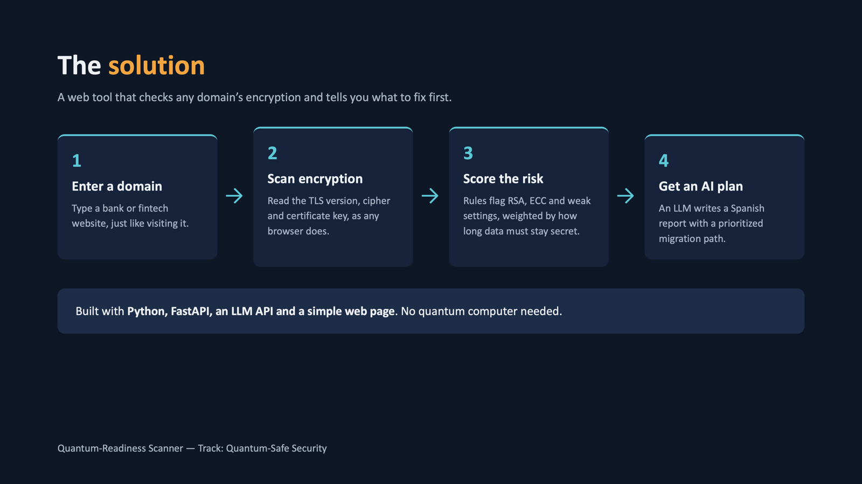

Slide 9
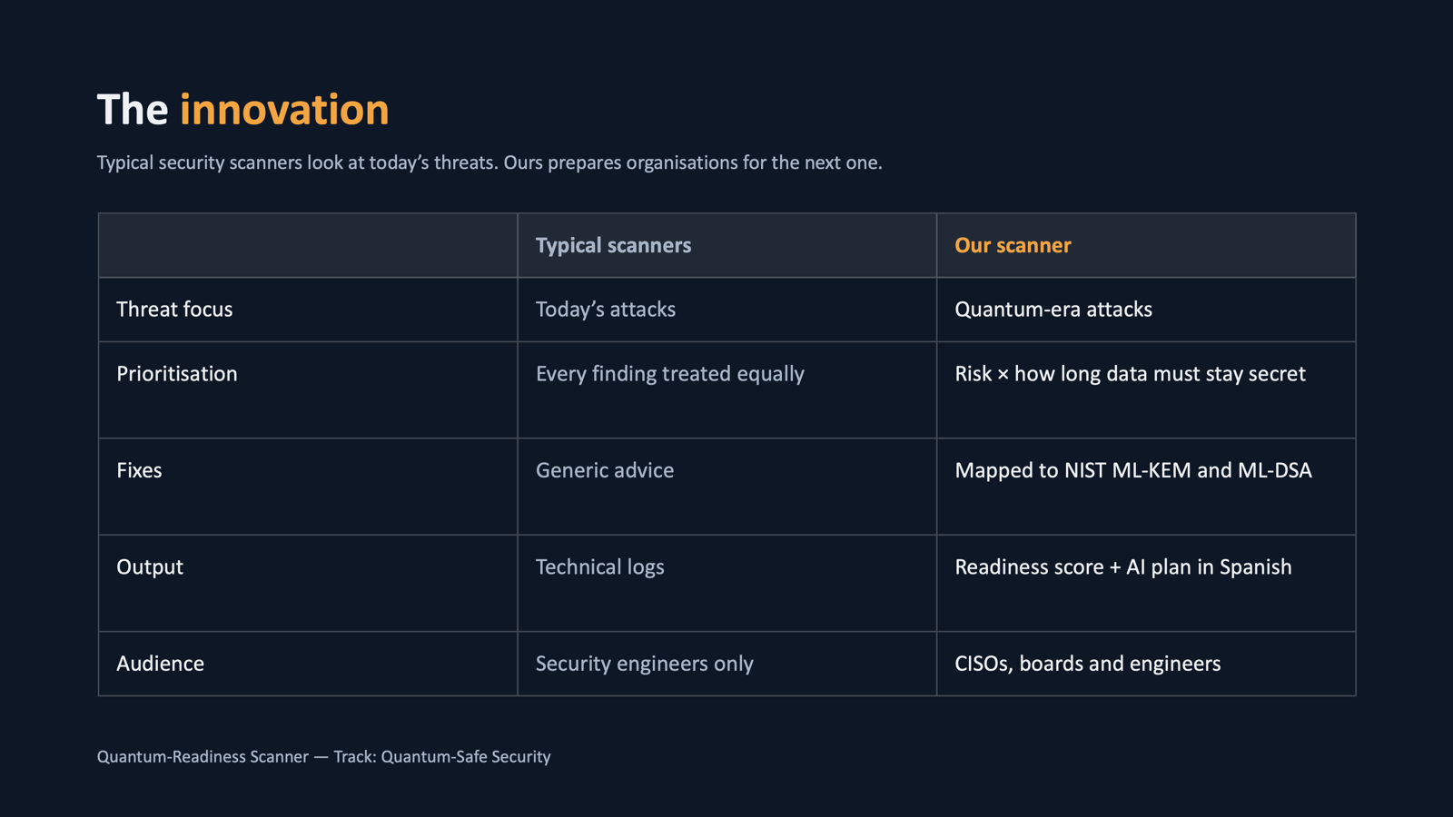

Slide 10
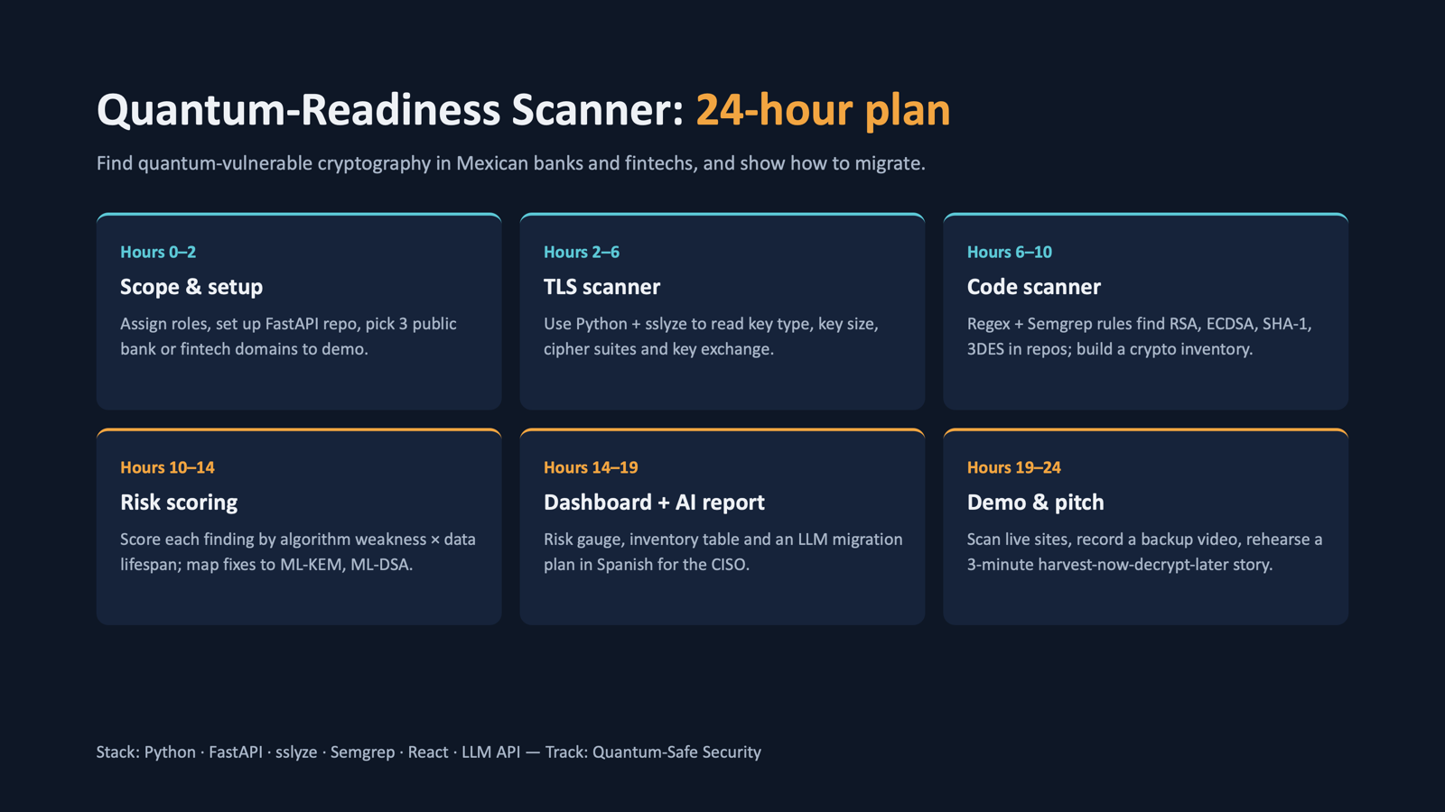

Slide 11
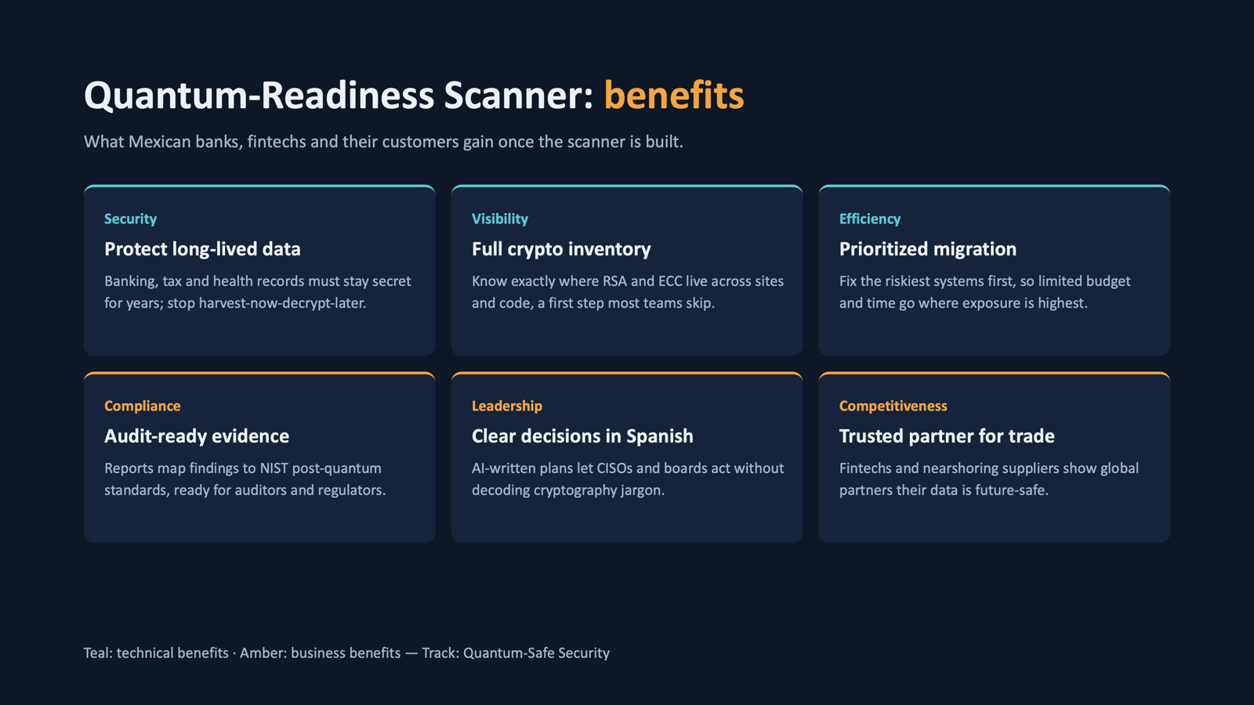

Slide 12

Los Antimarrulla
IBM Z DATATHON 2026 · THEME 2: AI SECURED
United States
Transfers without borders
Proposed fast, fee-free remittances protected by encryption and AI on LinuxONE
Mexico
Javier Augusto Rebull Saucedo · Álvaro Hernández Jarquín
Carlos Enrique Gonzalez Moran · Yazmin Ivonne Flores Martinez
UACJ · Master’s in AI and Data Analytics (MIAAD)
Colombia
Notes:
HISTORICAL CONCEPT ONLY. The selected implementation is the Paillier screening MVP; this remittance proposal was not implemented.
Historical concept: Transfers without borders. Proposed instant, fee-free remittances protected by three AI layers on LinuxONE. This was a planning proposal, not an implemented or validated product.

Slide 13



Cross-border transfers can be costly and slow
01 · THE PROBLEM
6.49%
illustrative global cost to send US$200 abroad
Fast
US$61.7B
remittances reported for Mexico in the original concept; historical figure, not reverified
Often a trade-off
fraud adds another risk
3%
UN 2030 target (SDG 10.c)
Secure
Affordable
Could encrypted, automated screening improve cross-border transfers?
Original concept sources: World Bank Remittance Prices Worldwide (Q1 2025); Banxico 2025 remittances; UN SDG 10.c. Historical planning assumptions, not current product results.
Notes:
HISTORICAL CONCEPT ONLY. The selected implementation is the Paillier screening MVP; this remittance proposal was not implemented.
Historical proposal. The original concept cited a 6.49% average remittance cost, a 3% UN target and US$61.7 billion in remittances to Mexico. These figures are retained as proposal assumptions, not newly verified facts. The proposal explored fast, affordable, encrypted transfers with fraud screening.

Slide 14







Three proposed AI layers screen each transfer
02 · THE SOLUTION
Transfer
1 · OFAC screening
2 · Fraud / AML risk
3 · Settlement
Mexico ↔ United States ↔ Colombia; encrypted transport
Fuzzy matching against sanctions lists
XGBoost scores transactions
Cleared transfers proceed to simulated settlement
Encrypted
Blocked
Held for review
Settled
Names and accounts encrypted; risk model receives tokens
Possible sanctions match: review required
Suspicious pattern: human review with a proposed Granite explanation
Illustrative fast settlement with no fee
App convenience with banking safeguards
Notes:
HISTORICAL CONCEPT ONLY. The selected implementation is the Paillier screening MVP; this remittance proposal was not implemented.
Historical concept: encrypted transport, OFAC screening, XGBoost fraud/AML scoring and simulated settlement. Potential matches require review. Granite explanations and instant fee-free settlement were proposed, not implemented or demonstrated.

Slide 15


Proposed protection of sensitive data
03 · END-TO-END ENCRYPTION
In transit
At rest
During use
TLS 1.3 between each app and LinuxONE
AES-256-GCM; effective hardware acceleration would require measurement
Names and accounts → HMAC-SHA256 tokens; keys outside code
Who can see what?
Component | Name and account | Amount · country · time
User app | Plaintext: the user’s own data | Plaintext
OFAC screening (LinuxONE) | Memory only; no plaintext disk/log storage proposed | Not required
Risk model (XGBoost) | Tokens only | Model features
Granite assistant (generative AI) | Tokens only | Alert summary
Disk, logs and backups | AES-256-GCM ciphertext | AES-256-GCM ciphertext
CPACF support on IBM Z does not establish that an application or library actually uses it; measurement would be required.
Notes:
HISTORICAL CONCEPT ONLY. The selected implementation is the Paillier screening MVP; this remittance proposal was not implemented.
Historical concept. Proposed TLS 1.3 transport, AES-256-GCM storage and HMAC tokenization. Tokenization is not homomorphic encryption or a guarantee of anonymity. OFAC matching would inspect names in a trusted component. The original automatic CPACF claim was unverified; measure effective use before claiming acceleration.

Slide 16




Place AI alongside the financial workload
04 · WHY IBM Z
IBM LinuxONE · s390x
Docker
Financial infrastructure
Mexico app
Mainframes already support major financial workloads
Transfers API
Tokenizer
Settlement
container · TLS 1.3
HMAC-SHA256
Security controls
U.S. app
Encryption, workload isolation and high availability
OFAC screening
Risk model
Compliance dashboard
fuzzy matching
scikit-learn · XGBoost
Colombia app
AI near the data
Granite · llama.cpp
Encrypted vault
Proposed inference on the same platform
proposed alert explanations
AES-256-GCM · acceleration unmeasured
Proposed stack: Python · scikit-learn · XGBoost · RapidFuzz · Granite (llama.cpp) · OpenSSL · Docker · Jupyter Lab ML
Original context source: IBM Z Datathon 2026 Participant Guidebook.
Notes:
HISTORICAL CONCEPT ONLY. The selected implementation is the Paillier screening MVP; this remittance proposal was not implemented.
Historical architecture proposal: containerized API, tokenizer, sanctions screening, risk model, Granite and encrypted vault on LinuxONE. No current implementation or benchmark is claimed. The selected project is the Paillier screening MVP described in docs/PROJECT.md.

Slide 17
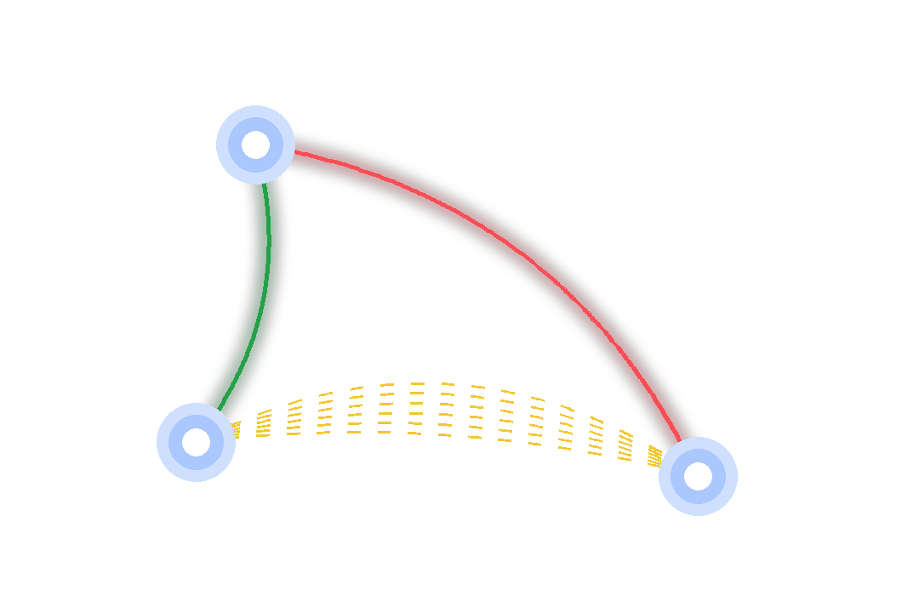




Three proposed scenarios for the demo
05 · LIVE DEMO
Ordinary transfer · Mexico → United States
United States
Pass the checks and show simulated settlement
Potential OFAC name match · United States → Colombia
Highlight the possible match for review
Smurfing · Mexico → Colombia
Mexico
Colombia
Six small transfers in 90 minutes; hold for review and explain the flag
p95 latency
Detection rate
False positives
Transfers / second
to be measured on LinuxONE
to be measured on LinuxONE
to be measured on LinuxONE
to be measured on LinuxONE
Notes:
HISTORICAL CONCEPT ONLY. The selected implementation is the Paillier screening MVP; this remittance proposal was not implemented.
Historical proposed demo: one ordinary transfer, one possible sanctions match and one smurfing pattern in a simulated Mexico/U.S./Colombia network. All metrics, Granite explanations and LinuxONE execution were planned rather than measured.

Slide 18

Synthetic data with injected fraud patterns
06 · DATA AND MODEL
1
Transaction generator
Amount, origin, destination, frequency and time across American corridors
2
Simulated sanctions lists
Use the public OFAC SDN format
3
Injected patterns
Labeled smurfing, layering and unusual activity
4
Models
Name fuzzy matching + XGBoost / Random Forest
Precision
Recall
F1
Latency
False positives
Synthetic customer records proposed from the outset
Notes:
HISTORICAL CONCEPT ONLY. The selected implementation is the Paillier screening MVP; this remittance proposal was not implemented.
Historical proposal: generate synthetic cross-border transactions and simulated sanctions lists, inject labeled smurfing/layering patterns, then measure precision, recall, F1, latency and false positives. The original US$8,400 split over six transfers was illustrative, not an observed fraud case.

Slide 19


Lower fees could leave more money with families
07 · IMPACT · AI FOR GOOD
Families
Financial inclusion
Efficient compliance
Further applications
Remittances support households across the Americas
Proposed access for underserved users
Support screening and documented human review
Explore additional transfer corridors
Transfers without borders; risk with controls
Los Antimarrulla · UACJ · MIAAD
We challenge idleness and procrastination
github.com/UACJ-MIAAD/antimarrulla-ibmz-datathon-2026
Thank you
Notes:
HISTORICAL CONCEPT ONLY. The selected implementation is the Paillier screening MVP; this remittance proposal was not implemented.
Historical proposal conclusion: explore lower remittance costs, financial inclusion and more efficient compliance. These are intended benefits, not demonstrated outcomes. This proposal was not selected as the delivered project.

