Slide 1

Los Antimarrulla
IBM Z DATATHON 2026 · THEME 2: AI SECURED
Privacy-preserving screening
AI estimates diabetes risk from encrypted inputs. Designed for IBM LinuxONE; local results available today.
Javier Augusto Rebull Saucedo · Álvaro Hernández Jarquín
Carlos Enrique Gonzalez Moran · Yazmin Ivonne Flores Martinez
UACJ · Master’s in AI and Data Analytics (MIAAD)
Notes:
We are Los Antimarrulla from UACJ. Our project estimates diabetes risk from encrypted inputs. The risk service receives ciphertexts only. Local execution is verified; LinuxONE evidence remains pending. Theme 2: AI Secured.

Slide 2



Diabetes is widespread; health records are sensitive
01 · THE PROBLEM
18.3%
of adults in Mexico live with diabetes
Share health records
Privacy and legal risk
Hospital
1 in 3
people with diabetes are unaware of it
112,577
deaths in 2024: Mexico’s second leading cause of death
Keep records local
External models cannot read them
Can AI calculate risk without reading the patient’s inputs?
Sources: ENSANUT 2022 (Basto-Abreu et al., Salud Pública de México, 2023); 2024 registered deaths and SSA hospital discharge microdata, DGIS/INEGI.
Notes:
In Mexico, 18.3% of adults live with diabetes; around one in three people with diabetes are unaware of it. In 2024, 112,577 deaths were attributed to diabetes. We explore whether an external risk service can evaluate encrypted inputs without receiving readable patient records.

Slide 3
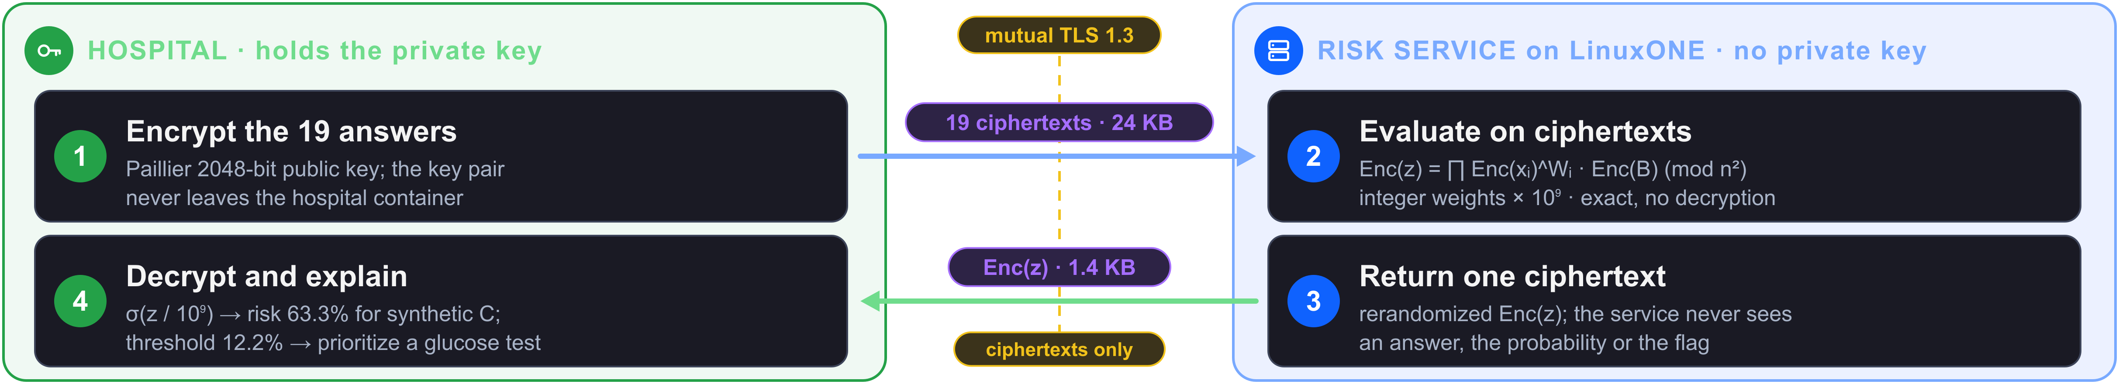







Calculate risk from encrypted inputs
02 · THE SOLUTION
Ciphertexts only
Same ranking
Screening support
The risk service receives no readable age, BMI, blood pressure or other feature
Local sample: encrypted AUC equals plaintext AUC
Prioritize confirmatory glucose testing; this is not a diagnosis
AI sees the risk. Nobody sees the patient.
Scope: the risk service receives ciphertexts only. The planned LinuxONE demo uses two containers on one VM with a trusted administrator and synthetic patients. VM execution is still pending.
Notes:
The hospital encrypts the 19 indicators and retains the private key. The service evaluates ciphertexts. Only the hospital decrypts and displays the risk and feature contributions. This is screening support, not diagnosis. The same-VM administrator remains trusted; demonstration patients are synthetic.

Slide 4
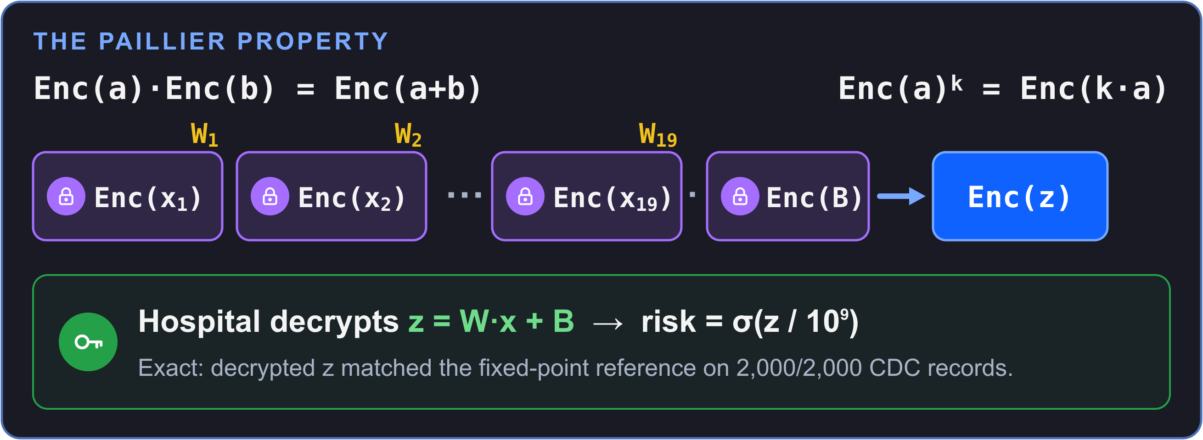



Calculate a score without decrypting inputs
03 · HOMOMORPHIC ENCRYPTION
In transit
Mutual TLS 1.3 between hospital and service
At rest
AES-256-GCM in the hospital vault
During use
2048-bit Paillier: calculation without decryption
Who can see what?
Component | Patient inputs | Risk result
Hospital (private-key holder) | Plaintext: its own patients | Plaintext
Risk service (no private key) | Ciphertexts only | Ciphertext only
Hospital vault records | AES-256-GCM ciphertext | AES-256-GCM ciphertext
Service logs | No: IDs, ms and byte counts only | No
Notes:
Paillier multiplies ciphertexts to add their plaintext values and raises ciphertexts to integer powers to multiply those values. This produces the model score without service-side decryption. Mutual TLS 1.3 protects transport; AES-256-GCM protects vault records. Capture LinuxONE/OpenSSL evidence before making any hardware-acceleration claim.

Slide 5
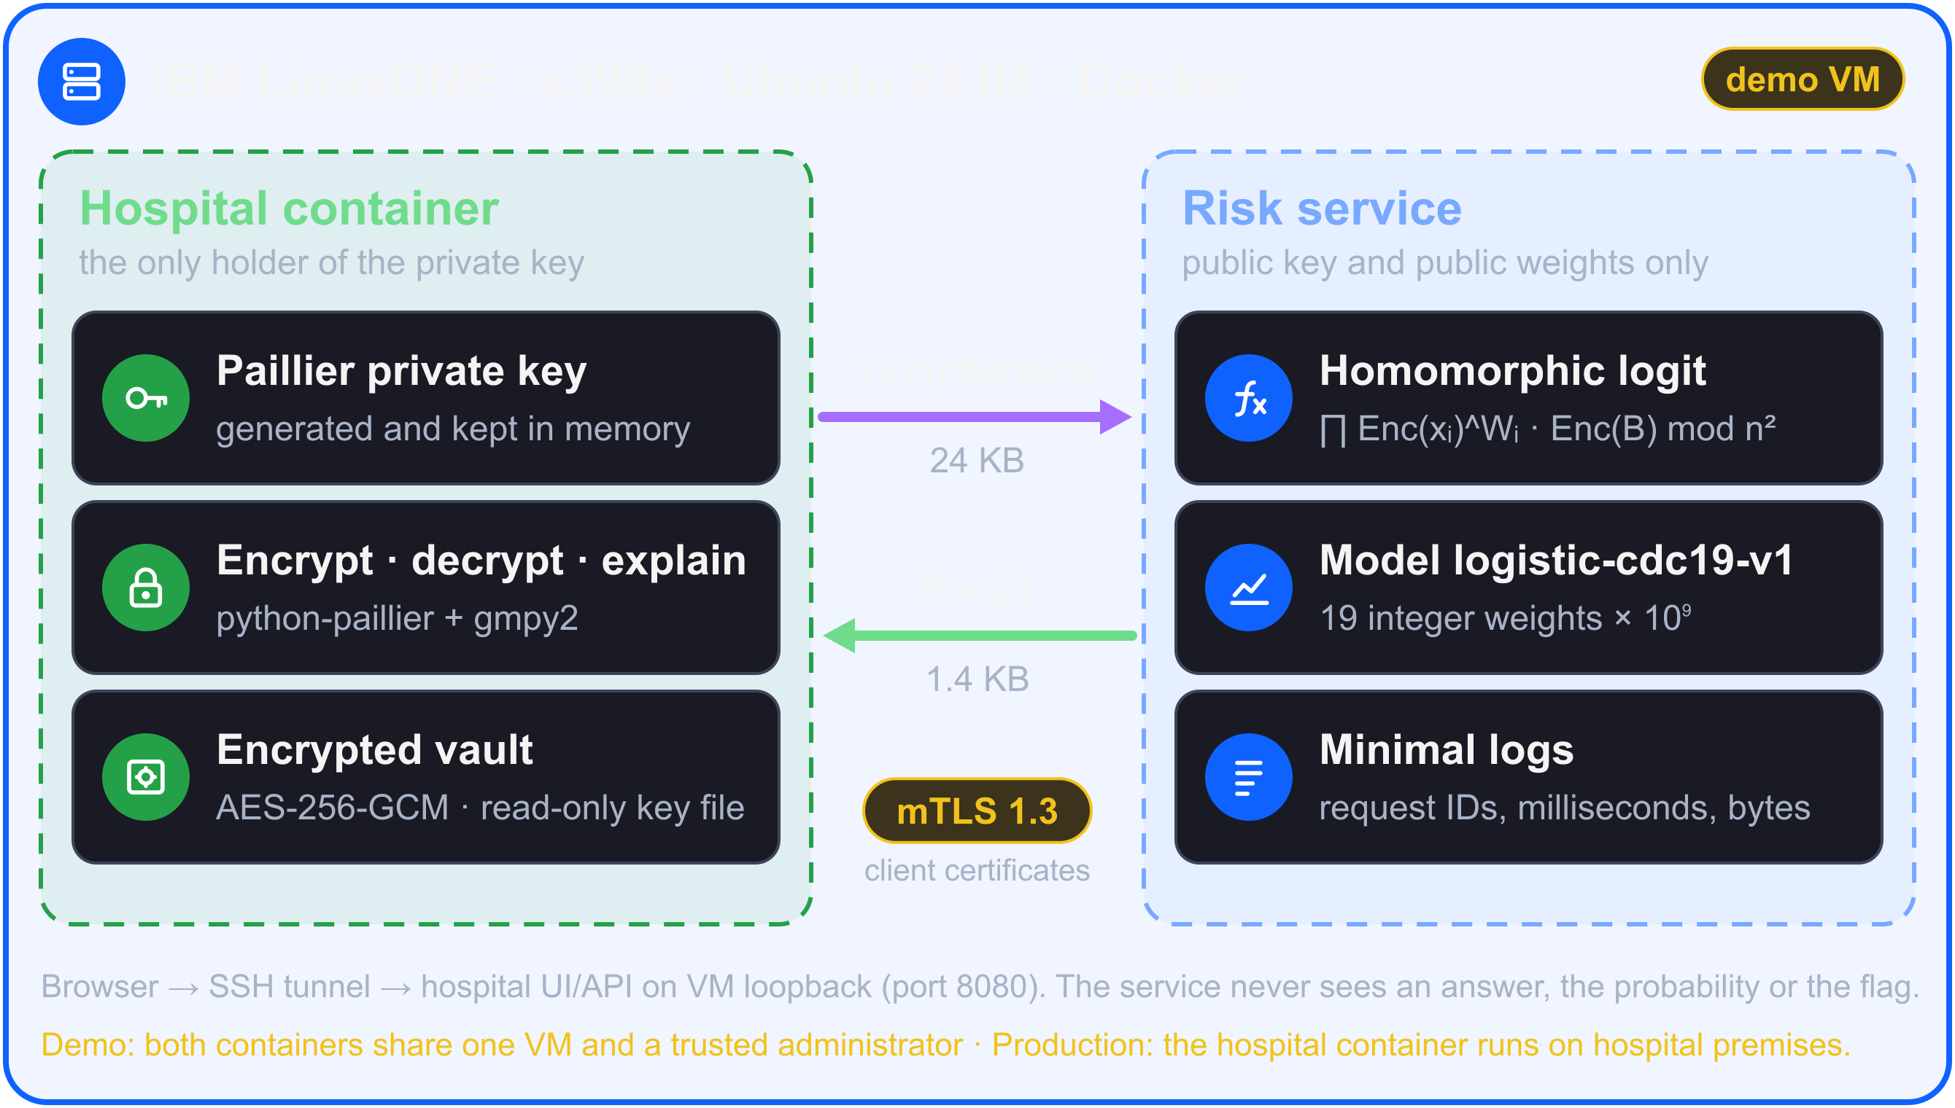




Two containers; the private key stays at the hospital
04 · WHY IBM Z
Large-integer workload
Modular exponentiation over integers thousands of bits long for every patient
Isolation and encryption
Separate containers and mutual TLS; effective CPACF use has not been measured
Measure the actual platform
Local results available; repeat the same benchmark on LinuxONE
Stack: Python · scikit-learn · python-paillier + gmpy2 · cryptography (TLS 1.3, AES-256-GCM) · Docker (Ubuntu 24.04, s390x)
Notes:
Show the VM terminal only after running the release on it: docs/LINUXONE.md. Capture uname -m, lscpu, provider dashboard, OpenSSL versions and both containers. The hospital owns the Paillier private key and AES vault; the service has no Paillier private key. The planned demo shares a trusted VM. CPACF support does not establish measured acceleration of Paillier.

Slide 6
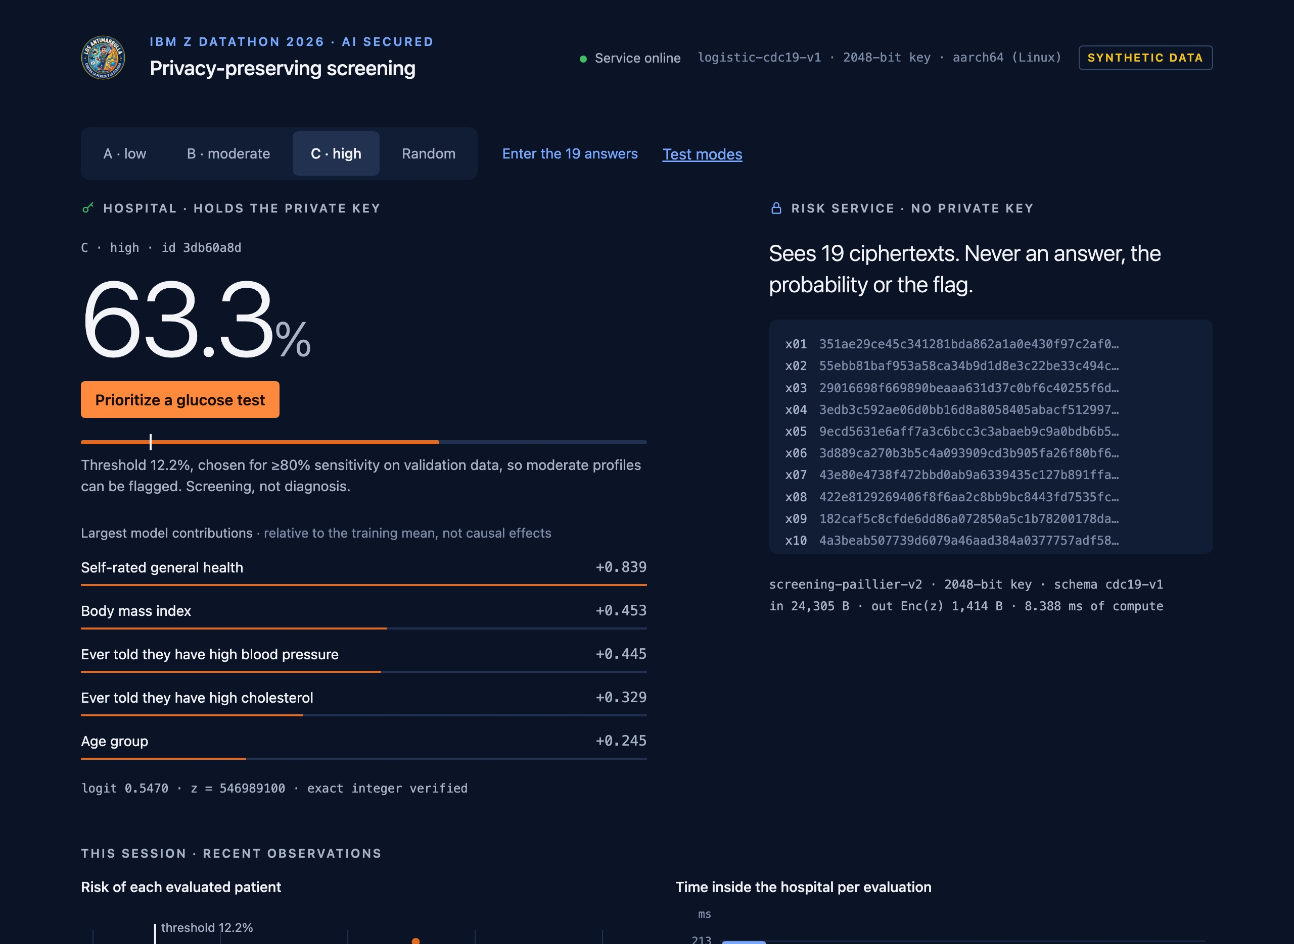



The service sees ciphertexts; the hospital sees risk
05 · ACTUAL LOCAL DEMO
2,000 of 2,000
decrypted integers exactly match the fixed-point reference
ROC-AUC 0.807
equal across float, fixed point and encryption on the same 2,000 records
115 ms (p50)
Hospital API: encrypt, mTLS, evaluate, decrypt and vault write (200 synthetic requests)
24.3 KB → 1.4 KB
19 input ciphertexts → one encrypted score
Actual English UI with a synthetic patient · local containers · LinuxONE run pending
LOCAL benchmark · model logistic-cdc19-v1 · commit be9b27e · macOS arm64 / Docker · 2048-bit key. API p95: 118 ms. LinuxONE run pending; repeat with make measure-api-docker.
Notes:
The 19-feature model logistic-cdc19-v1 was measured at clean commit be9b27e. All 2,000 stratified CDC decrypted integers matched the fixed-point reference, and all three ROC-AUC values were 0.806525. A separate 200-request synthetic benchmark against two local Docker containers matched every expected integer, with client p50 114.8 ms and p95 118.2 ms; requests carry 19 ciphertexts (24.3 KB). The UI screenshot is actual local execution of synthetic profile C (63.3%). These results do not establish LinuxONE execution. Evidence: submission/evidence/metrics/measurement_process_local-darwin-arm64_20261018T030142Z.json and measurement_api_local-darwin-arm64_20261018T030546Z.json.

Slide 7
Train on public data; evaluate encrypted patient inputs
06 · DATA, MODEL AND LIMITS
253,680
public CDC BRFSS 2015 health survey records (UCI ID 891)
19
indicators: BMI, blood pressure, cholesterol, activity, age… (Education and Income removed)
13.9%
self-reported prediabetes or diabetes: account for class imbalance
1
Train on public records
TEST RESULTS (38,052 RECORDS)
Logistic regression; standardization folded into model weights
Metrics
2
Quantize the weights
ROC-AUC 0.825 · AP 0.414 · sensitivity 0.807 · specificity 0.689 · PPV 0.296 · Brier 0.098. Threshold selected on validation.
Round weights × 10⁹; all 19 inputs are already integers
3
Encrypt patient inputs
Encrypt 19 indicators using the hospital’s key
Limitations
Label: self-reported U.S. diagnosis, not future diabetes. A separate reduced ten-feature ENSANUT model reaches AUC ≈0.77 and underestimates risk.
4
Encrypted score → risk
The service evaluates w · x on ciphertexts; the hospital decrypts and applies sigmoid
Source: UCI Machine Learning Repository, CDC Diabetes Health Indicators (ID 891).
Notes:
The public-data model reaches test AUC 0.825 and sensitivity 0.807 with 19 features (Education and Income removed) at a validation-selected threshold. This predicts the survey label, not future diabetes or mortality. A separate reduced model evaluated on ENSANUT reaches AUC around 0.77 and underestimates risk; it does not validate the MVP for Mexican clinical use.

Slide 8
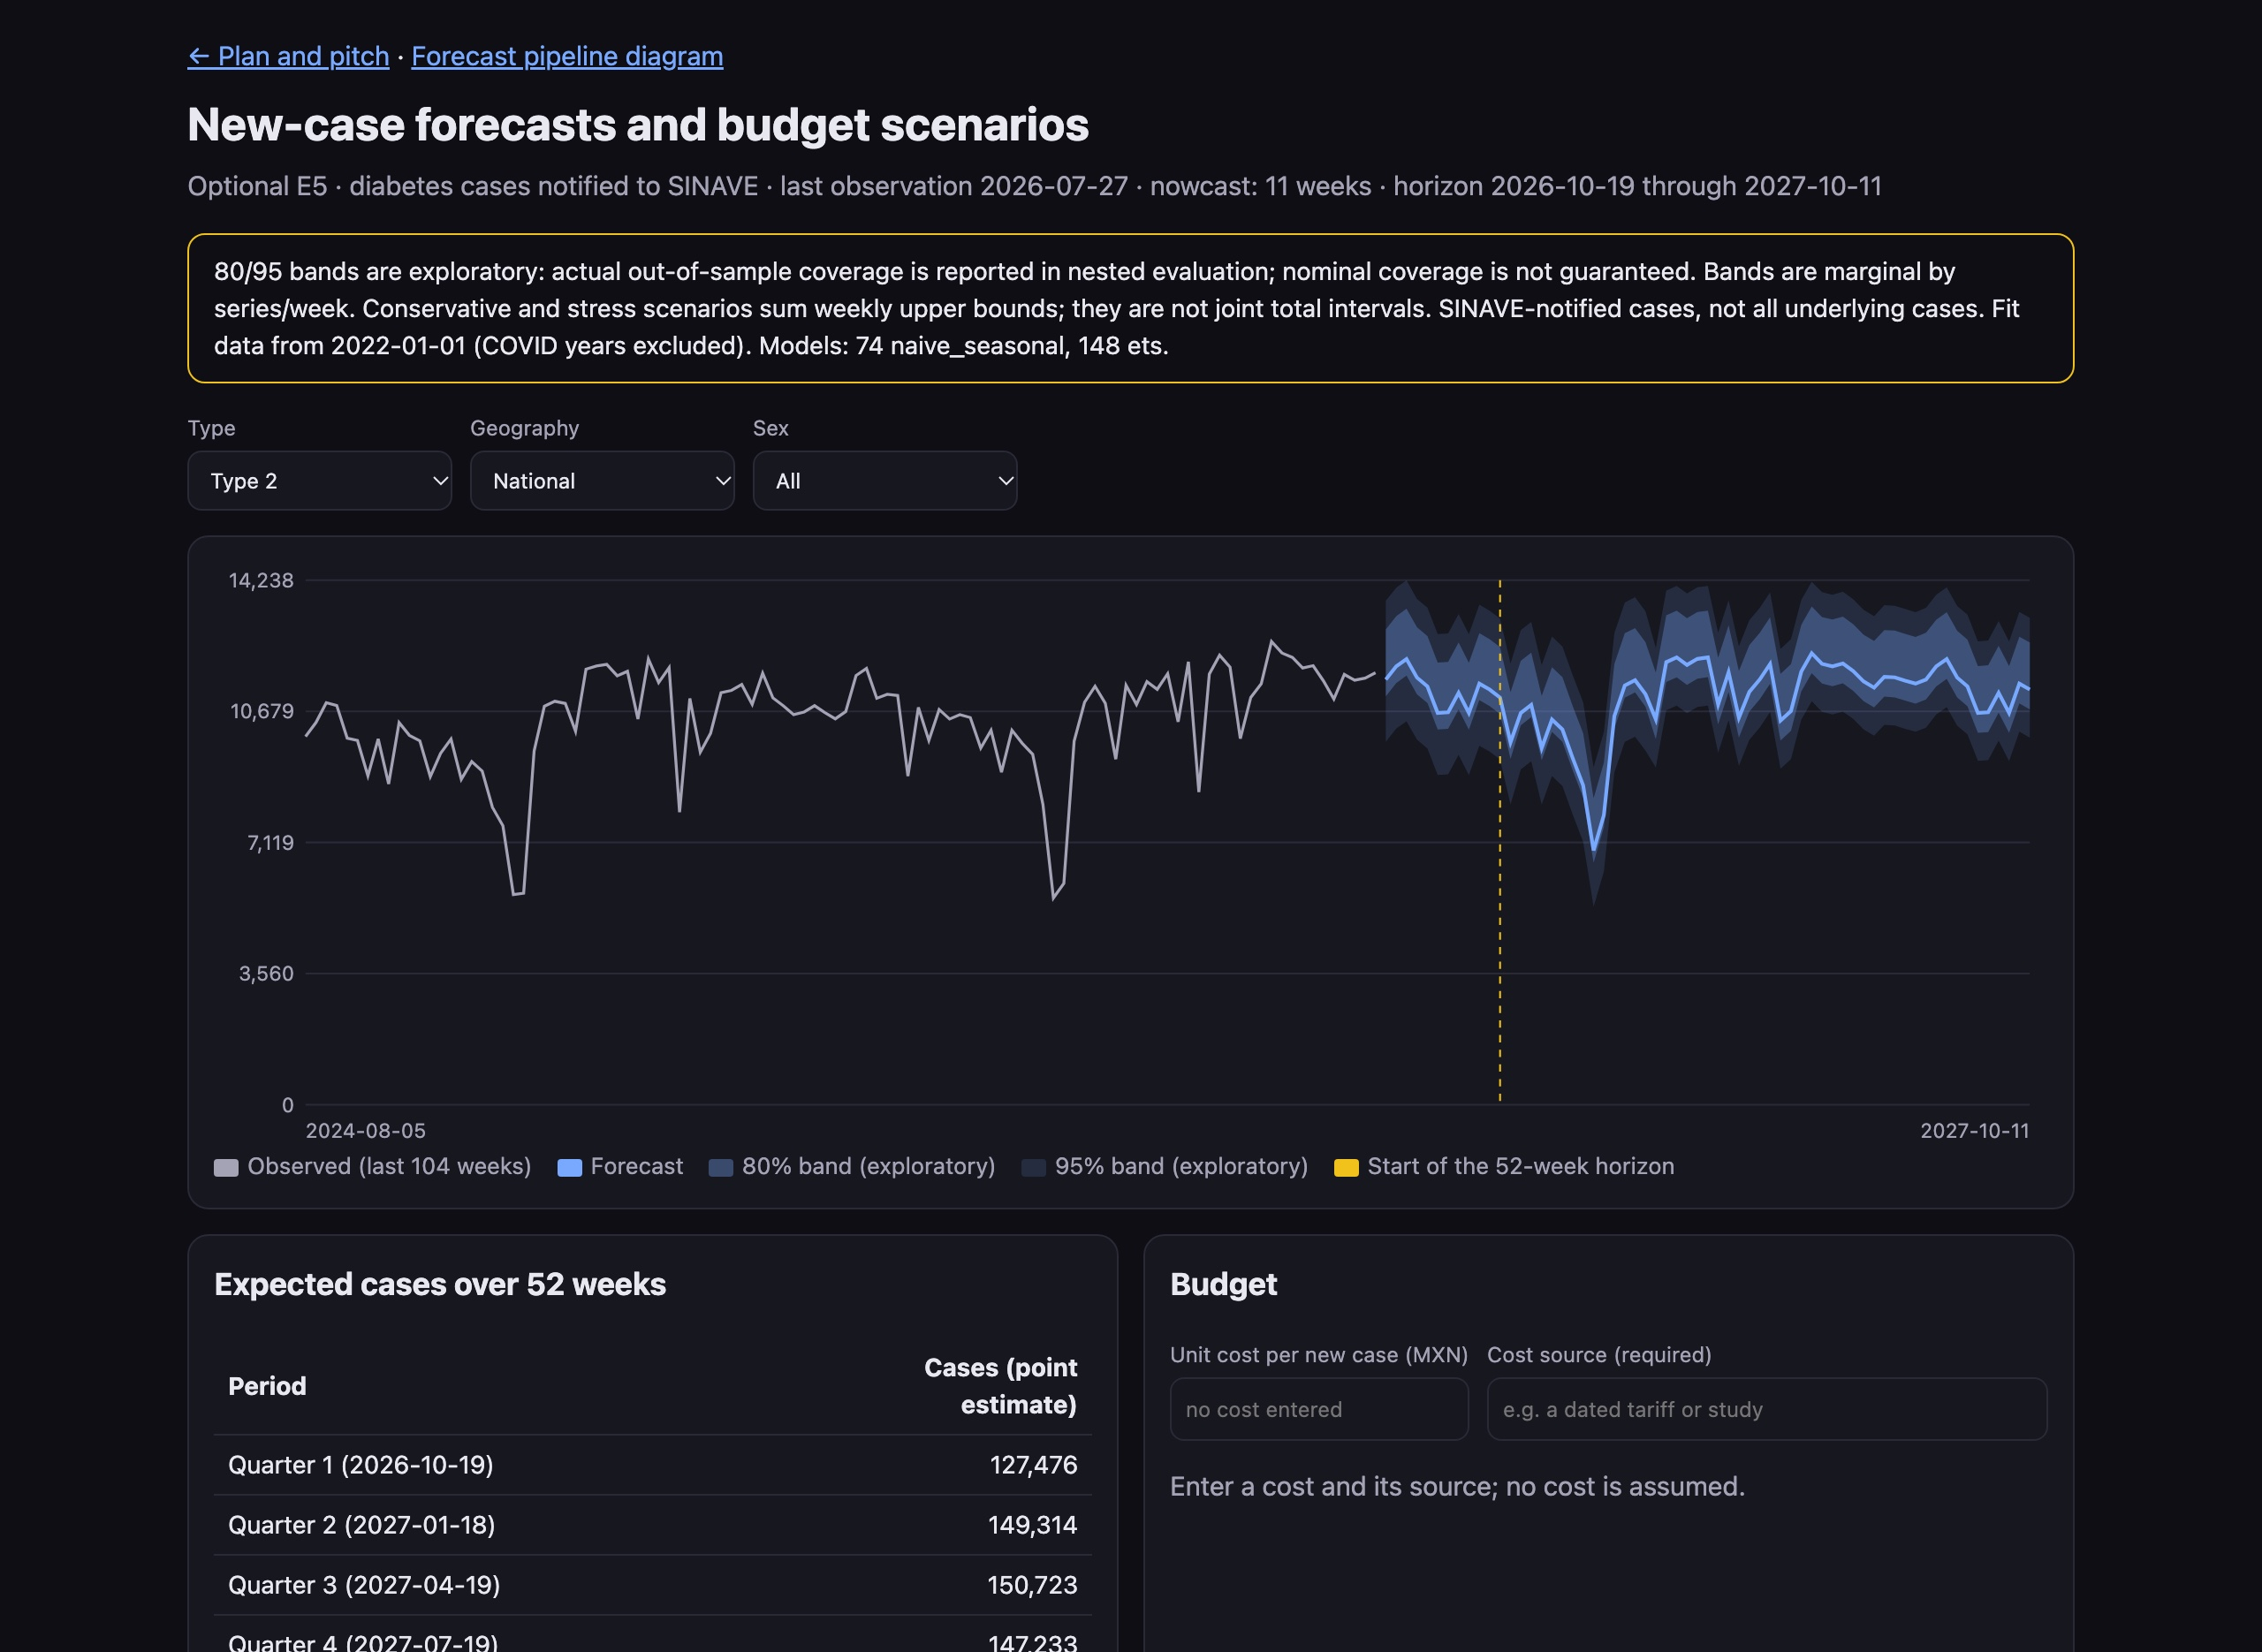
Plan demand: weekly diabetes forecasts by state
07 · TIME-SERIES FORECAST (E5)
222 weekly series
T1/T2 × national, 4 regions and 32 states × men/women/all, reconciled top-down
SMAPE 13% national
nested out-of-sample test, weeks 12–63; regions 25%, states 60% (sparse type 1)
52 weeks ahead
Oct 19, 2026 – Oct 11, 2027 after an 11-week nowcast; ETS or seasonal naive per series
Budget = cases × cost
shown only with a sourced unit cost; no cost is assumed
Live dashboard · Type 2 · national · all sexes · antimarrulla-tamizaje.netlify.app/forecast
EXPLORATORY · SINAVE-notified cases, not all cases · nominal 80% bands cover ≈64% in practice · public aggregates, no patient data · not yet run on LinuxONE.
Notes:
Optional E5, unencrypted public aggregates. Weekly SINAVE-notified type 1 and type 2 diabetes cases for 222 series: national, four regions and 32 states, by men, women and all. Each series uses damped ETS or seasonal naive, chosen on rolling origins, then reconciled top-down. A separate nested evaluation over weeks 12 to 63 gives SMAPE about 13% nationally, 25% by region and 60% by state, where sparse type 1 series dominate. Nominal 80% bands cover about 64% in practice, so they stay exploratory. Budgets appear only when a user enters a sourced unit cost. Forecasting has not been run on LinuxONE. Dashboard: antimarrulla-tamizaje.netlify.app/forecast.

Slide 9
From a verified demo to a hospital pilot
08 · ROADMAP
0
plaintext patient inputs reach the external risk service
4
test profiles ready for LinuxONE: 20 to 16,000 patients
222
weekly forecast series ready for capacity and budget planning
1
Oct 2026 · Datathon MVP
WHAT IT TAKES
Encrypted screening MVP; LinuxONE runs recorded with logs and CI checks
Partners
2
Q1 2027 · Calibrate for Mexico
A public hospital or clinic network for the pilot, LinuxONE capacity and a sourced unit cost for budgets.
Recalibrate on Mexican data (ENSANUT) and benchmark s390x at scale
3
Q2 2027 · Hospital pilot
Hospital container on site, risk service on LinuxONE; de-identified records
Gates before clinical use
Clinical validation in Mexico, legal and privacy review, an independent security audit and a stronger host trust model.
4
Q4 2027 · Scale
Non-linear models with CKKS, Granite explanations at the hospital, forecasts on LinuxONE
A plan, not a commitment: dates assume partner access and funding.
Notes:
Roadmap, stated as a plan. October 2026: the encrypted screening MVP, with LinuxONE evidence runs recorded by make evidence-run (profiles 20, 200, 2,000 and 16,000) and validated in CI. Q1 2027: recalibrate on Mexican data, because the reduced ENSANUT experiment underestimated risk, and benchmark s390x at scale. Q2 2027: a hospital pilot with the hospital container on site and the risk service on LinuxONE. Q4 2027: CKKS for non-linear models, Granite explanations on the hospital side and forecasts on LinuxONE. Clinical validation, legal and privacy review and a security audit are gates before any clinical use.

Slide 10



Screening support without sharing readable records
09 · IMPACT · AI FOR GOOD
Earlier screening
Patient trust
Privacy safeguards
Further applications
Support earlier confirmatory testing for people who may be unaware of diabetes
The external risk service receives encrypted inputs
A privacy-preserving design; clinical and legal review remain necessary
Explore other linear screening models after separate validation
AI sees the risk. Nobody sees the patient.
Los Antimarrulla · UACJ · MIAAD
We challenge idleness and procrastination
github.com/UACJ-MIAAD/antimarrulla-ibmz-datathon-2026
Thank you
Screening support does not replace medical diagnosis.
Notes:
We aim to support earlier screening without sharing readable patient records with the risk service. The hospital retains decryption and clinical interpretation. AI sees the risk; the service receives ciphertexts only. Thank you.

