Slide 1
CSc 120 Introduction to Computer Programming II Saumya Debray
02: Problem Decomposition and Program Development
Notes:
On Oct 24, 2017, at 9:12 AM, Saumya Debray <debray@cs.arizona.edu> wrote:
Ravi,
Sorry for the delay in responding: I had meant to reply towards the end of last week, but somehow managed to get distracted.
I really enjoyed the way you used iterative refinement in your example -- and also the use of the sunny-day scenario to get the common case done first.
My intuition is that students will need to work on graded homework (and/or discussion section) problems in order to get the hang of these ideas. There are a number of basic skills -- problem decomposition among them, and also debugging, and maybe testing -- where facility only comes with usage and feedback (especially for students who are not at the top of the class). Do you think it would be useful for some subset of us to work on devising specific exercises for these skills for the various intro-sequence courses?
--s
On Tue, Oct 17, 2017 at 5:00 PM, Sethi, Ravi - (rsethi) <rsethi@email.arizona.edu> wrote: Saumya,
Testing can be integrated by testing at the end of each iteration or refinement of the solution. I'm attaching some notes I put together back when we were creating exercises for introductory courses. The notes include 5 increasingly functional versions of a 41 line to play a guessing game that was popular in the early days of Unix.
Comments?
Ravi
P.S. I'm taking the liberty of adding Michelle back into this thread.
From: saumya.debray@gmail.com <saumya.debray@gmail.com> on behalf of Saumya Debray <debray@cs.arizona.edu> Sent: Tuesday, October 17, 2017 3:34 PM To: Sethi, Ravi - (rsethi) Subject: Re: slides on top-down program development
I think I spent 3 lectures on it. A big reason I wasn't happy with this is that I didn't have time to think of and implement appropriate follow-up activities and assignments that would have students work on problem decomposition and incremental development and get feedback on their efforts. Because of that I don't think they internalized much of that material.
--s
On Tue, Oct 17, 2017 at 3:19 PM, Sethi, Ravi - (rsethi) <rsethi@email.arizona.edu> wrote: Saumya,
These slides are very helpful. How much lecture time did you devote to them?
Ravi
From: saumya.debray@gmail.com <saumya.debray@gmail.com> on behalf of Saumya Debray <debray@cs.arizona.edu> Sent: Tuesday, October 17, 2017 3:12 PM To: Strout, Michelle - (mstrout); Sethi, Ravi - (rsethi); Anson, Eric Lance - (eanson); Daniel Dicken Subject: slides on top-down program development
I've attached the slides I made up for CS 120. When I looked them over just now I realized that these slides don't talk about integrating testing with development -- that ought to be changed.
--s
-- Saumya Debray saumya.debray@gmail.com / debray@cs.arizona.edu http://www.cs.arizona.edu/~debray

Slide 2

A common student lament
"I have this big programming assignment.
I don't know where to start."

Slide 3
Steps in writing a program
1. Understand what tasks the program needs to perform
2a. Figure out how to do those tasks
2b. Write the code
3. Make sure the program works correctly

Slide 4
An example
Problem statement:
"Write a program to compute student GPAs from their grades."

Slide 5
Steps in writing a program
1. Understand what tasks the program needs to perform
2a. Figure out how to do those tasks
2b. Write the code
3. Make sure the program works correctly

Slide 6
Step 1. Problem specification
Before you start writing code, make sure you understand exactly what your code needs to do.
what is the input?
what is the output?
what is the computation to be performed?
how can we tell that the program is working correctly?
If necessary, ask questions to clarify these points.
Time spent doing this is an investment, not a waste.

Slide 7
Example: cont'd
Problem statement:
"Write a program to compute student GPAs from their grades."

Slide 8
Example: cont'd
Problem statement:
"Write a program to compute student GPAs from their grades."
Input:
read from a file, or from the keyboard?
what is the format?
how many students?
…

Slide 9
Example: cont'd
Problem statement:
"Write a program to compute student GPAs from their grades."
Output:
to a file, or to the screen?
what is the format?
compute GPA for all students, or only specific students?
…

Slide 10
Example: cont'd
Problem statement:
"Write a program to compute student GPAs from their grades."
Computation:
how is a GPA computed?
what information do we need?

Slide 11
Example: cont'd
Problem statement:
"Write a program to compute student GPAs from their grades."
Testing:
how can we tell whether the program is working correctly?
how should we test it?
how can we tell whether all the pieces of the program are working properly?

Slide 12
Example: cont'd
Problem statement:
"Write a program to compute student GPAs from their grades."
Input:
read from a file, or from the keyboard?
from a file
what is the format?
one student per line
format of each line: student name, course₁ : grade₁, …, course_{n} : grade_{n}
different students may take different numbers of courses
how many students?
not fixed ahead of time

Slide 13
Example: cont'd
Problem statement:
"Write a program to compute student GPAs from their grades."
Output:
to a file, or to the screen?
to the screen
what is the format?
one student per line
student name : GPA
compute GPA for all students, or only specific students?
all students in the input file

Slide 14
Example: cont'd (digression: computing GPAs)
Suppose a student has the following grades:
The student's GPA = (Total UxG) / (Total U) = 26/8 = 3.25
Course | No. of units (U) | Grade (G) | U x G*
CSc 110 | 4 | A | 4 x 4 = 16
CSc 352 | 3 | C | 3 x 2 = 6
CSc 391 | 1 | A | 1 x 4 = 4
TOTAL: | 4 + 3 + 1 = 8 |  | 16 + 6 + 4 = 26
* | A = 4
 | B = 3
 | C = 2
 | D = 1
 | E = 0

Slide 15
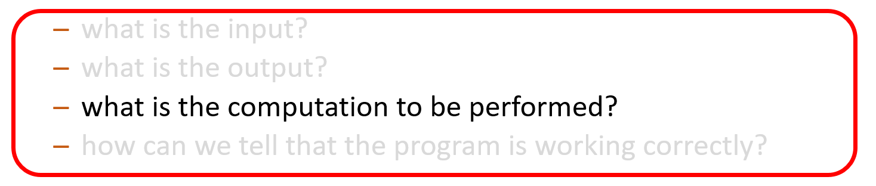
Example: cont'd
Problem statement:
"Write a program to compute student GPAs from their grades."
There may be more than one way to do these
Need to:
figure out the no. of units for each course
translate letter grades to numbers (e.g., A = 4, B = 3, …)

Slide 16
Steps in writing a program
1. Understand what tasks the program needs to perform
2a. Figure out how to do those tasks
2b. Write the code
3. Make sure the program works correctly

Slide 17
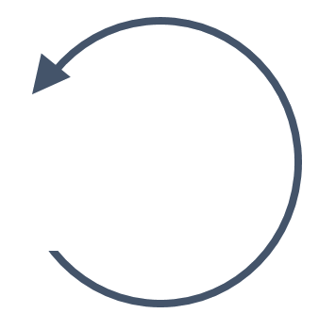
Step 2a. Problem decomposition (conceptual)
Write down the task(s) the program needs to perform
pick a task A
break A down into a set of simpler tasks A₁, …, A_{n}
A₁, …, A_{n} together accomplish A
repeat as needed
before you start writing code to solve a problem, make sure you know how to solve the problem yourself.

Slide 18
Steps in writing a program
1. Understand what tasks the program needs to perform
2a. Figure out how to do those tasks
2b. Write the code
3. Make sure the program works correctly

Slide 19
Step 2b. Problem decomposition (programming)
Write a piece of code for each task that has to be performed
initially the code will contain stubs, i.e., parts that have not yet been fleshed out
write down the task to be performed as a comment
Decomposing a task into sub-tasks ⇒ fleshing out the code for a stub
repeat until no more stubs to flesh out

Slide 20
Example: GPA computation (conceptual)
top-level task
read a file containing student grades, compute GPAs, and write them out

Slide 21
Example: GPA computation (conceptual)
top-level task
read a file containing student grades, compute GPAs, and write them out
next level of
decomposition
read the student grades file
compute each student's GPA
write out each student's GPA

Slide 22
Example: GPA computation (conceptual)
read a file containing student grades, compute GPAs, and write them out
read the student grades file
compute each student's GPA
write out each student's GPA
for each course C taken by the student, with grade G:
look up no. of units U for C
convert grade G to a number
compute total UxG and total U
GPA = | total UxG
 | total U

Slide 23
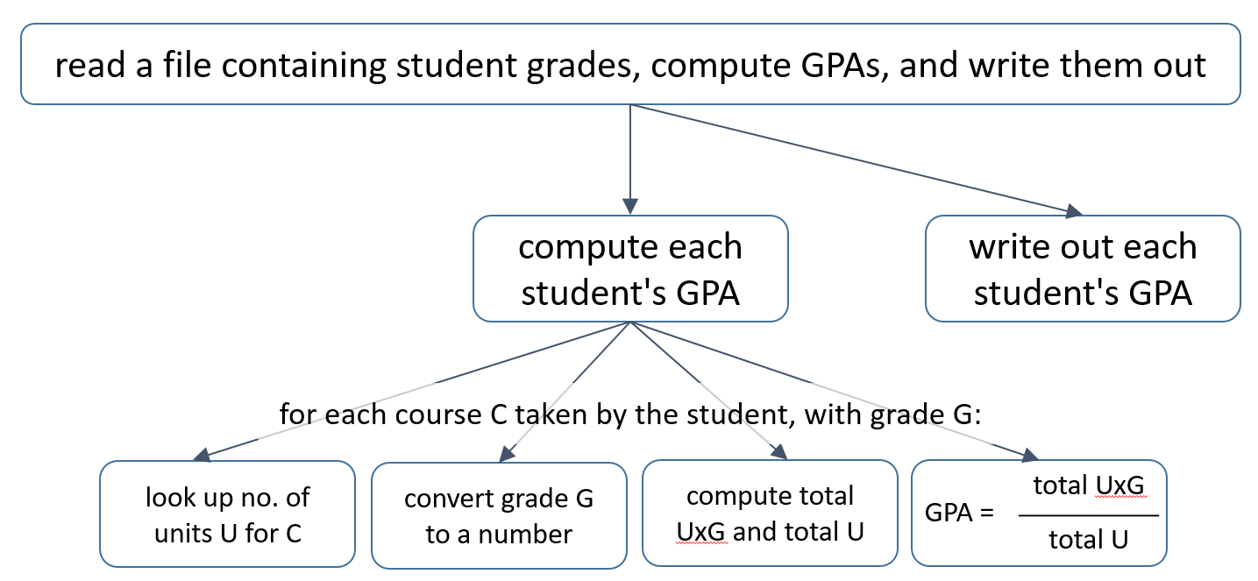
Example: GPA computation (conceptual)
read the student grades file
read a file of courses + no. of units

Slide 24
Example: GPA computation (conceptual)
read the student grades file
read a file of courses + no. of units
split it into a list, one element per student
split each student's list into a list of (course, grade)

Slide 25
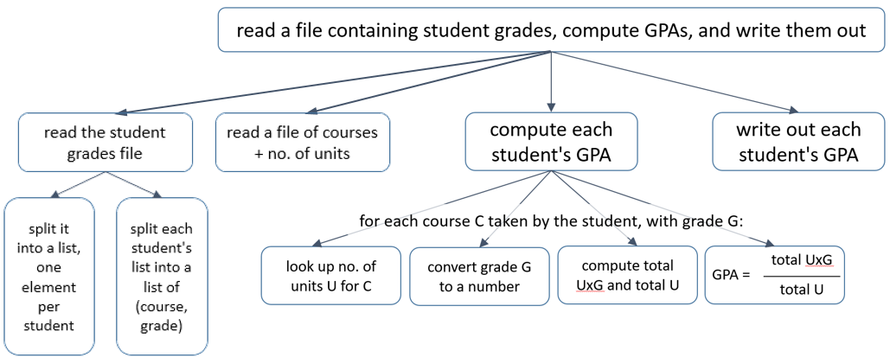
Example: GPA computation (conceptual)
As you decompose the problem, ask whether it is a “good”
(simple, efficient) decomposition

Slide 26
Example: GPA computation (conceptual)
As you decompose the problem, ask whether it is a “good”
(simple, efficient) decomposition
This structure suggests that everyone’s GPA is computed first, then all GPAs are written out
This is more complex and less efficient

Slide 27
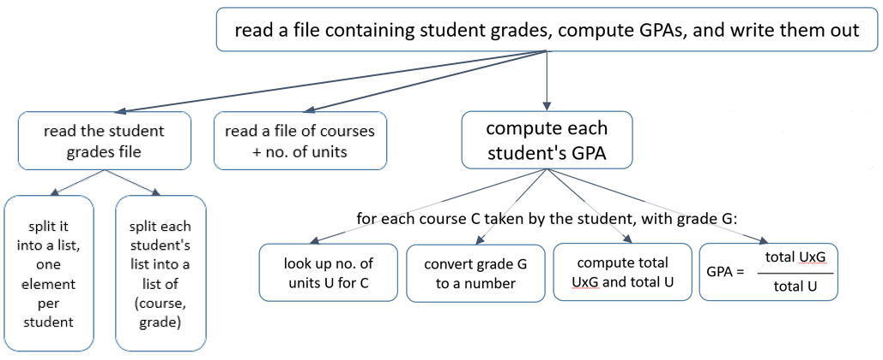
Example: GPA computation (conceptual)
As you decompose the problem, ask whether it is a “good”
(simple, efficient) decomposition
A better approach is to write out each student’s GPA as it is computed
This is simpler and more efficient
write out each student's GPA

Slide 28
Example: GPA computation (conceptual)
As you decompose the problem, ask whether it is a “good”
(simple, efficient) decomposition
write out each student's GPA

Slide 29
Example: GPA computation (programming)
Conceptual decomposition
Incremental Program Development
# main(): read student grades file, compute GPAs,
# write them out
def main():
pass
main()
read a file containing student grades, compute GPAs, and write them out
pass : a placeholder statement
does nothing
useful for parts of the code that have not yet been fleshed out

Slide 30
Example: GPA computation (programming)
Conceptual decomposition
Incremental Program Development
# main(): read student grades file, compute GPAs,
# write them out
def main():
grades = read_grades()
compute_gpas(grades)
# read_grades() : read a grade file into a list of each student’s grades
def read_grades():
pass
# compute_gpas(grades) : compute and write out the GPA for each student
def compute_gpas(grades):
pass
main()
read a file containing student grades, compute GPAs, and write them out
read the student grades file
compute and write out each student's GPA

Slide 31
Example: GPA computation (programming)
Conceptual decomposition
Incremental Program Development
# compute_gpas(grades) : compute and write out the GPA for each student
def compute_gpas(grades):
for student_grades in grades:
compute_student_gpa(student_grades)
# compute_student_gpa(student_data): compute
# and write out an individual student’s GPA
def compute_student_gpa(student_grades):
pass
compute and write out each student's GPA
compute GPA
write out GPA
for each course C taken by the student, with grade G:
look up no. of units U for C
convert grade G to a number
compute total UxG and total U
GPA = | total UxG
 | total U

Slide 32
Example: GPA computation (programming)
Conceptual decomposition
Incremental Program Development
# compute_student_gpa(student_data): compute
# and write out an individual student’s GPA
def compute_student_gpa(student_grades):
for [course,grade] in student_grades:
# compute the gpa
pass
write_gpa()
compute and write out each student's GPA
compute GPA
write out GPA
for each course C taken by the student, with grade G:
look up no. of units U for C
convert grade G to a number
compute total UxG and total U
GPA = | total UxG
 | total U

Slide 33
Example: GPA computation (programming)
Conceptual decomposition
Incremental Program Development
# compute_student_gpa(student_data): compute
# and write out an individual student’s GPA
def compute_student_gpa(student_grades):
for [course,grade] in student_data:
units = lookup_units(course)
gval = grade_value(grade)
weighted_gval += units * gval # TBD: init
total_units += units # TBD: init
gpa = weighted_gval / total_units
student_name = lookup_name(student_grades)
write_gpa(student_name, gpa)
def lookup_units(course):
pass
...
compute and write out each student's GPA
compute GPA
write out GPA
for each course C taken by the student, with grade G:
look up no. of units U for C
convert grade G to a number
compute total UxG and total U
GPA = | total UxG
 | total U

Slide 34
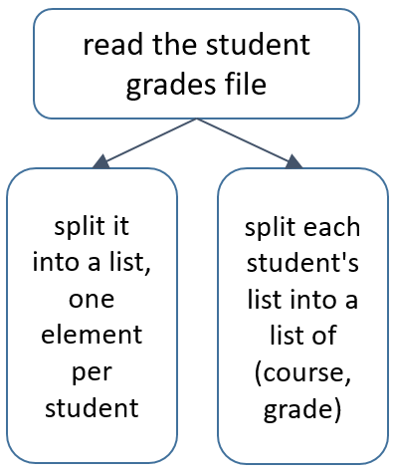
EXERCISE
Conceptual decomposition
Incremental Program Development
?

Slide 35
Steps 2a+2b. Problem decomposition (summary)
Begin:
identify the task(s) the program needs to do
define a stub function for each task
while not done:
pick a task A and break it down into simpler tasks A₁, …, A_{n}
flesh out the stub for A to execute the code for A₁, …, A_{n} (these may themselves be stubs)
conceptual step
programming step

Slide 36
Steps in writing a program
1. Understand what tasks the program needs to perform
2a. Figure out how to do those tasks
2b. Write the code
3. Make sure the program works correctly

Slide 37
Step 3. Ensuring correctness
Goals:
the program produces the expected outputs for all (selected) inputs
very often, this is the only thing that programmers check
In general this is not enough
a program can produce the expected output "accidentally"

Slide 38
Passing test cases "accidentally"
Problem spec:
"Write a function grid_is_square(arglist) that returns True if arglist is a square grid, i.e., its no. of rows equals its no. of columns."
Submitted "solution":
def grid_is_square(arglist):
return True
Passes half the test cases …
… but is wrong!

Slide 39
Step 3. Ensuring correctness
Goals:
the program produces the expected outputs for all (selected) inputs
each piece of the program behaves the way it's supposed to
each piece is used the way it's supposed to be used
any assumptions made by the code are satisfied
Approach:
add assertions in the code to pinpoint problems
test the code to ensure that there are no problems

Slide 40
Invariants and assertions
Invariant: an expression at a program point that always evaluates to True when execution reaches that point
Assertion: a statement that some expression E is an invariant at some point in a program
Python syntax:
assert E
assert E , ″error message″

Slide 41
Example
# compute_student_gpa(student_grades): compute
# and write out an individual student’s GPA
def compute_student_gpa(student_grades):
weighted_gval = 0
total_units = 0
for [course,grade] in student_grades:
units = lookup_units(course)
gval = grade_value(grade)
assert units > 0 and gval >= 0, “data error”
weighted_gval += units * gval
total_units += units
gpa = weighted_gval / total_units
student_name = lookup_name(student_grades)
write_gpa(student_name, gpa)

Slide 42
Example
# compute_student_gpa(student_grades): compute
# and write out an individual student’s GPA
def compute_student_gpa(student_grades):
weighted_gval = 0
total_units = 0
for [course,grade] in student_grades:
units = lookup_units(course)
gval = grade_value(grade)
assert units > 0 and gval >= 0, “data error”
weighted_gval += units * gval
total_units += units
gpa = weighted_gval / total_units
student_name = lookup_name(student_grades)
write_gpa(student_name, gpa)
lookup_units() returns the number of units
for a course
e.g., lookup_units('CSc 120') → 4
grade_value() returns the numerical value
of a grade
e.g., grade_value(“C") → 2

Slide 43
Example
# compute_student_gpa(student_grades): compute
# and write out an individual student’s GPA
def compute_student_gpa(student_grades):
weighted_gval = 0
total_units = 0
for [course,grade] in student_grades:
units = lookup_units(course)
gval = grade_value(grade)
assert units > 0 and gval >= 0, “data error”
weighted_gval += units * gval
total_units += units
gpa = weighted_gval / total_units
student_name = lookup_name(student_grades)
write_gpa(student_name, gpa)
this assert states that all courses must have
nonzero units and that a grade value cannot
be negative
guards against data entry errors

Slide 44
Example
# compute_student_gpa(student_grades): compute
# and write out an individual student’s GPA
def compute_student_gpa(student_grades):
weighted_gval = 0
total_units = 0
for [course,grade] in student_grades:
units = lookup_units(course)
gval = grade_value(grade)
assert units > 0 and gval >= 0, “data error”
weighted_gval += units * gval
total_units += units
gpa = weighted_gval / total_units
student_name = lookup_name(student_grades)
write_gpa(student_name, gpa)
this assert states that all courses must have
nonzero units and that a grade value cannot
be negative
guards against data entry errors
It’s better to catch errors early
It’s better to catch bad values close to where they are computed
So it would be to better to push these asserts into the functions that compute these values

Slide 45
Example
# lookup_units(course, course_units) : looks up the
# no. of units for a course
def lookup_units(course, course_units):
for crs, units in course_units:
if course == crs:
assert units > 0, “lookup_units: grade error”
return units
assert False, “lookup_units: course not found”
# grade_value(grade) : returns the numerical value
# for a letter grade
def grade_value(grade):
if grade == ‘A’ :
return 4
elif grade == ‘B’:
return 3
elif grade == ‘C’:
return 2
elif grade == ‘D’:
return 1
elif grade == ‘E’:
return 0
else:
assert False, “grade_value: unknown grade”

Slide 46
Using asserts
checking arguments to functions
e.g., if an argument's value has to be positive
checking data structure invariants
e.g., i >= 0 and i < len(name)
checking "can't happen" situations
this also serves as documentation that the situation can't happen
after calling a function, to make sure its return value is reasonable

Slide 47
Steps in writing a program: summary
Understand what the program needs to do before you start coding
Develop the program logic incrementally
top-down problem decomposition
incremental program development
use stubs for as-yet-undeveloped parts of the program
Program defensively
figure out invariants that must hold in the program
use asserts to express invariants in the code

