Slide 1
Adaptive Stabilization Techniques
for Ill-Conditioned Linear Regression
Final Project Progress Report • AIMA 203 – Numerical Methods
Utsab Baral • Aman Sapkota • Kushagra Poudel
Kathmandu University, Nepal | May 2026

Slide 2
1
Research Question & Motivation
"Does minimizing training loss guarantee recovering the true model parameters under ill-conditioning?"
• Real-world datasets contain redundant / collinear features
• This creates an ill-conditioned data matrix X
• Condition number κ = λ_max / λ_min of the Hessian H = XᵀX
• High κ → steep ravines in some directions, infinitely flat valleys in others
• Same learning rate must serve both — an inherent conflict
• Central Thesis: Modern optimizers can achieve near-perfect loss (~10⁻⁶)
while parameters diverge catastrophically — the "Optimization Mirage"
The Condition Number κ
κ = 10 → Nearly circular loss bowl (easy)
κ = 10⁴ → Elongated valley (tricky)
κ = 10⁷ → Ultra-flat ravine (catastrophic)
At κ = 10⁷, moving thousands of units
along the flat direction changes the loss
by less than floating-point precision.

Slide 3
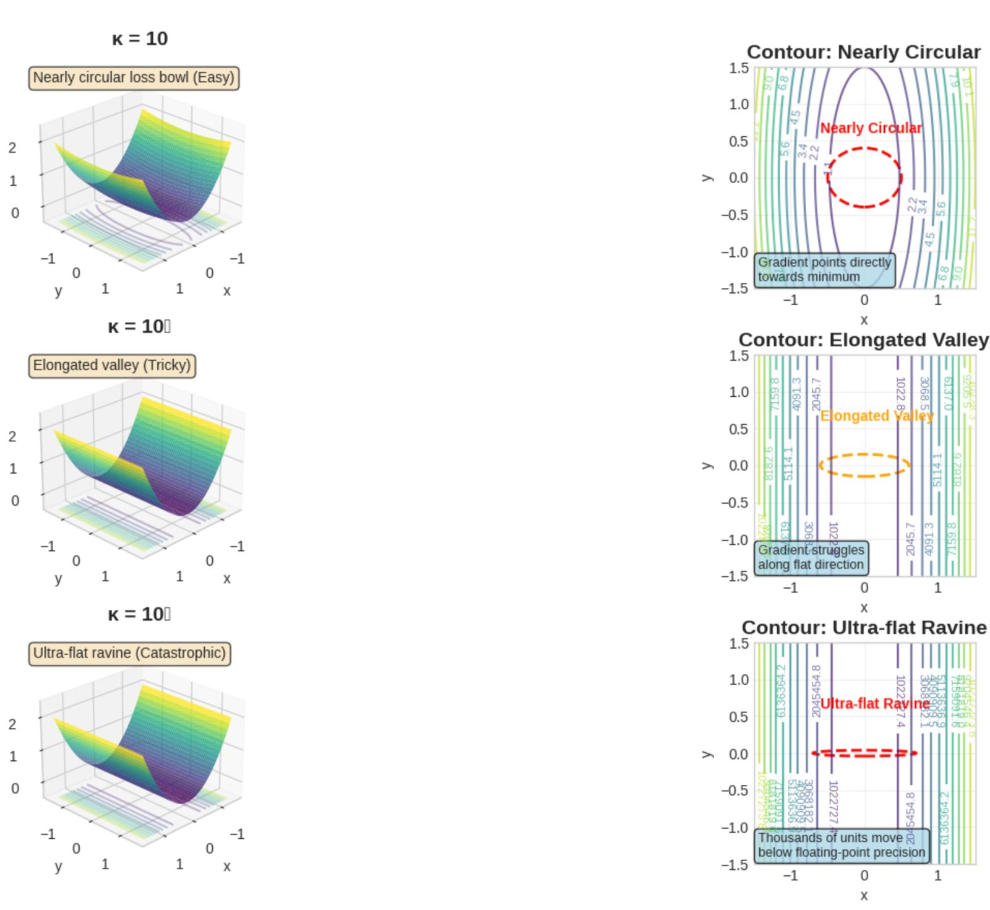

Slide 4
2
Code Architecture & Pipeline
File | Lines | Purpose
config.py | 82 | All hyperparameters, dataset specs, LR formulas
data_generator.py | 78 | SVD-based synthetic data with exact κ control
models.py | 28 | LinearModel and LinearWithBatchNorm
optimizers.py | 157 | 6 training loops with metric tracking
train.py | 126 | Main orchestrator: data → train → save
plot_results.py | 148 | 4 core publication-quality plots
plot_advanced.py | 245 | Multi-level drill-down plots
Pipeline Flow:
config.py → data_generator.py → train.py
train.py → results/results.pkl (77.6 MB)
results.pkl → plot_results.py → plots/
Total: 90 training runs
(3 datasets × 6 methods × 5 seeds)
Key Design: Linear Regression chosen to isolate
optimizer dynamics from neural-net complexity
(no local minima, constant Hessian, quadratic loss).

Slide 5
3
Experimental Design — Datasets
Dataset | κ | Epochs | Description
Well-Conditioned | 10 | 1,005 | Isotropic loss bowl – all methods should converge
Moderate | 10⁴ | 6,000 | Elongated valley – methods begin to diverge
Severe | 10⁷ | 50,000 | Ultra-flat valley – tests numerical limits
Data Generation (SVD-Constructed):
• X = U Σ Vᵀ with exact κ control
• n = 1,000 train, 200 test samples
• d = 50 features
• σ log-spaced from σ_max=1.0 to σ_min = σ_max/√κ
• Noise: ε ~ N(0, 10⁻³)
• Precision: float64 (avoids float32 breakdown)
Metrics Tracked Per Epoch:
• Train Loss — ½‖Xθ − y‖²/n
• Test Loss — same on held-out data
• Parameter Error — ‖θ − θ*‖₂
• Gradient Norm — ‖∇L‖₂
• Eigen-Direction Errors (top & bottom eigenvectors)
• Wall clock time, CPU %, RAM MB
• Divergence detection (NaN/Inf)

Slide 6
4
Experimental Design — 6 Optimization Methods
Method | Key Mechanism | Learning Rate | Special Parameters
Vanilla SGD | Raw gradient descent | 1800 | None
Momentum SGD | Velocity accumulation | 1900 | β* = ((√κ−1)/(√κ+1))²
Adam | Per-coord adaptive scaling | 0.1 | β₁=0.9, β₂=0.999, ε=10⁻⁸
Ridge L2 | SGD + L2 penalty | 1800 | λ from κ (reduce eff. conditioning)
BN-on-Linear | BatchNorm before linear | 0.1 (Adam) | affine=False
AdamW | Adam + decoupled decay | 0.1 | weight_decay = Ridge λ
Statistical Design: 5 random initialization seeds per method-dataset pair → 90 total training runs
Results include mean ± std bands across seeds • Bias² and Variance computed from final θ across seeds

Slide 7
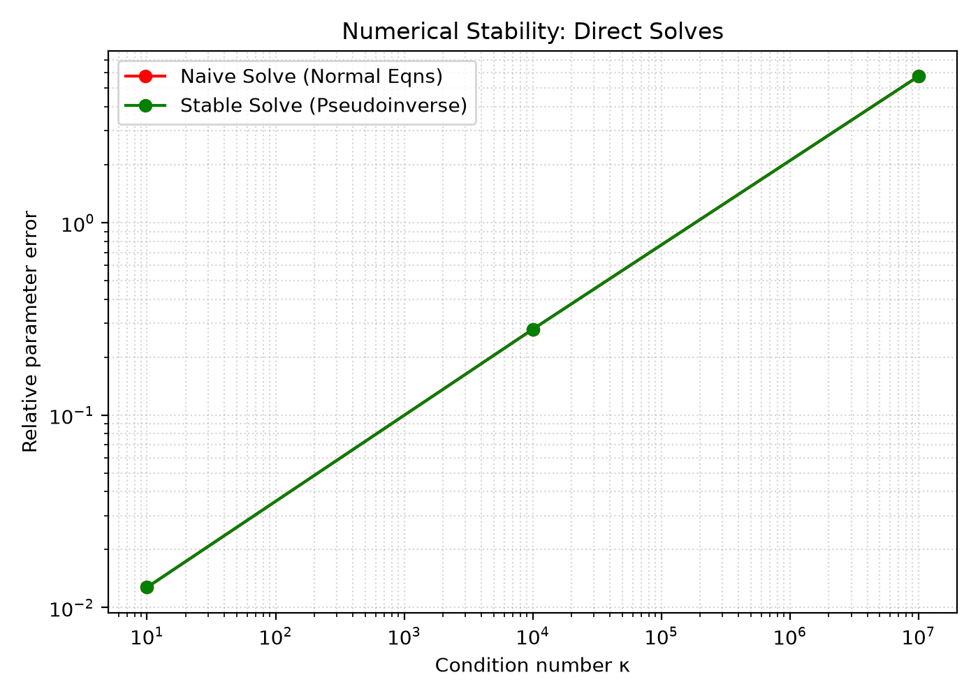
5
Result 1 — Numerical Stability Baselines
Dataset | κ | Naive Solve Error | Stable (Pseudoinverse)
Well-Conditioned | 10 | 1.273 × 10⁻² | 1.273 × 10⁻²
Moderate | 10⁴ | 2.793 × 10⁻¹ | 2.793 × 10⁻¹
Severe | 10⁷ | 5.764 | 5.764
Key Insight:
• Both solvers produce identical errors (float64 precision)
• Error growth is NOT numerical breakdown
• It is inherent noise amplification:
‖δθ‖/‖θ‖ ≈ κ × ‖δb‖/‖b‖
• noise_std=10⁻³ × κ=10⁷ → relative error ≈ O(1–10)
• Confirms the theoretical perturbation bound

Slide 8
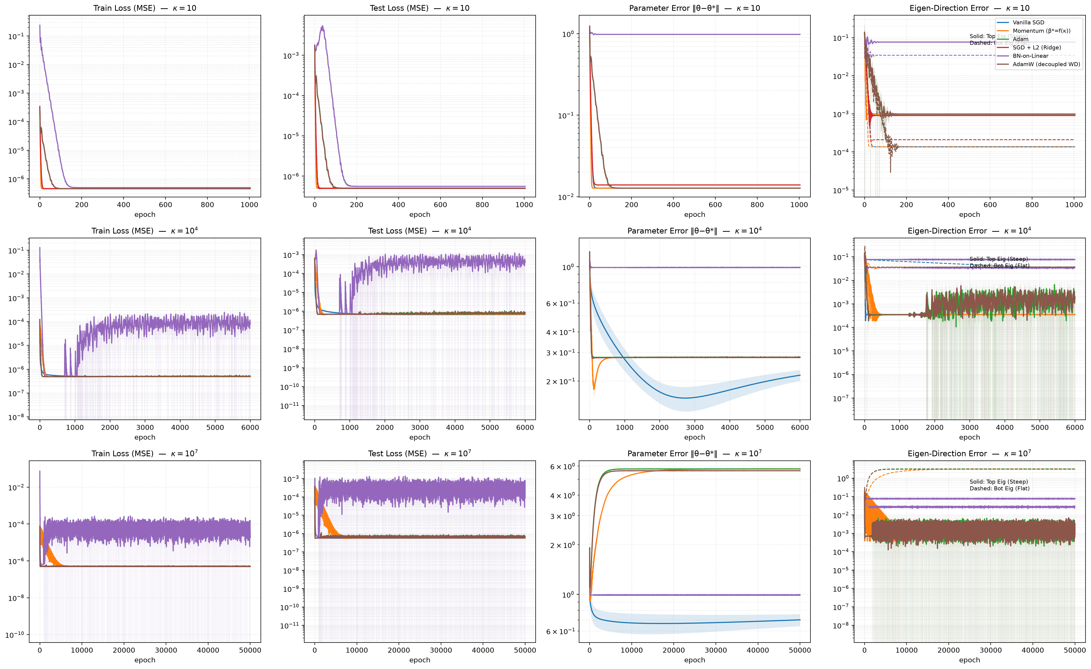
6
Result 2 — Global Convergence Trajectories

Slide 9
⚠️ THE OPTIMIZATION MIRAGE
Perfect loss does NOT mean correct parameters.
Method | Train Loss (κ=10⁷) | Param Error (κ=10⁷) | Verdict
Vanilla SGD | 4.93 × 10⁻⁷ | 0.701 (still falling) | ✅ Robust
Momentum SGD | 4.89 × 10⁻⁷ | 5.764 | ❌ Catastrophic
Adam | 4.97 × 10⁻⁷ | 5.764 | ❌ Catastrophic
AdamW | 5.06 × 10⁻⁷ | 5.621 | ❌ Catastrophic
BN-on-Linear | 2.58 × 10⁻⁵ | 0.991 | ⚠️ Broken by design
Ridge L2 | ∞ (DIVERGED) | ∞ | 💥 LR bug
At κ=10⁷, Adam/Momentum/AdamW losses drop to ~5×10⁻⁷ (near-perfect!) but parameters are 5.76× further from θ* than random initialization.

Slide 10
7
Per-Dataset Results — κ = 10 (Well-Conditioned)
Method | Train Loss | Test Loss | Param Error | Diverged | Time
Vanilla SGD | 4.507×10⁻⁷ | 5.019×10⁻⁷ | 0.01273 | 0/5 | 0.6s
Momentum SGD | 4.507×10⁻⁷ | 5.019×10⁻⁷ | 0.01273 | 0/5 | 0.2s
Adam | 4.507×10⁻⁷ | 5.019×10⁻⁷ | 0.01273 | 0/5 | 0.4s
Ridge L2 | 4.524×10⁻⁷ | 4.943×10⁻⁷ | 0.01393 | 0/5 | 0.2s
BN-on-Linear | 4.933×10⁻⁷ | 5.562×10⁻⁷ | 0.979 ⚠️ | 0/5 | 0.5s
AdamW | 4.507×10⁻⁷ | 5.019×10⁻⁷ | 0.01273 | 0/5 | 0.3s
Insight: All methods converge to noise-floor loss (~10⁻⁷). Param error ≈ 0.013 for all EXCEPT BN-on-Linear (stuck at 0.979).
BatchNorm's first failure signal — even in the easiest scenario, it cannot recover parameter magnitude due to scale invariance.

Slide 11
8
Per-Dataset Results — κ = 10⁴ (Moderate)
Method | Train Loss | Test Loss | Param Error | Diverged | Time
Vanilla SGD | 4.881×10⁻⁷ | 6.673×10⁻⁷ | 0.217 ± 0.016 | 0/5 | 1.3s
Momentum SGD | 4.875×10⁻⁷ | 6.810×10⁻⁷ | 0.279 | 0/5 | 1.3s
Adam | 5.014×10⁻⁷ | 7.594×10⁻⁷ | 0.280 | 0/5 | 1.8s
Ridge L2 | ∞ (DIVERGED) | ∞ | ∞ | 5/5 ❌ | 0.0s
BN-on-Linear | 8.406×10⁻⁵ | 4.179×10⁻⁴ | 0.991 | 0/5 | 2.9s
AdamW | 5.155×10⁻⁷ | 8.441×10⁻⁷ | 0.280 | 0/5 | 1.8s
The Mirage Begins: Losses are all ~10⁻⁷ (excellent!) but param errors stabilize around 0.28 (28% error). Perfect loss ≠ correct parameters.
Ridge L2 diverges (all 5 seeds) — LR=1800 + large λ penalty overshoots stability bound η < 2/L_eff. This is a hyperparameter bug.

Slide 12
9
Per-Dataset Results — κ = 10⁷ (Severe)
Method | Train Loss | Test Loss | Param Error | Diverged | Time
Vanilla SGD | 4.930×10⁻⁷ | 5.657×10⁻⁷ | 0.701 ± 0.059 | 0/5 | 10.7s
Momentum SGD | 4.886×10⁻⁷ | 5.751×10⁻⁷ | 5.764 ❌ | 0/5 | 10.8s
Adam | 4.965×10⁻⁷ | 6.123×10⁻⁷ | 5.764 ❌ | 0/5 | 14.9s
Ridge L2 | ∞ (DIVERGED) | ∞ | ∞ | 5/5 💥 | 0.3s
BN-on-Linear | 2.578×10⁻⁵ | 1.256×10⁻⁴ | 0.991 ⚠️ | 0/5 | 24.1s
AdamW | 5.061×10⁻⁷ | 6.416×10⁻⁷ | 5.621 ❌ | 0/5 | 15.1s
Catastrophic Parameter Explosion: Adam, Momentum, AdamW all achieve train loss ~5×10⁻⁷ while param error explodes to 5.76 — further from θ* than random init.
Vanilla SGD is the most robust unregularized method — param error 0.701 and still falling at epoch 50,000. Its raw gradient steps naturally ignore flat directions.

Slide 13
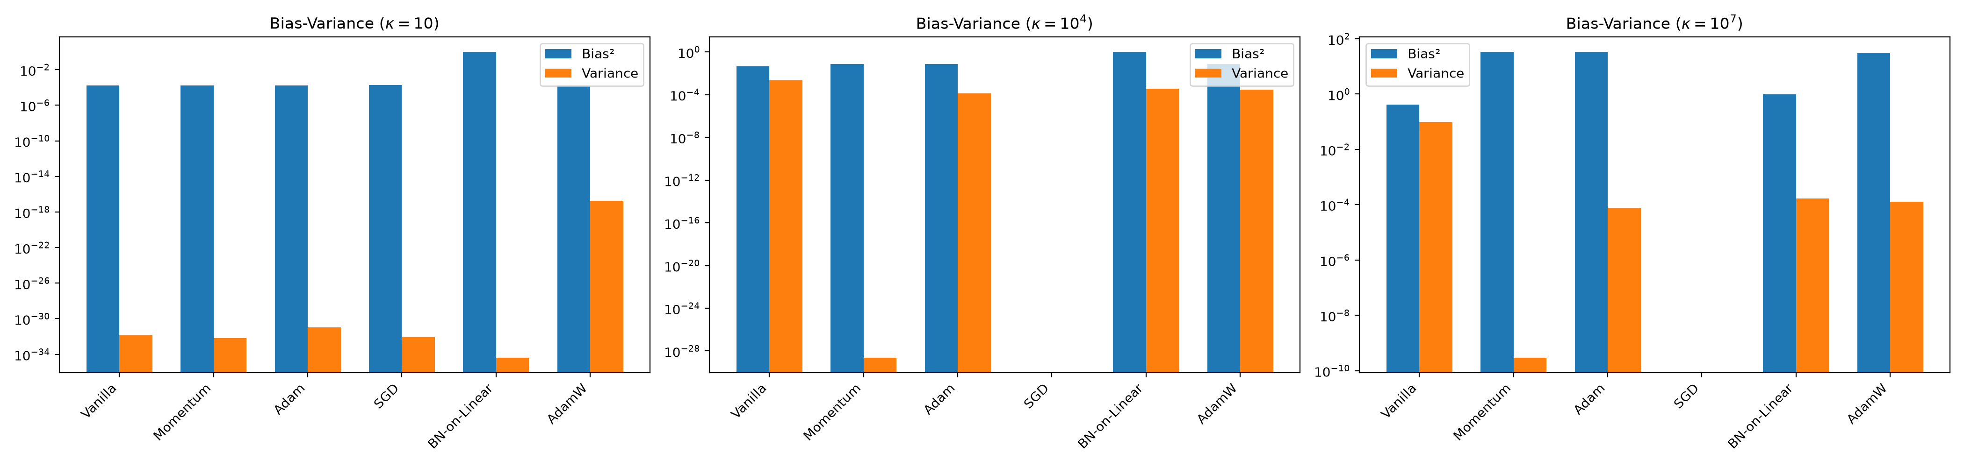
10
Result 3 — Bias-Variance Decomposition
Dataset / Method | Bias² | Variance
κ=10 All standard | ~1.6×10⁻⁴ | ~10⁻³² (negligible)
κ=10 BN-on-Linear | 0.959 | 4.3×10⁻³⁵
κ=10⁴ Vanilla SGD | 0.046 | 2.1×10⁻³
κ=10⁴ Adam/Mom/AdamW | ~0.078 | ~10⁻⁴
κ=10⁷ Vanilla SGD | 0.417 | 0.098
κ=10⁷ Mom/Adam/AdamW | 31 – 33 ❌ | ~10⁻⁴ to 10⁻¹⁰
Adam/Momentum at κ=10⁷: Bias² ≈ 33 → catastrophically biased
BN-on-Linear: Bias² ≈ 0.98 always → deterministically wrong
Vanilla SGD: High variance (0.098) but trending toward θ*

Slide 14
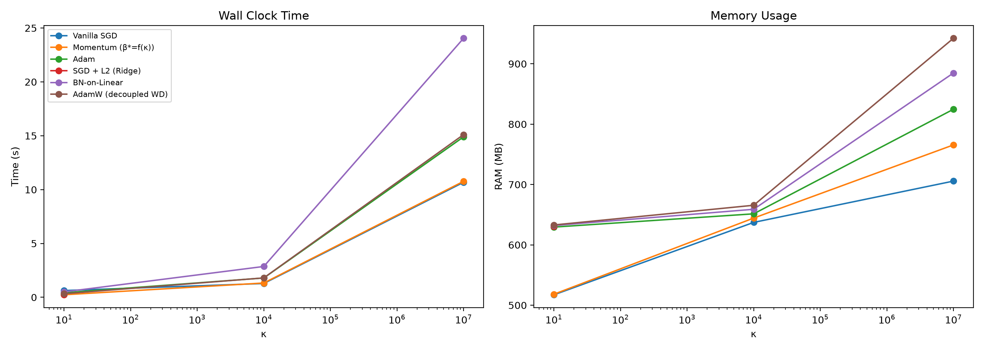
11
Result 4 — Computational Resource Usage
Method | Time (κ=10⁷) | RAM (κ=10⁷)
Vanilla SGD | 10.7s | 706 MB
Momentum SGD | 10.8s | 766 MB
Adam | 14.9s | 825 MB
BN-on-Linear | 24.1s (slowest) | 885 MB
AdamW | 15.1s | 942 MB (most)
BN-on-Linear is slowest (extra BN computation)
AdamW uses the most memory (optimizer states)
Time scales linearly with epochs
(epochs scale with κ, capped at 50,000)

Slide 15
12
Why These Results Occur — Mechanistic Analysis
Adam / AdamW Parameter Explosion:
θ_{t+1} = θ_t − α · m_t / (√v_t + ε)
Along flat eigenvectors: true gradient ≈ 0
But stochastic noise ≠ 0 → small v_t denominator
→ Noise amplified into large parameter steps
→ Parameters explode along uninformative directions
Momentum Drift:
v_t = β · v_{t-1} + g_t
β* ≈ 0.999 at κ=10⁷ (retains 99.9% of history)
Without restoring gradient on flat dirs,
accumulated noise → uncontrolled random walk
Vanilla SGD's Geometric Safety:
θ_{t+1} = θ_t − η · g_t
Step is proportional to gradient magnitude
Flat direction → tiny gradient → tiny step
→ Naturally ignores noise-dominated directions
→ Slower but fundamentally safer
BN-on-Linear's Structural Impossibility:
BN normalizes: X̂ = (X − μ) / σ
For linear model: BN(c·θᵀx) = BN(θᵀx)
Output is invariant to scale of θ
→ Gradient w.r.t. radial scale is exactly zero
→ Can find direction but never magnitude

Slide 16
13
Architectural Summary
Optimizer | Loss | Param (κ ≤ 10⁴) | Param (κ = 10⁷) | Failure Mode
Adam / AdamW | ~10⁻⁷ ✅ | 0.28 error | 5.76 error ❌ | Inverse-variance noise amp.
Momentum SGD | ~10⁻⁷ ✅ | 0.28 error | 5.76 error ❌ | Velocity drift on flat subspace
Vanilla SGD | ~10⁻⁷ ✅ | 0.22 error | 0.70 (falling) ✅ | Slow convergence (safe)
BN-on-Linear | ~10⁻⁵ ⚠️ | 0.98 error ❌ | 0.99 error ❌ | Scale elimination
Ridge L2 | DIVERGED 💥 | DIVERGED | DIVERGED | LR too aggressive
Key Takeaway: Loss monitoring alone is dangerously misleading.
• Adam/Momentum are excellent at minimizing loss but catastrophic at parameter recovery under ill-conditioning.
• Vanilla SGD's simplicity is its strength — gradient-proportional steps provide inherent geometric safety.
• Robust system identification requires geometric stabilization (Ridge/L2), not just faster optimizers.

Slide 17
Conclusion
1. Modern optimizers can achieve perfect loss while parameters
completely diverge from reality — the "Optimization Mirage".
2. The failure is localized to flat, noise-dominated eigen-directions
of the Hessian, not to the overall optimization process.
3. Vanilla SGD's gradient-proportional steps are inherently self-limiting
and geometrically safe, despite being the simplest method.
4. Geometric stabilization (Ridge regularization with correct LR)
is essential for reliable parameter recovery.
5. You cannot blindly trust a low error rate.
Structure-aware diagnostics are critical for real-world ML.
Thank You! • Questions?

