Slide 1
GIT PUSH FORCE
Group Expense Tracking Platform
Full-Stack | Cloud | AI Ready

Slide 2
ABOUT THE PROJECT
A sophisticated group expense platform featuring enterprise architecture, AI receipt processing, and production-ready cloud deployment across web, mobile, and backend services.

Slide 3
TEAM MEMBERS
BĂLĂU MIHAI
Team Lead & Business Analyst
BOȚA MIHNEA CĂTĂLIN
Frontend Developer
BEREȘ ROBERT
Cloud & DevOps & Backend Developer
ILOVAN CRISTIAN DANIEL
Frontend Developer
BIRĂU DENIS RAUL
AI Integration & Backend Developer
Backend Developer
MOLDOVAN ANDREI
Mobile Developer
MEDER EDUART
BOLOȘ MIHAI
Backend Developer & QA Engineer
HAJ LAITH
Mobile Developer
Backend Developer & Tester
BIGHIU IONUȚ RĂZVAN

Slide 4
PROJECT VISION & OBJECTIVES
VISION
KEY OBJECTIVES
Track shared expenses efficiently
Split costs intelligently
Provide insights via analytics
Multi-platform accessibility
Production-ready application deployed on AWS
Enterprise-grade security & scalability
AI-powered receipt processing
Seamless user experience across platforms

Slide 5
DEVELOPMENT BREAKDOWN
81
337
44
27,209
TASKS
COMMITS
PULL REQUESTS
LINES OF CODE
Project management and sprint planning
Development workflow and version control
Code review and quality gates
Full-stack implementation across all platforms

Slide 6
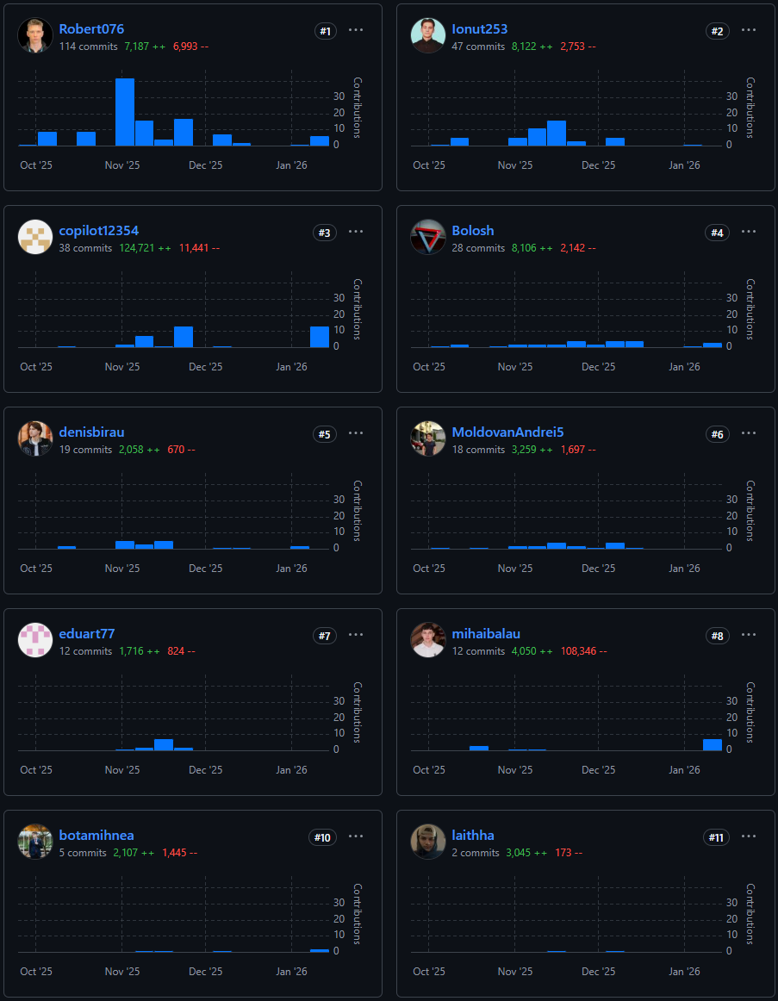
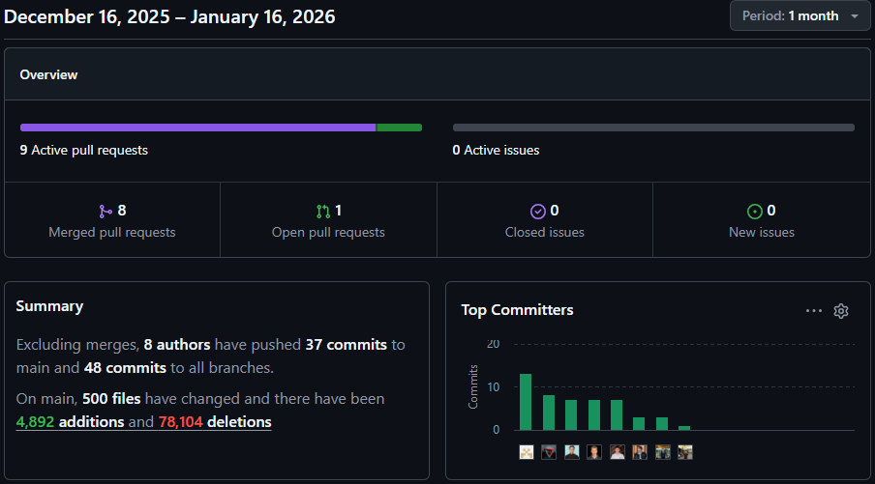
EXECUTION METRICS

Slide 7
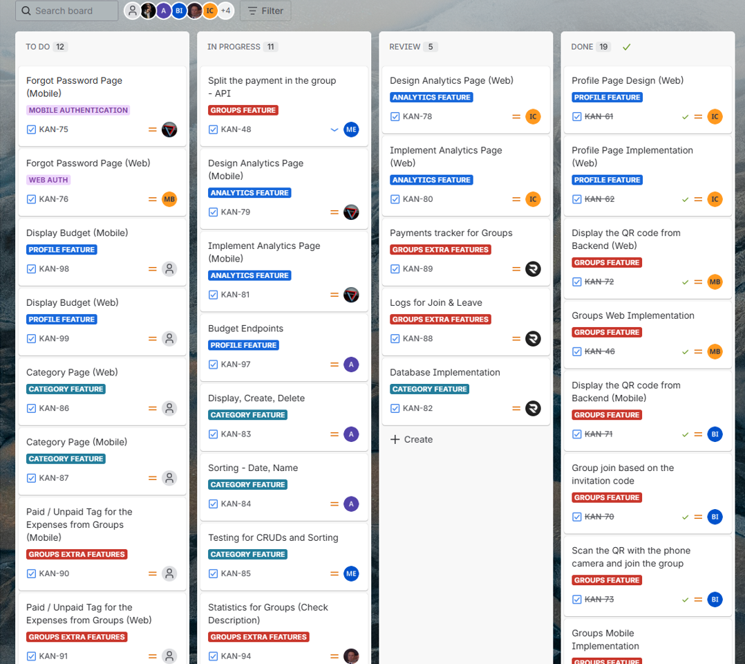
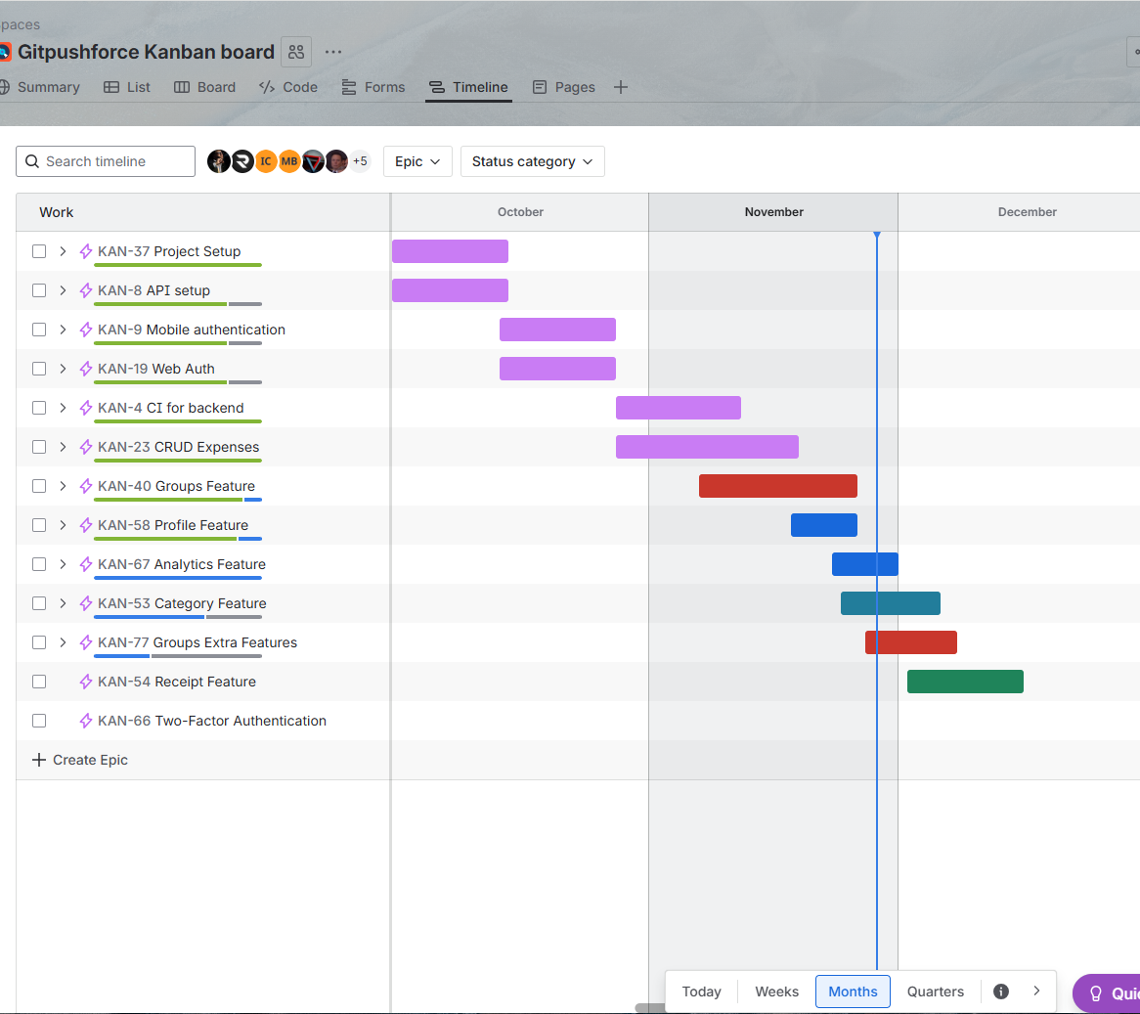
AGILE EXECUTION

Slide 8
TECH STACK
BACKEND
MOBILE
FRONTEND
CLOUD
Architecture Layers
FastAPI, Python, PostgreSQL, SQLAlchemy
Kotlin Multiplatform (KMM)
React 18.2, TypeScript, Vite, Bootstrap
AWS Lambda, API Gateway, CloudFront, S3, RDS

Slide 9
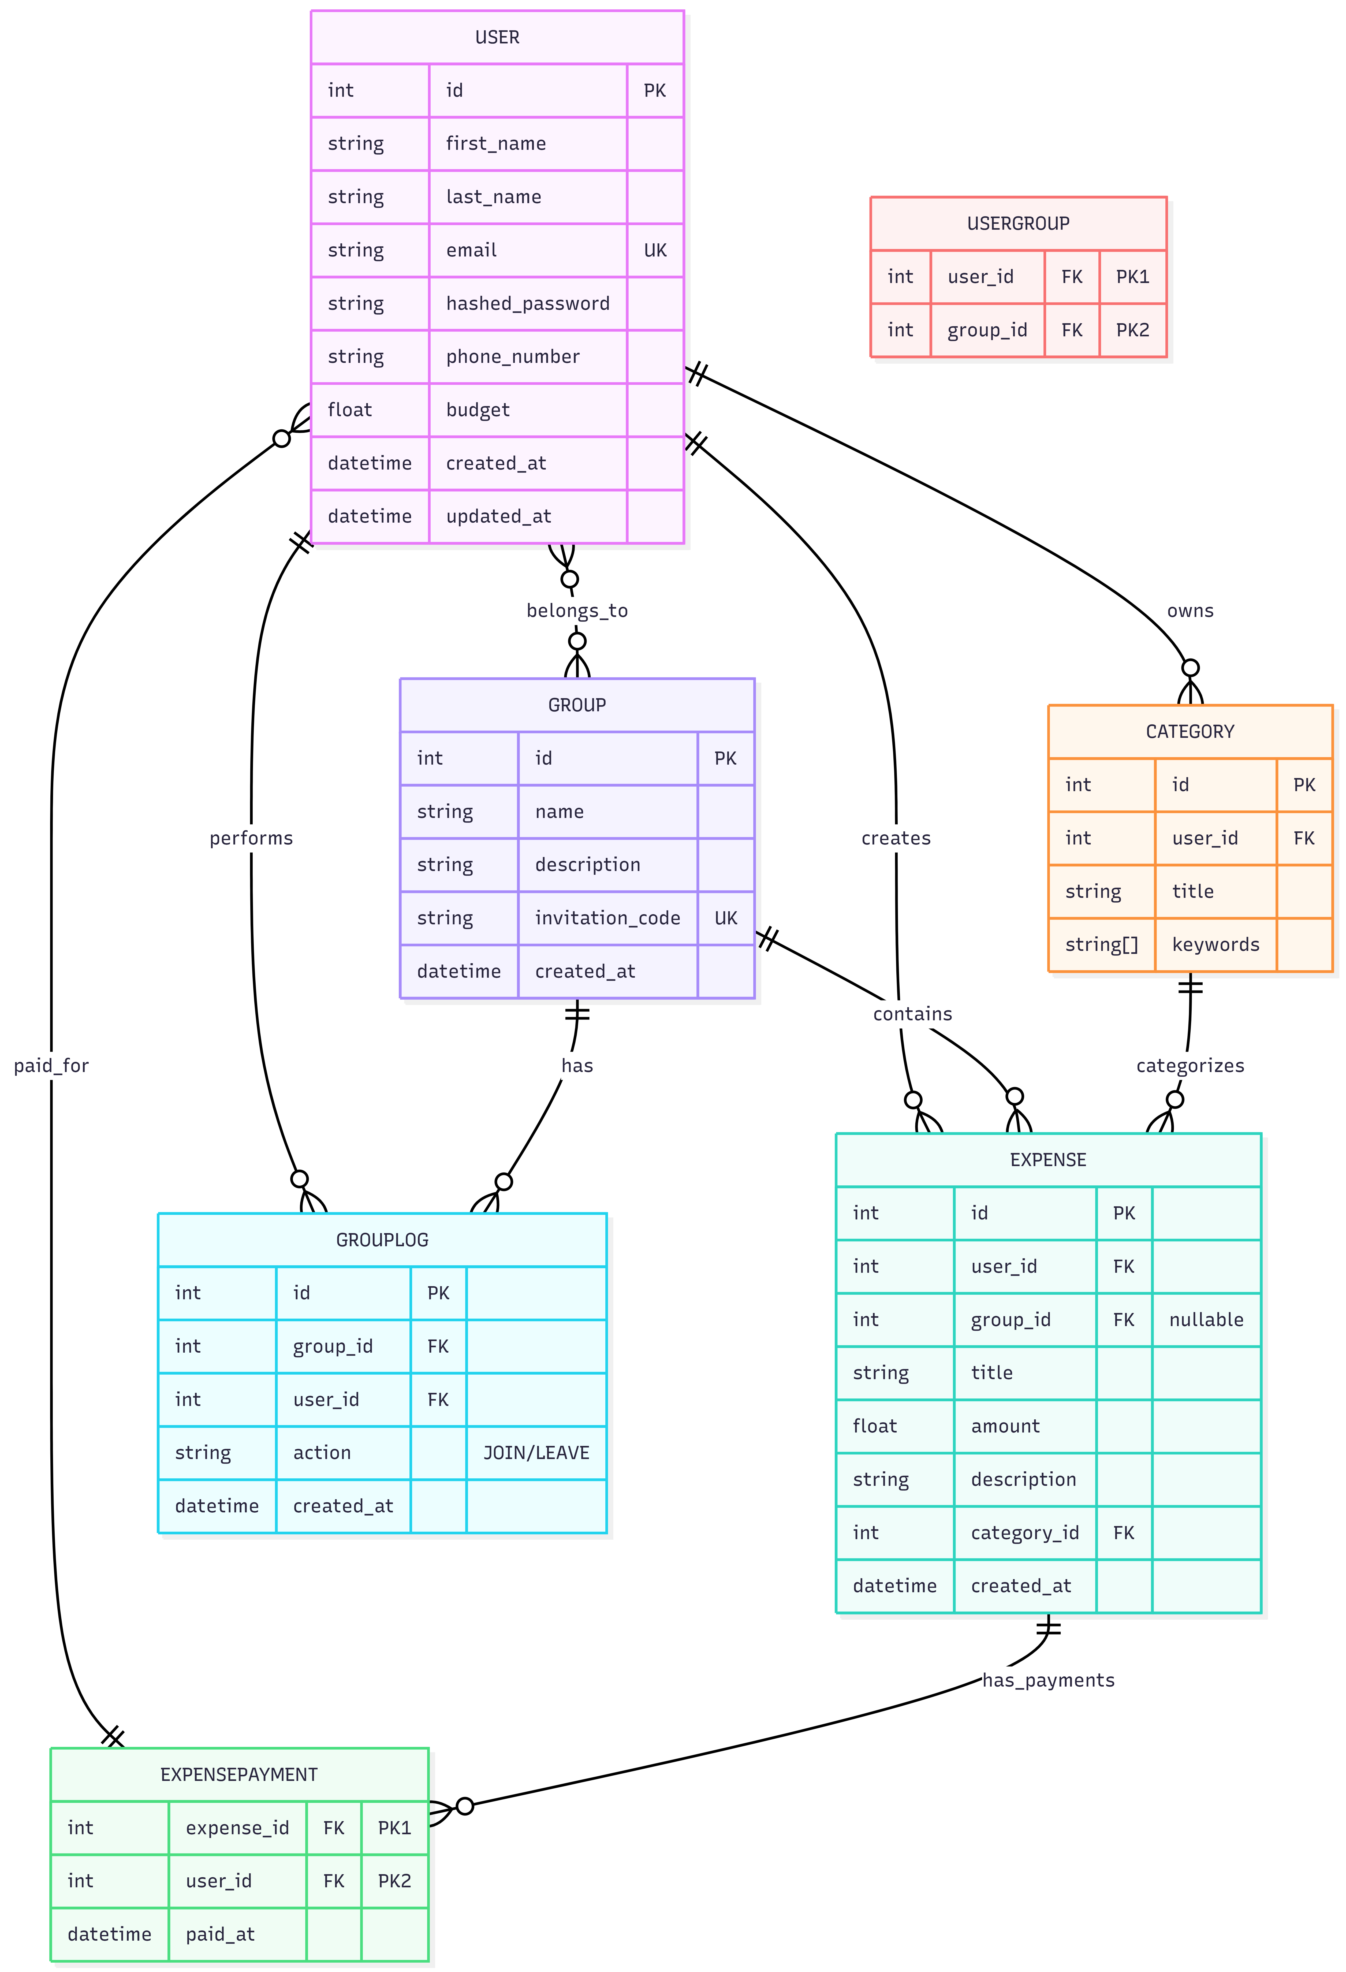
GROUND LEVEL
DATA ARCHITECTURE

Slide 10
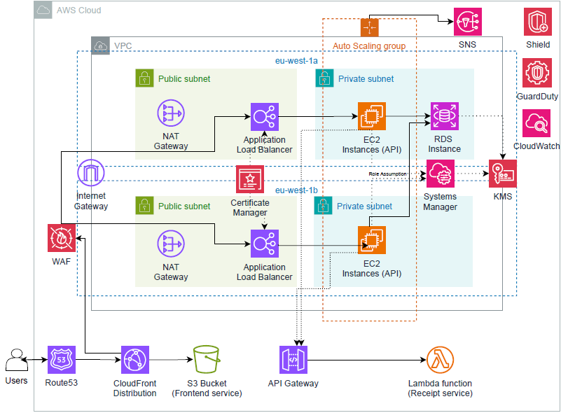
SKYLINE
CLOUD INFRASTRUCTURE

Slide 11
THANKS!
Do you have any questions?

