Slide 1
Stacking

Slide 2

Averaging - prediction
f1 | f2 | f3 | … | fn | Class
0.345 | -0.983 | 1.201 | … | -0.004 | 1
1!
Decision Tree
1
Log. Regression
0
Random Forest
0
XGBoost
1
LightGBM
1

Slide 3
Stacking - prediction
f1 | f2 | f3 | … | fn | Class
0.345 | -0.983 | 1.201 | … | -0.004 | 1
m1 | m2 | m3 | m4 | m5 | Class
 |  |  |  |  | 1
m1
Decision Tree
1
Meta classifier
m2
Log. Regression
0
m3
Random Forest
0
1
m4
XGBoost
1
Note on fitting these classifiers: “estimators_ are fitted on the full X while final_estimator_ is trained using cross-validated predictions of the base estimators using cross_val_predict.” StackingClassifier documentation
m5
LightGBM
1

Slide 4
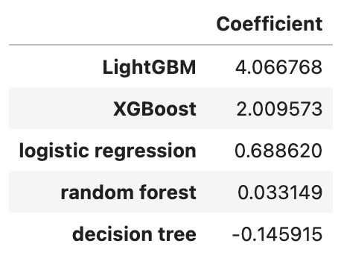
Confidence in estimators

Slide 5
iClicker
See
iClicker Exercise 11.2

