Slide 1
BendSketch: Modeling Freeform Surfaces Through 2D Sketching
CHANGJIAN LI, The University of Hong Kong and Microsoft Research Asia HAO PAN, YANG LIU, and XIN TONG, Microsoft Research Asia ALLA SHEFFER, University of British Columbia WENPING WANG, The University of Hong Kong
(2017)

Slide 2
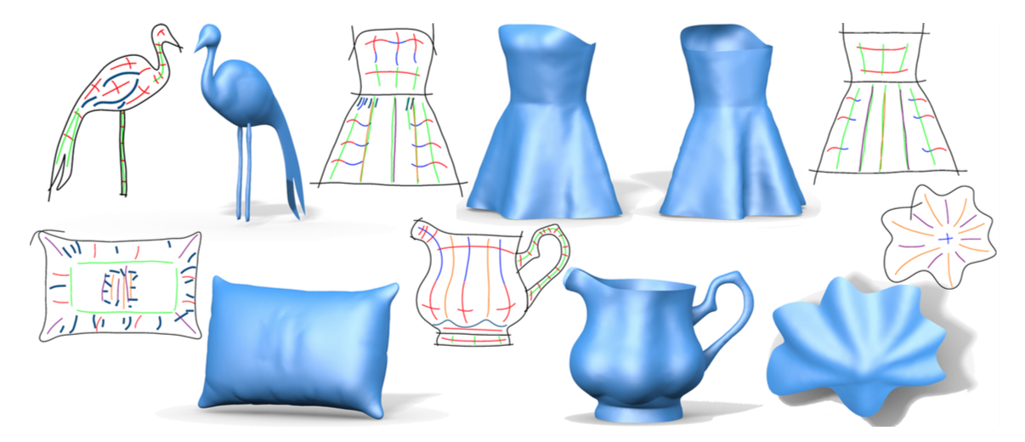

Slide 3
motivation
Existing sketching tools are suitable for modeling many classes of shapes, but they are not well suited for designing free form surfaces with complex curvature patterns.
The local curvature variation of a freeform shape can be described by a small set of curves showing the major bending directions on the surface.

Slide 4
technical contributions
Disambiguating between convex and concave curves on 2D depictions of 3D shapes.
Estimating actual curvature of unknown surfaces along curves.
Propagating geometric information from sparse strokes locally to their surroundings smoothly and in a meaningful way.

Slide 5
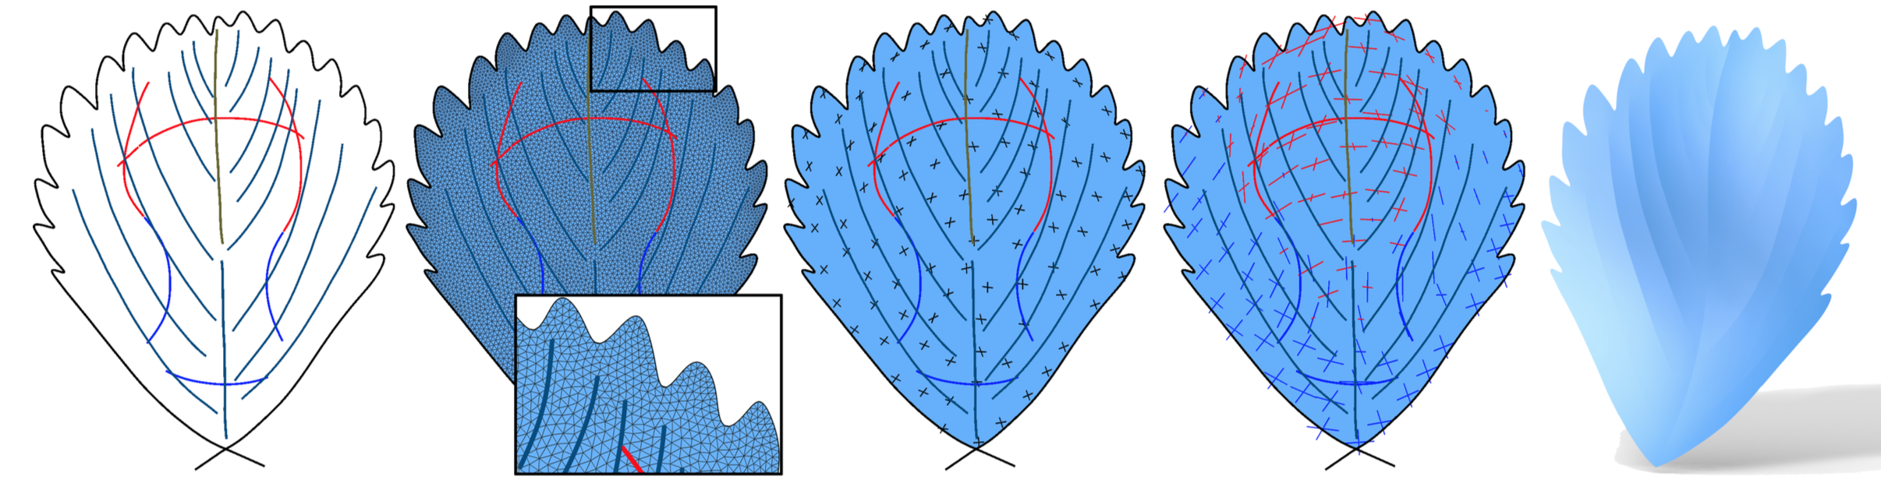
algorithm: high level
Processing input strokes, disambiguating convex/concave curves.
Triangulation of the sketched domain.
Initialize with uniform curvature values to solve for initial guess.
Joint computation of the curvature field and surface, iteratively solving curvature magnitudes and surface shape.
1
2
3
4

Slide 6
algorithm: high level
Processing input strokes, disambiguating convex/concave curves.
Triangulation of the sketched domain.
Initialize with uniform curvature values and solve for initial guess.
Joint computation of the curvature field and surface, iteratively solving curvature magnitudes and surface shape.
output

Slide 7
(input/auto) stroke types
Boundary - surface discontinues.
Bending - projection of principal curvature line, convex/concave.
Sharp Feature - a curve across which normals change discontinuously.
Ridge/Valley - a curve across which surface bends back/forward.
Flat - a curve along which the surface has no bending.
Contour - boundary with known normals, or object silhouette.

Slide 8
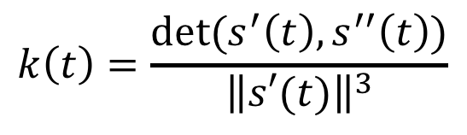


processing of input strokes
Simple Strokes - strokes that only bend in one direction in 2D plane.
Signed curvature, if k ≤ 0 or k ≥ 0 then the stroke is a simple stroke.
Denote planar convex (k ≥ 0) and concave (k ≤ 0) with sign of traversal tangent direction and stroke.
$$s\left(t\right), t∈[0,1]$$
$$k\left(t\right)=\frac{det⁡(s^{′}\left(t\right),s^{′′}\left(t\right))}{{\left\|s′(t)\right\|}^{3}}$$
$$sign\left(s,\overset{⃑}{T}\right)∈\{−,+\}$$

Slide 9
processing of input strokes
Resolving convex/concave ambiguity is hard, use clues about stroke labeling patterns at local regions.
A simple stroke is slightly more likely to be convex.
Two sequential simple strokes with the same/opposite planar convexity are likely to have the same/opposite convexity properties.
Two parallel simple strokes with the same planar convexity are likely to have the same convexity property.

Slide 10
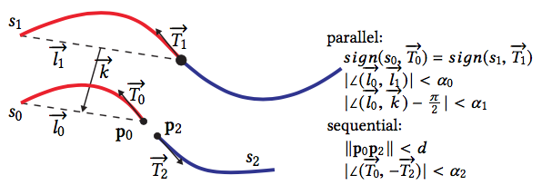
processing of input strokes
α₀ = α₂ = 15°, α₁ = 20°, d = D/30, and two simple strokes are considered neighbors if their closest distance is less than D/10, with D the diagonal length of the bounding box of sketch domain.

Slide 11
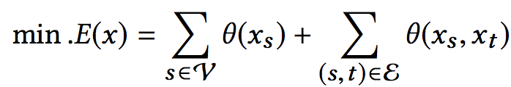
convexity labeling
Segment input strokes into simple strokes.
Build graph G = (V, E), simple strokes as nodes V and parallel/sequential simple strokes denoted by edges E.
Solve graph labelling problem using approximate solver
Notes:
{0, 1} denotes if the stroke s is convex or concave.
θ(0) = 0.4 and θ(1) = 0.6, favoring convex strokes.
θ(0,0) = (1,1) = 0.0 and θ(1,0) = (0,1) = 1.0 for same convexity.
1 - θ(·, ·) for opposite convexity.
Approximate solver good for reasonably sized graphs (not huge).
Approximate solver from Vladimir Kolmogorov. 2006. Convergent Tree-Reweighted Message Passing for Energy
Minimization.

Slide 12
domain triangulation
Triangulate 2D domain Ω defined by boundary curves into a planar mesh M.
Height field discretized by lifted version of M, variables encoded by z-coordinates of vertices.
Feature curves preserved by M, edges located on sharp features.
Notes:
We use the Delaunay refinement algorithm of CGAL [CGA 2016] to quickly generate a dense and high quality mesh confined to the boundary curves.

Slide 13
aside: curvature field terminologies
Curvature direction field {u, v} is defined as a piecewise constant non-orthogonal 4-direction field over M.
Curvature magnitude field {λ_{u}, λ_{v}} is defined as two piecewise constant scalar fields.
Differential of Gauss map (Weingarten shape operator) encodes principle curvature directions and magnitudes as its two eigenvectors and eigenvalues.
Notes:
We find an initial estimation of the surface first, so that subsequent joint optimization of surface shape and curvature field can escape the trivial solution of a at surface with zero curvature everywhere that minimizes Ematch.

Slide 14

initialization (initial guess)
Assign a uniform positive curvature value to the bending strokes.
Minimize E_{bend_field} and E_{λ} under bending stroke constraints to get curvature field.
Notes:
We find an initial estimation of the surface first, so that subsequent joint optimization of surface shape and curvature field can escape the trivial solution of a at surface with zero curvature everywhere that minimizes Ematch.

Slide 15
energy: curvature direction field
Regulates the principal curvature directions of a smooth surface as projected onto a plane.
Discretized as piecewise constant over the triangle mesh M.
Integrand over each triangle.
Weighted by triangle area.

Slide 16

energy: (constrained) curvature direction field
To minimize the energy under bending stroke constraints initialize u, v as a harmonic non-orthogonal 4-direction field.
Field found by solving quadratic optimization problem using PolyVector representation of curvature direction field, {u, v} recovered from solution.
Directions further refined through an iterative sequence of linear optimizations
Notes:
direction field is encoded by another pair of complex variables a = u^2 + v^2 and b = u^2v^2,
which is derived from the coefficients of the polynomial equation (z^2 – u^2)(z^2 – v^2)=0.
Optimization minimizes smoothness energy + a, b, and tangent direction of strokes crossing triangles+ and mild orthogonality requirement.

Slide 17
energy: curvature magnitude field
Regulates principal curvature values subject to the estimated surface curvature values along the bending strokes.
Discretized as piecewise constant over the triangle mesh M.
Integrand over each triangle.
Weighted by triangle area.
Notes:
Beta weight of curvature variation term, want smooth curvature

Slide 18
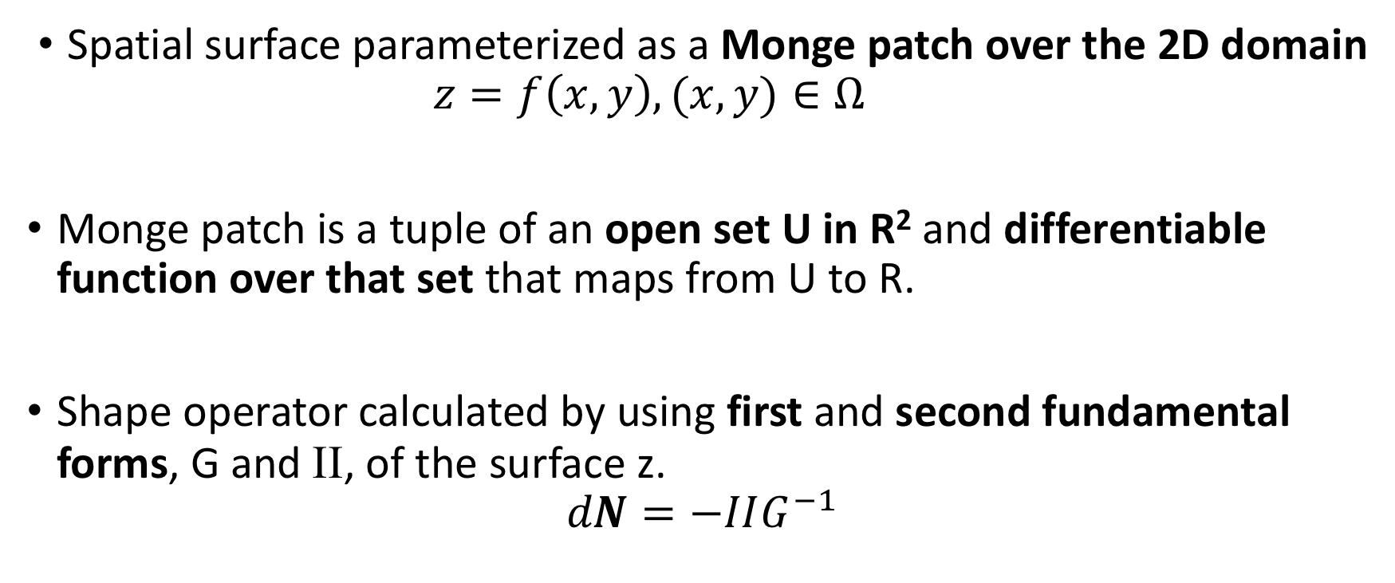
aside: surface shape terminology
Spatial surface parameterized as a Monge patch over the 2D domain $z=f\left(x,y\right),(x,y)∈Ω$
Monge patch is a tuple of an open set U in R² and differentiable function over that set that maps from U to R.
Shape operator calculated by using first and second fundamental forms, G and II, of the surface z.
$$dN=−IIG^{−1}$$
Notes:
initial estimation of the surface first, so that subsequent joint optimization of surface shape and curvature field can escape the trivial solution of a at surface with zero curvature everywhere that minimizes Ematch.

Slide 19

initialization (initial guess)
3. Minimize E_{match} with one iteration of optimization (only initial surface estimation needed)
Notes:
We find an initial estimation of the surface first, so that subsequent joint optimization of surface shape and curvature field can escape the trivial solution of a at surface with zero curvature everywhere that minimizes Ematch.

Slide 20
energy: surface shape
Discretized as piecewise constant over the triangle mesh M.
Integrand over each triangle.
Weighted by triangle area.

Slide 21
joint optimization
Given the planar stroke, it is impossible to recover the true surface curvature along the stroke without knowing the surface first.
Solve for both simultaneously.
Iterative process, three steps per iteration
Estimate principal curvatures by analyzing lifted strokes.
diffuse curvature values through minimizing E_{λ}.
update surface shape by minimizing E_{match} for one iteration.
Curvature directions don’t change, simplifies minimizing E_{λ}.

Slide 22
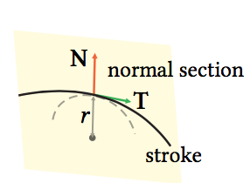
estimate principle curvatures
Lift planar curve to surface.
Project neighborhood of spatial curve to normal section plane at each point along curve.
Fit circle to projected image, inverse radius is estimated curvature at point.
If neighborhood size too large, estimated curvature too conservative.
If neighborhood size too small, estimated curvature unstable.

Slide 23
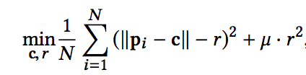
estimate principle curvatures
Minimize geometric fitting error to estimate circle.
p_{i} points to be fitted
(c, r) defines circle
μ small weight

Slide 24
boundary conditions
Imposed on height values z along boundary curves.
Positional constraint – boundary points should be close to drawing plane or specified boundary curve.
Regularity constraint – boundary curve should be smooth.

Slide 25
other strokes
Contour – normal vector constraints on surface at boundary, interpolated between contour normal and surface normal at interior vertex.
Ridge/Valley – converted to bending lines with known convexity.
Flat – imposes normal constraints along triangles intersecting stroke.
Sharp Feature – induces sharp angles between neighbor triangles.

Slide 26

energy: surface shape
Complete height surface energy combines match energy with energies induced by boundary, contour, flat, and sharp feature curves.

Slide 27
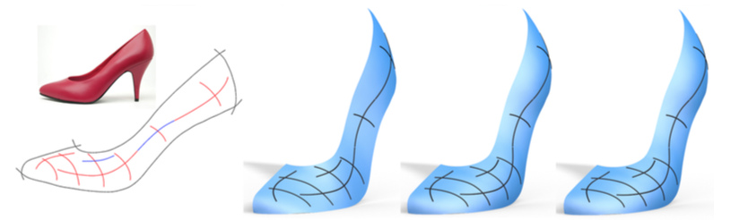
1
2
3
4
Input with reference image
After initialization step
3 iterations of solver
5 iterations of solver

Slide 28
limitations
Height field cannot handle self-occluding shapes or layers, however this is remedied (albeit tedious for users) by their multi-view framework (not included for brevity).

Slide 29
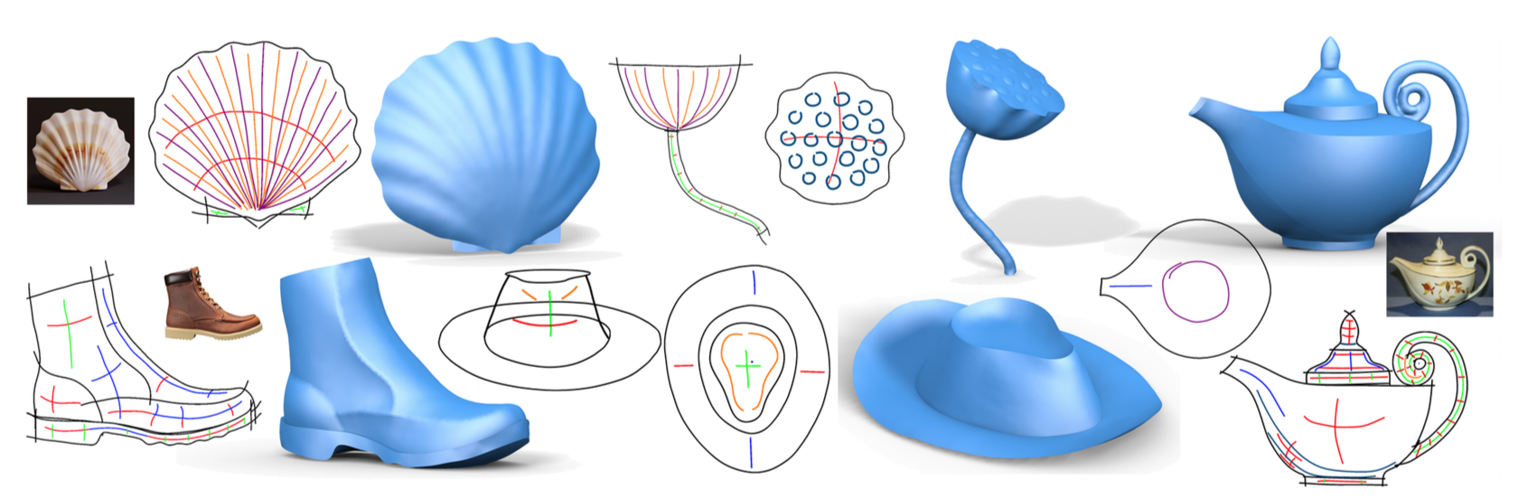
results
*multiple view modeling system not covered in slides

Slide 30
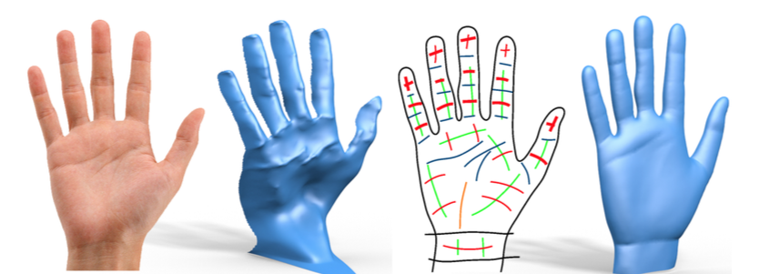
comparison
Sequential Feature Selector (SFS) methods fail with complex shading/materials, where BendSketch does not.

