Slide 1
Tetrahedral Meshing in the Wild
YIXIN HU, New York University
QINGNAN ZHOU, Adobe Research
XIFENG GAO, New York University
ALEC JACOBSON, University of Toronto
DENIS ZORIN, New York University
DANIELE PANOZZO, New York University
Jinfan Yang
October 22, 2018

Slide 2
OUTLINE
Related Work
Method
Results
Limitations

Slide 3
Related Work
Background Grids
Delaunay
Constrained Delaunay tetrahedralization
Restricted Delaunay tetrahedralization
Variational meshing
Surface envelope
Low element quality, “sliver” tetrahedra, heavy or over refinement,
Lacking of robustness, requiring initial starting points …

Slide 4
Method
Tetrahedralize arbitrary meshes without assumptions on mesh manifoldness, watertightness, absence of self-intersections etc.

Slide 5
Method
Input: triangle soup
a user-specified tolerance ɛ
a desired target edge length l
Output: an approximately constrained tetrahedral mesh
Contains an approximation of the input set of triangles with in user-defined tolerance
Has no inverted elements
Edge length below user-defined bound l

Slide 6
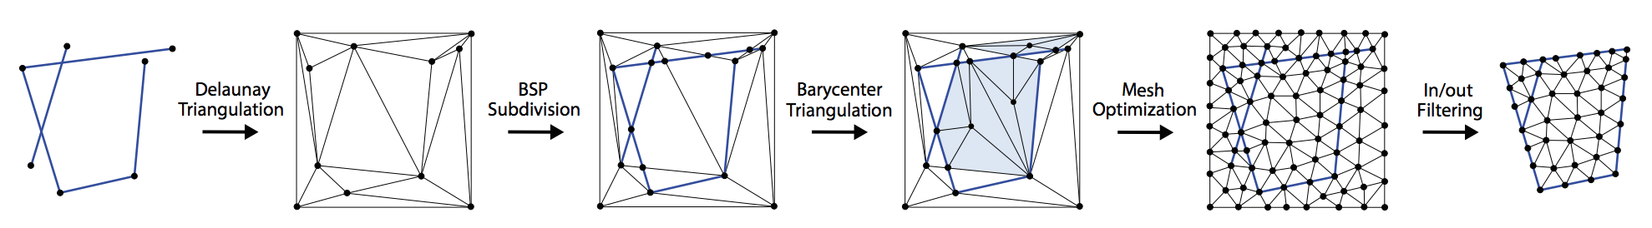
Method
Phase 1: Generation of a valid mesh
Phase 2: Mesh Improvement
Phase 3: Interior volume extraction

Slide 7
Method
Phase 1: Generation of a valid mesh
Create an initial, non-conforming tetrahedral mesh using Delaunay tetrahedralization
BSP-Tree Subdivison
Polyhedral mesh is converted to a tetrahedral mesh by adding a vertex at the barycenter, and connecting it to all triangular faces on the boundary
Self-intersection are naturally handled

Slide 8
Method
Phase 2: Mesh Improvement
Invariant
Disallow every operation introducing inverted tetrahedra
Only accept operations that keep the faces on the surface at a distance smaller than user-defined ɛ

Slide 9
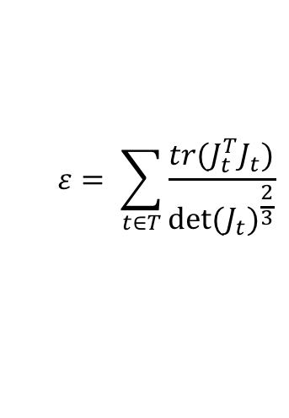
Method
Phase 2: Mesh Improvement
Quality
Minimize 3D conformal energy¹ which is well-correlated with many common measures of quality
$$ε= \sum_{t∈T}{\frac{tr(J_{t}^{T}J_{t})}{det⁡{(J_{t})}^{\frac{2}{3}}}}$$
1. Rabinovich et al. 2017
Notes:
Oblivious to isotropic scaling, but naturally penalizes needle-like elements, flat and fat elements, slivers, and prevents inversions since it diverges to infinity as an element approaches zero volume

Slide 10
Method
Phase 2: Mesh Improvement
Local Operations
Edge splitting (refining)
Edge collapsing (coarsening)
Face swapping
Vertex smoothing
Notes:
Coarsening and optimization operators are applied only if they improve the mesh quality
Refinement operator is applied until a predefined edge length is reached or whatever a region is locked due to the lack of enough degrees of freedom

Slide 11
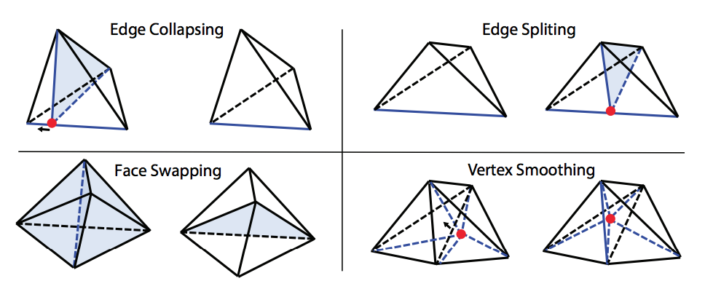
Method
Phase 2: Mesh Improvement
Notes:
The mesh improvement process stops when either the maximum energy is sufficiently small (default: less than 10) or the maximum number of iteration is reached (default: 80 iterations)

Slide 12
Method
Phase 3: Interior volume extraction
Define an inside-outside function that can be used to extract an interior volume associated with the mesh¹
Calculate the winding number of the centroid of each tetrahedron with respect to the embedded surface
If the winding number is smaller than 0.5, drop it
Both small gaps and large surface holes are filled according to the induced winding number field
1. Jacobson et al. 2013
Notes:
The algorithm has not attempted to define a closed surface bounding a volume: the result of the previous stage is a construction of the approximately constrained tetrahedralization

Slide 13
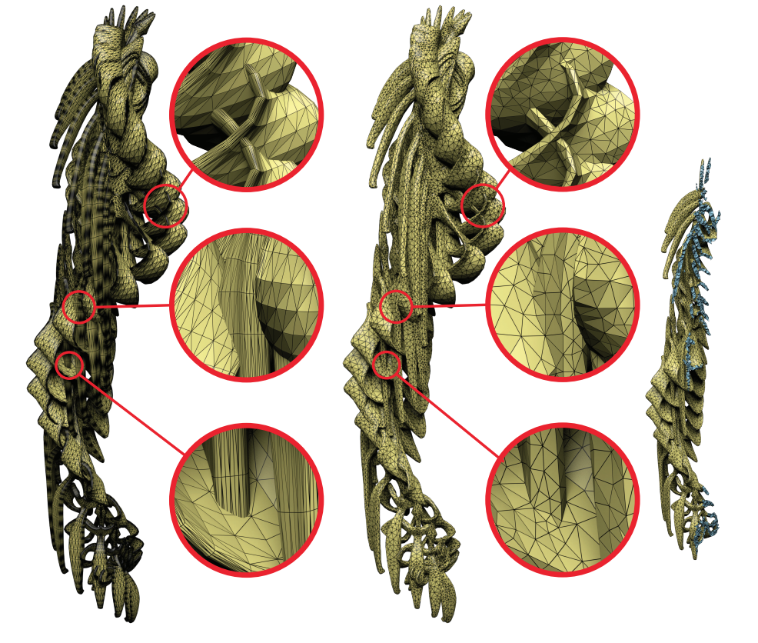
Results
Self-intersection

Slide 14
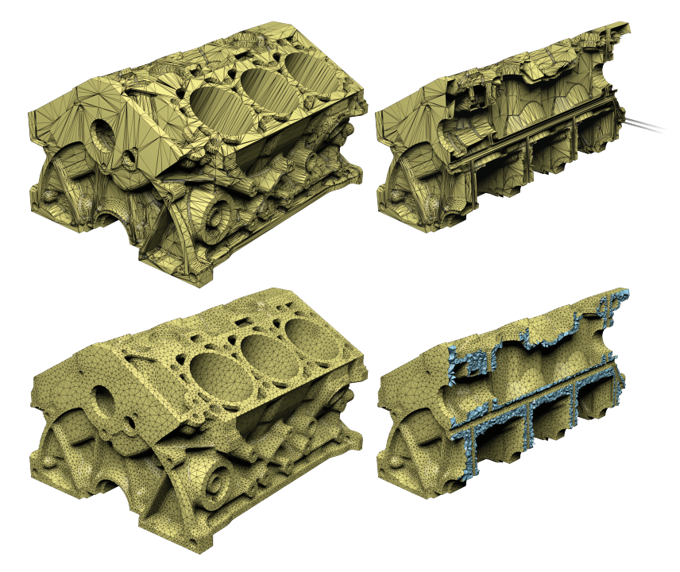
Results
High Quality

Slide 15
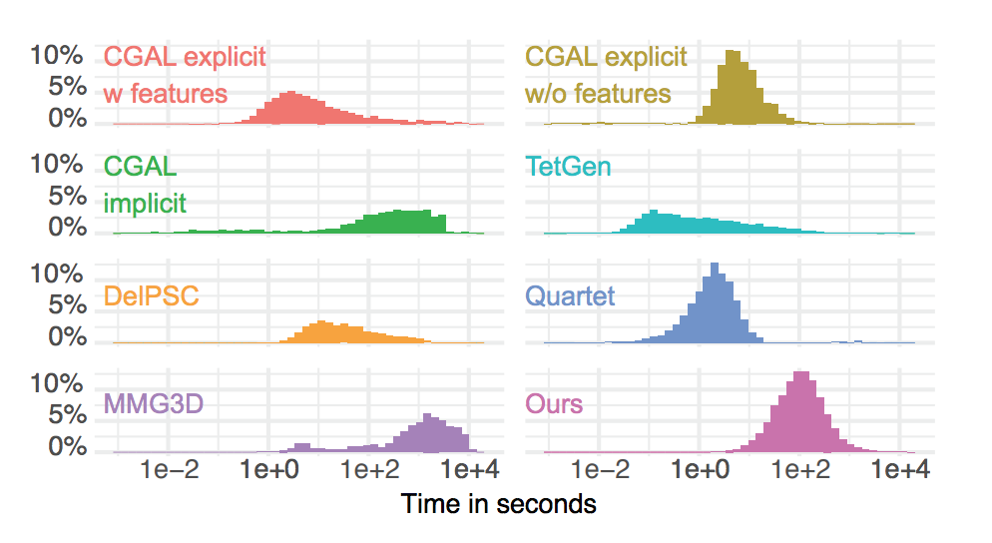
Results
Comparison of running time

Slide 16
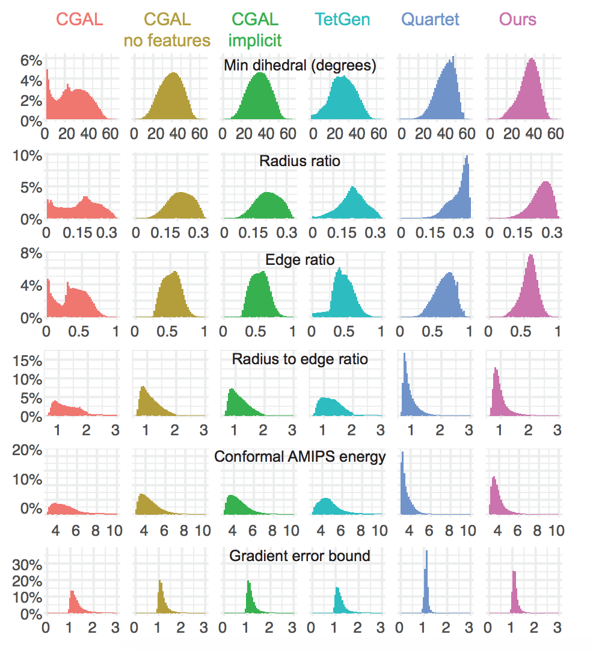
Results
Comparison of mesh quality
Notes:
The distribution of 6 common quality measures of all tetrahedra in 1000 randomly sampled meshes generated from Thingi10k dataset. Quality measures: dihedral angle, inscribed/circumscribed sphere radius ratio, conformal AMIPS energy, and normalized Shewchuk’s gradient error estimate factor

Slide 17
Limitations
Vertices could be displaces
Causing a straight line to zigzag
Preservation of sharp features
Limited to closed surfaces
Slow

Slide 18
Thank you!

