Slide 1
Paparazzi: Surface Editing by way of Multi-view Image Processing
HSUEH-TI DEREK LIU MICHAEL TAO ALEC JACOBSON
University of Toronto, Canada
Presented by: Edoardo A. Dominici

Slide 2
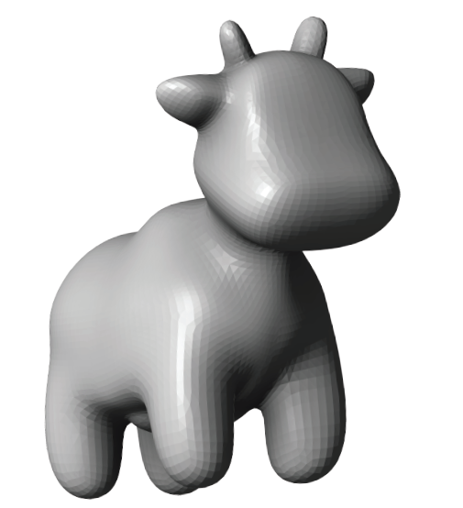
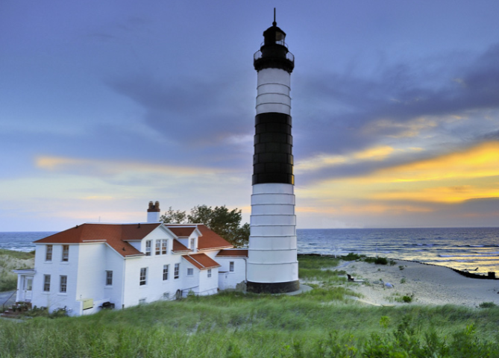
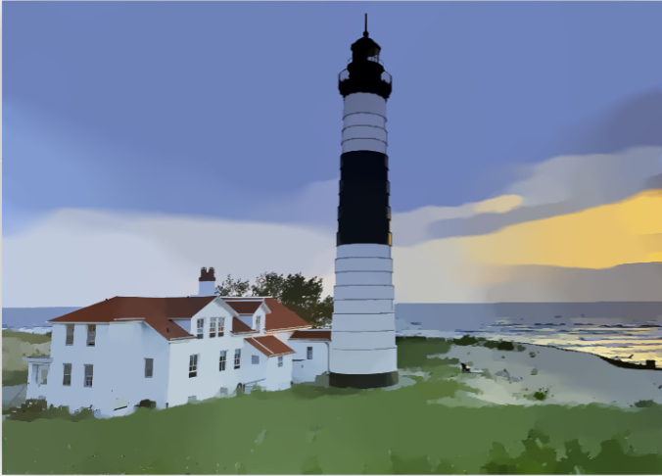


Problem
Task: Compute mesh deformations from changes in the image domain
Notes:
Hi, today I am presenting a interesting work from the geometry processing group at the university of Toronto.
The task that they want to solve is deforming a 3d mesh using image processing algorithms on rendered surface views.
They operate on the vertices of a triangular mesh V Using any image processing algorithm that can be expressed as energy minimization

Slide 3
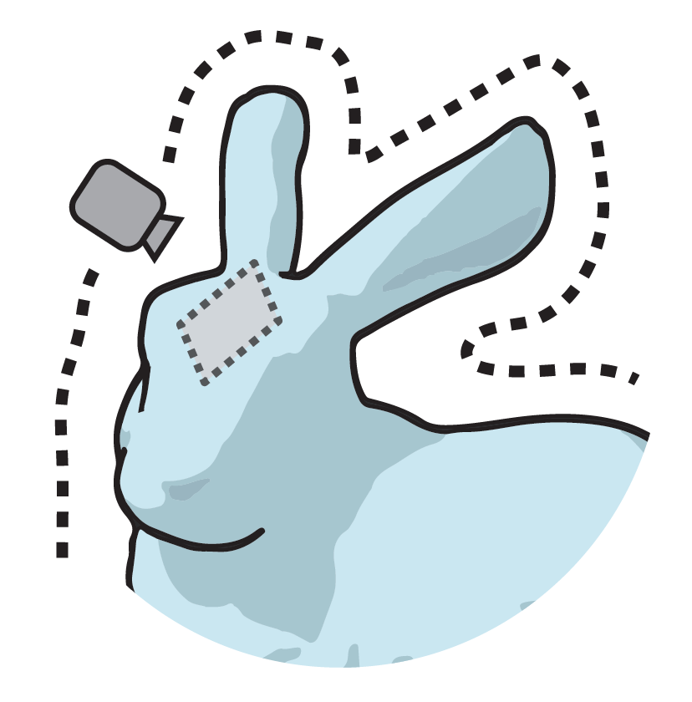
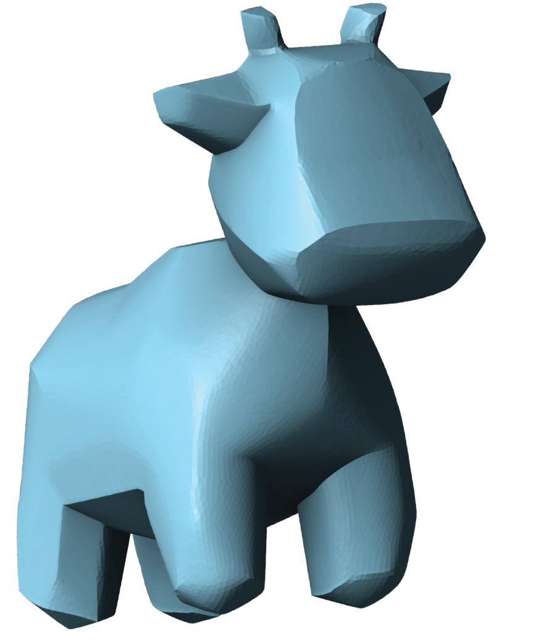
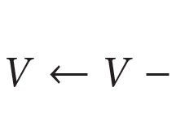
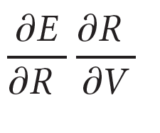

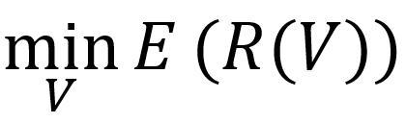
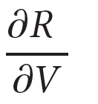
Paparazzi’s approach
Gradient Descent
Challenge: Differentiable rendering function
Notes:
Their challenge is to express changes in the image domain as vertex deformations. The image processing operates on a rendered view of the model and minimizes the energy with respect to the model vertices.
This is well suited for minimization using gradient descent applying the chain rule, but it requires computing the derivative of the renderer (forward image synthesis) with respect to the model. The challenge is thus to design a differentiable renderer.
The first derivative is not a particular problem as it can be replaced for iterative algorithms and indicates the change in energy as the rendered view changes (l2 distance example)

Slide 4
Contribution and challenges
Paparazzi’s Contribution: An analytically differentiable renderer
But inverse image synthesis faces many challenges:
- Differentiable rendering (parameters) (numerical derivatives)
Multi-view surface editing (view ambiguity) (uniform coverage)
Shape from shading (lighting model)
Style transfer (approximate derivatives)
Notes:
Think it’s worth spending a couple of minutes reviewing this because as we will see the contribution is the design of an analytically differentiable renderer. The work touches on different fields and since Paparazzi wants to be a general framework, it requires a robust solution to the very same problems that these fields face.
On a higher level we are in the field of inverse image synthesis, which comes with many challenging problems that it needs to overcome in order to have a robust solution.
Differentiably rendering essentially means studying the derivatives of the rendering with respect to the model parameters. There are general purpose frameworks in this area (OpenRD), but they rely on automatic differentiation and also consider many derivatives with respect to different scene parameters, not only the vertices. Similarly, this can be seen in a style transfer view, which suffers of the similar problem of using image gradients to drive the deformation process.
Also, this hopefully hints at the details without having to go into them, paparazzi too has to make strong assumptions

Slide 5
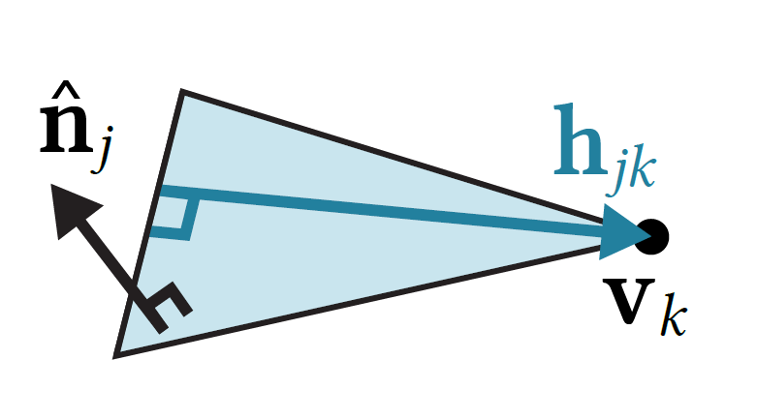

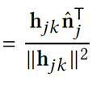
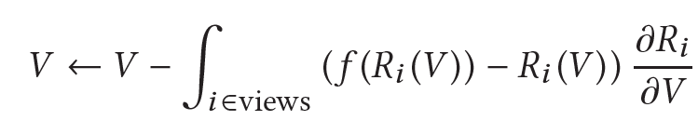
Paparazzi’s solution
Lambertian: Illumination depends only on changes in normal
Flat shading: Per-face normal changes only along “height” vector
Stochastic gradient descent can be applied to multiple views
Support for non-differentiable iterative filters
Notes:
So far I have described the idea behind a single view, but they handle multiple views with stochastic gradient descent, picking a subset of views each iteration. Interestingly, they only pick 1 as surface edits are very local.
Extension to non-differentiable filters only requires replacing the dE/dR with the change the difference in the rendered image

Slide 6
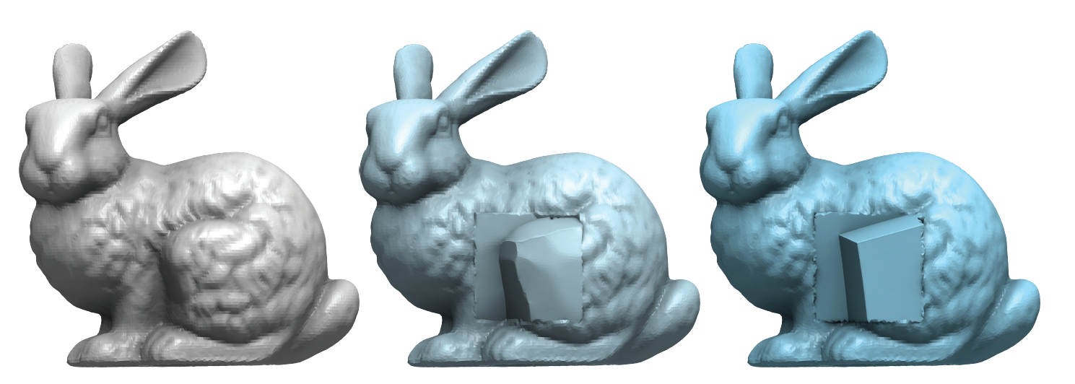

Results –$L_{0}$ smoothing

Slide 7
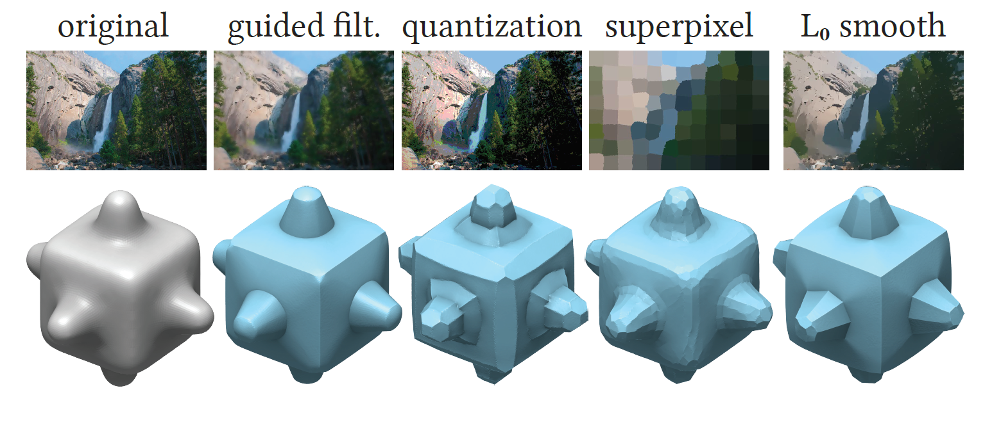
Results – Various filters

Slide 8
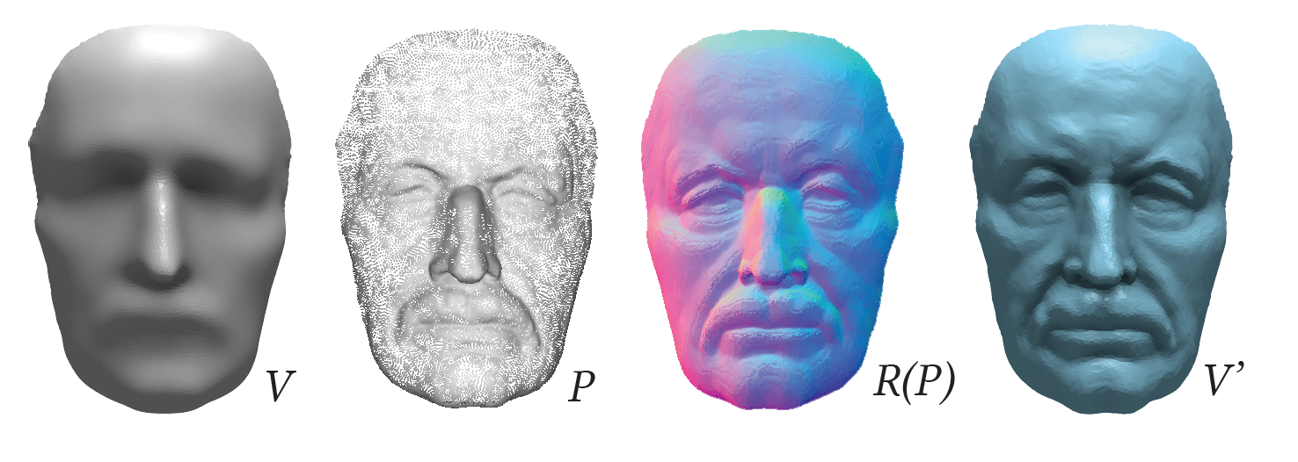
Results – Detail transfer

Slide 9
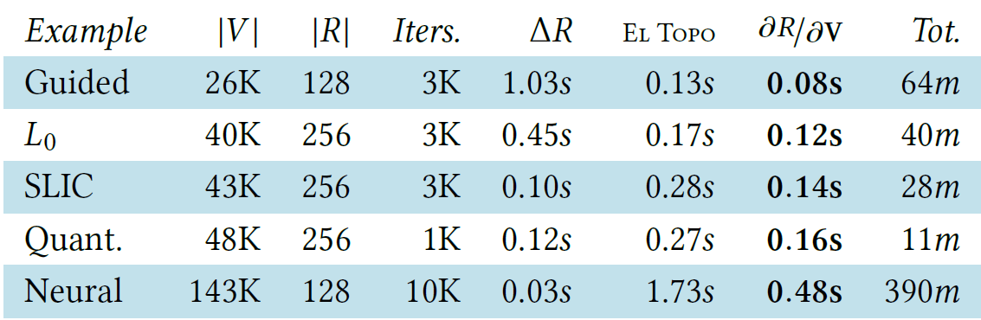
Limitations
Heuristic and scene-dependent camera parameters
Remeshing required to avoid self intersections
Remeshing required to guarantee mesh quality
Simple albedo-free lighting setup with flat shading
(many) Small iterations for convergence
Notes:
Evaluating the derivative is very fast, but

Slide 10

Considerations and Doubts
Interpretation of 2D filter in 3D space (No target deformation)
Optimization convergence controlled “technically”
How much can result diverge from prior?
Details on how to compute ?

Slide 11
Thank you

