Slide 1
Medical Image Analysis 2026
Reason like a Radiologist
Chain-of-Thought and Reinforcement Learning
for Verifiable Report Generation
BoxMed-RL
Peiyuan Jing*, Kinhei Lee*, Zhenxuan Zhang*, Huichi Zhou,
Zhengqing Yuan, Zhifan Gao, Lei Zhu, Giorgos Papanastasiou,
Yingying Fang, Guang Yang
Imperial College London | University of Notre Dame | Sun Yat-sen University | HKUST(GZ) | Academy of Athens

Slide 2
Presentation Outline
01
Introduction & Motivation
Why explainable radiology reports matter
02
Challenges & Prior Work
Workflow mismatch and textual-visual misalignment
03
BoxMed-RL Framework
MCL + SVR pretraining and downstream adapter
04
Experiments & Results
MIMIC-CXR, IU X-Ray benchmarks and ablations
05
Conclusion & Future Work
Summary and next steps

Slide 3
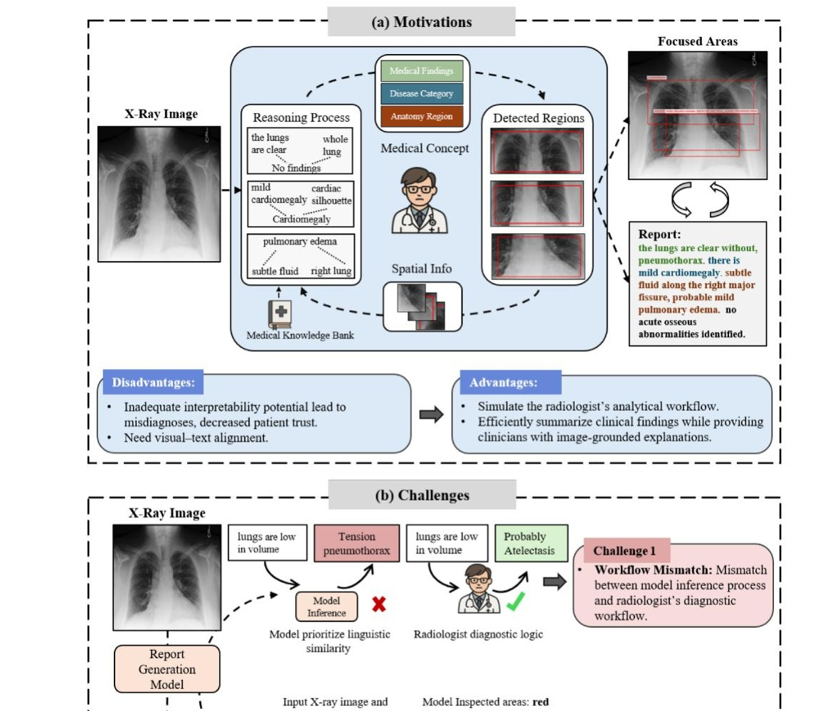
Introduction & Motivation
Radiological imaging is critical for clinical decision-making
Explainability and transparency of AI-generated medical reports are essential for clinical trust
Inadequate explainability leads to miscommunications, potential misdiagnoses, and compromised patient safety
Rapidly increasing imaging volumes create substantial workload pressures on radiologists
Need: Explainable automated report generation combining fine-grained visual perception with clinical reasoning
Fig. 1(a): Clinical motivation — radiologists combine medical
concepts with spatial clues when interpreting chest X-rays

Slide 4
Key Challenges
Challenge 1: Workflow Mismatch
Models generate free-form narratives that deviate from radiologists' structured diagnostic logic
May produce contradictory findings (e.g., "low volume" + "tension pneumothorax")
Prioritize linguistic similarity over clinical plausibility
Challenge 2: Textual-Visual Misalignment
Limited ability to correlate text with visual evidence (e.g., noting a "lung nodule" without localizing it)
Clinicians cannot verify if findings are image-based or from biased language priors
Models "guess" plausible findings without spatial fidelity

Slide 5
Our Contributions
1
BoxMed-RL Framework
First method to combine reasoning and spatial grounding in chest X-ray report generation
2
Medical Concept Learning (MCL)
Forces models to internalize radiologists' diagnostic logic through hierarchical reasoning steps (Findings → Disease → Anatomy)
3
Spatially Verifiable Reinforcement (SVR)
Explicitly aligns textual descriptions with anatomical regions using IoU-based rewards
4
State-of-the-Art Results
Average 7% improvement in METEOR & ROUGE-L, 5% in LLM-based metrics on MIMIC-CXR and IU X-Ray

Slide 6
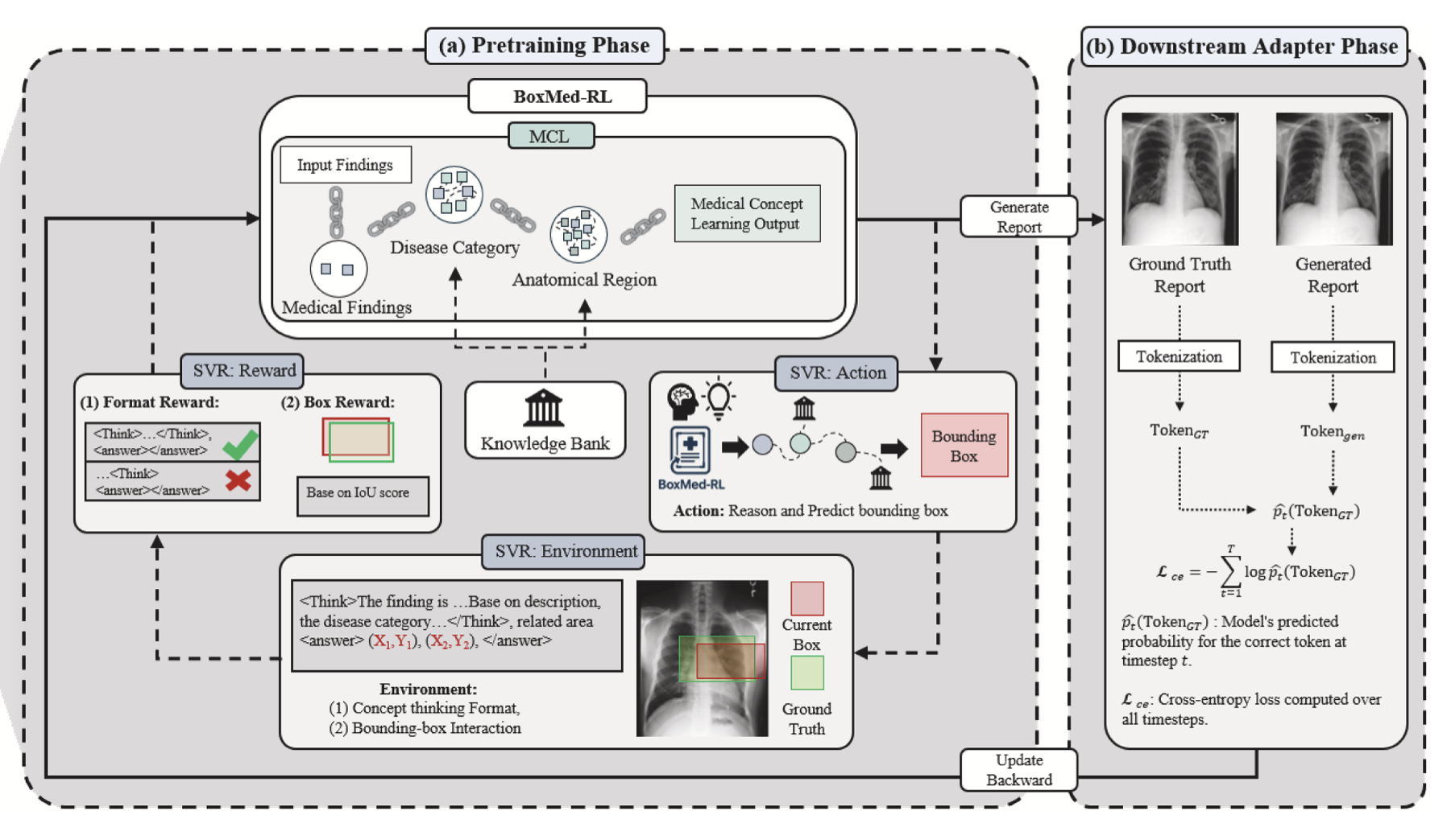
BoxMed-RL: Framework Overview
Two-Phase Training Framework:
Phase 1 — Pretraining:
MCL: Learn radiologist-like reasoning via structured Chain-of-Thought
SVR: Enforce spatial grounding with RL (IoU-based rewards)
Phase 2 — Downstream Adapter:
Freeze pretrained weights
Fine-tune lightweight LoRA adapter for fluent report generation

Slide 7
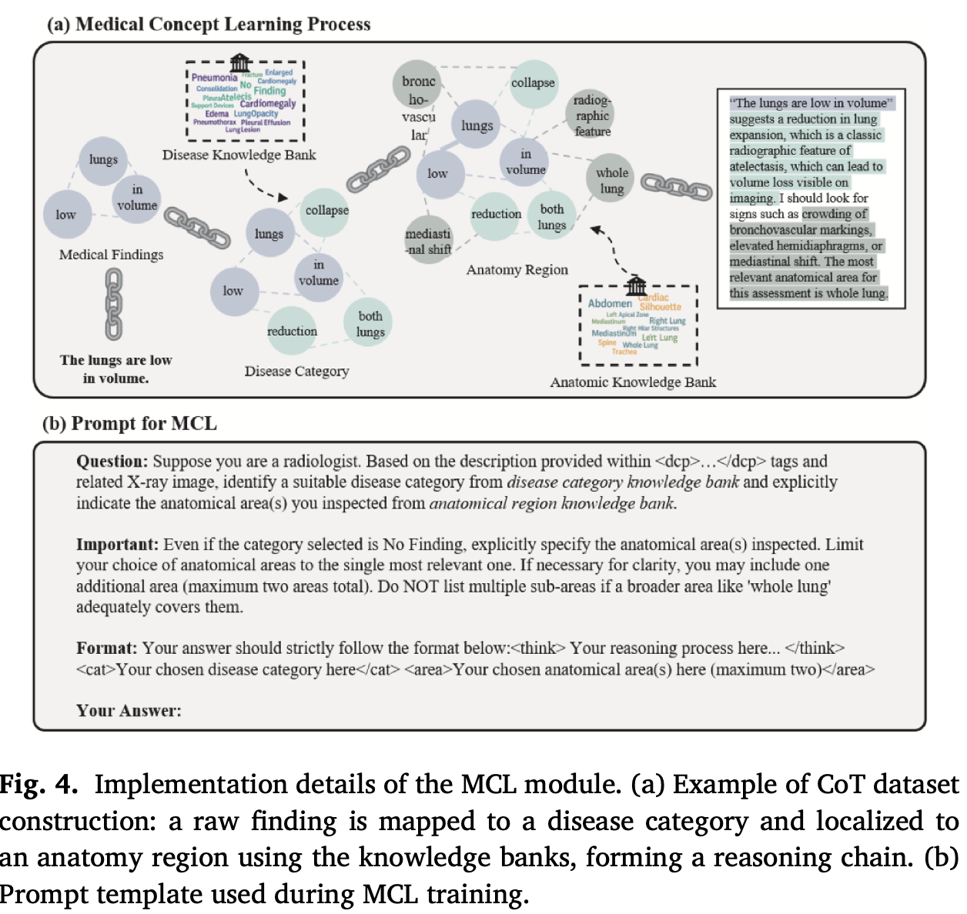
Medical Concept Learning (MCL)
Goal: Internalize hierarchical diagnostic logic of radiologists
Structured Chain-of-Thought reasoning dataset:
Findings → Disease Category → Anatomical Region
Knowledge banks curated with senior radiologist:
Disease Knowledge Bank: 14 CheXbert labels
Anatomy Knowledge Bank: 12 regions (11 STREAM + "whole lung")
Output format: <think> reasoning → <cat> disease → <area> anatomy
3,772 structured reasoning chains constructed
Optimized with cross-entropy loss on CoT annotations

Slide 8
Spatially Verifiable Reinforcement (SVR)
Goal: Bridge the gap between textual descriptions and anatomical evidence
RL with Verifiable Rewards:
Uses Group Relative Policy Optimization (GRPO)
No separate value network needed — compares within group
Two Reward Components:
IoU Reward: Measures overlap between predicted and ground-truth bounding boxes (threshold > 0.3)
Format Reward: Binary signal enforcing <think>...<answer> structured output
Combined reward:
R(q, yᵢ) = R_IoU(q, yᵢ) + R_format(q, yᵢ)
KL divergence regularization against frozen reference model

Slide 9
Downstream Adapter Phase
Freeze Backbone
Pretrained BoxMed-RL weights (θ'') are frozen to preserve structured reasoning and spatial alignment from MCL + SVR
LoRA Adapter
Lightweight Low-Rank Adaptation adapter is attached and fine-tuned on raw radiology reports for fluent, clinically coherent text generation
Cross-Entropy Training
Adapter trained with cross-entropy loss on chest X-ray image–report pairs, learning professional phrasing while preserving diagnostic logic
Key Insight: Freezing backbone prevents catastrophic forgetting of reasoning and grounding abilities

Slide 10
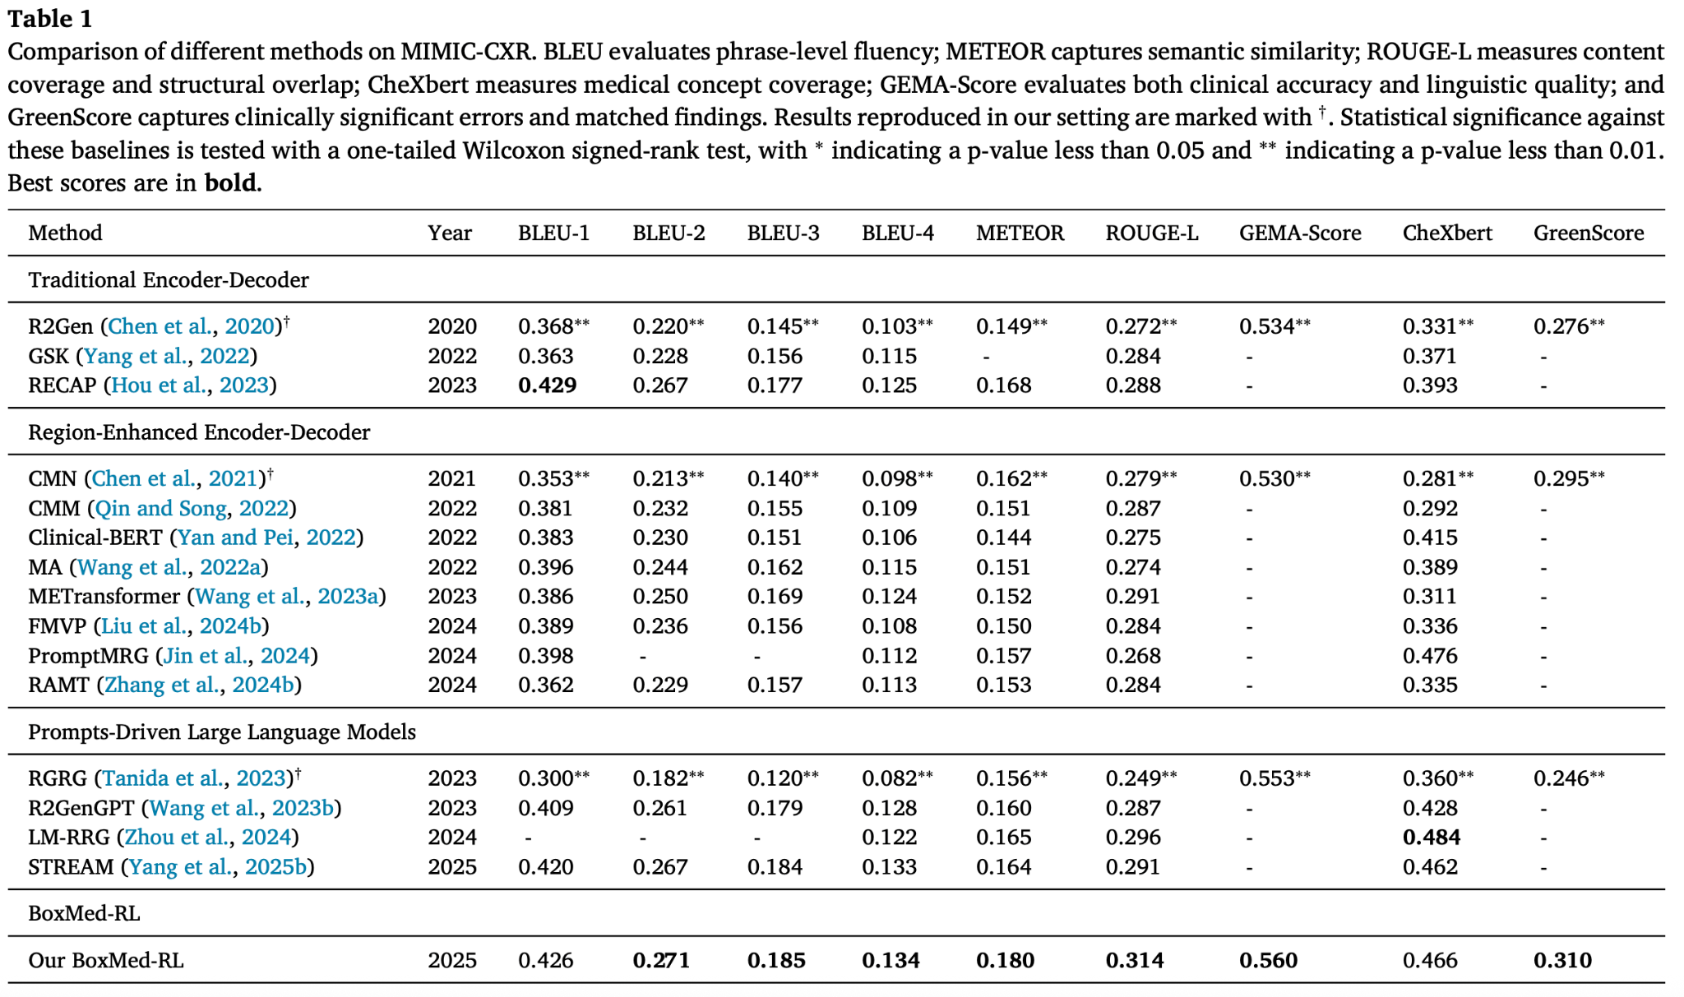
Results: MIMIC-CXR Benchmark
Key Findings on MIMIC-CXR:
SOTA in BLEU-3 (0.185), BLEU-4 (0.134)
Best METEOR (0.180) and ROUGE-L (0.314) — avg. 7% improvement
Best LLM-based metrics: GEMA-Score (0.560) and GreenScore (0.310)
Competitive CheXbert (0.466) without explicit clinical metric optimization
Higher-order BLEU scores reflect clinical coherence over surface fluency

Slide 11
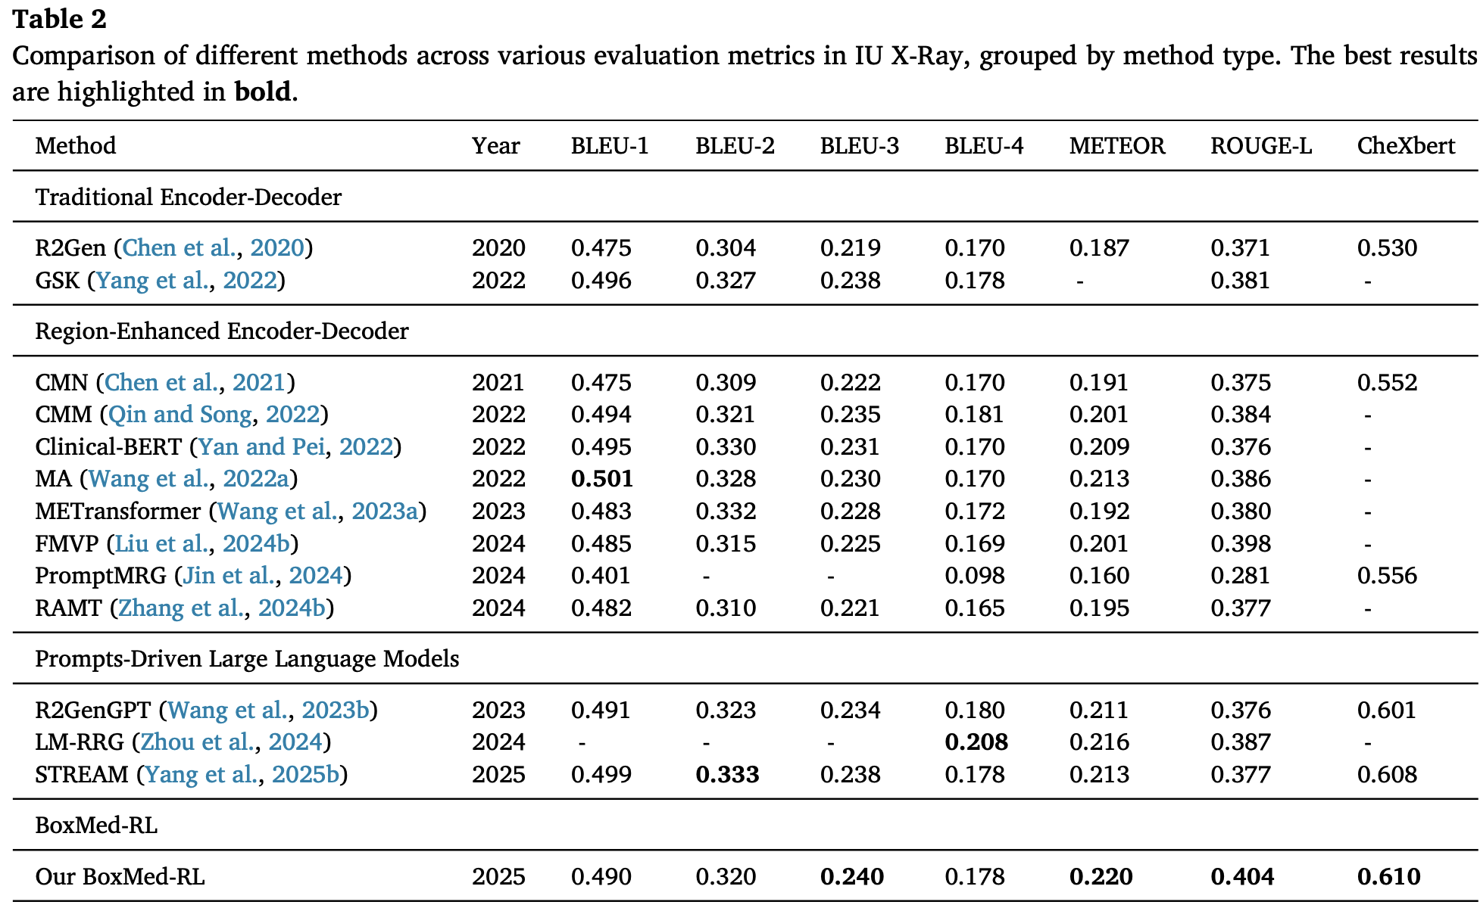
Results: IU X-Ray Benchmark
Key Findings on IU X-Ray:
Best BLEU-3 (0.240), best METEOR (0.220)
Best ROUGE-L (0.404) — significant improvement over all baselines
Best CheXbert cosine similarity (0.610)
Consistent gains across datasets demonstrate robustness and generalizability
BoxMed-RL uniquely balances NLG quality, clinical accuracy, and explainability

Slide 12
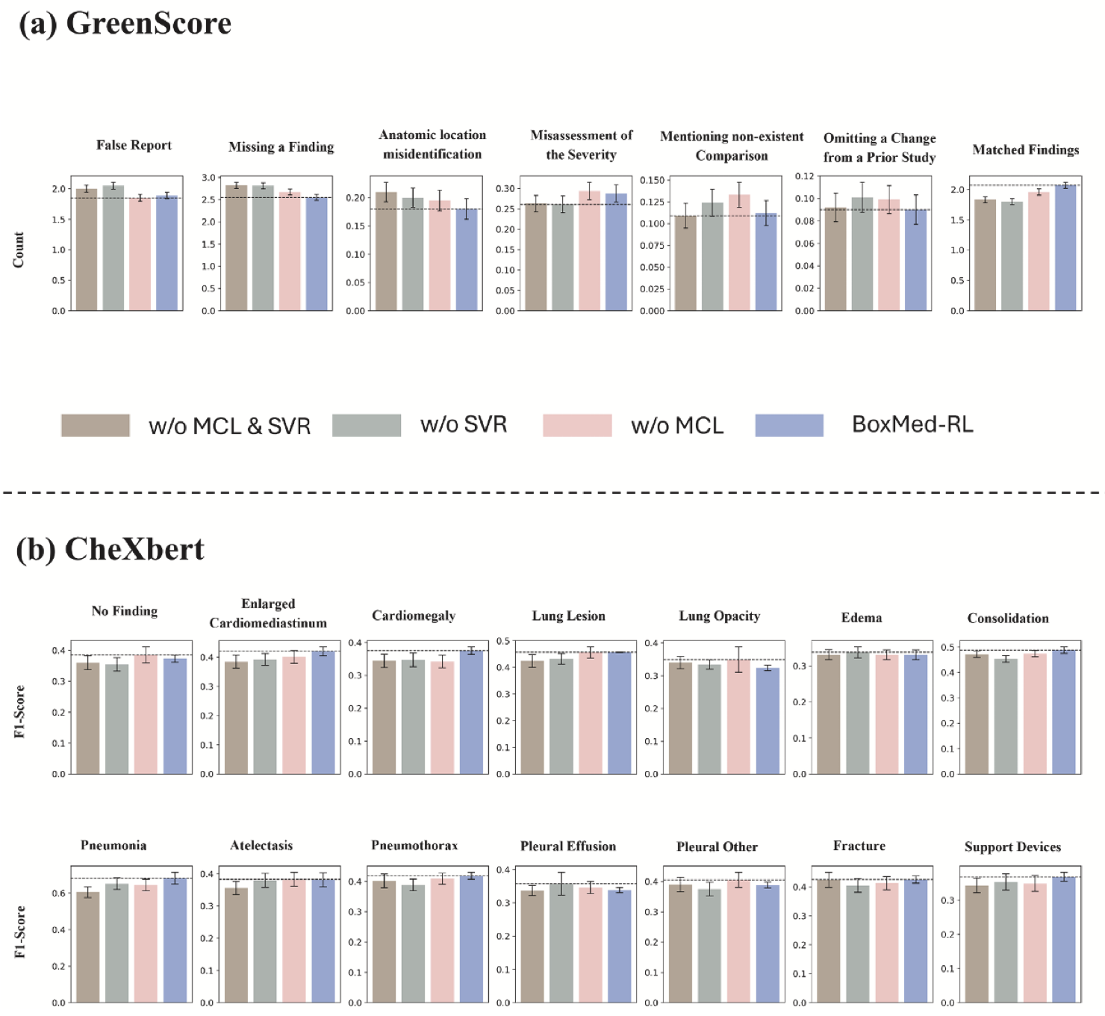
Ablation Study
Component Analysis:
w/o MCL & SVR: Adapter-only baseline — no reasoning or grounding
w/o SVR: MCL alone improves BLEU-3/4 and CheXbert (+7% BLEU)
w/o MCL: SVR alone strengthens GreenScore & GEMA-Score (+3% BLEU)
w/o Frozen: Full fine-tuning improves BLEU-1/2 but hurts all other metrics — loses internalized reasoning
Full BoxMed-RL: Best overall — 22% avg BLEU improvement, 15% CE improvement
Fig. 5: GreenScore criteria and CheXbert category analysis

Slide 13
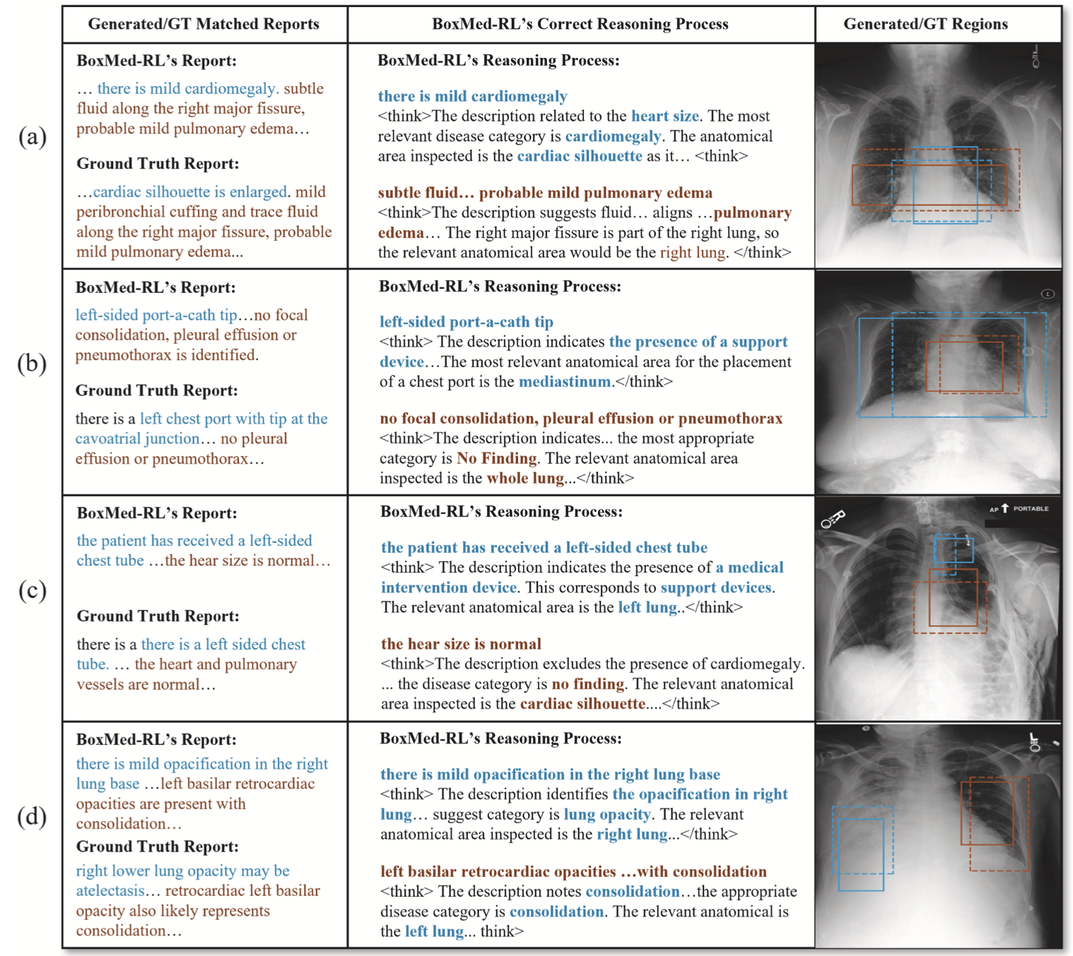
Qualitative Results: Success Cases
BoxMed-RL produces interpretable reasoning chains:
Correctly links findings to disease categories (e.g., "mild cardiomegaly" → heart size → cardiac silhouette)
Detects support devices and localizes to correct anatomy regions
Predicted bounding boxes (dashed) closely match ground truth (solid)
Color-coded report findings match their corresponding anatomical regions
Enables clinicians to verify and understand how each report statement arises from image evidence
Fig. 6: Qualitative examples — generated/GT reports, reasoning chains, and detected anatomy regions

Slide 14
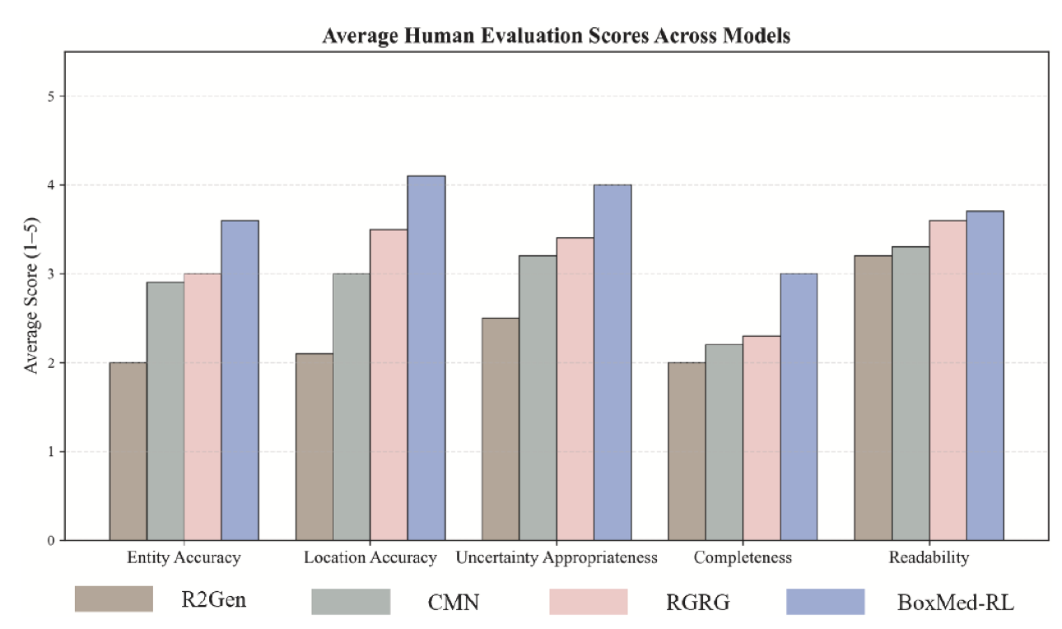
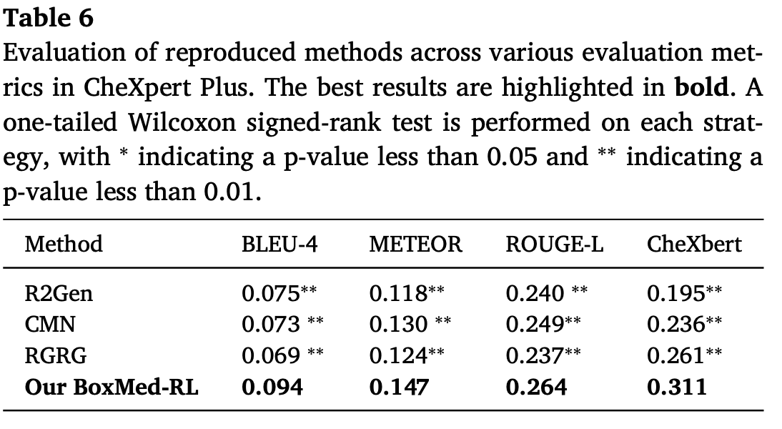
Human Evaluation & External Validation
Radiologist Evaluation (5-point Likert):
BoxMed-RL achieves highest scores across all 5 metrics
Especially strong in Entity Accuracy and Location Accuracy — reflecting MCL + SVR benefits
External Validation (CheXpert Plus):
Consistently outperforms baselines under cross-domain distribution shifts
CheXbert improved by avg. 36% vs prior models — demonstrating strong generalization

Slide 15
Conclusion & Future Work
Summary
BoxMed-RL unifies medical concept learning with spatially verifiable RL for chest X-ray report generation
Addresses workflow mismatch and textual-visual misalignment simultaneously
Avg. 7% improvement in METEOR & ROUGE-L; 5% in LLM-based metrics
Strong generalization on external CheXpert Plus dataset

Slide 16
Thank You!

