Slide 1
Self-improving LLM agents · clinical FHIR benchmarks
GRASP
Gated Regression-Aware Skill Proposer
Agent self-improvement as a sequence of validated edits to a small, reversible skill library
Moll, Corbeil, Pan, Hadamitzky, Rueckert, Adams, Bressem · TU Munich & TUM University Hospital · Microsoft Healthcare & Life Sciences
*Presentation prepared with Claude

Slide 2
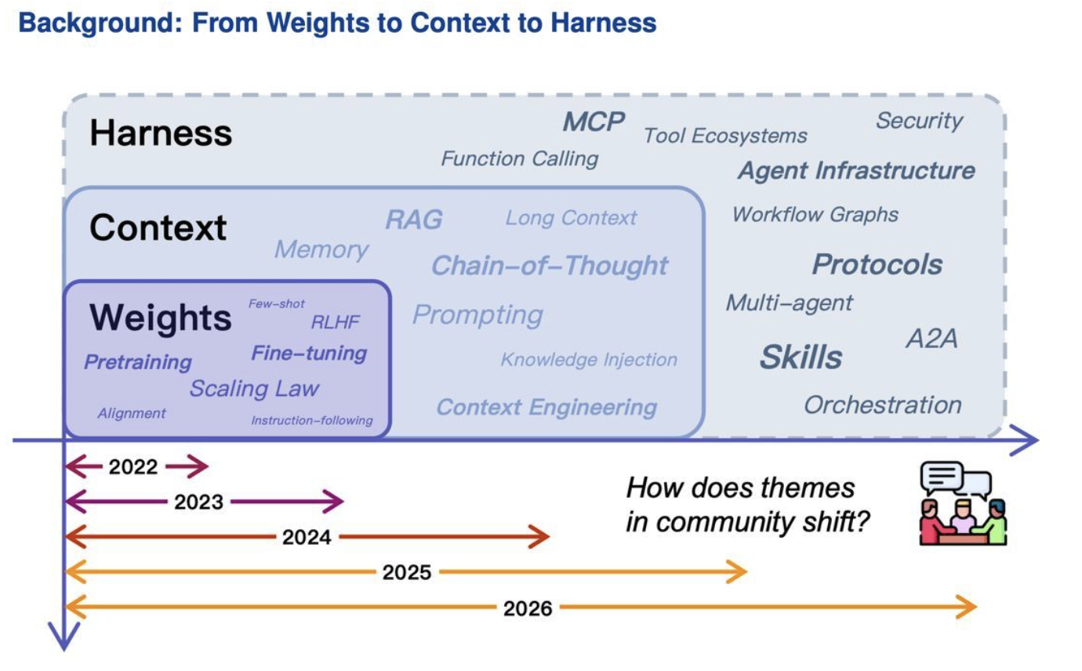

Slide 3



PROMPT → SKILL
A prompt is what you say. A skill is what the agent keeps.
Prompt
Skill
A single instruction, used once.
A reusable capability the agent loads on demand — a real file.
SKILL.md
Lives in the context for one turn
One-shot — re-typed every time
Nothing persists after the chat
Great for a quick, specific ask
---
name: pdf-filler
description: Read and fill PDF forms.
Use whenever a .pdf form needs to
be completed, merged, or extracted.
---
# PDF Filler
## Workflow
1. Inspect the form’s field names
2. Run “vi data/info.txt” in CLI to extract the information
3. Write the output, then verify
Example
“Write a Python CLI that scores a webpage’s SEO.”
Progressive disclosure: the model sees only the description up front, and loads the full file only when the task calls for it.

Slide 4










AGENT VS HARNESS
A harness wraps the agent
AGENT
HARNESS
the reasoning entity
the system the agent runs inside
runs the agent(s):
agent
agent
…
Model — reasons & decides
Loads their skills
Gives tools & context
Runs the agent loop
A goal + an identity
Acts: think → act → observe
Logs actions & errors
Evaluates outputs
Manages many agents
A model given a goal: it decides and acts, one turn at a time.
The agent runs inside the harness. One harness can run, equip, log, and grade many agents.

Slide 5
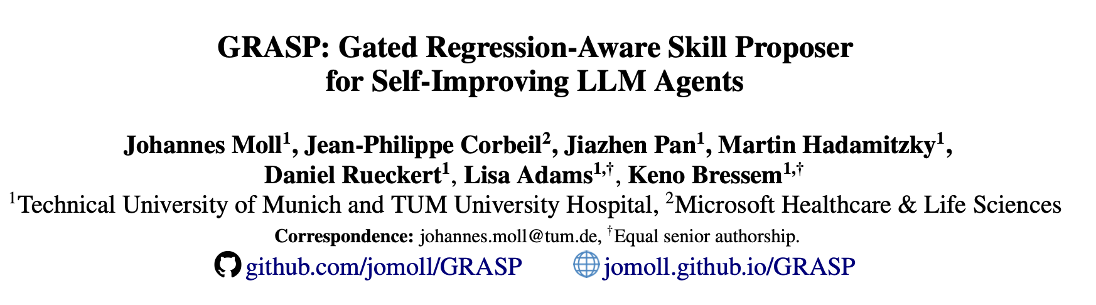
Today’s Paper

Slide 6
BENCHMARKS · TASK EXAMPLES
Task Examples
Each task is scored independently against its own patient record. {MRN} is a placeholder for a patient identifier; distinct IDs below denote distinct patients.
ACTION TASKS
RECORDING PATIENT DATA
“Record a blood pressure of 118/77 mmHg for patient S6534835.”
TEST ORDERING (CONDITIONAL)
“Check patient S3236936's most recent potassium level. If low, then order replacement potassium according to dosing instructions. Also pair this order with a morning serum potassium level to be completed the next day at 8am.
MEDICATION ORDERING (CONDITIONAL + DOSING)
“Review potassium (LOINC 2823-3) for S1023381. If <3.5, order 10 mEq oral repletion per 0.1 below goal (NDC 40032-917-01).”
REFERRAL / SAFETY PROTOCOL (V2)
“Order an orthopedic referral for S2703270 (ACL tear).” · “For each active opioid order, ensure a matching naloxone prescription.”

Slide 7
MOTIVATION
Why agents fail — and why prior fixes regress
Structured environments (EHRs, databases, web) impose operational rules. Agents fail procedurally — wrong resource, missed temporal filter, duplicate order, unverified write — not for lack of language ability.
Prior self-improvement
What GRASP requires instead
Accumulates natural-language guidance monotonically
Reflexion-style critiques or ExpeL-style rules, admitted as soon as produced
No held-out check that a new note preserves prior correct behavior
A note that fixes one trajectory can silently regress another
Unbounded growth dilutes context and degrades the agent
Held-out validation of every candidate before it is admitted
A bounded library that supports modify and remove, not just add
An explicit regression budget on previously correct behavior
Skills are small, versioned, reversible Markdown documents
No parameter updates — improvement lives entirely in context
Reliability depends on procedural knowledge of the environment — how to act in it — not on general clinical or language competence.

Slide 8
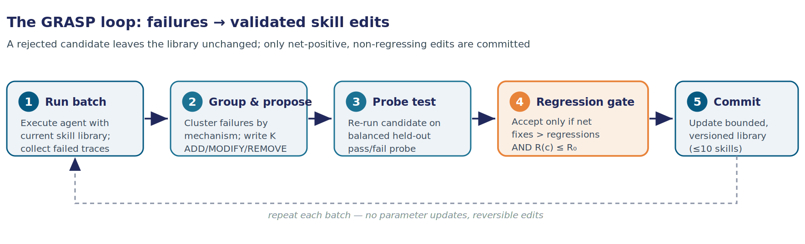
THE METHOD
How GRASP turns failures into validated edits

Slide 9
THE METHOD · SECTION 2
Inside GRASP: skills, proposal, and gated selection
2.1 · THE UNIT
2.2 · PROPOSAL
2.3 · SELECTION
What a skill is
Failure-driven editing
Regression-aware gate
A structured behavioral instruction injected into context at inference
Four parts: trigger condition, behavioral rule, optional verification step, contrastive example
Written as Markdown + YAML frontmatter — auditable and reversible
Library starts empty; populated only from training trajectories
Classify: an LLM labels each failed trace by mechanism — two labels imply two different fixes
e.g. date_filter_omitted, not wrong_answer; new labels minted only when none fit
Group by label (no minimum size) — one distinct failure can trigger a proposal
Skill Writer returns ADD / MODIFY / REMOVE to the skills
Each candidate re-run on a balanced probe of previously-failing + previously-passing samples
Probe is out-of-sample, drawn only from the dev split (never val / test)
Current library re-run first for a fresh causal baseline (F₀, R₀)
Accept iff net fixes > 0 AND no new regression (R(c) ≤ R₀); else unchanged
ACCEPTANCE CRITERION
( F(c) − F₀ ) − ( R(c) − R₀ ) > 0 and R(c) ≤ R₀
left net fixes over regressions right hard regression budget
If the winner still causes any regression, a contrastive revision narrows its trigger or adds a guard clause — kept only if it scores strictly higher and stays within budget.

Slide 10
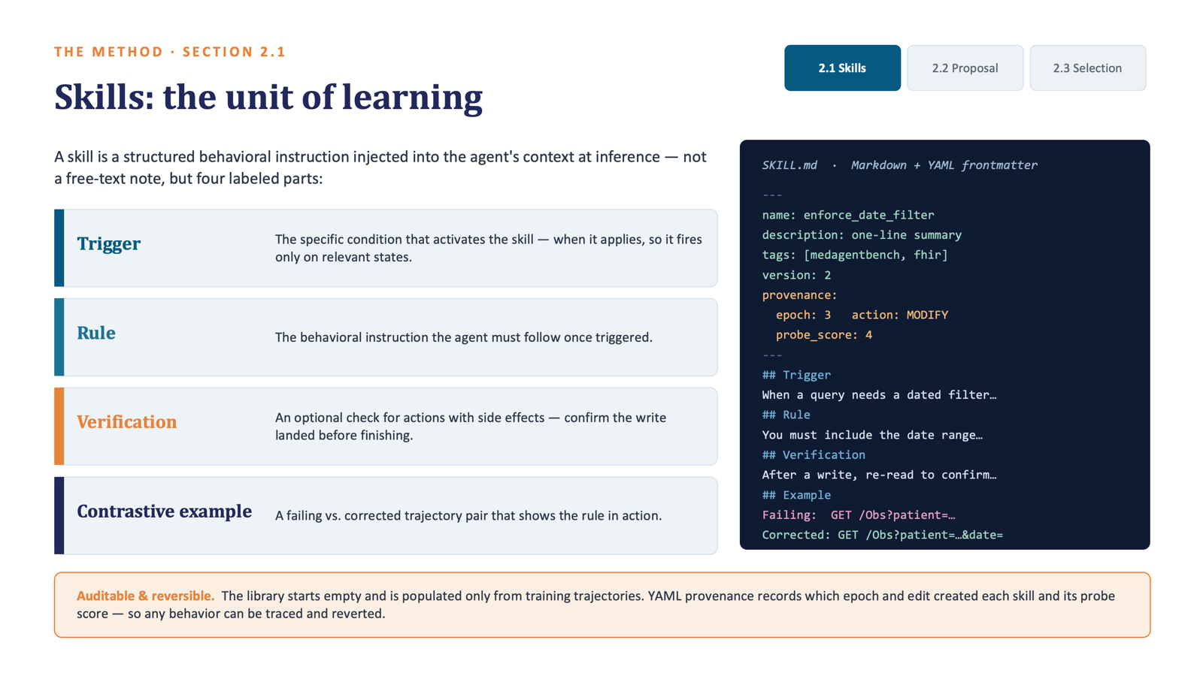

Slide 11
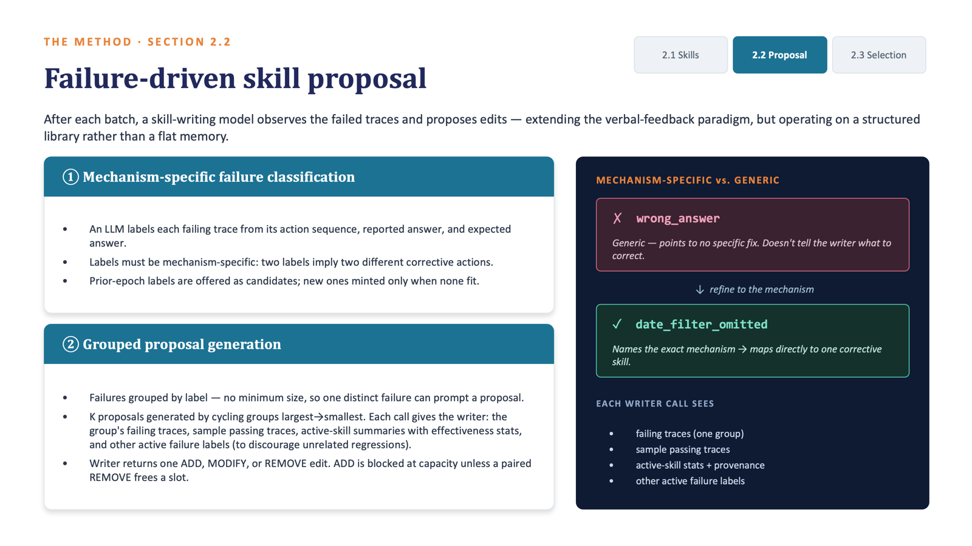

Slide 12
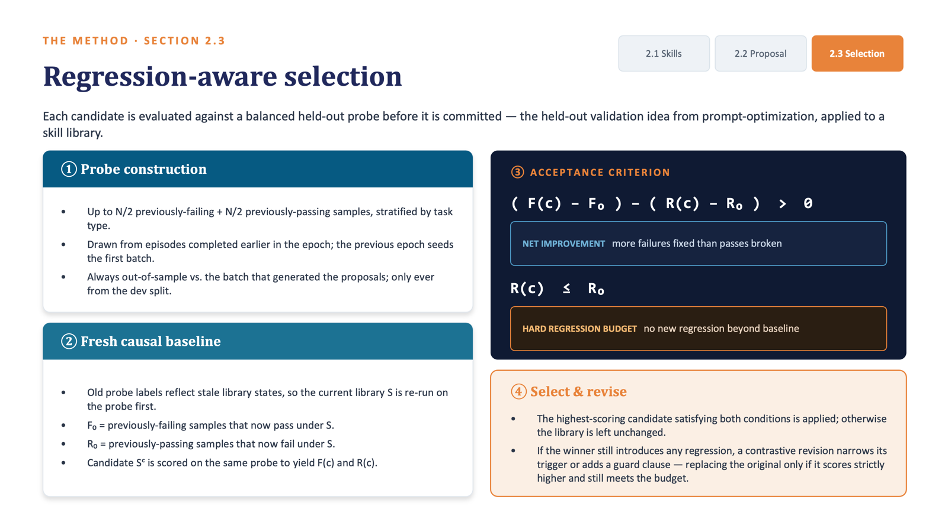

Slide 13
APPENDIX B.1 · ALGORITHM 1
The per-batch GRASP update, step by step
Input: library S · batch B · prior runs H · max proposals K · probe size N
1
Run & record
// 1 — Run batch, record outcomes
Execute the agent on the batch with the current library; log which episodes pass or fail.
1
Tᴮ ← run agent with library S on episodes in B
2
record per-episode correctness in H
3
Fᴮ ← failed traces in Tᴮ
2
Group & propose
// 2 — Group failures & propose K edits
Cluster failures by mechanism, then write K candidate edits (add / modify / remove) for the most frequent modes.
4
L ← ClassifyByFailureMode(Fᴮ)
5
{Cₖ} ← Propose(Fᴮ, L, S) // K candidates
// 3 — Build probe (never touches val / test)
3
Construct probe
6
P_fail, P_pass ← StratifiedSample(H\B, N/2, N/2)
Sample a balanced, stratified probe from earlier dev runs — strictly out-of-sample, never val or test.
// 4 — Baseline: re-run current S on probe
7
F₀ ← |{x∈P_fail : x passes under S}|
8
R₀ ← |{x∈P_pass : x fails under S}|
4
Causal baseline
// 5 — Score each candidate on the same probe
Re-run the current library on that probe for fresh fix / regress counts F₀, R₀ under today's state.
10
for c in {C₁..Cₖ}:
11
Sᶜ ← apply c to a fork of S
Score candidates
12
compute F(c), R(c) on probe under Sᶜ
5
14
score(c) ← (F(c)−F₀) − (R(c)−R₀)
For each fork, recount fixes and regressions: score = net fixes minus net regressions.
// 6 — Accept best within regression budget
15
C* ← {c : score(c) > 0 and R(c) ≤ R₀}
6
Gate & commit
17
c* ← argmax score(c) // if C* nonempty
Keep the top candidate that clears the budget; if it still regresses, revise its trigger — else leave S unchanged.
19
if R(c*)>0: c* ← ContrastiveRevision(c*)
20
S ← apply c* to S → return S

Slide 14
BENCHMARKS
FHIR clinical agent environments
Agents query a live FHIR server via GET/POST calls, within an 8-action budget. Scoring is exact-match against ground-truth answers and server state.
MedAgentBench
MedAgentBench-v2
FHIR-AgentBench
Jiang et al., 2025 · NEJM AI
Chen et al., 2025 · PSB 2026
Lee et al., 2025 (supporting)
300 physician-written tasks, 10 categories
100 patient profiles, 700k+ records (Stanford STARR)
Retrieval, medication reconciliation, verified writes
~2–3 steps per task; query + action types
10 redesigned task types with safety protocols
Multi-step decision logic & coordinated writes
Anticoagulation, QTc, opioid–naloxone, oncology referral
Independent held-out OOD workflows
Read-only structured clinical QA
MIMIC-IV FHIR on Google Cloud Healthcare API
Python-tool + free-text interface (different convention)
LLM-judged answer accuracy

Slide 15
COMPARISON
Baselines: memory, rules, and skill libraries
All methods share the same base agent, decoding, training episodes, and injection field — isolating the learned content and update rule.
No skills
Sequential memory
1
The bare agent with no learned guidance — the floor every method is measured against.
2
Appends a natural-language correction note after each failing episode; memory grows unbounded with no acceptance gate.
Batch memory
ExpeL
3
Same as sequential but updated once per batch, matching GRASP's cadence to isolate the gate from update frequency.
4
Extracts contrastive rules by pairing failing traces with nearest successes; AGREE/EDIT/REMOVE/ADD on a rule list capped at 20.
Evo-MedAgent
SkillX
5
Maintains episodic + semantic memory stores with top-k retrieval and per-rule utility tracking, but no probe-based gate.
6
Extracts skills from successful trajectories via LLM decomposition, retrieved by token overlap, with no regression control.

Slide 16
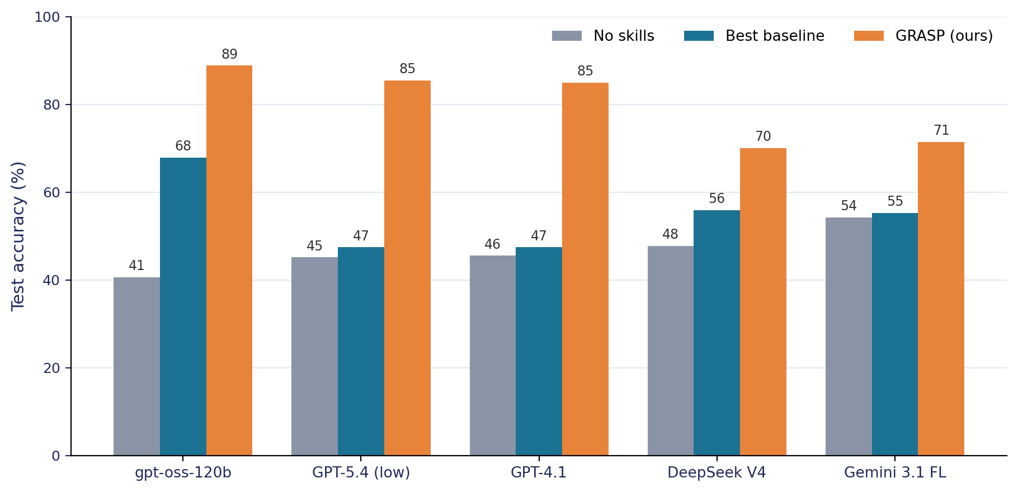
RESULTS — HEADLINE
GRASP wins on every model, in-domain and OOD
Takeaways
gpt-oss-120b: 40.6 → 88.8%
+48.2 over no-skills, +21.0 over the best baseline (Evo-MedAgent)
Every model improves 17.2–40.3 points
GPT-5.4 +40.3 · GPT-4.1 +39.4 · DeepSeek +22.3 · Gemini +17.2
OOD lead is larger
e.g. GPT-5.4 80.6% vs 16.7% best baseline
MedAgentBench in-domain test accuracy

Slide 17
RESULTS — FULL TABLE
Table 1 · Test accuracy on two FHIR benchmarks
 | MedAgentBench |  |  | MedAgentBench-v2
Method | Val* | Test | OOD | Val* | Test | OOD
gpt-oss-120b
No skills | 36.4 | 40.6 | 8.7 | 57.6 | 61.1 | 75.2
Evo-MedAgent | 62.5 | 67.8 | 31.3 | 65.3 | 66.9 | 86.7
SkillX | 51.5 | 53.1 | 21.3 | 67.5 | 64.1 | 87.1
GRASP (ours) | 86.0 | 88.8 | 56.3 | 77.0 | 76.9 | 86.0
GPT-5.4 (low)
No skills | 40.6 | 45.1 | 1.7 | 63.5 | 59.9 | 82.7
Best baseline | 47.9 | 47.4 | 16.7 | 70.4 | 63.5 | 86.7
GRASP (ours) | 84.6 | 85.4 | 80.6 | 71.2 | 63.3 | 80.0
GPT-4.1
No skills | 40.1 | 45.5 | 0.3 | 65.9 | 70.5 | 84.9
Best baseline | 46.2 | 47.4 | 2.2 | 72.5 | 74.0 | 84.4
GRASP (ours) | 86.2 | 84.9 | 27.2 | 73.8 | 70.3 | 82.8
Reading the table
MedAgentBench: GRASP is strongest on every model, in-domain and OOD.
v2 is more mixed: GRASP leads in-domain on 3 of 5 models. On GPT-4.1/GPT-5.4 it ties baselines where the 8-action budget is exhausted on paginated search.
v2 OOD: closely matched; no superiority claimed.
Bold = best in column within a model. Val* = best validation across epochs; OOD = held-out task types. Full table covers all five models × six baselines.

Slide 18
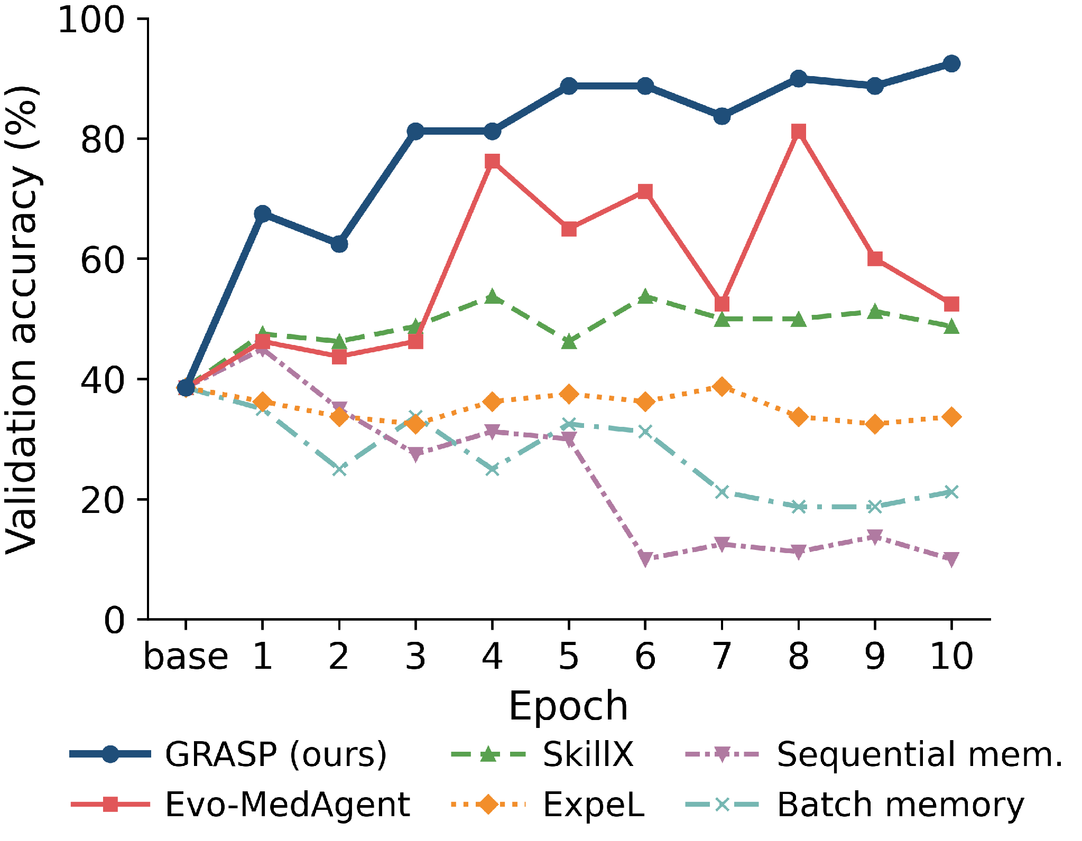
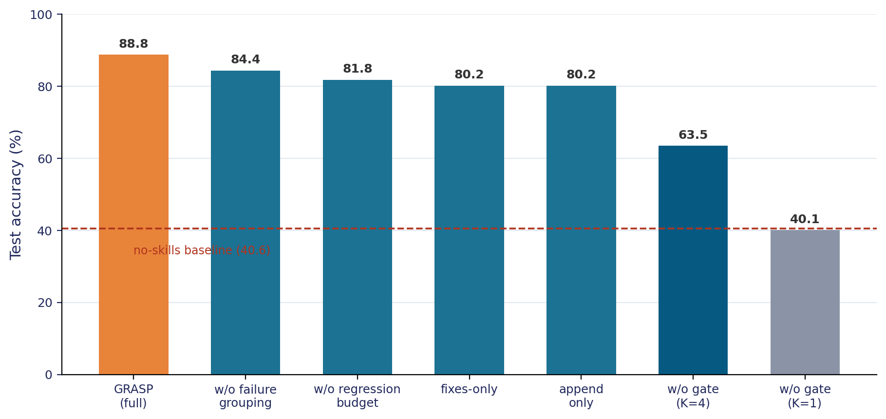
WHY IT WORKS
Stable learning, and the gate is the source of the gain
Learning stability (Figure 1)
Ablations (Table 4)
Removing the acceptance gate is decisive: K=1 with no gate falls to 40.1% — the no-skills baseline. Skill writing alone is no better than no skills.
GRASP rises near-monotonically, stable >85% from epoch 3. Memory baselines regress below no-skills as context accumulates; Evo oscillates >20 pts.
Matched-compute controls spend the full probe budget but discard its verdict → stay at no-gate level. The gain is the validation decision, not the compute.

Slide 19
GENERALIZATION
Frozen skill libraries transfer across models & benchmarks
Cross-model transfer (MedAgentBench)
Cross-benchmark transfer (gpt-oss-120b)
Skill source ↓ / Executor → | Split | gpt-oss | Gemini | GPT-5.4
None | Test | 40.6 | 54.2 | 45.1
 | OOD | 8.7 | 18.1 | 1.7
gpt-oss | Test | 88.8 | 79.7 | 72.4
 | OOD | 56.3 | 36.1 | 51.7
GPT-5.4 | Test | 76.0 | 76.6 | 85.4
 | OOD | 77.8 | 71.1 | 80.6
MAB ↔ MAB-v2
Positive both ways — shared tool-calling convention. MAB skills reach 78.1% on v2 (> v2 self-training).
→ FHIR-AgentBench
Every transferred library degrades it: a different Python-tool / free-text interface yields malformed calls.
A stronger writer (GPT-5.4) lifts every weaker executor's OOD beyond self-training — the reverse never holds. No ungated baseline reproduces this asymmetry (Appendix E.5).
DBBench control
The non-clinical control transfers negatively or neutrally to every clinical target.
What transfers is procedural knowledge tied to an environment and its interface — not clinical FHIR competence in general.

Slide 20
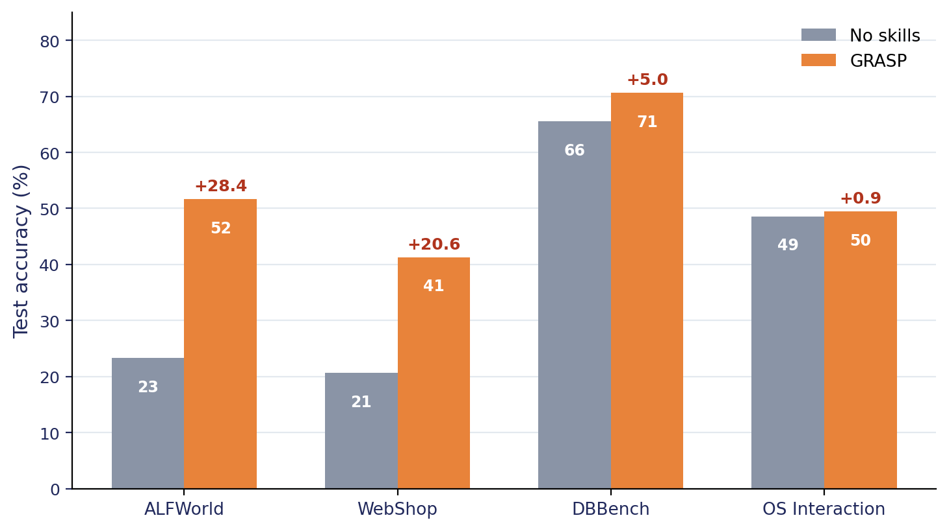
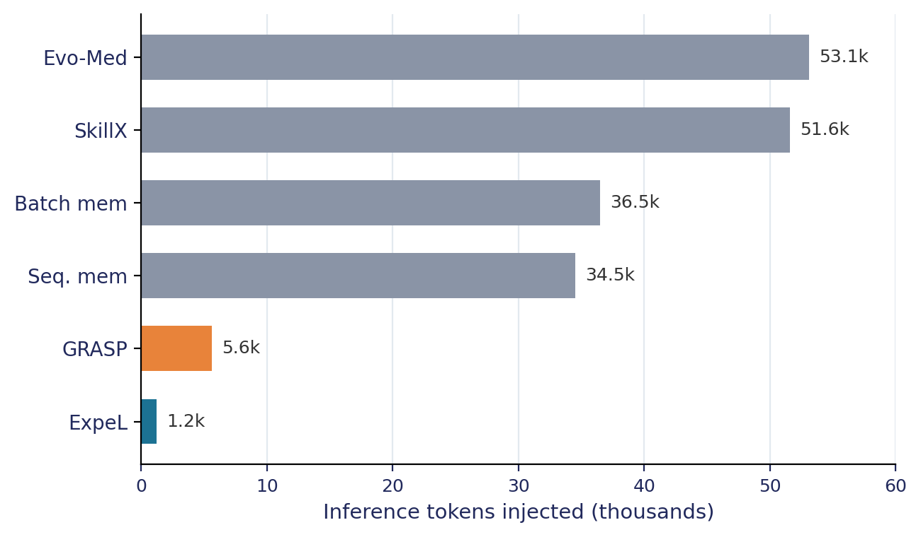
SCOPE & PRACTICALITY
Where it generalizes — and why it's deployable
Helps where tasks recur with verifiable structure (ALFWorld, WebShop); flat where the action space is open-ended (OS Interaction).
Bounded & auditable. ~5 skills, ≈5.6k tokens vs 34–53k for memory baselines — an order of magnitude less, and it doesn't grow with training. Each skill is a versioned document recording its trigger, probe score, and what it replaced.

Slide 21
CONCLUSION
Gated editing beats monotonic accumulation
1
Validated edits, not accumulation
2
The gate is the mechanism
GRASP converts failures into gated edits of a bounded, reversible skill library — +21.0 pts over the strongest baseline, across five models on two FHIR benchmarks.
Ablations localize the gain to the acceptance gate, not skill writing: without validation, skill writing is no better than no skills.
3
Environment-procedural knowledge
4
Practical to deploy
Stronger-writer libraries lift weaker executors (the reverse fails); skills break across interface boundaries — encoding procedure, not model quirks.
Bounded token cost and per-skill auditability suit settings that must be inspected and corrected after deployment rather than retrained.
Limitations: benchmarks score procedural reliability against FHIR state, not clinical outcomes; the probe is GRASP's dominant cost (~440 agent calls/batch); transfer is asymmetric. Clinical deployment would require clinician review of each skill.

