Slide 1
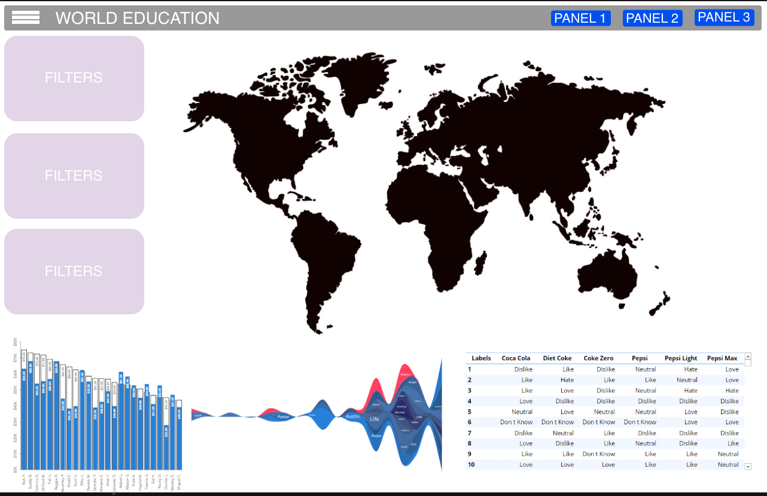
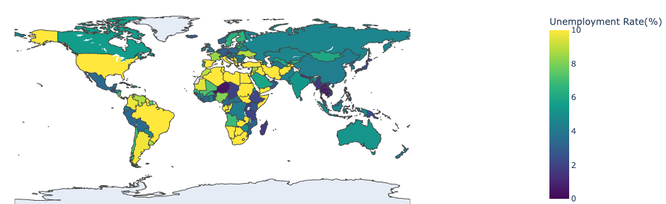
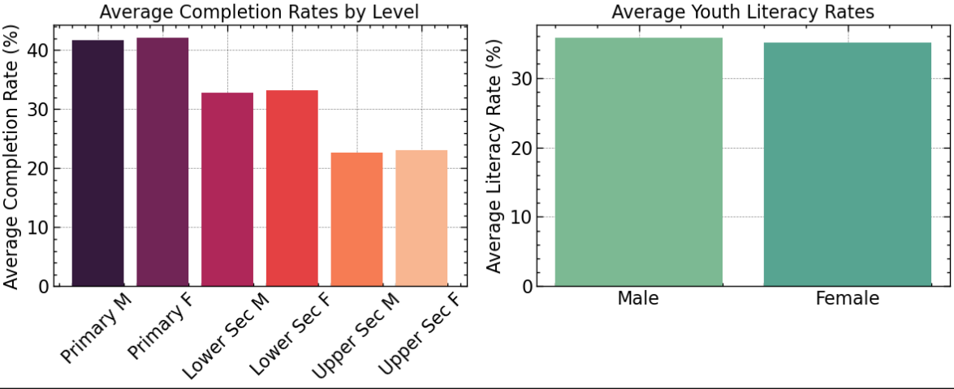
Multipaned View for additional information [if any]
Dashboard title and filter toggle
FILTERS
WORLD EDUCATION
HEAT MAP which we can visualize each feature
Dropdown menus
SELECT REGION
EDUCATION LEVEL
INDICATOR
Slider filters
YEAR RANGE
GENDER
MALE
FEMALE
APPLY FILTERS
Bar charts / stream charts for comparing trends
DATA TABLE showing filtered statistics

