Slide 1
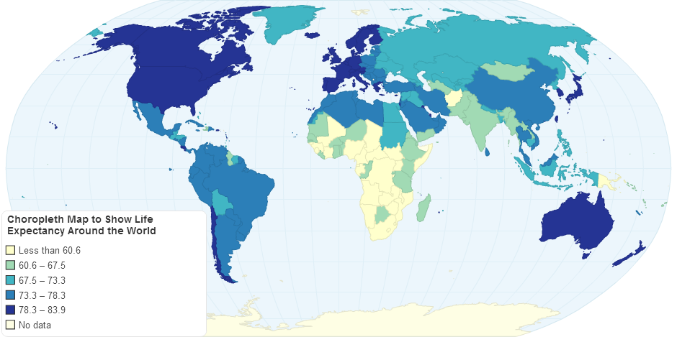

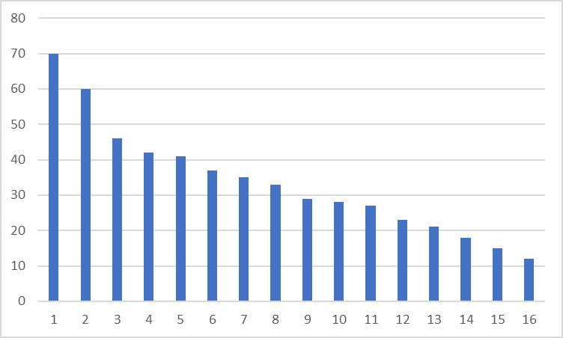
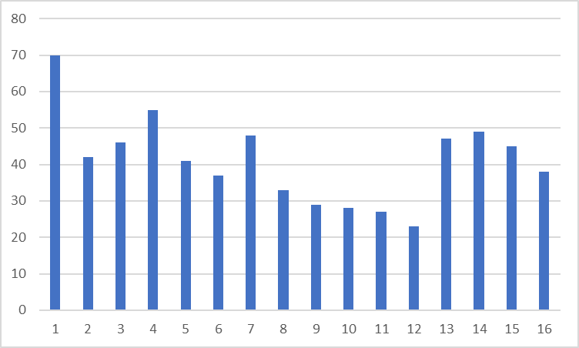
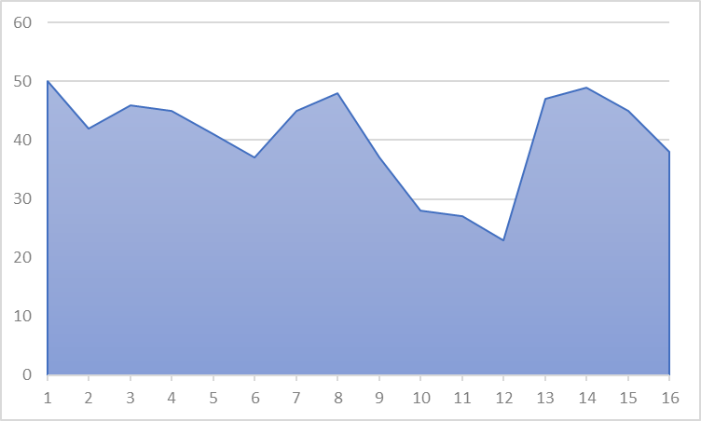
World Wide Arms and Ammunition Movement and GDP effects
IMPORT
EXPORT
Interactive choropleth that allows a country to be selected for the bottom two graphs
NET IMPORT
Import USD
Gradient
of values
Corresponding to
Button selected
Three buttons to change what is shown on the choropleth and weapons % GDP graph
Year
Year slider bar that changes the choropleth map and weapons as % of GDP chart for the year on the slider bar
Weapons as % of GDP “Year” – (changes with slider)
Import as % of GDP
Country changes based on selection in choropleth
Countries of Interest
USA Weapons Import share in GDP
USA Weapons Import
Year highlighted based on slider bar
GDP%
USD
Year highlighted based on slider bar
Year
Year

