Slide 1
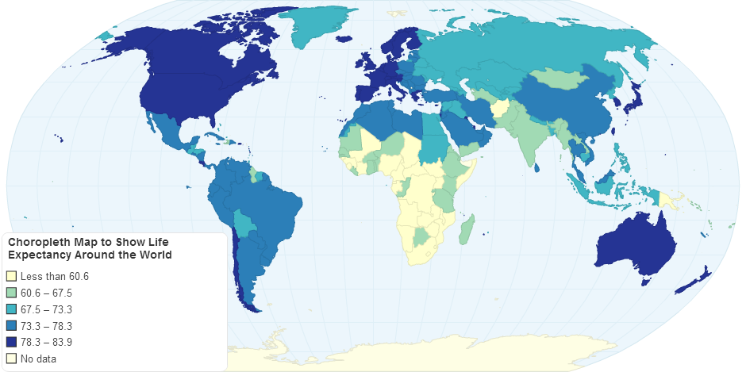
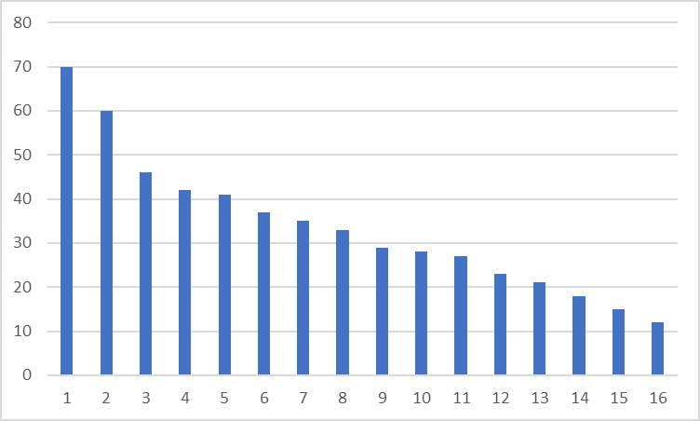
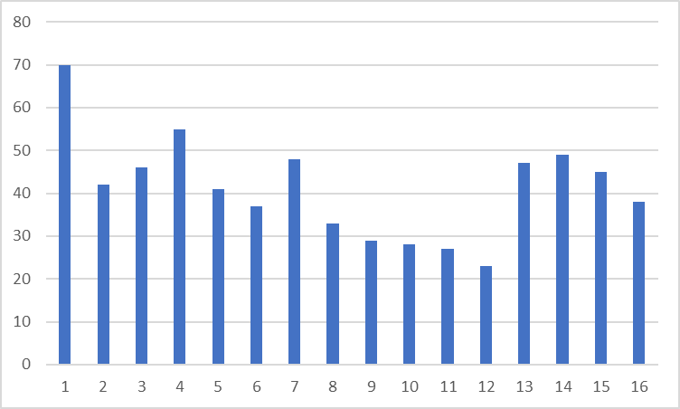
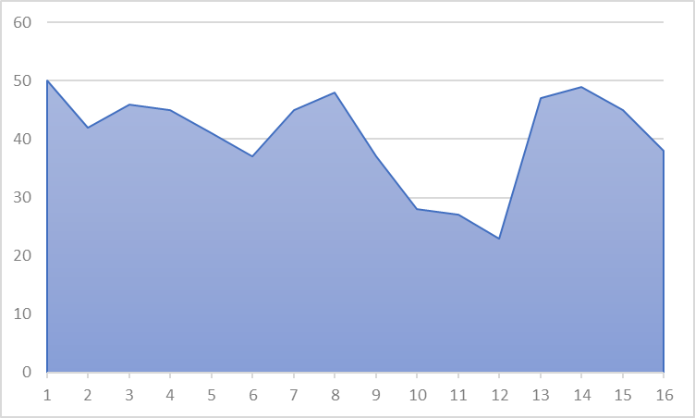
World Wide Arms and Ammunition Movement and GDP effects
Buttons to change what is shown on the choropleth and weapons % GDP graph
Choose Statistic:
Import
Export
Change the country visible on lowermost visualization.
Choose Country:
USA
Import USD
Toggles to change the choropleth to remove or include USA outlier, and change whether % of GDP is shown
Include USA
Gradient
of values
Corresponding to
Button selected
% of GDP
Year
Year slider bar that changes the choropleth map and weapons as % of GDP chart for the year on the slider bar
Weapons as % of GDP “Year” – (changes with slider)
Import as % of GDP
Country changes based on selection in choropleth
Countries of Interest
USA Weapons Import share in GDP
USA Weapons Import
Year highlighted based on slider bar
GDP%
USD
Year highlighted based on slider bar
Year
Year

