Slide 1
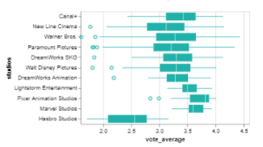
MOVIE SELECTION
Studios
(Tooltip on movies name,
Studios, etc.)
Filter
DROPDOWN MENU
Genre
Budget
SLIDER
Sort: by vote average, profit
Vote average by studios
Top 10 movies
 | Name | Profit | Run time | Vote average
1
2
3
4
5
6
Average box office value
$123,238
Average profit
$123,238

