Slide 1
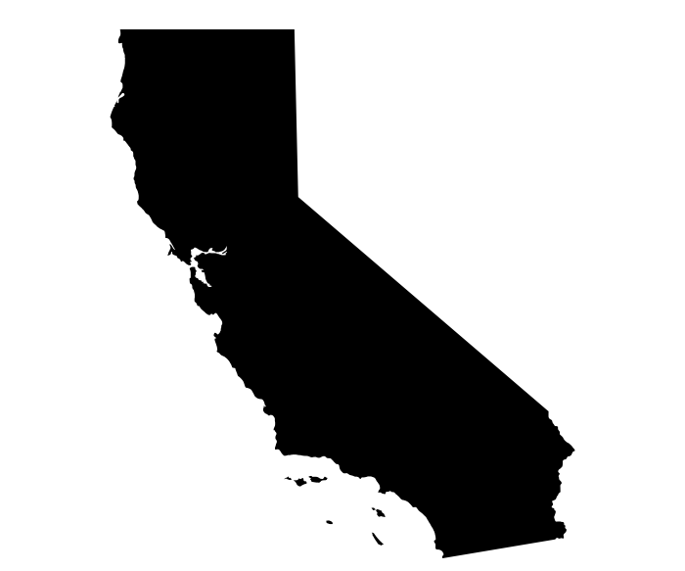
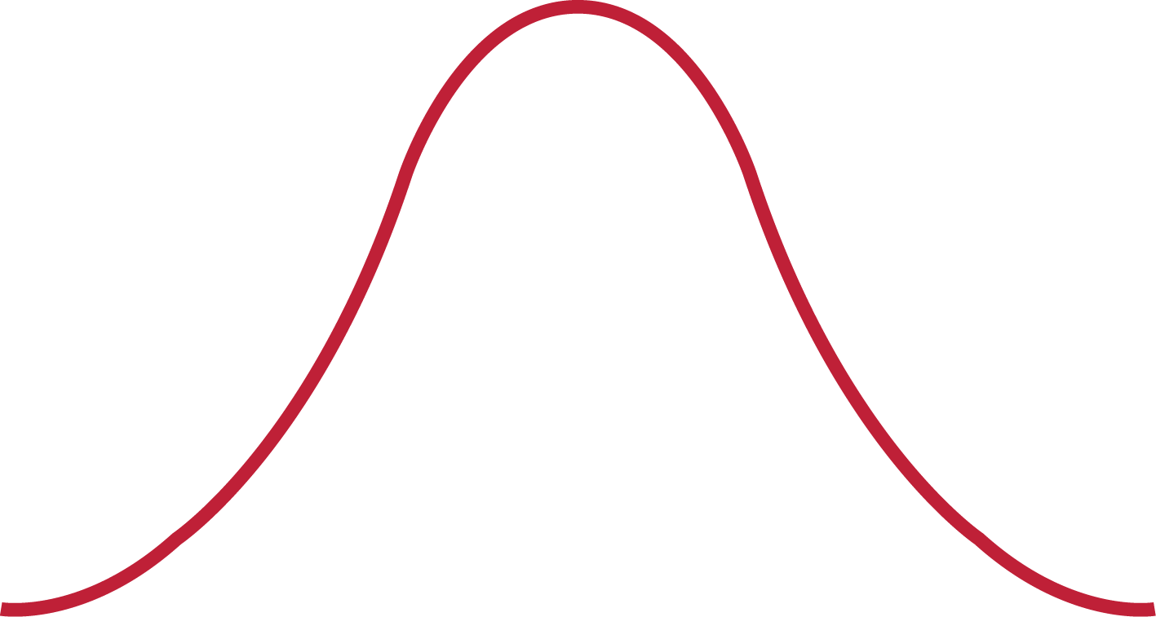
CALIFORNIA HOUSING
Map of median house value and owner’s median income
MAP BY MEDIAN VALUE& MEDIAN INCOME
(Tooltip on point for summarized records)
Filter
DROPDOWN MENU
Ocean proximity
Average median income
$64,453
California map by Bence Bezeredy from the Noun Project
Relationship between house age and value
Top 10 records by median income
 | Median House Value | Avg rooms | Population
1
2
3
4
Average median house value
$123,238
HOUSE AGE & HOUSE VALUE DIST
https://www.clipartmax.co

Slide 2
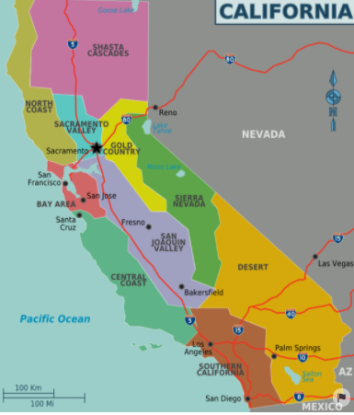
Summarized records for tool tip
Region in California
housingmedianage
total_rooms/avg
total_bedrooms/avg
population
households
median_income
medianhousevalue
ocean_proximity

Slide 3
List of variables
* Location
longitude
Latitude
ocean_proximity
* Building age
housingmedianage
* Rooms
total_rooms
total_bedrooms
* Demography
population
Households
*Income
median_income
medianhousevalue
Derived: county
longitude
latitude
housingmedianage
total_rooms
total_bedrooms
population
households
median_income
medianhousevalue
ocean_proximity

