Slide 1
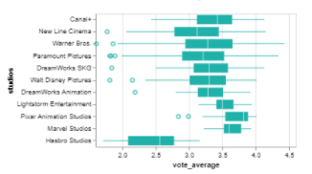
(Tooltip on movies name,
Studios, etc.), click on the studio and reflect on the scatter plot
MOVIE SELECTION
Vote average by studios
Revenue by studios
Filter
DROPDOWN MENU
Genre
Budget
SLIDER
Average box office value
$123,238
Top 5 [Genre] movies from [StudioA]
 | Name | Profit | Run time | Vote average
1
2
3
4
5
Average voting average
4.3

